Slide 1
SIMA in a nutshell
António Câmara
Theo Fernandes
Pedro Coelho
2020

Slide 2
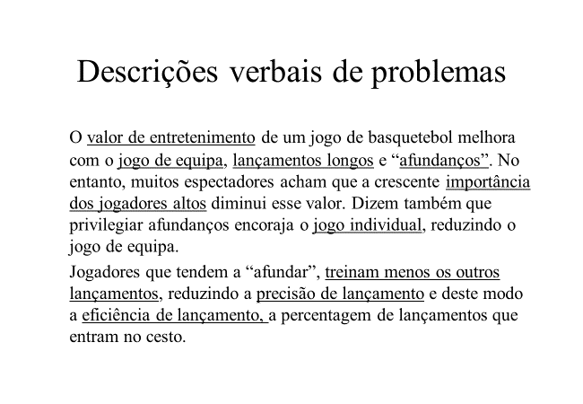
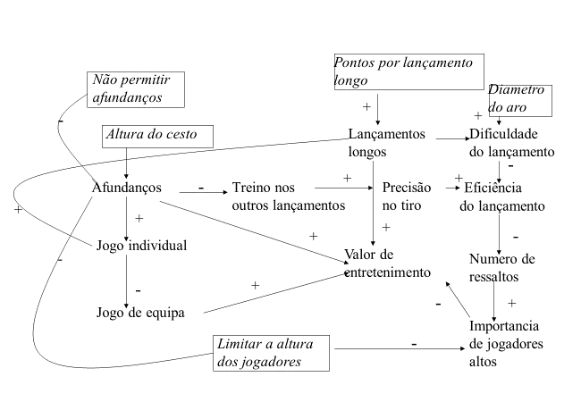
Mathematical models
  Analyze a system
  Applications of mathematics in real life

Slide 3
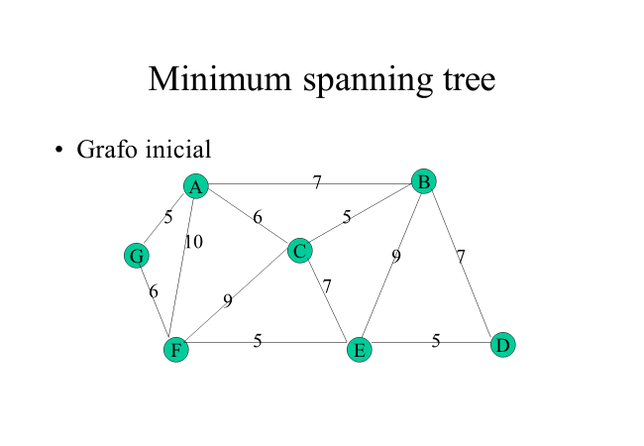
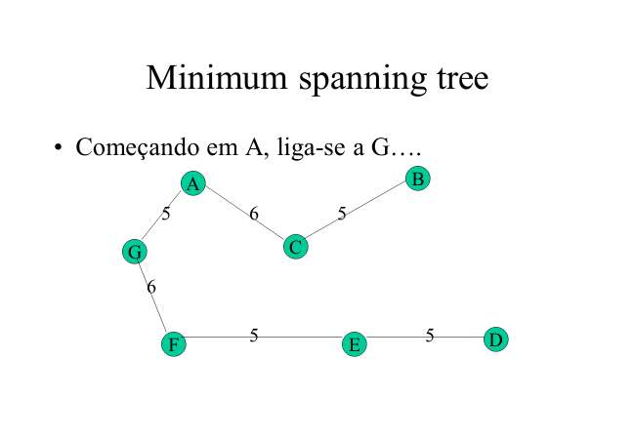
Mathematical models
  Obtain an optimal solution
  Applications of mathematics in real life

Slide 4
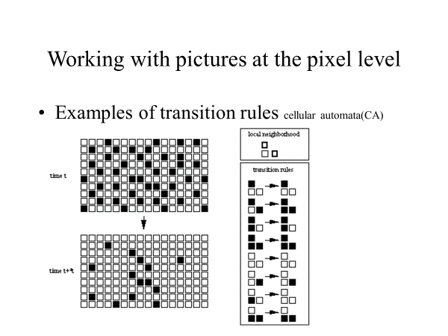
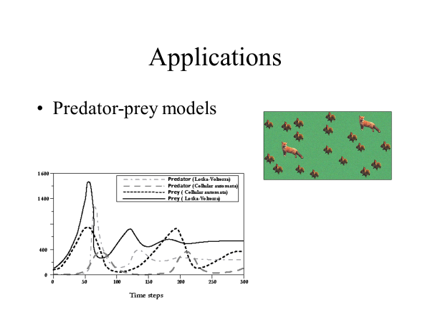
Mathematical models
  Predict the evolution of a system
  Applications of mathematics in real life

Slide 5
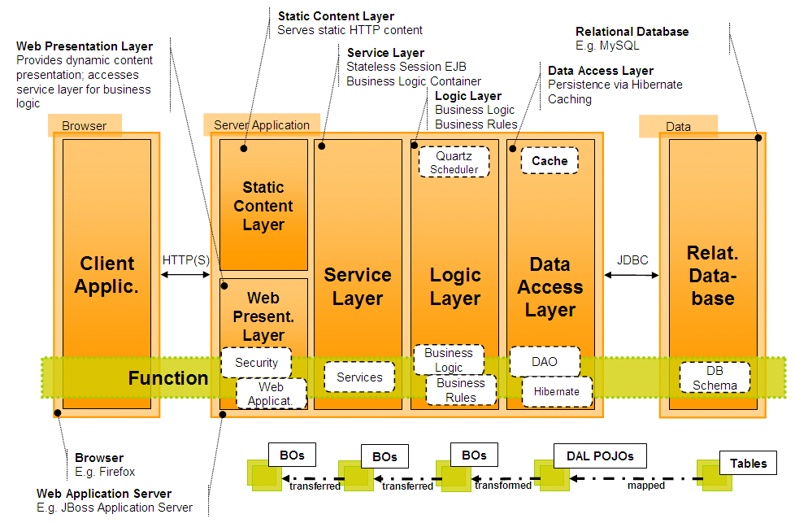
Software architectures
Ten software architectural systems

Slide 6
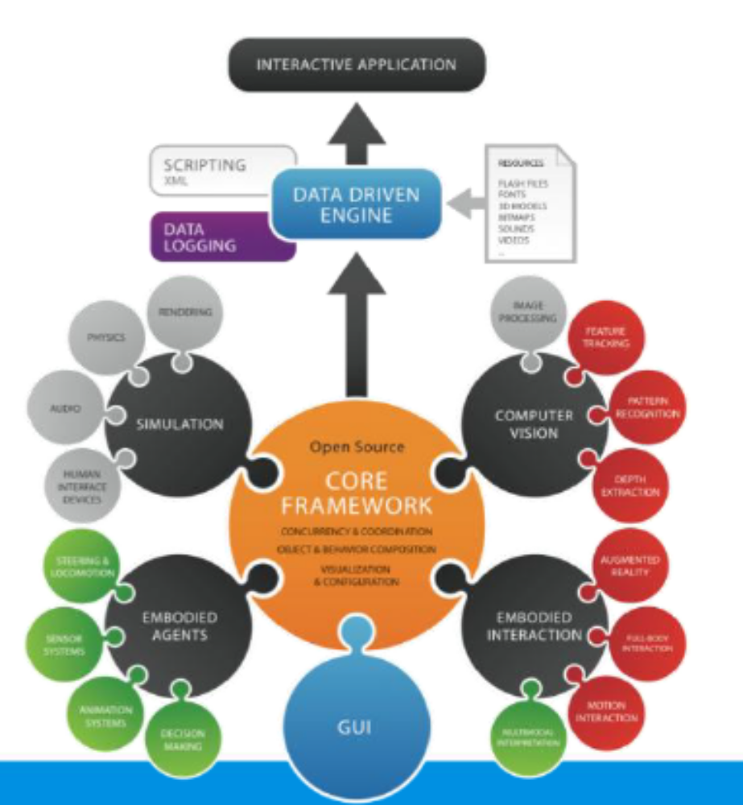
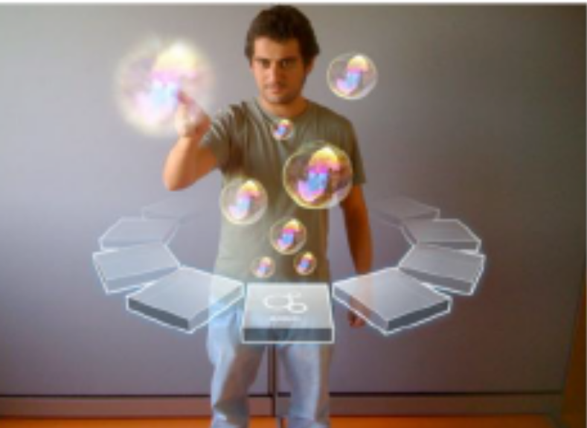
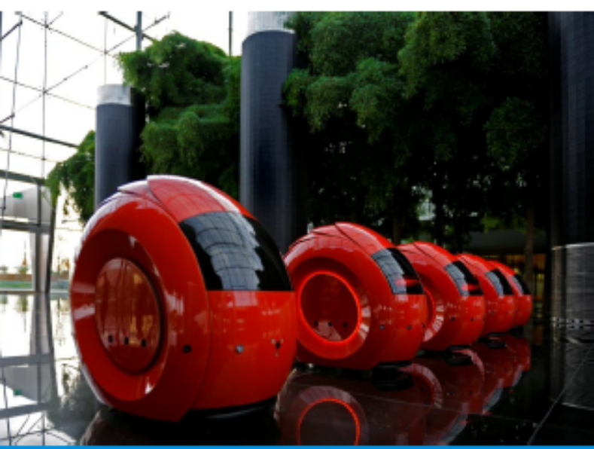

Slide 7
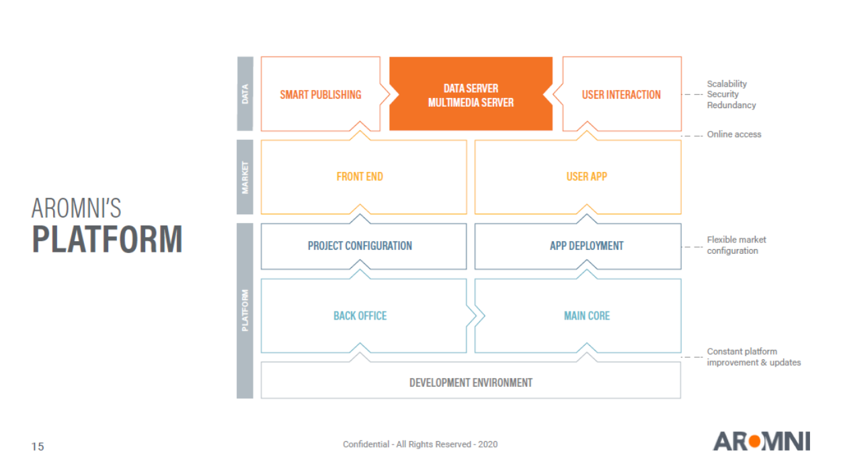

Slide 8
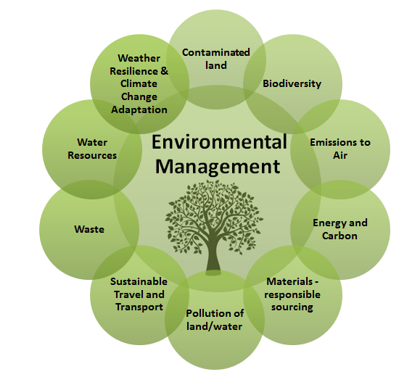
Environmental data sources
SILIAMB
SNIAmb
SNIRH - Recursos Hídricos
SIAIA - Avaliação de Impacte Ambiental
QUALAR - Qualidade do Ar
COSMO
SILOGR
Participa
APA Information systems
Environmental information components

Slide 9
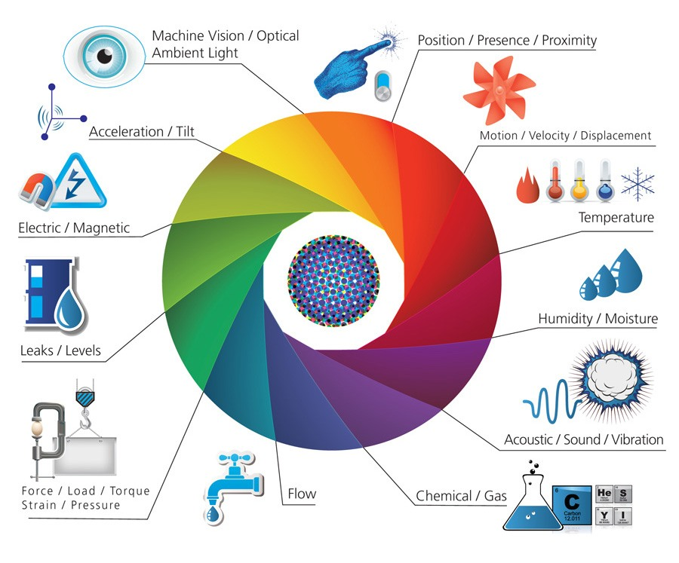
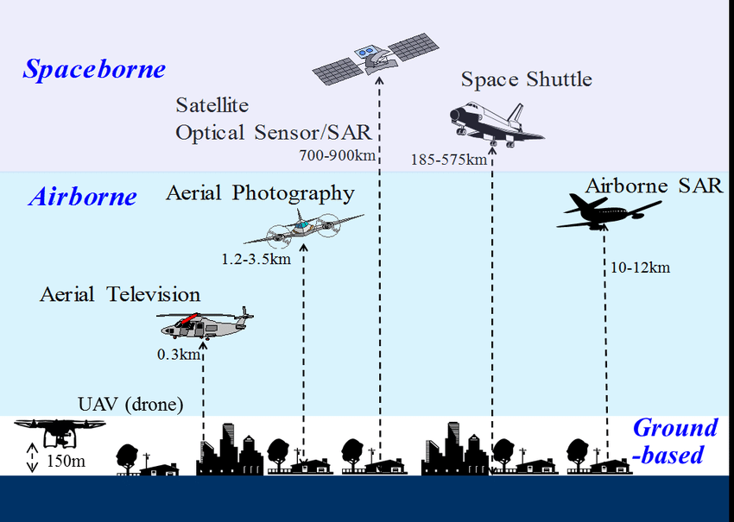
Environmental sensors
Environmental IoT sensors
Sensors used for remote sensing

Slide 10
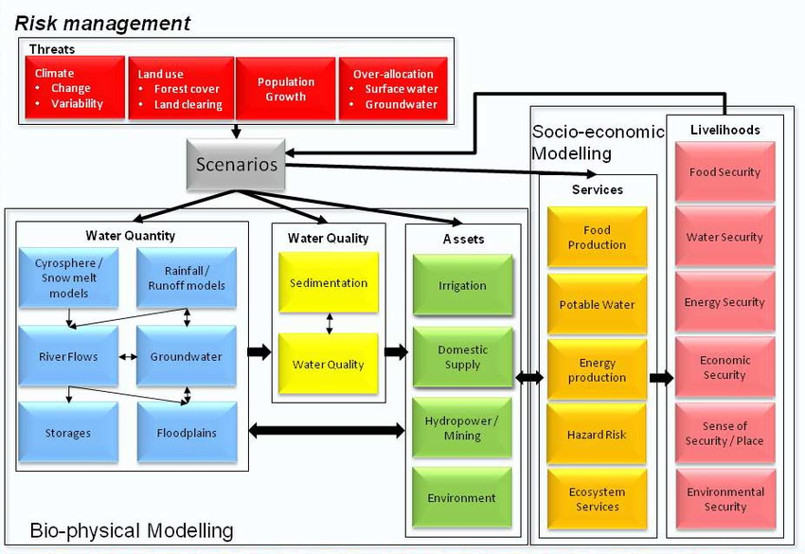
Environmental models
Water resource management models

Slide 11
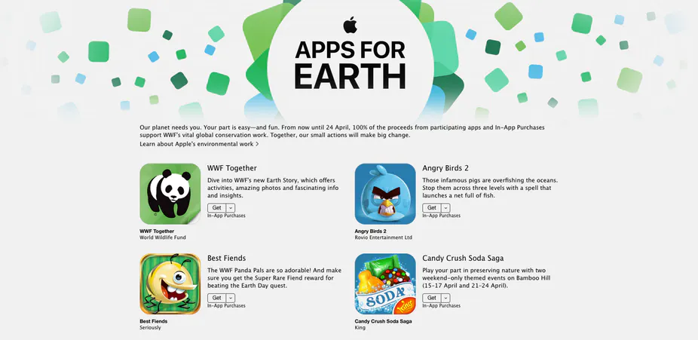
Environmental apps
Apple’s apps for Earth

Slide 12
AI approaches
Machine learning and NOVA environmental engineering students
  Input
    Environmental Enginnering students 1982-2019
  Output
    Success (conventional, craftsmanship, societal) 1982-2019
  Hidden nodes
    Accounting for F in Output= F (Input)

Slide 13
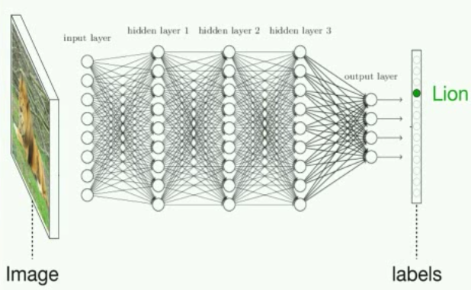
Neural networks

Slide 14
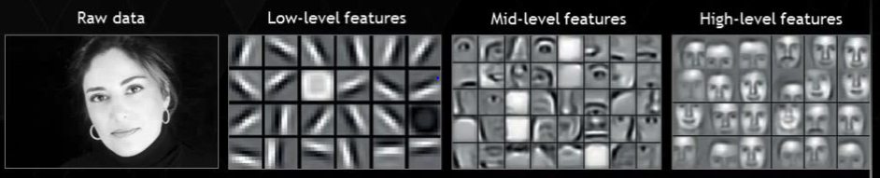
Neural networks

Slide 15
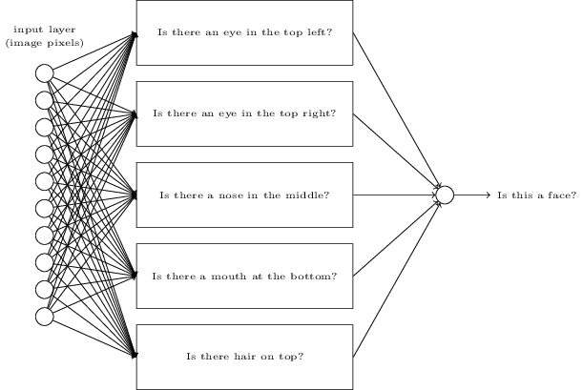
Neural networks

Slide 16
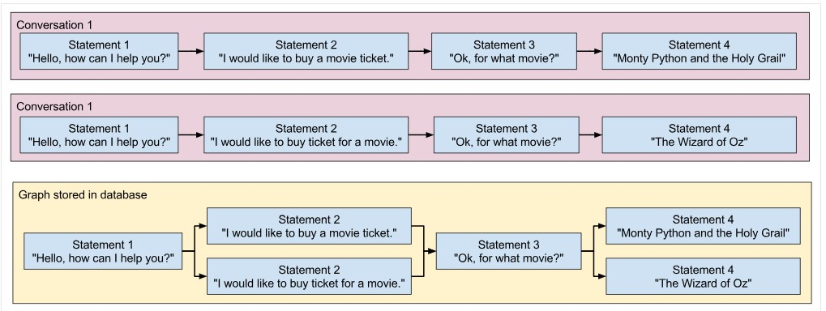
Chat bots

Slide 17
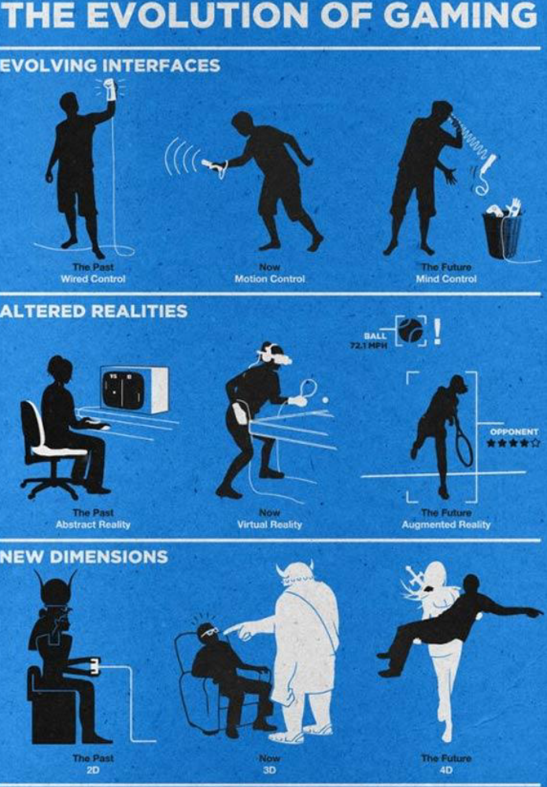

Slide 18
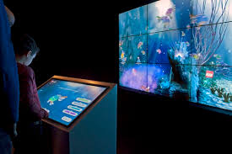
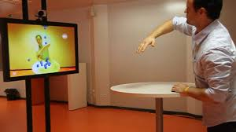
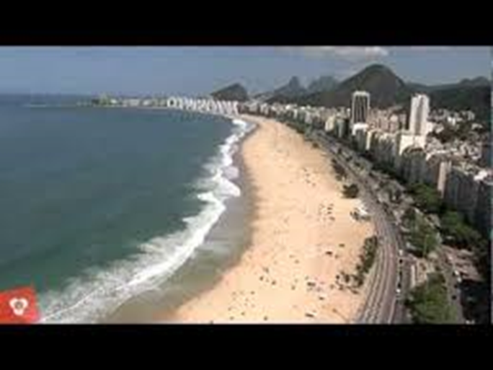
New interfaces: VR/AR/AI
https://www.youtube.com/watch?v=UaC0UoakO7k
https://www.youtube.com/watch?v=qXcIZ1R68SQ
https://www.youtube.com/watch?v=hnMBTU-kyh0

Slide 19

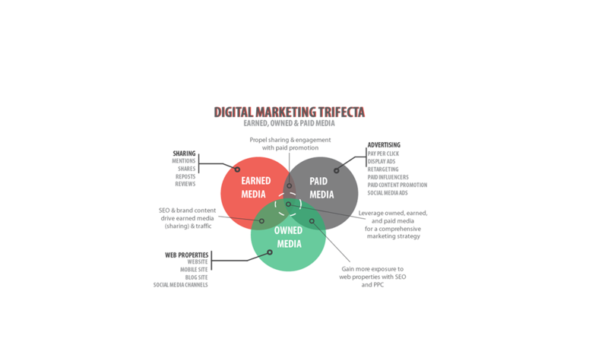
Product development
Generation and selection of ideas
Prototyping
Intellectual property
Communication
Financing
MVP
Marketing and sales

Slide 20
Ars Digita* Layer Cake
Ideas
Management (strategic, financial, IP, operations, product and project management, marketing & communications, human resources)
Design (conceptual, UI, UX, industrial)
Technology (energy, communications, hardware, software)
*https://en.wikipedia.org/wiki/ArsDigita

Slide 21
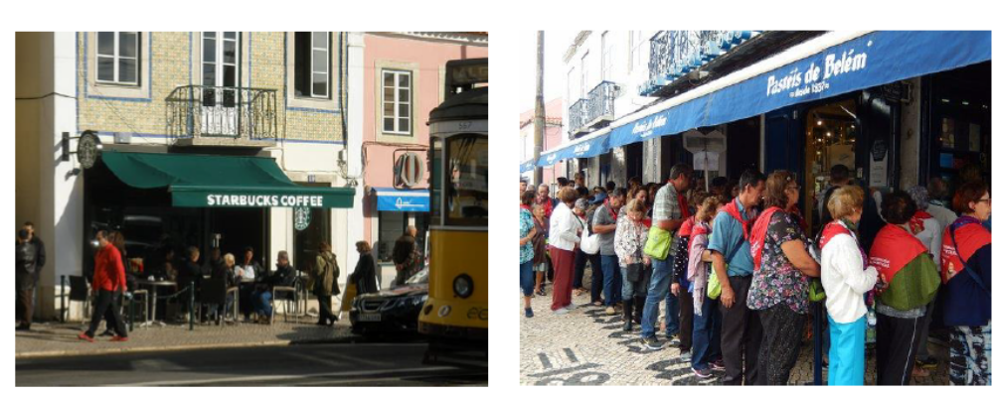

Slide 22
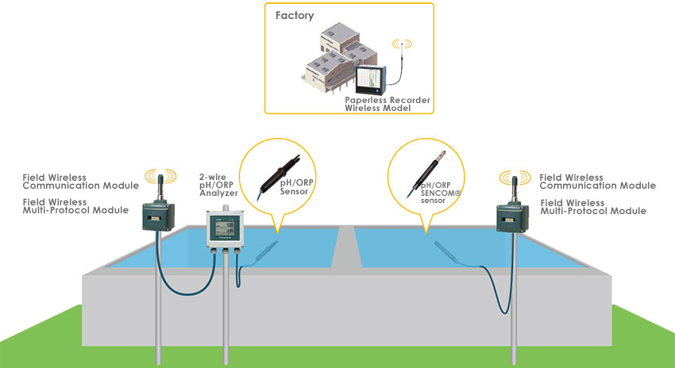
Your problems: benchmark levels
Wastewater treatment monitoring
Self-organizing map and clustering for wastewater treatment monitoring (academic)
Wastewater treatment system and method (intellectual property)
Wastewater treatment monitoring (industry)
Water market data (market)

Slide 23
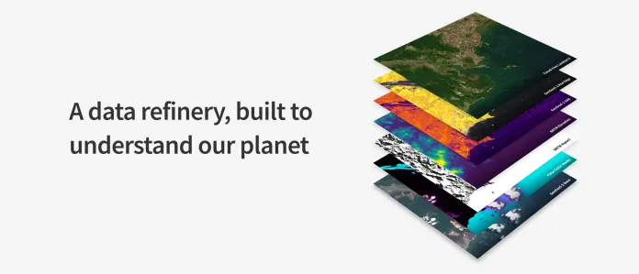
Your problems: quality standards
Remote sensing data analysis
  https://www.descarteslabs.com/

Slide 24
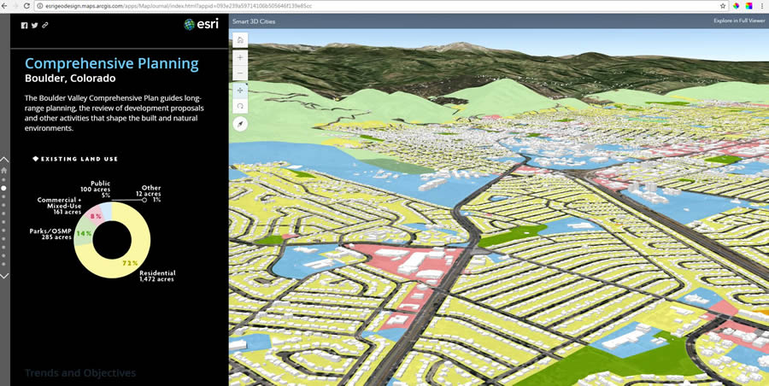
Your problems: quality standards
Land use planning engine
  Building blocks of a smart city

Slide 25
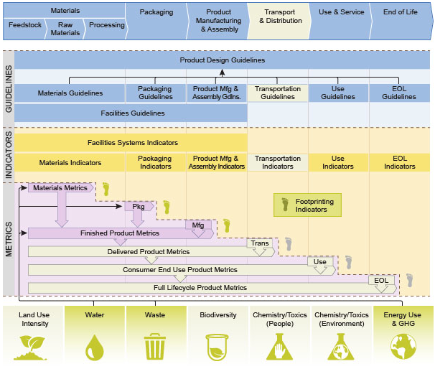
Your problems: quality standards
Life cycle analysis
  Sustainable design guide
  by Solid Works

