Slide 1
Sistemas de Informação e Modelação em Ambiente (SIMA)
António Câmara
Pedro Coelho
Theo Fernandes
2020

Slide 2
SIMA
Fridays 9h-13h
Building XI/1
Antonio Camara asc@fct.unl.pt
Pedro Coelho pmhc@fct.unl.pt
Theo Fernandes theo.fernandes@chimp.pt

Slide 3
SIMA
https://myexplora.live/sima-2020/ (lectures)
https://sima-fct.slack.com (Slack channel)
https://www.facebook.com/groups/183536175571026/ (Explora group)

Slide 4
Date | Topic | Who
6th March | Introduction. “Clean tech” and “Smart cities” market maps First go at defining “student problems” | AC, TF
13th March | Mental models in mathematics and software engineering | AC
 | Environmental data sources, environmental sensors, environmental models and other software; traditional approaches; the AI approach; new interfaces | AC, TF
 | Product development | AC
 | Your Problems | Students
20th March | Environmental data sources | AC, TF
 | Data analysis tools- one example | TF
27th March | Environmental sensors | AC, TF
3rd April | Environmental data infrastructures | AC, TF
 | Using a data infrastructure | TF
17th April | Environmental modeling | AC, TF, PC
 | Using an environmental model | TF/PC

Slide 5
24th April | Environmental models | AC, TF
8th May | The AI approach | AC
 | New interfaces | AC, TF
 | Back of the envelope approaches to your problems (Hand “benchmark reports”) | AC
15th May | Prototyping tools | AC, TF
 | Prototyping your “back of the envelope” approaches | TF
22nd May | Intellectual property, communication, financing, product development, business models, marketing and sales | AC
29th May | Try run” of student “decks”
5th June | Presentation of student “decks” | AC, TF, PC

Slide 6
Deliverables
  Benchmark report 40%
  Deck with non-functional prototype 60%

Slide 7
Key Readings
https://valuer.ai/blog/everything-you-need-to-know-about-cleantech/
https://www.cbinsights.com/research/iot-smart-cities-market-map-company-list/

Slide 8
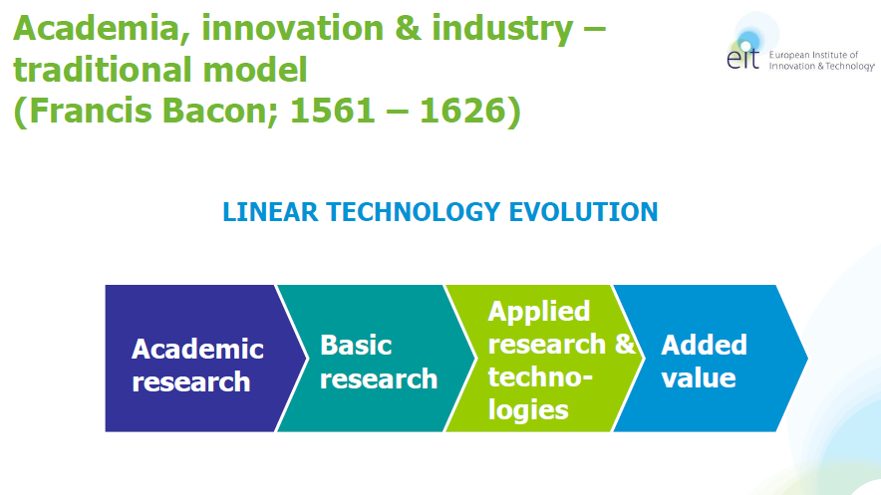
Knowledge Based Entrepreneurship

Slide 9
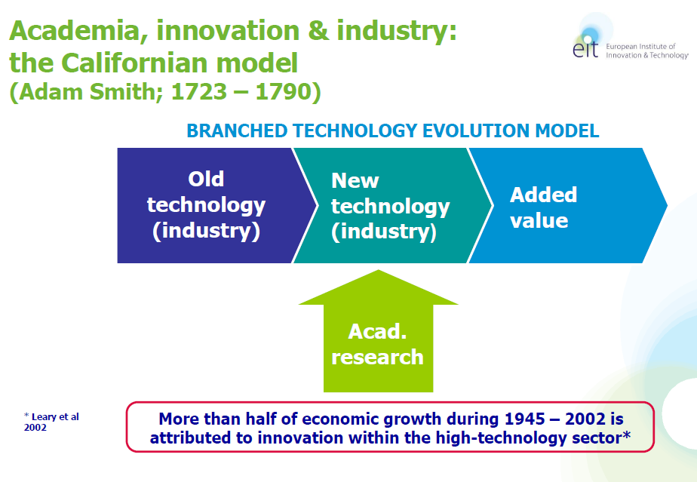
Knowledge Based Entrepreneurship

Slide 10
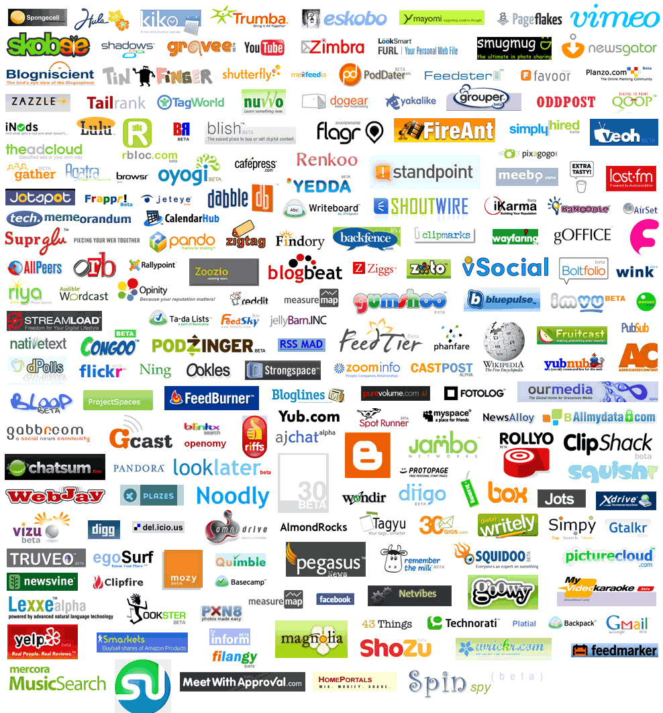

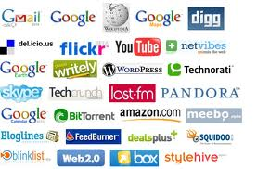


Silicon Valley Model
Angel funded start-ups
Billions of revenue
Winners
User Traction
VC Backing
Picture Credits: Ludwig Gatzke

Slide 11
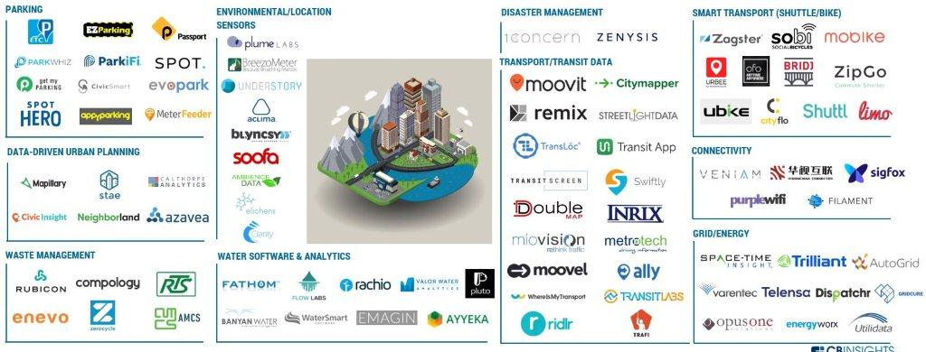
“Smart Cities”

Slide 12
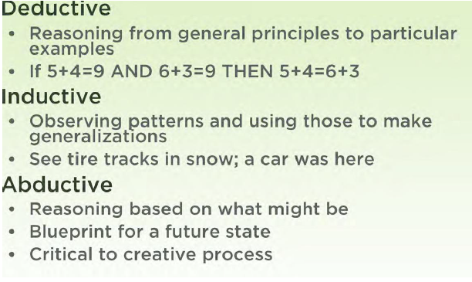

Slide 13

Learning from KOFAC (South Korea) program for 9th year students
1 Artificial Intelligence
2 Driverless vehicles
3 Internet of things
4 Virtual reality
5 CRISPR
6 Space launch vehicles
7 Natural disasters
8 Smart medicine
9 Game engines
10 Sports statistics

Slide 14
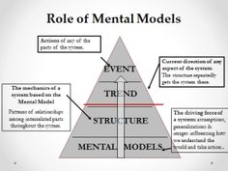
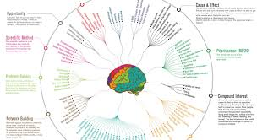
Mental models
https://www.visualcapitalist.com/12-ways-smarter-mental-models/
https://fs.blog/mental-models/
https://tinyurl.com/ydaktvz8

Slide 15
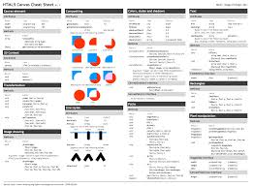
Knowledge summaries
https://www.cheatography.com/
http://www.cheat-sheets.org/
https://tinyurl.com/y8wuv9vk

Slide 16

Software tools
https://education.github.com/pack

Slide 17
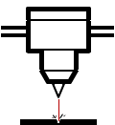






Hardware tools
DIY
Corte a laser
Impressão 3D
Electrónica
Kits DIY
Hacker
Spaces
Material open-source
Creative
commons
Crowdfunding
http://www.makery.info/en/2015/06/09/le-top-10-des-kits-de-prototypage-hardware-suite/

Slide 18
Additional readings
Abraham Flexner, The Usefulness of Useless Knowledge, 1939 (https://library.ias.edu/files/UsefulnessHarpers.pdf)
Alexander Von Gabain, The EIT: Addressing Societal Changes Via the Integration of the Knowledge Triangle, 2012, (em http://slideplayer.com/slide/7723914/)
Clayton Christensen, The Innovator’s Dilemma, Harper, 2002 (http://dl4a.org/uploads/doc/The_Innovators_Dilemma.pdf)
Peter Thiel and Blake Masters, From Zero to One, Crown, 2014 (ver http://blakemasters.com/peter-thiels-cs183-startup)
Ralph Waldo Emerson, Self-Reliance (essay), 1841 (https://math.dartmouth.edu/~doyle/docs/self/self.pdf)
Robert Pirsig, Zen and the Art of Motorcycle Maintenance, Harper, 1974 (http://www.arvindguptatoys.com/arvindgupta/zen-motorcycle.pdf)

