Slide 1
Environmental data infrastructures and modelling
The case of the US EPA
António Câmara
April 2020

Slide 2
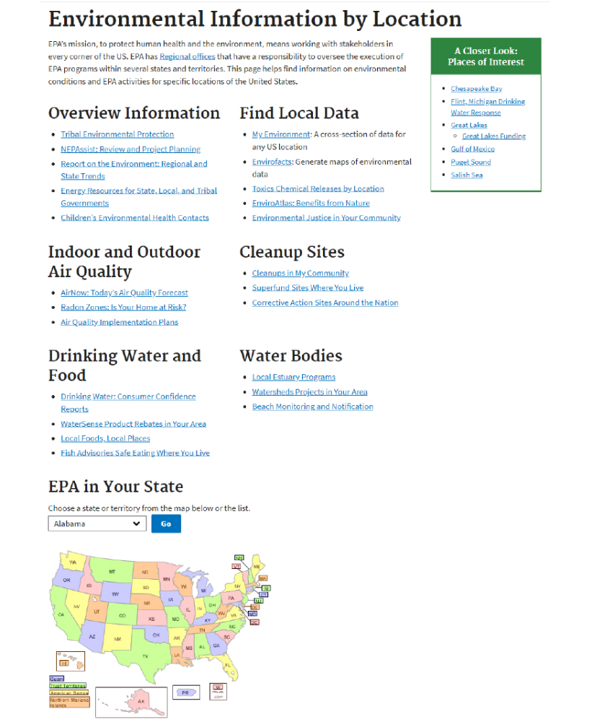

Slide 3
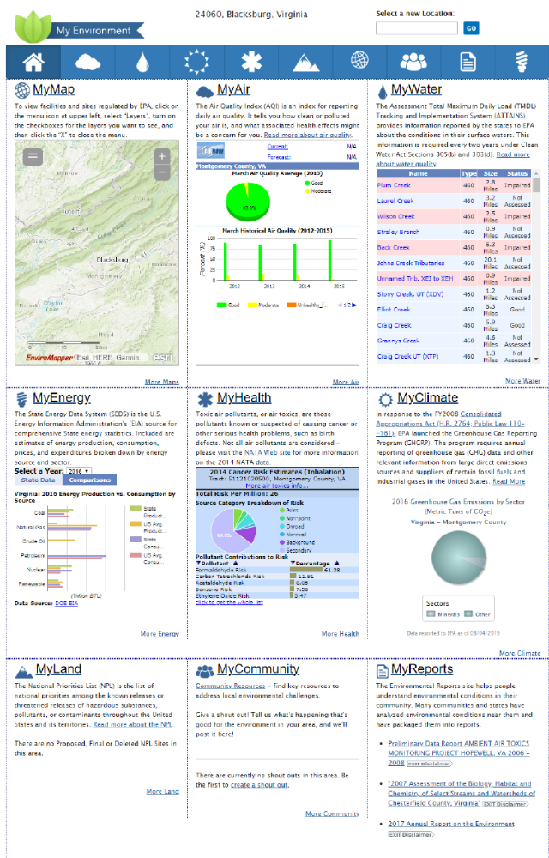

Slide 4
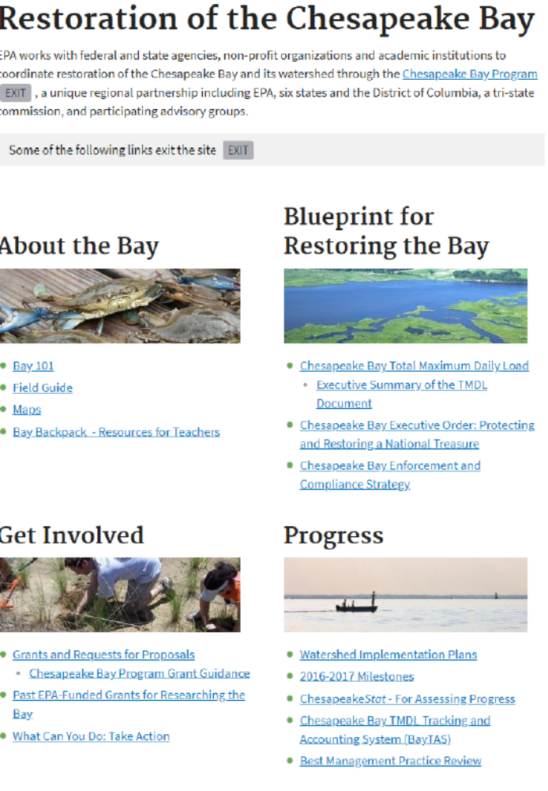

Slide 5
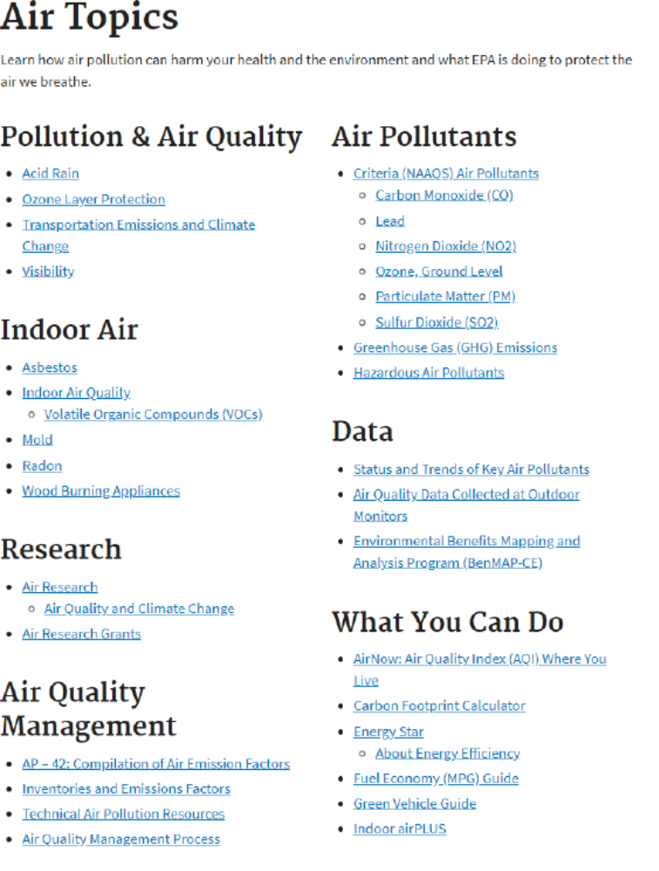

Slide 6
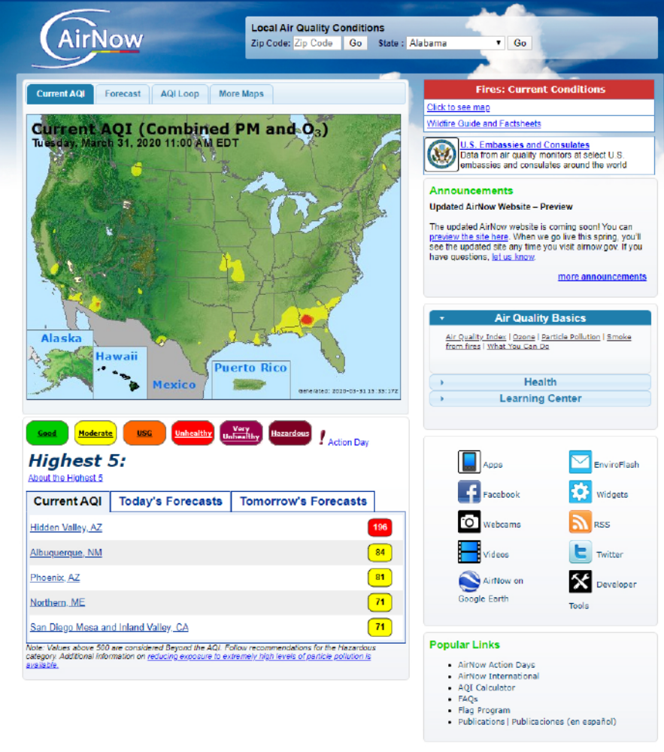

Slide 7
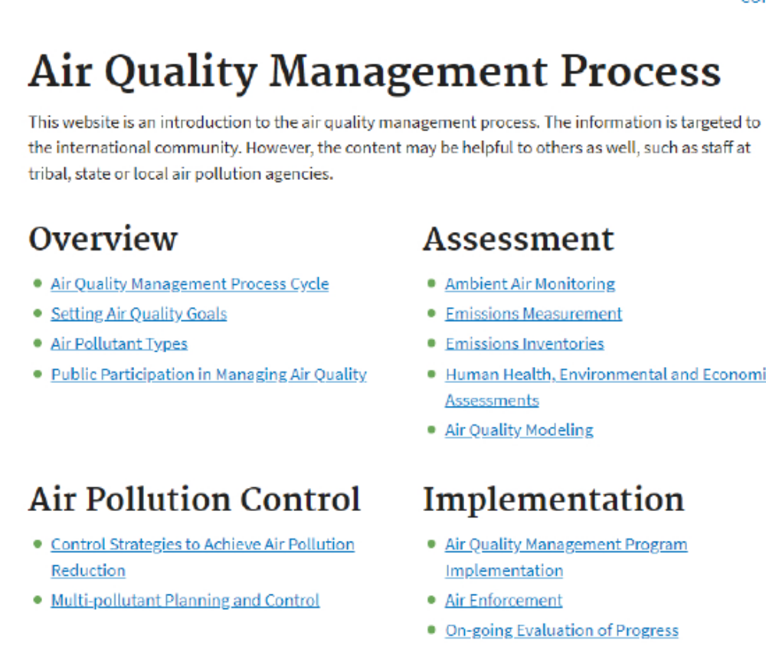

Slide 8
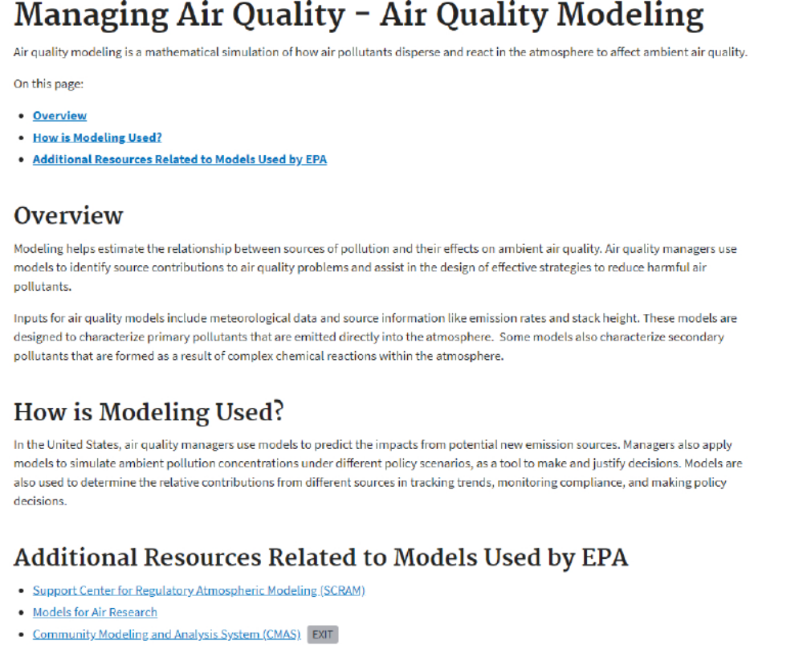

Slide 9
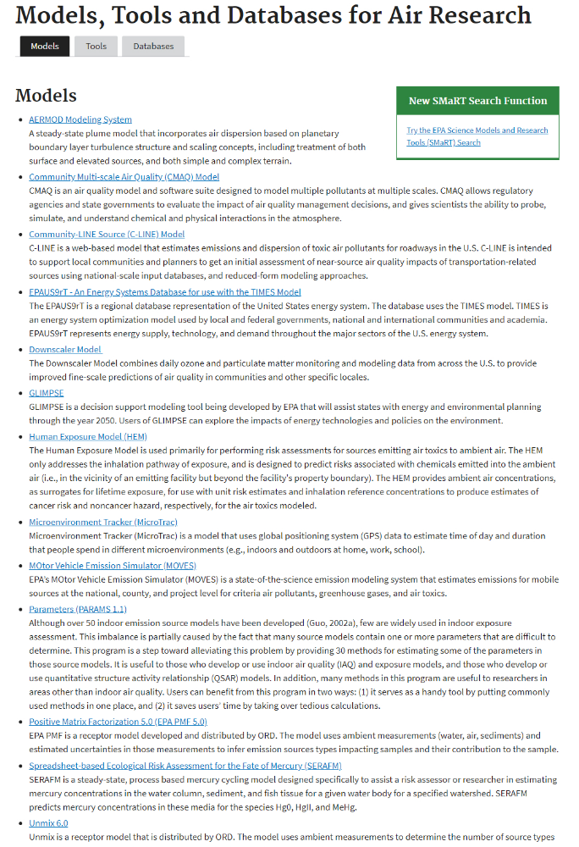

Slide 10
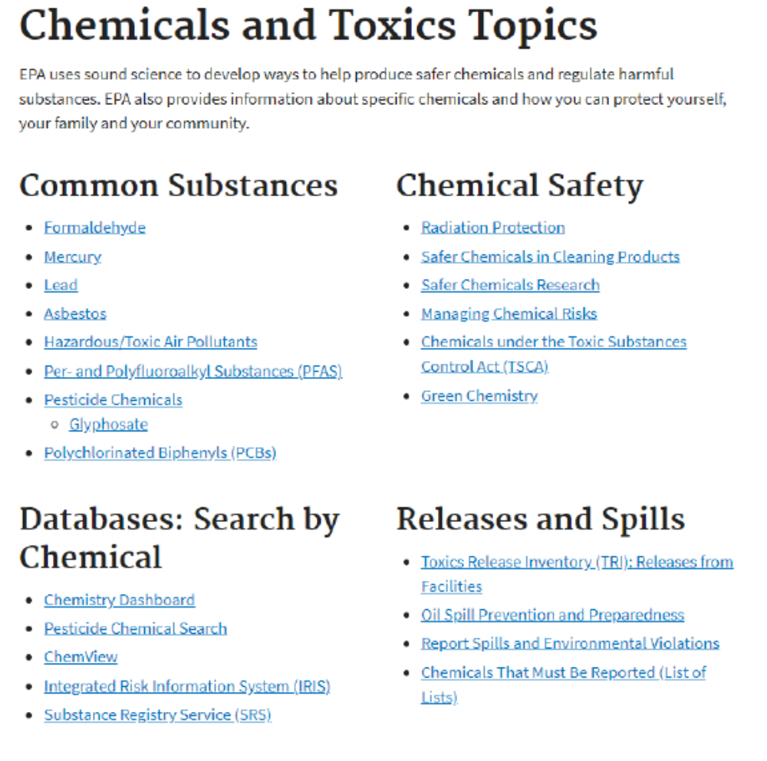

Slide 11
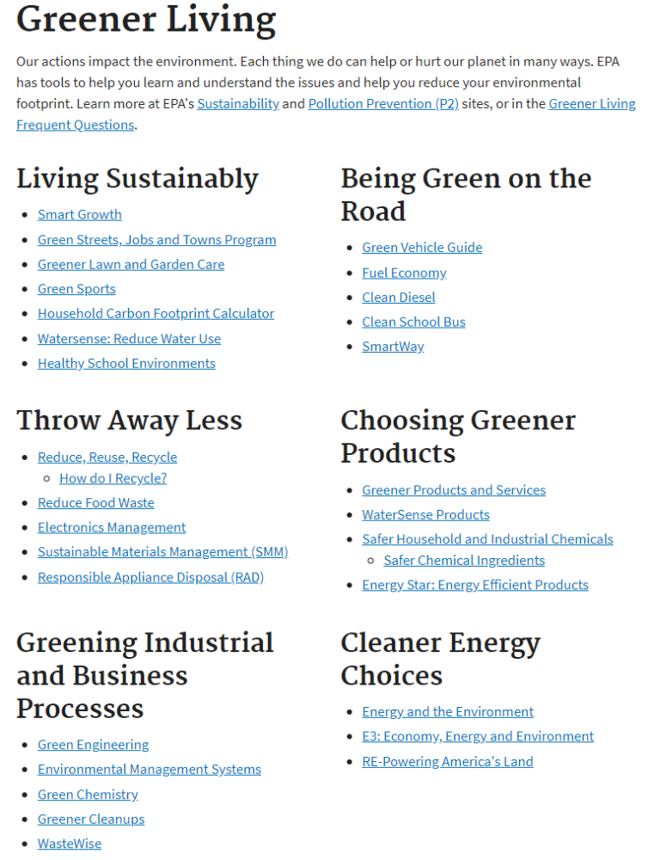

Slide 12
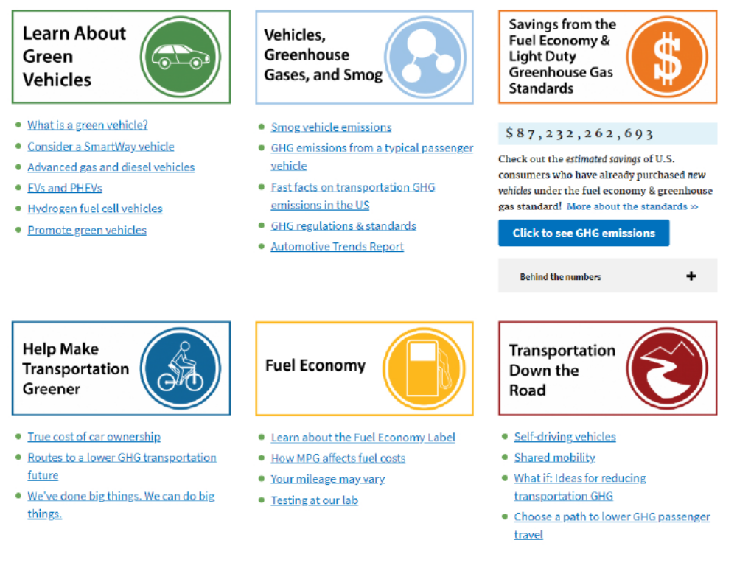

Slide 13
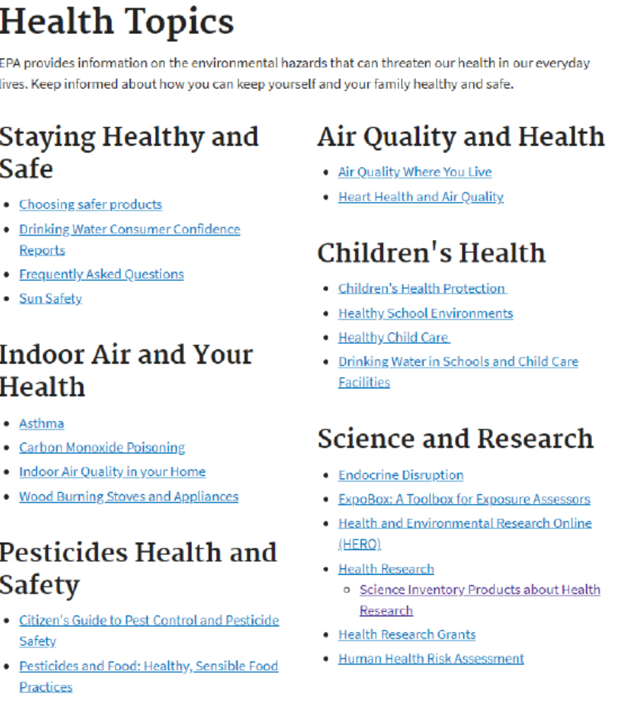

Slide 14
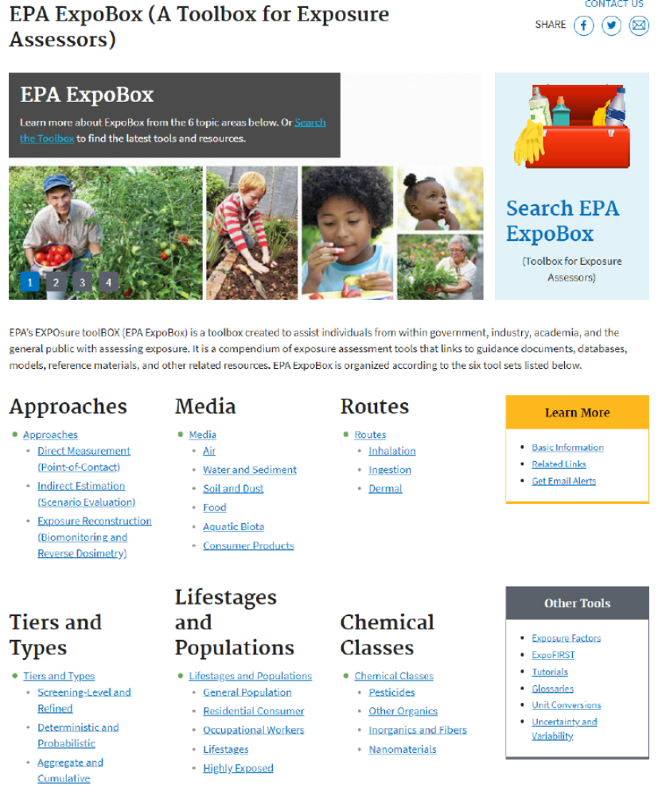

Slide 15
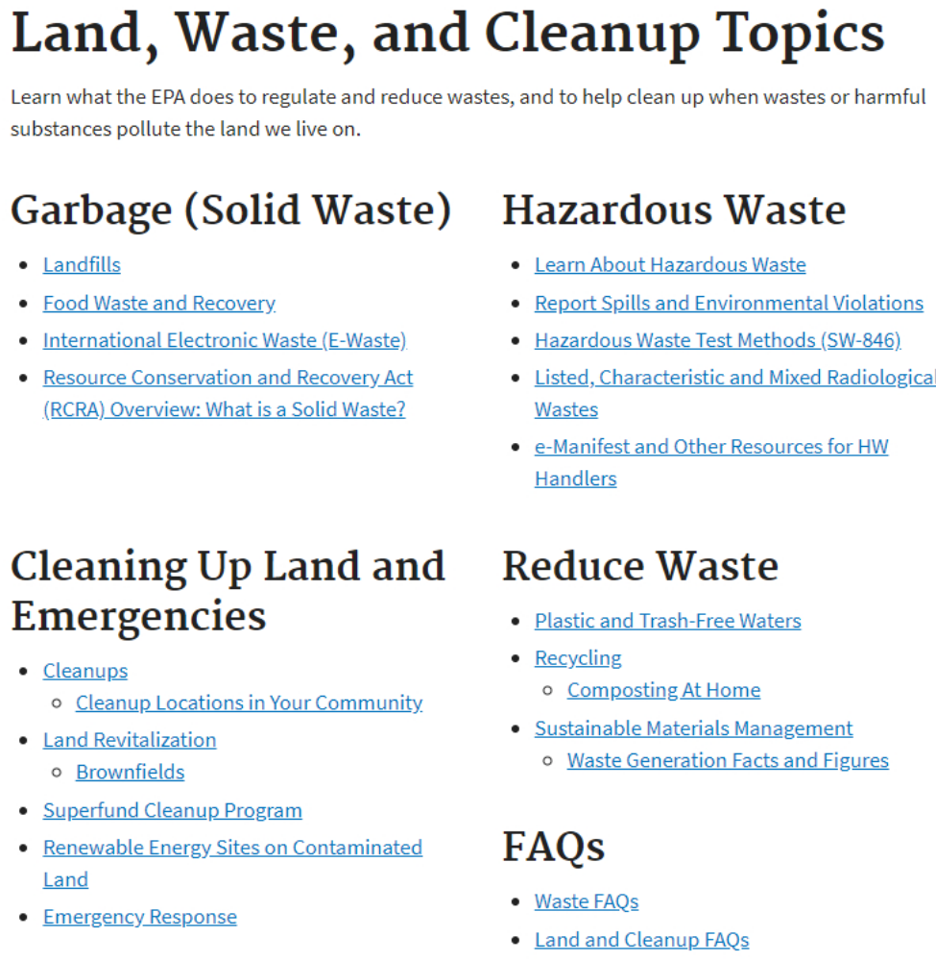

Slide 16
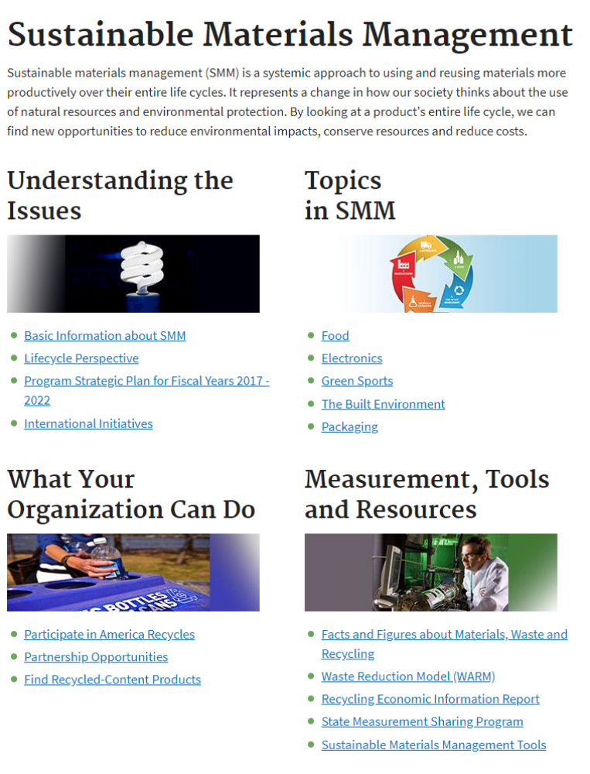

Slide 17
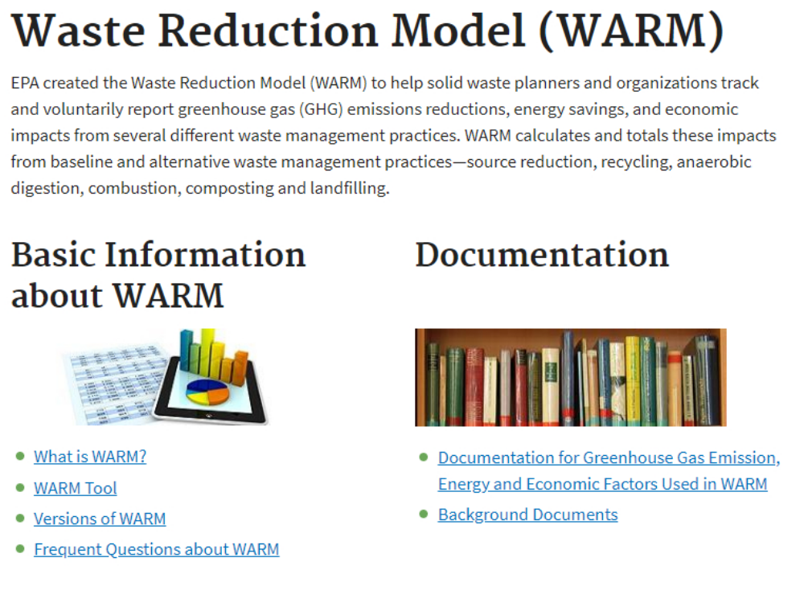

Slide 18
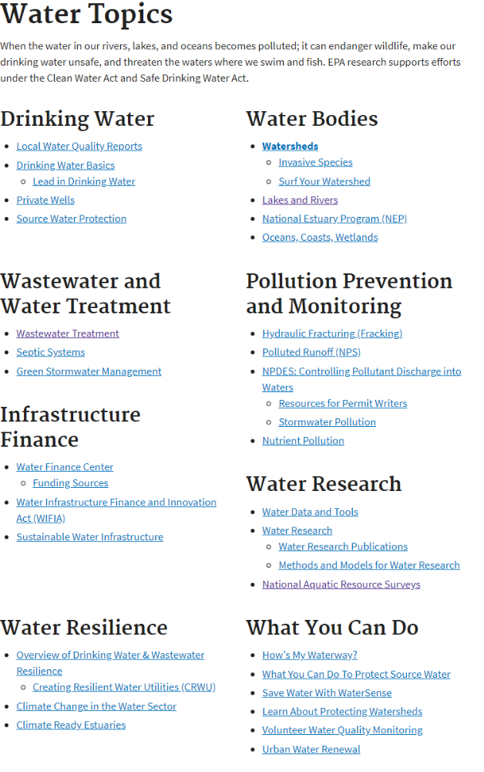

Slide 19
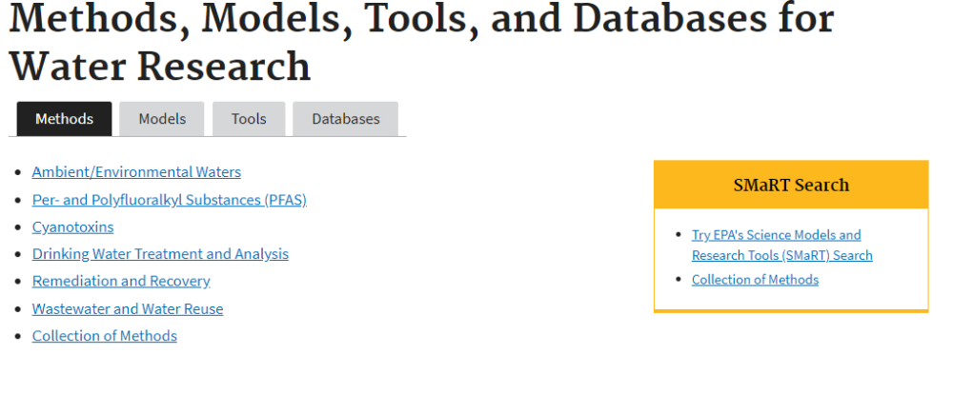

Slide 20
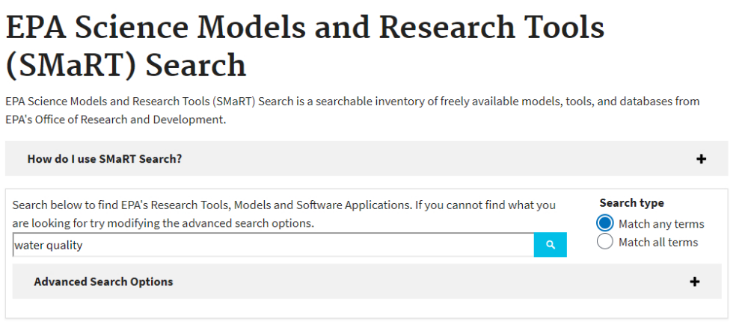

Slide 21
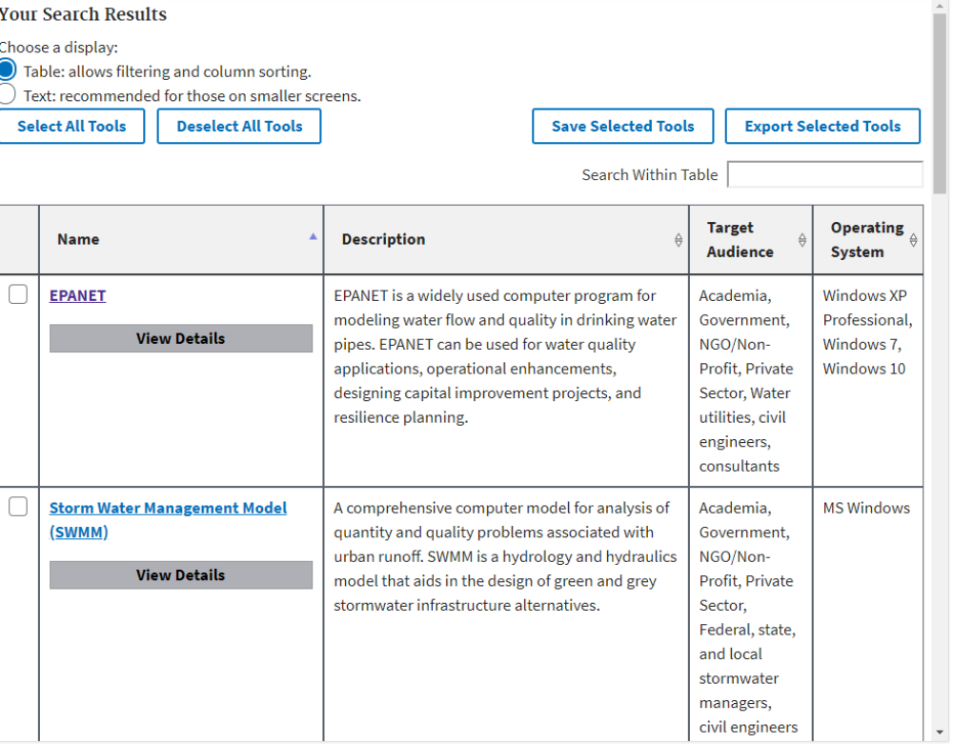

Slide 22
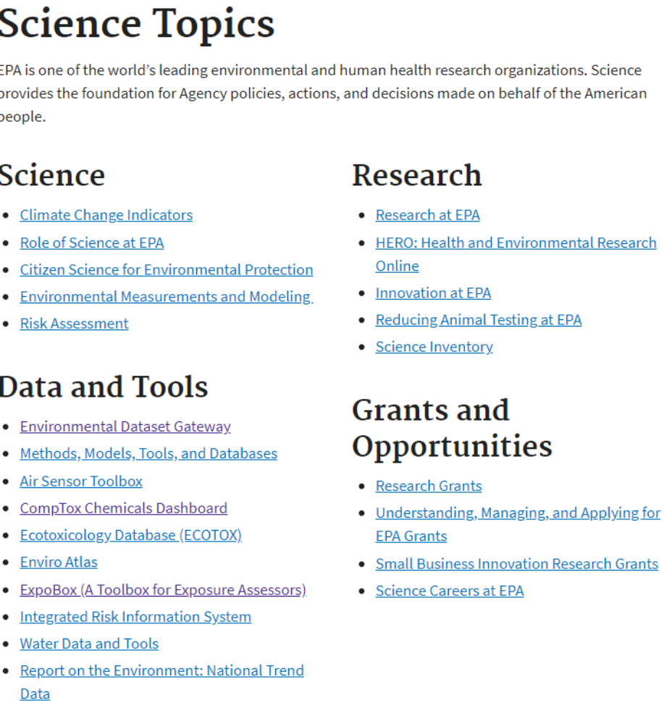

Slide 23
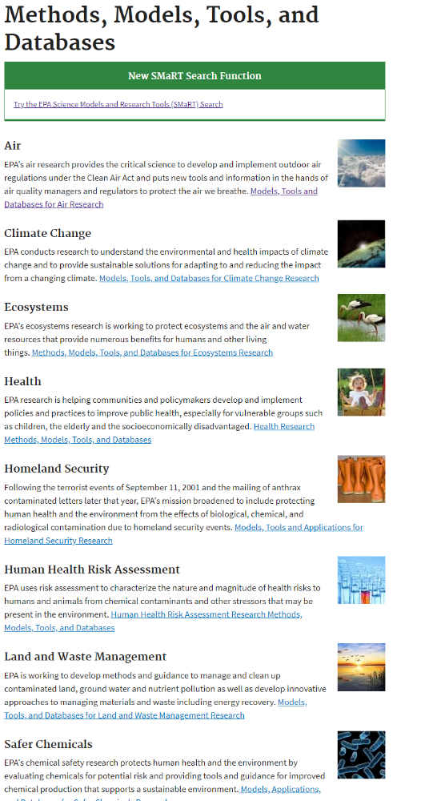

Slide 24
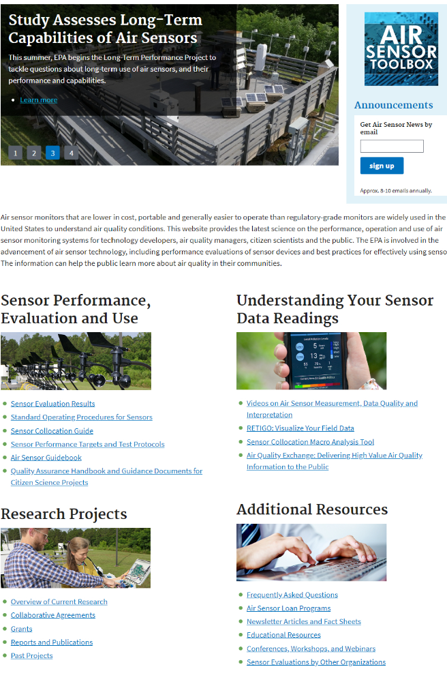

Slide 25
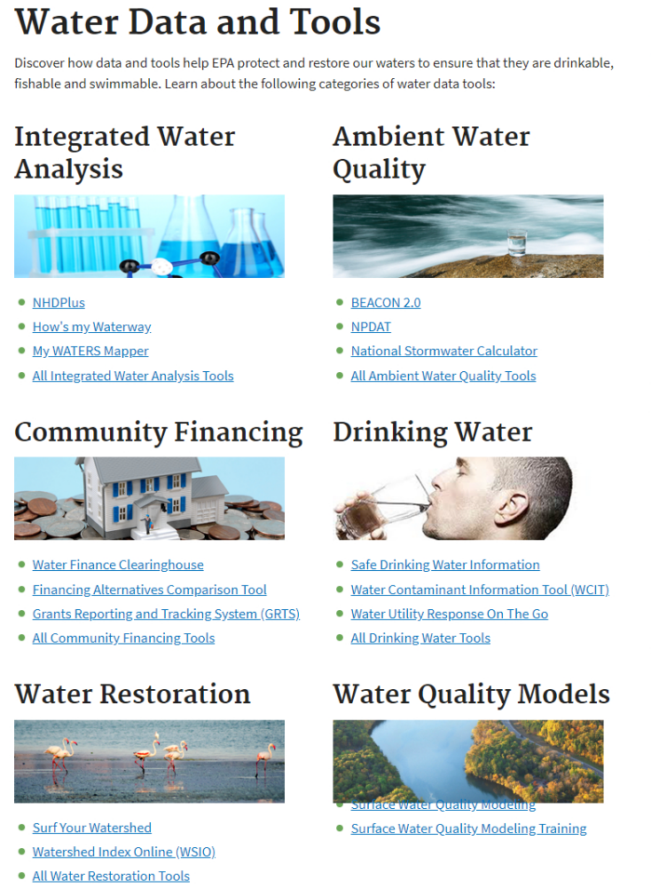

Slide 26
Exercise
Let us do a list of all the environmental models and
tools you used during your degree

Slide 27
US Environmental Protection Agency topics
https://www.epa.gov/environmental-topics/environmental-information-location
https://www.epa.gov/environmental-topics/air-topics
https://www.epa.gov/environmental-topics/chemicals-and-toxics-topics
https://www.epa.gov/environmental-topics/greener-living
https://www.epa.gov/environmental-topics/health-topics
https://www.epa.gov/environmental-topics/land-waste-and-cleanup-topics
https://www.epa.gov/environmental-topics/water-topics
https://www.epa.gov/environmental-topics/science-topics

