Slide 1
Environmental sensors a primer
António Câmara
Theo Fernandes
March 2020

Slide 2
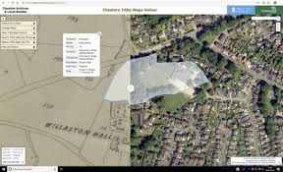
Environmental data
Realistic data
  Ground and remote static and dynamic
  imagery
  Sound
  Other senses
Symbolic data
  Maps
  Alphanumerical data (numerical and
  linguistic)
https://geoinformatics.com/aerial-photographs-bring-to-life-early-tax-maps/

Slide 3
Environmental data collection
Permanent
Semi-permanent
Ephemeral
Global
International
National
Regional
Local

Slide 4

Environmental data collection
Key issues
  Selection of sampling sites, frequencies, variables, and sampling duration
  Type of sampling (random, systematic, restricted random, stratified or selective)
https://www.amazon.com/Guidance-Choosing-Sampling-Environmental-Collection/dp/1243695994

Slide 5
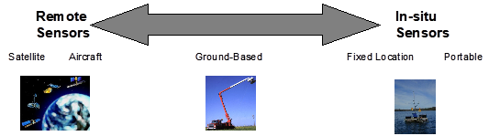

Slide 6
Environmental sensors
Remote sensing satellite and aircrafts imagery
Aerial photography and videography
Ground photography and videography (including 360 and volumetric imaging)
Sound (unwanted and natural sounds)
Fiber-optic, optic, laser, electro-chemical, biosensor devices, SPR, colorimetry, mass piezolectric
Consumer oriented sensing
Human sensing
In red, sensors covered in the Appendices

Slide 7
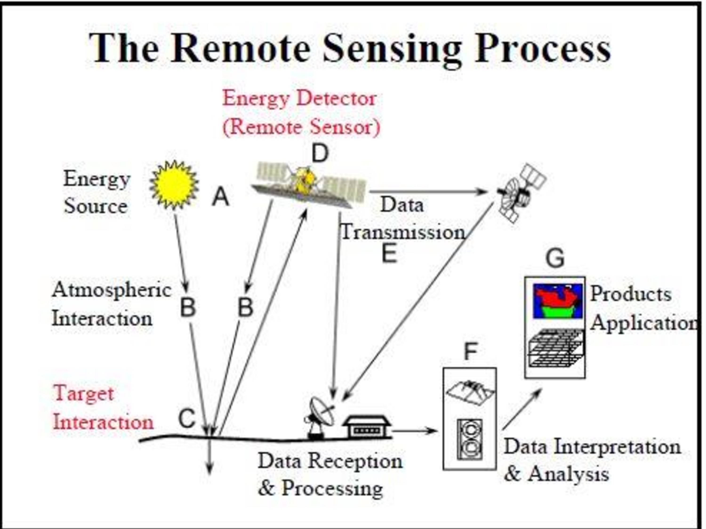
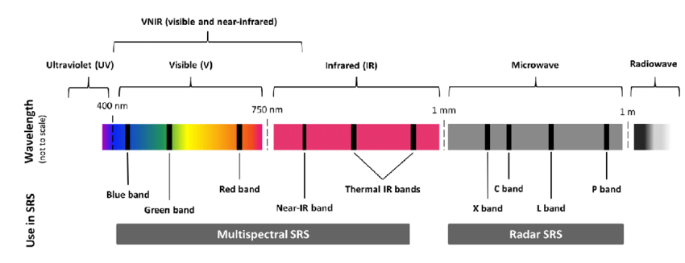
Remote sensing satellite and aircrafts imagery
Key features
  Spatial resolution, which is a measure of the smallest angular or linear separation between two objects obtained by the sensor
  Spectral resolution, that refers to the number of observed bands of the electromagnetic spectrum to which the sensor is sensitive and the width of each band in terms of frequency or wavelength
  Radiometric resolution specifying the radiance or intensity levels observed for each spectral band
  Temporal resolution, which refers to how often the sensor records imagery of a particular area and is related to the sensor’s ground field of view or swath width, a measure of its coverage capability
https://www.researchgate.net/figure/The-difference-between-four-major-types-of-remote-sensors-passive-sensors_fig3_324537528

Slide 8
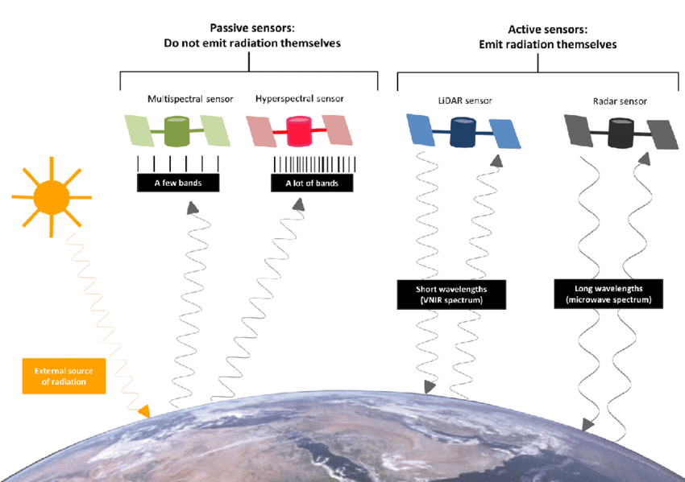
Remote sensing satellite and aircrafts imagery
Remote sensing systems may be classified as
  Passive systems register naturally occurring radiation that is reflected or emitted from the terrain in the visible, infrared and other parts of the electromagnetic spectrum
  Active systems such as microwave (radar) and sonar emit electromagnetic energy and then measure and time the backscatter radiation returned to the sensor system
https://www.researchgate.net/figure/The-difference-between-four-major-types-of-remote-sensors-passive-sensors_fig3_324537528

Slide 9
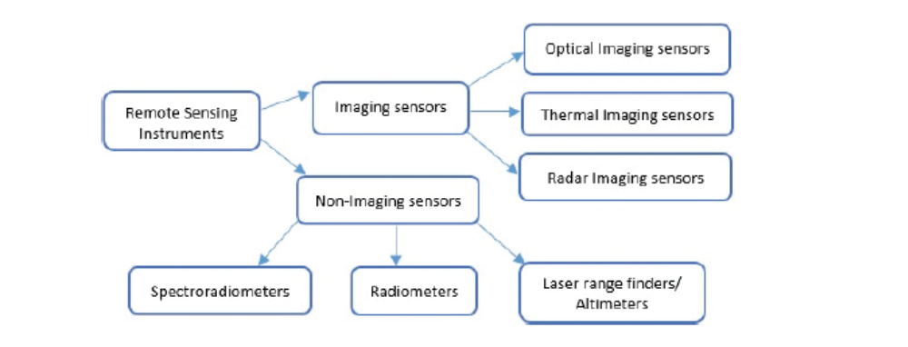
Remote sensing satellite and aircrafts imagery
Remote sensing systems typology
  Multi-spectral and hyper-spectral sensors (weather, marine and land observation)
  High spatial resolution sensors (moderate spatial coverage but high resolution)
  RADAR sensors (can function both day and night; marine and land observation)
L. Zhu et al, 2017

Slide 10
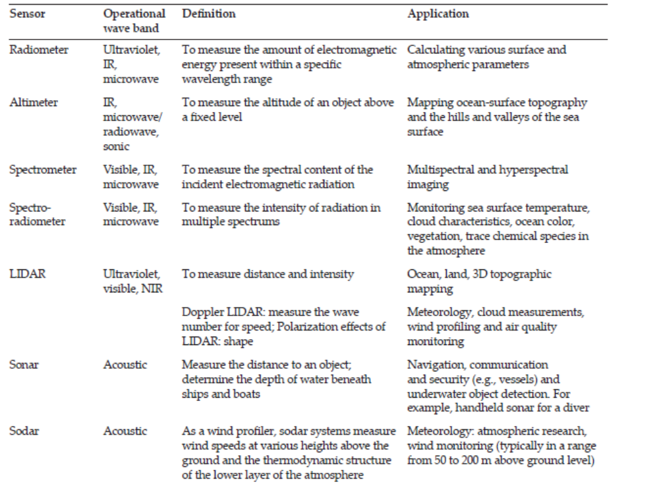
Remote sensing satellite and aircrafts imagery
Other remote sensing alternatives include
  Photography, videography and LIDAR (LIght Detection And Ranging), FLIR (Forward Looking InfraRed) and Laser fluoresce-sensors
  FLIR sensors are positioned on aircraft or helicopters. They are used in search and rescue operations and forest fire monitoring
  Laser fluoresce-sensors are based on the principle that some targets fluoresce, or emit energy, upon receiving energy. These sensors are applied for ocean applications to detect oil spills and map chlorophyll
L. Zhu et al., 2017

Slide 11
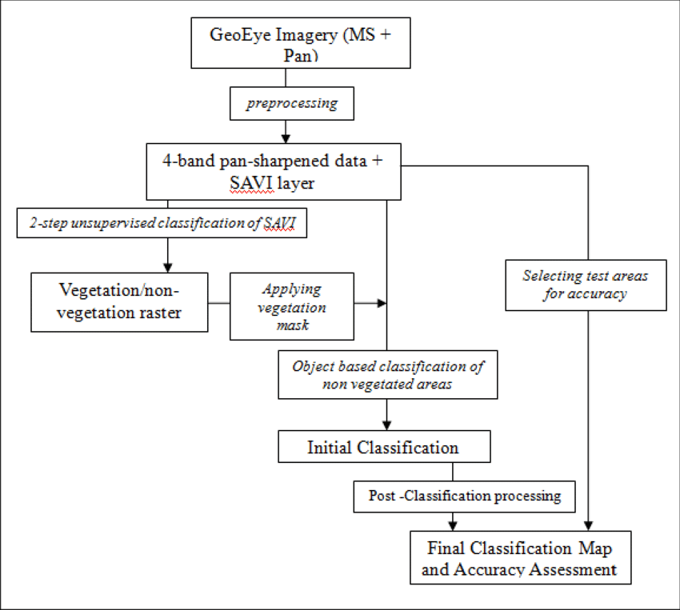
Remote sensing satellite and aircrafts imagery
Processing of remotely sensed images is a requirement to correct for distortions and facilitate visual or machine-based analyses
Remotely sensed images are subject to the following processing stages:
  Rectification of the data to a map projection (pre-processing)
  Image enhancement
  Image transformation
  Classification
  Change detection
The goal is to summarize remote sensor data as enhanced images, image maps, spatial database files, statistics or graphs
https://www.researchgate.net/figure/Satellite-image-processing-workflow-Using-the-Band-Expression-tool-in-ENVI-software_fig3_312233638

Slide 12
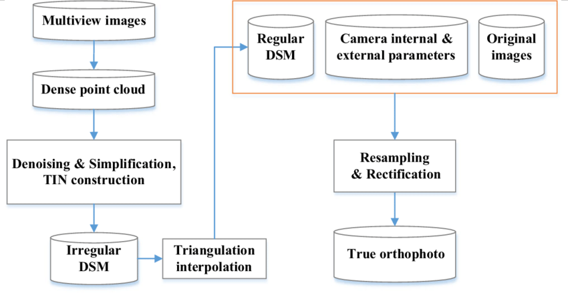
Aerial photography and videography
Aerial photography can use panchromatic black-and-white, color or color infrared film, depending on the user goals
Aerial photos can be taken vertically or with an oblique view from manned or unmanned aircraft. Vertical photos are a realistic counterpart to the information provided by a map of an area. Oblique photos, usually obtained at 30 or 60 degrees, provide a three-dimensional effect
By removing image displacement one can rectify aerial photos and obtain orthophotos. Image displacement is due to terrain relief, plane tilt and camera lens distortion
https://www.researchgate.net/figure/The-flowchart-of-true-orthophoto-generation_fig2_323329942

Slide 13
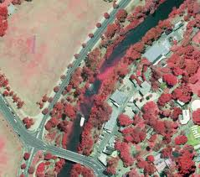
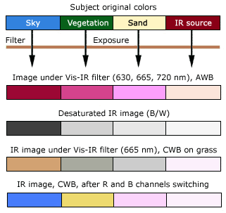
Aerial photography and videography
Color infrared aerial photographs are used to analyze vegetation cover
  USGS through its National Aerial Photography Program (NAPP) systematically collects infrared aerial photography at 1:40.000 scale of the entire country every five years.
  A complete coverage of infrared aerial photos for the country of Portugal is also available

Slide 14
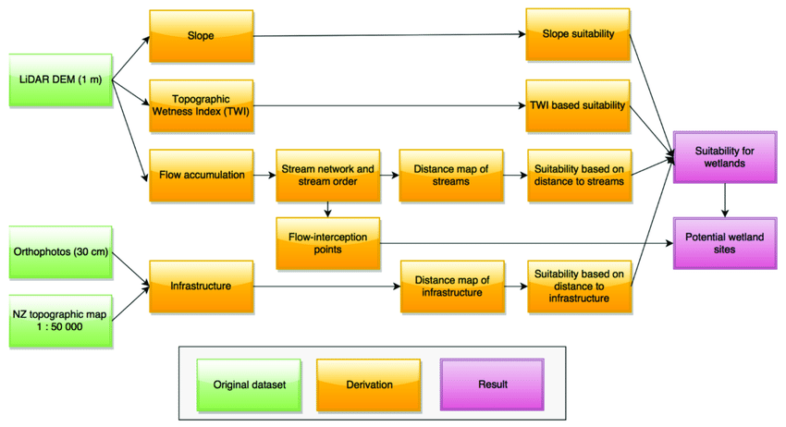
Aerial photography and videography
Digital elevation models (DEM’s) provide a realistic representation of the terrain
  Elevation may be derived from stereoscopic images or single aerial photos
  DEM’s are usually derived from stereo pairs of aerial photographs and satellite images.
  The method is inspired on the recognition that human inter-pupillary distance enables one to perceive depth. In remote sensing, that distance is exaggerated to become the length between the two consecutive exposures needed to obtain the stereo pairs. These should overlap at least fifty percent.
https://www.researchgate.net/figure/Workflow-used-for-processing-of-the-digital-elevation-model-DEM-data-to-generate_fig3_324454470

Slide 15
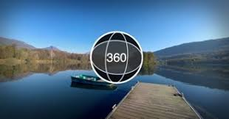
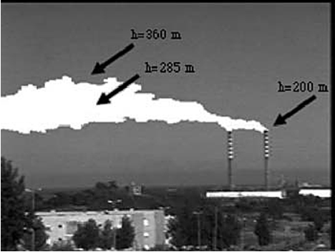
Ground photography and videography
360 images
  Each 360 degrees panorama is essentially a node. To cover an area, several nodes may be used. Multi-node photographic environments are represented in two-dimensional maps to facilitate navigation
  https://smartstories.online/
Videography
  Video is a sequence of images, usually called frames. Important features of video are the frame rate and number of scanning lines (rows of pixels)
  Environmental applications include automobile traffic and pollution, wetlands classification, industrial emissions analysis, estimation of air pollution model parameters, environmental education, environmental journalism

Slide 16
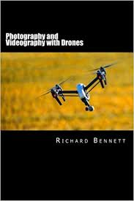
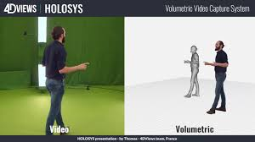
Ground photography and videography
Airborne videography (drones, aircrafts)
  Real-time or close to real-time availability of imagery for digital processing
  Real-time or near real-time availability of images for visual assessment
  Ability to collect spectral data in the very narrow bands in the visible to near infrared and mid-infrared water absorption regions
Volumetric video
  Volumetric video is the process of capturing moving images of the real world, people and objects that can be later viewed from any angle at any moment in time (known as six degrees of freedom)
  https://youtu.be/LnY3JKf4Rn0

Slide 17
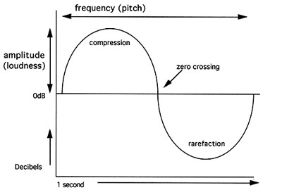
Sound
Sound consists of pressure waves travelling through air having a frequency between 20 to 20.000 Hertz. Any sound can be characterized as the superimposition of sine waves) with different frequencies and amplitudes
Sound frequency refers to how quickly the air vibrates. With higher frequencies, sound waves are closer to each other. Frequency is felt as the “pitch” of s sound, or its “highness” (i.e., as a piccolo) or “lowness” (i.e., as a tuba)
Sound amplitude refers to the amount of pressure exerted by the air. It can be seen as the height of the wave. Amplitude is described in units of pressure per unit area, and its is felt as the loudness of a sound. As the pressure measures cover a broad range, they are not used. Instead, a logarithmic scale of decibels (dB) has been adopted.
http://www.geoffadams.com/videoclass/sound1.html

Slide 18
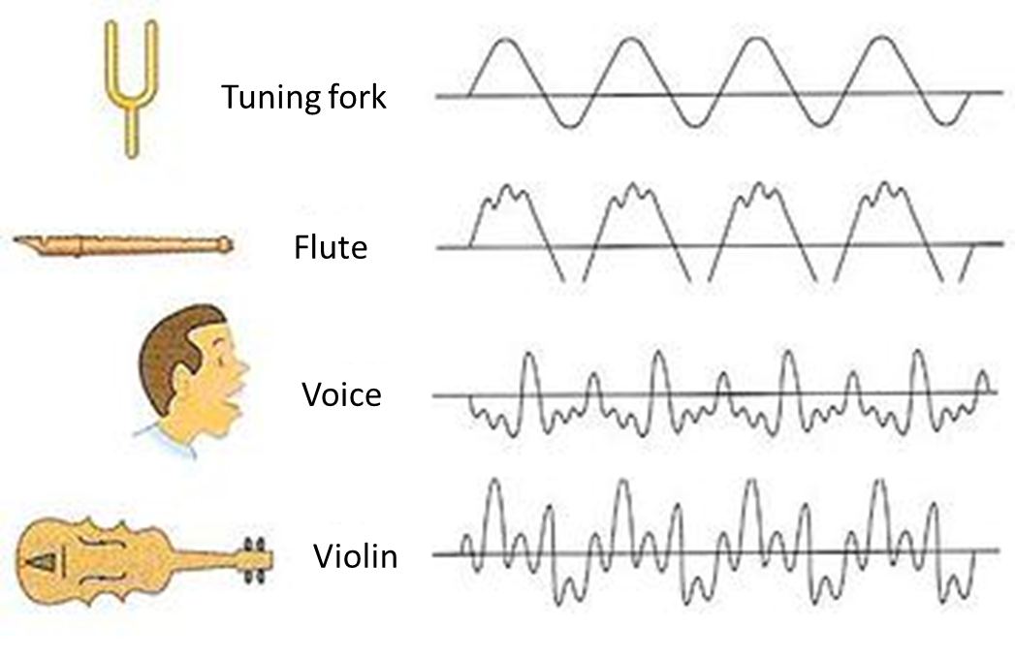
Sound
The most obvious characteristic of noise (or unwanted sound) is loudness, but the annoyance it may cause is also a function of the frequency of the noise. Given equal noise levels, a higher frequency noise is usually considered more annoying than a lower frequency sound
Another sound feature is timbre, the general prevailing quality, or characteristics of a sound. A saxophone does not sound like a violin when playing the same note. This is because the shape of the corresponding sound waves is different
https://www.simplifyingtheory.com/timbre/

Slide 19
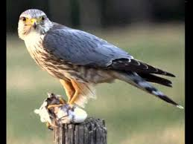
Sound
There has been an extensive work in biology and ecology, recording nature sounds. A most impressive source is Cornell University’s Library of Natural Sounds
https://www.macaulaylibrary.org/
https://www.allaboutbirds.org/guide/Merlin/sounds

Slide 20
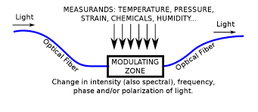
Fiber-optic sensors
Fiber optic sensors enable the transmission of light over large distances (hundreds of meters). Thus, a sensor head may be remotely located from the instrumentation, which makes them suitable for harsh environments
The intensity, wavelength, phase, and polarization of light can be used as measurement parameters
As multiplexing of fiber optic systems is feasible, expensive instrumentation can be shared among a number of sampling sites
https://www.researchgate.net/figure/Working-principle-of-a-fiber-optic-sensor_fig1_314441124

Slide 21
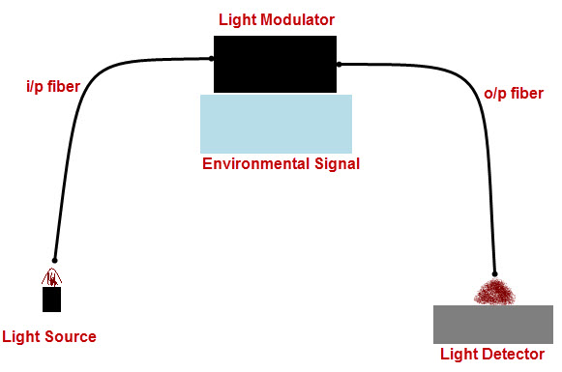
Fiber-optic sensors
Fiber optic sensors have been used to monitor:
  Air pollution. Carbon monoxide has been measured by direct absorption using the infrared or the near infrared bands
  Seawater. Using absorbing and fluorescent indicator dyes, pH and dissolved oxygen have been measured
  Groundwater and drinking water contamination. Chloroform and trichloroethylene have been measured by using sensors based on pyridine that absorbs light in the green region
https://www.elprocus.com/diffrent-types-of-fiber-optic-sensors/

Slide 22
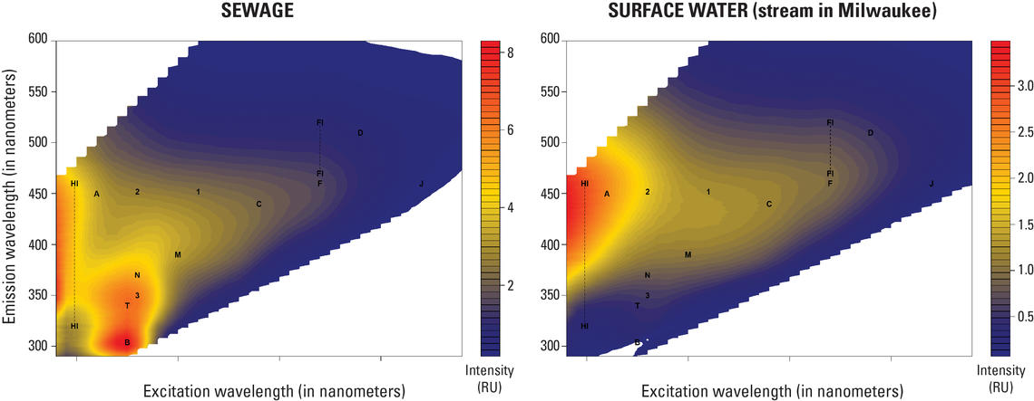
Optical sensors
Optical sensors rely on the use of beams of light. Electrical connections are replaced by optical waveguides and semiconductor integrated circuits by optical circuits
Optical sensing relies upon detecting a change in an optical signal as a result of a change occurring at the site being sensed. Optical parameters used include absorbency, refractive index change or fluorescence
These sensors may be applied for gases (i.e., carbon dioxide, carbon monoxide, oxides of nitrogen and sulphur) and water (i.e., phosphates, heavy metals)
https://www.usgs.gov/media/images/optical-sensors-fluorescence-signals-sewage-and-stream-samples

Slide 23
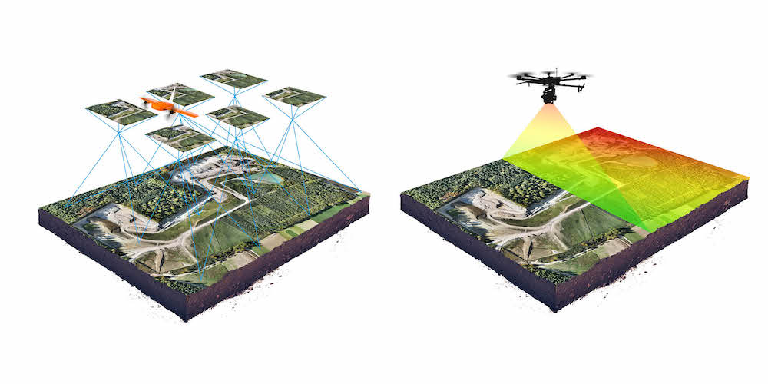
Laser sensors
Laser sensors are based on laser mass spectrometry that can be applied to any sample, solid, liquid, or gas
It uses laser beams in conjunction with mass spectrometers, nuclear detectors, and gas chromatographic techniques. Typically, laser beams hit targets and the back scattered light is collected and processed
LIDAR (after LIght Detection And Ranging), the optical equivalent of RADAR (radio beam), is one of the most used laser sensors. It is used for monitoring tropospheric and stratospheric pollutants for distances up to hundreds of kilometres. LIDAR has been also used to measure heights of forest canopies and water depth relative to the water surface
https://wingtra.com/drone-photogrammetry-vs-lidar/
https://appleinsider.com/articles/20/03/19/new-video-shows-what-the-ipad-pros-lidar-scanner-is-capable-of

Slide 24
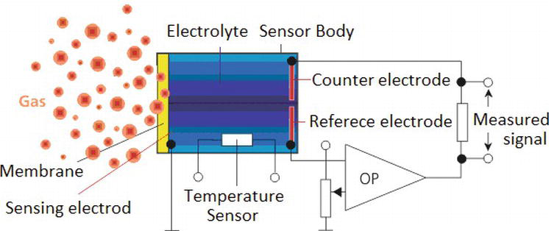
Electro-chemical sensors
These sensors are based in microelectrodes and can be battery operated, which makes them portable. They have been used mainly in water and air pollution analysis. Electrode fouling and polishing is a problem hampering practical application of these sensors
https://www.intechopen.com/books/electrochemical-sensors-technology/electrochemical-sensors-for-monitoring-of-indoor-and-outdoor-air-pollution

Slide 25
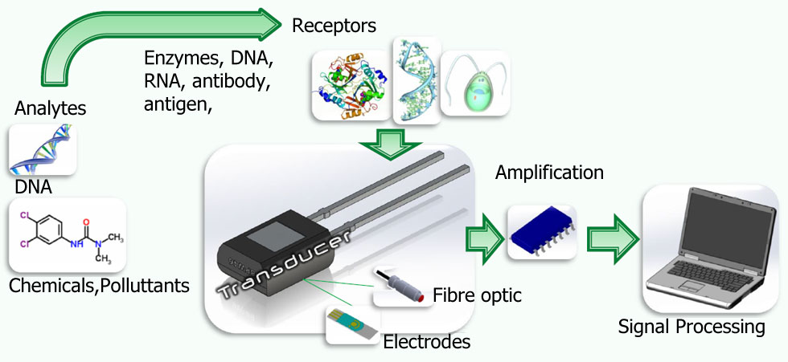
Bio-sensor devices
Biosensors are devices that transform biological reactions into electrical signals
Biosensors rely in biological sensing elements that may include tissues, cells, organelles, membranes, enzymes, receptors, antibodies or nucleic acids
These elements work with transducers based on a variety of principles ranging from potentiometry to acoustics
Biosensors are specific for a particular chemical or group of related chemicals
https://www.biosensor-srl.eu/about-us/what-is-a-biosensor.html

Slide 26
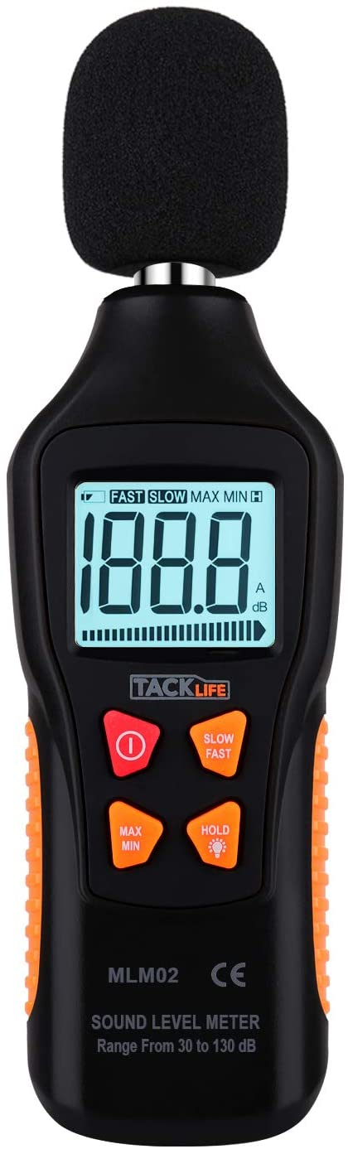
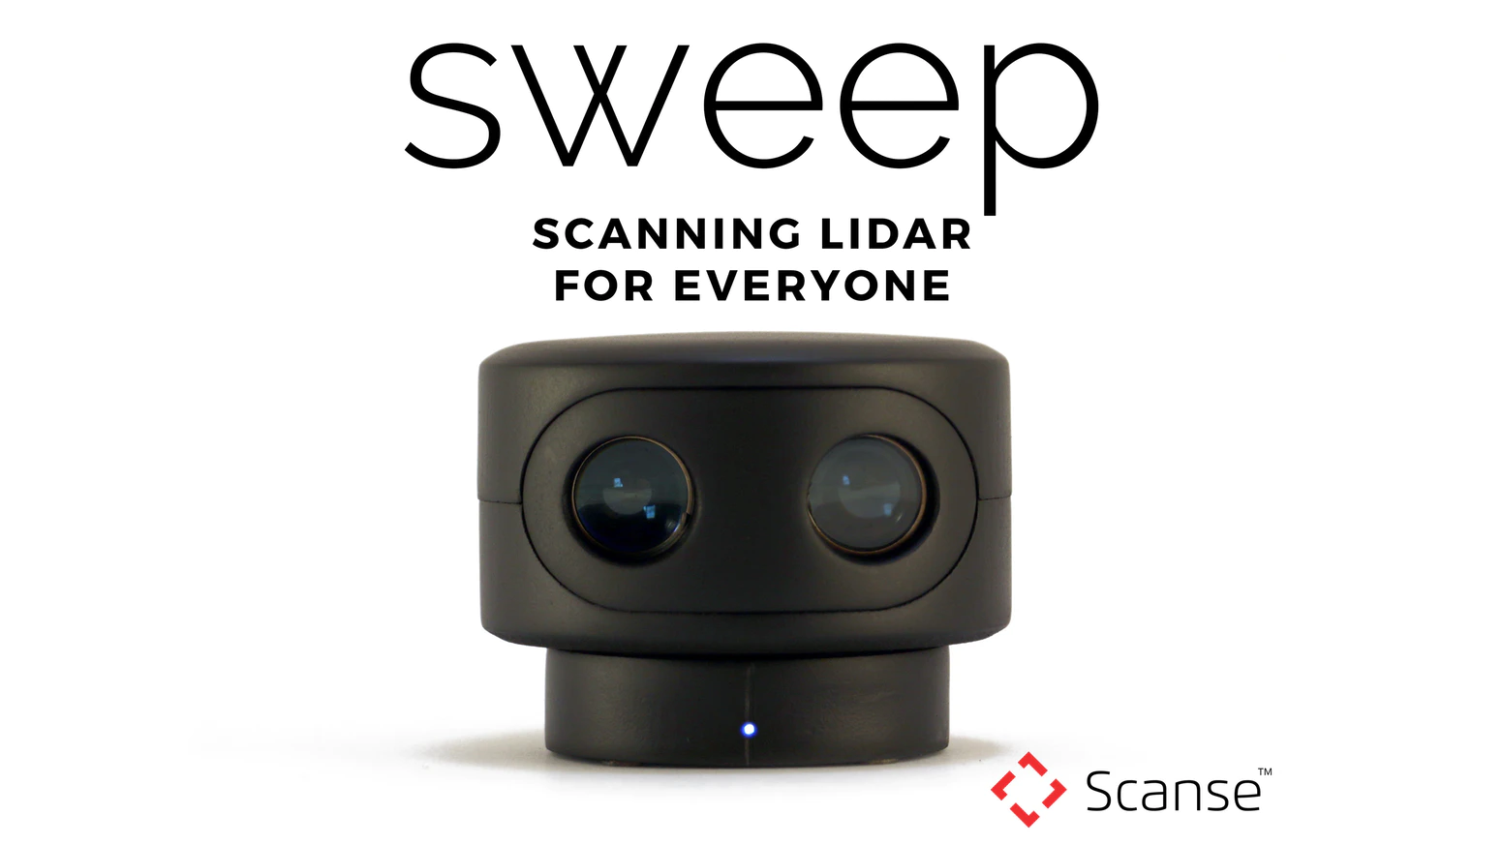
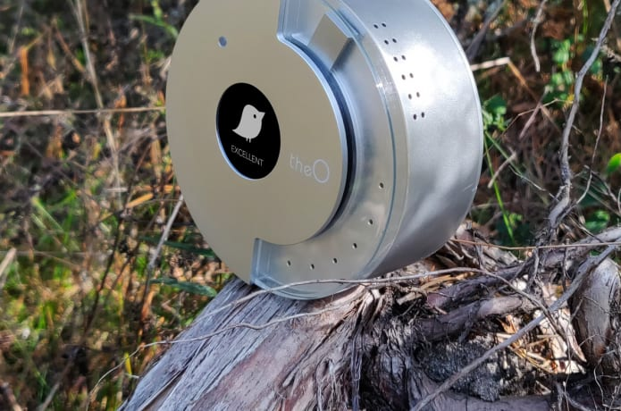
Consumer oriented sensors
LIDAR sensor
The O- Indoor air quality sensor
Tacklife- sound level meter

Slide 27
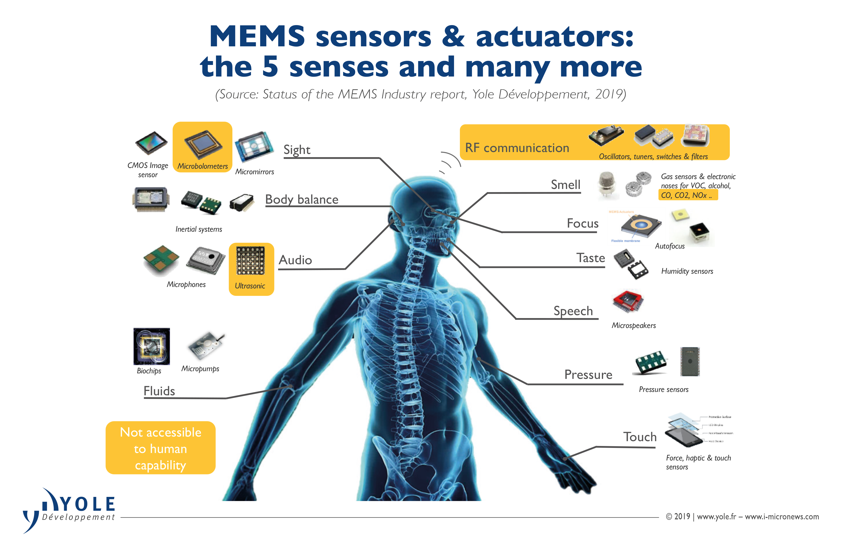
Human sensors
Vision enables the identification of water pollution, air pollution, solid wastes and landscape deterioration as discussed in the section related to videography
Noise is captured by hearing
Olfaction and taste detect chemicals present in the water and air. Skin becomes irritated under adverse environmental conditions
As environmental sensors, humans are subjective which limits their credibility: environmental conditions that are acceptable for some become totally unacceptable to others. This subjectivity is due to differences in age, gender, type of occupation, education, previous illnesses, medication and other factors
https://www.microcontrollertips.com/what-is-the-role-of-sensors-in-an-iot-network-part-1/

Slide 28
Additional readings
Antonio Camara, Environmental Systems, Oxford University Press, New York, 2002 (Chapter 2 available here)
Cristina Gouveia, “Collaborative Environmental Monitoring: Linking the Senses”, PhD Dissertation, FCT-UNL, 2007.
Cristina Gouveia, Alexandra Fonseca, António Câmara, Francisco Ferreira, “Promoting the use of environmental data collected by concerned citizens through information and communication technologies”, Journal of Environmental Management, 71, 2, 135-154, 2004 (available in SIMA Facebook group)
Enviro DiY, “Environmental Sensors” https://www.envirodiy.org/forum/environmental-sensors/
GIS Geography, “Remote Sensing of the Environment: Local and Global Environmental Issues” https://gisgeography.com/remote-sensing-of-the-environment/
Hasan Hayat et al., “The State-of-the-Art of Sensors and Environmental Monitoring Technologies in Buildings”, Sensors (Basel), 19, 17, 3648, 2019 https://www.ncbi.nlm.nih.gov/pmc/articles/PMC6749305/
J. Koon,” What are the roles of sensors in an IoT network? Part 1”, 2019 https://www.microcontrollertips.com/what-is-the-role-of-sensors-in-an-iot-network-part-1/
L. Zhu et al. “A Review: Remote Sensing Sensors”, 2017 https://www.intechopen.com/books/multi-purposeful-application-of-geospatial-data/a-review-remote-sensing-sensors

Slide 29
Appendix I Examples of environmental variables and sensors to measure them (Gouveia 2007).
Environmental Variables |  | Sensors
Chemical | pH | A variety of methods to measure pH are available from pH paper to electrochemical sensors. An example of an available sensor is the electrochemical pocket pH meter (http://www.hannashop.co.uk/acatalog/HI_98129.html).
 | Volatile Organic Compounds (VOC) | Ho et. al (2001) reviewed the use of chemical sensors for monitoring VOC. The ppbRAE is a handheld photo-ionization VOC Detector, commercially available (http://www.raesystems.com/ppb.html).
Physical | Temperature | Temperature sensors may be bimetallic or thermistor (Sinclair, 2002). For a list of vendors refer to www.sensorland.com.
 | Relative Humidity | The simplest sensor uses the hair hygrometer principle (Sinclair, 2002.) However, other operating principles exist such as capacitive, resistive and thermal humidity sensors. For a list of vendors refer to www.sensorland.com
Biological | Bio-toxicity | Biosensors are used to measure ecological variables such as toxicity. DeltaTox Analyzer uses a specialized strain of freeze-dried luminescent bacteria to detect biological effects of contaminants present in samples (http://www.azurenv.com/dtox.htm).
 | Organism Tracking | A specially designed microphone plus a computer with a sound processing card can make a bio-acoustic monitoring station for tracking nighttime birds’ migration (USEPA, 1998a).

Slide 30
Appendix II- Fibre-optic sensors for environmental monitoring (Gouveia, 2007)
Technology | Brief description | Advantages | Disadvantages | Application examples
Fibre Optic Sensors | A typical fibre sensor includes an optoelectronic package, optical fibre, and the sensor. The transduction mechanism involves a change in a parameter of the guided light such as its intensity, lifetime, or phase (USDOE, n.d.). While some devices rely only on changes in the light that is emitted or reflected, others incorporate a chemical layer on the tip of an optical fibre (Ho et al., 2001). Fiber optic sensors can be used to measure different types of variables such as: chemical, temperature, strain, biomedical, electrical and magnetic, rotation, vibration displacement pressure and flow (Winn Hardin, 1998). | Multiple chemicals can be measured at one time. The same expensive instrument can be shared among a number of sampling sites (Stewart, 1997). Light signals are carried to and from a remote measurement arena via small optical fibers (Garrido, Ghodrati and Chendorain, 1999), which makes them suitable for monitoring harsh environments. Concentrations of volatile and toxic chemicals can be measured anywhere along the path of a fiber (Winn Hardin, 1998). | Concentration range sensitivity may be limited (Ho et al., 2001). Sensors that use chemically sensitive coatings may degrade with time (Ho et al., 2001). | Fibre optic gyroscopes as part of navigational systems in automobiles (Winn Hardin, 1998). A fibre optic sensor with a chemical coating has been used to measure iodine vapors for concentrations as low as 5 ppm (Ho et al., 2001). Carbon monoxide in air samples has been measured by direct absorption using the infrared and near-infrared bands (Camara, 2002)

Slide 31
Appendix III- Optical sensors for environmental monitoring (Gouveia, 2007)
Technology | Brief description | Advantages | Disadvantages | Application examples
Optical Sensors | Optical instruments can quantify the concentration of substances present in a sample by measuring the degree of electromagnetic radiation which is emitted, absorbed, fluoresced, or scattered by the substance (USDOE, n.d.). The optical sensors may use radiation having wavelengths that range from the infrared to the vacuum ultraviolet (uv), although microwave, x-ray, and gamma spectroscopic techniques may also have significant applications (USDOE, n.d.). In general, optical sensors present an excellent performance for air samples, a good application for soils and a poor performance for water samples (USDOE, n.d.). | Robustness and miniaturization (Camara, 2002). | Dust and dirt can coat the optics and impair response, which is a concern in in-situ environments (Ho et al., 2001). | Volatile organic compounds (VOC) in air samples have been measured using Fourier-Transformed Infrared Spectrometry (FTIR) (USEPA, 1997a). X-ray, gamma, and neutron spectroscopy have the potential to be effective tools for the examination of waste containers such as drums and boxes (USDOE, n.d.).

Slide 32
Appendix IV Electrochemical sensors for environmental monitoring (Gouveia, 2007)
Technology | Brief description | Advantages | Disadvantages | Application examples
Electrochemical | Can provide real-time information about the chemical composition of their surrounding environment. Ideally, such devices are capable of responding continuously and reversibly and do not perturb the sample (Wang, 1995). Electrochemical sensors may be grouped in three major types (Ho et al., 2001; Brett, 2001): (1) potentiometric (measurement of voltage); (2) amperometric (measurement of current); and (3) conductometric (measurement of conductivity). Chemical sensor arrays with instrumentation, having popular names such as the electronic nose or electronic tongue, have been constructed to address chemically complex analytes like taste, odor, toxicity, or freshness (Stetter, Penrose and Yao, 2003). | Inherently sensitive and selective towards electroactive species, fast and accurate, compact, portable and inexpensive (Ho et al., 2001). | May require frequent maintenance and may produce toxic byproducts (Wang, 1995). | Amperometric and potentiometric devices are used in air monitoring to measure gases such as oxygen, carbon monoxide, hydrogen sulfide or chlorine (Ho et al., 2001). Water quality parameters such as pH are traditionally measured with these devices (Ho et al., 2001). Conductometric sensors have used for vapor detection of gasoline spills and leaks in the subsurface (Ho et al., 2001). An electronic nose that employs an array of chemiresistors has been used for identification of organic acids in wastewater streams, and recognition of gasoline, diesel and crude contamination in recycled containers (Ho et al., 2001).

Slide 33
Appendix V Biosensors for environmental monitoring (Gouveia, 2007)
Technology | Brief description | Advantages | Disadvantages | Application examples
Biosensors | An analytical device composed of a biological recognition element associated with a signal transducer (Rogers and Mascini, n.d.). Biosensors can be considered a subset of chemical sensors (Stetter, Penrose and Yao, 2003). Biosensors for environmental applications have employed a wide range of biological recognition systems coupled to a similarly wide range of signal transducers. Biological recognition is accomplished using three basic mechanisms: biocatalytic (based on enzymes), bioaffinity (based on antibodies), and microorganism-based systems. These biological recognition systems have been linked to electrochemical, optical-electronic, optical, and acoustic transducers (Rogers and Mascini, n.d.). | Provide continuous or near-continuous information about multiple substances (Rogers and Mascini, n.d.). Measure biological effects such as toxicity, which are difficult to measure using conventional methods (Alcock and Newman, 2000) Cover a broad range of compounds (Rogers and Mascini, n.d.). | High development costs for single analyte systems, Biorecognition components may have limited lifetimes. The characteristics of the matrices may influence the measurements (e.g. pH of the water may affect the enzymatic activity) Relative assay format complexity for many potentially portable (but currently laboratory-based) biosensor systems (Rogers and Mascini, n.d.). | Pesticides, herbicides (Rogers and Mascini, n.d.; Wang, 1995). Biochemical Oxygen Demand (BOD) (Rogers and Mascini, n.d; Wang, 1995) can be measured replacing the 5 days conventional procedure. Identification and enumeration of microorganisms (Rogers and Mascini, n.d.).

Slide 34
Appendix VI SPR sensors for environmental monitoring (Gouveia, 2007)
Technology | Brief description | Advantages | Disadvantages | Application examples
Surface Plasmon Resonance (SPR) Sensors | SPR relies on the physical principle that the energy carried by photons of light can be transferred to electrons on a metal surface, creating a “plasmon”, which is an electric field. The wavelength at which this energy transfer takes place is characteristic of both the metal and the environment of the metal surface, which is illuminated (Frazer, 1998) The phenomenon of SPR is completely non-specific. It is then possible to combine SPR sensors with other biochemical analysis technologies. SPR sensors can be used to determine: 1) physical quantities based on sensitivity of the SPR sensor to the momentum of the incident light wave. 2) chemical variables by directly measuring the refractive index or by measuring variations due to adsorption or a chemical reaction of an analyte with a transducing medium which results in changes in its optical properties. 3) biomoelcular interactions (Homola, Yee, and Gauglitz, 1999). | Fast response (Katz, n.d.). SPR sensors can detect changes in the chemical composition of the environment within range of the plasmon field (Frazer, 1998). In most cases there is no need to pre-treat the sample before its presentation to the sensor (Katz, n.d.). A single sensor format (i.e. size, storage and usage protocol, reader, etc.) may be used for a variety of assay chemistries (Katz, n.d.). | Current direct SPR biosensors detection limits are not sufficient for detecting low concentrations of low molecular weight analytes (Homola, Yee, and Gauglitz, 1999). | Humidity sensor utilizing humidity-induced refractive index changes of porous thin layers and polymers (Homola, Yee, and Gauglitz, 1999). Monitoring of the concentration of vapors of hydrocarbons, aldehydes and alcoholes by adsorption in polyethylene glycol films (Homola, Yee, and Gauglitz, 1999).

Slide 35
Appendix VII Colorimetry for environmental monitoring (Gouveia, 2007)
Technology | Brief description | Advantages | Disadvantages | Application examples
Colorimetry | A reactive material produces a color, the intensity of which is proportional to the quantity of the substance that is present in the sample. The color intensity can be determined visually or with a spectrophotometer (Ho et al., 2001). Different technologies may be used to determine compounds in air, soil gas, soil, and water. 1) indicator tubes for air and soil gas and 2) reagent and immunoassay- based kits for water and solids. For air and soil and gas samples colorimetric tests can be used to measure instantaneous concentrations or to measure daily exposure levels. To test water and solid samples, the reagent colorimeter compares a reacted sample with a sample blank and yields results in concentration units (Ho et al., 2001). Immunoassay-based kits use the interaction of target analytes with analyte-specific antibodies to create a change in color. | Portable, simple to use and inexpensive (Ho et al., 2001; USEPA, 1997a). | Requires manual intervention and is not amenable to long-term in-situ applications Ho et al., 2001; USEPA, 1997). Results obtained by indicator tubes are qualitative to semi-quantitative (USEPA, 2002). Inaccurate readings due to limited visual accuracy (USEPA, 2002; 2003). | Applications ranging from health and safety monitoring to quantitative testing for definitive site characterization (USEPA, 2003). Petroleum hydrocarbons, pesticides and herbicides can be analyzed by immunoassay test kits (USEPA, 2003). Typical organic analytes detectable by reagent kits include petroleum hydrocarbons, polychlorinated biphenyls (PCB), polynuclear aromatic hydrocarbons (PAH), trihalomethanes, and nitroaromatics (explosives such as trinitrotoluene [TNT]) (USEPA, 2003).

Slide 36
Appendix VIII Mass piezoelectric for environmental monitoring (Gouveia, 2007)
Technology | Brief description | Advantages | Disadvantages | Application examples
Mass Piezoelectric Sensors | Sensors that typically adsorb the chemical of interest onto a surface, and detect the change in mass (Ho et al., 2001). Many natural and man-made materials, typically in the form of crystals, ceramics, or polymers, present a linear relationship between the change in the mass and the change in its oscillating frequency. These devices have the advantages that they can be fabricated in relatively small sizes (dimensions as small as a few mm) and are inexpensive to manufacture (Shear, 1999). Adequate to monitor chemicals in air and several types of piezoelectric sensors are capable to detect chemicals in liquids. For soil or solid materials analysis they require a sampling front end to transfer the species to be detected into an air or water sample (USDOE, n.d.). | Produce a measurable electrical output signal without the use of an external electrical power source, which can be a great benefit in low-power designs (Shear, 1999). Can operate remotely (USDOE, n.d.). | The output signal is prone to electromagnetic noise, and can be difficult to integrate into data acquisition systems (Shear, 1999). Heavy calibration requirements since the frequency of the crystal depends on the geometry and the immobilization technique used to coat the surface (Rogers and Mascini, n.d.). | Detection of VOC in air samples (USDOE, n.d.).

Slide 37
Appendix IX Human senses (Gouveia, 2007)
Types of sensors | Human senses | Description
Imagers | Vision | Imagers can be placed in a ground-based set up or used in a mobile context. They provide information on areas but require line-of-sight. The technological developments that have occurred in electronic imaging systems have increased the number and variety of applications. Visual surveillance systems in existence are applied to various monitoring purposes such as: coastal management (Holland, 1997), air pollution (Ferreira, 1999) and urban transit (Kilger, 1992) among others. Camara (2002) presents a review on the use of videography as a source of environmental data.
e-noses and e-tongues | Taste & Smell | E-noses and e-tongues are chemical sensor arrays that seek to provide quantitative measurements of chemically complex analytes like taste or odor (Stetter et al., 2003). They detect in real time chemicals that previously could be detected only by laboratory analysis.
Microphones | Hearing | A microphone transduces sound into electrical energy. They may use different transducers (for a review refer to Sinclair, 2002) and use an acoustic filter, whose shape and dimensions modify the response of the overall system Microphones are used as sensors in sound-level meters.

