Slide 1
Neural Networks introduction

Slide 2
AI approaches
Machine learning and NOVA environmental engineering students
  Input
    Environmental Enginnering students 1982-2019
  Output
    Success (conventional, craftsmanship, societal) 1982-2019
  Hidden nodes
    Accounting for F in Output= F (Input)

Slide 3
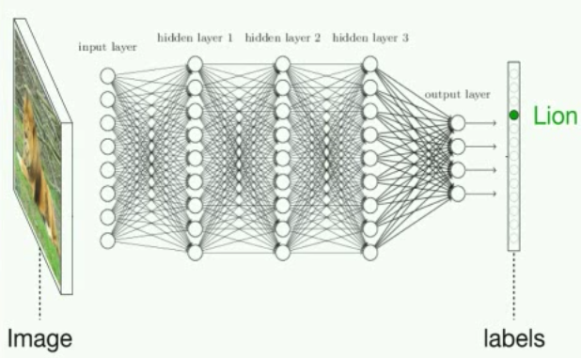
Neural networks

Slide 4
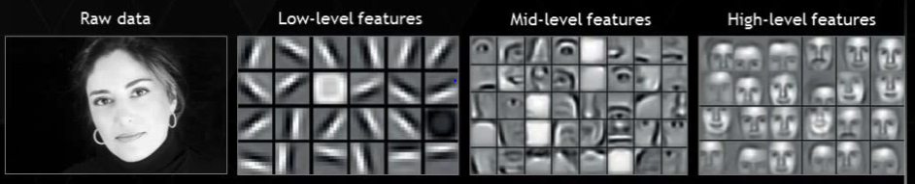
Neural networks

Slide 5
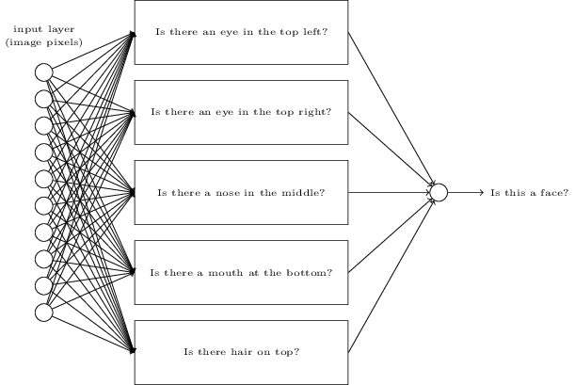
Neural networks

