Slide 1
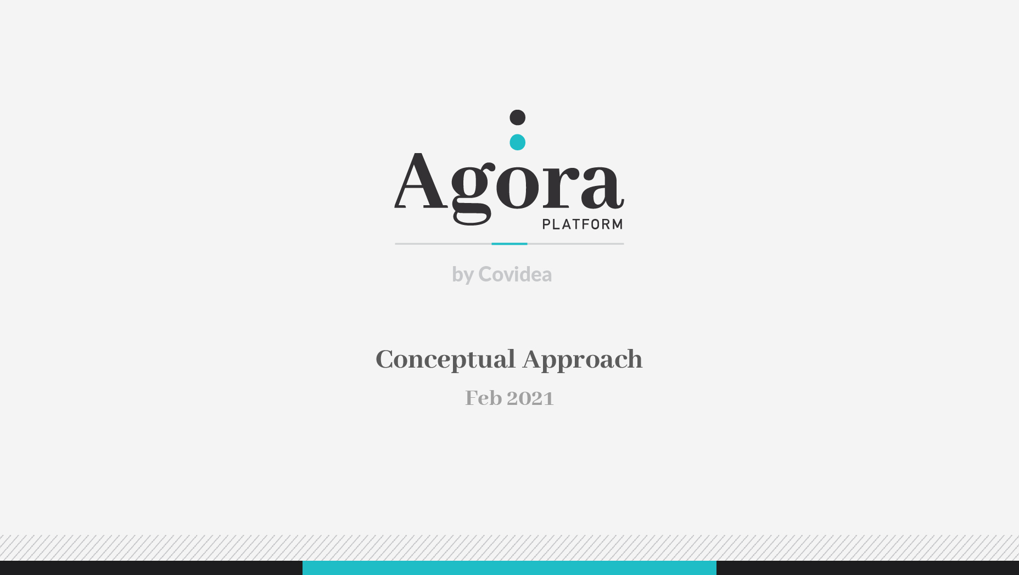

Slide 2
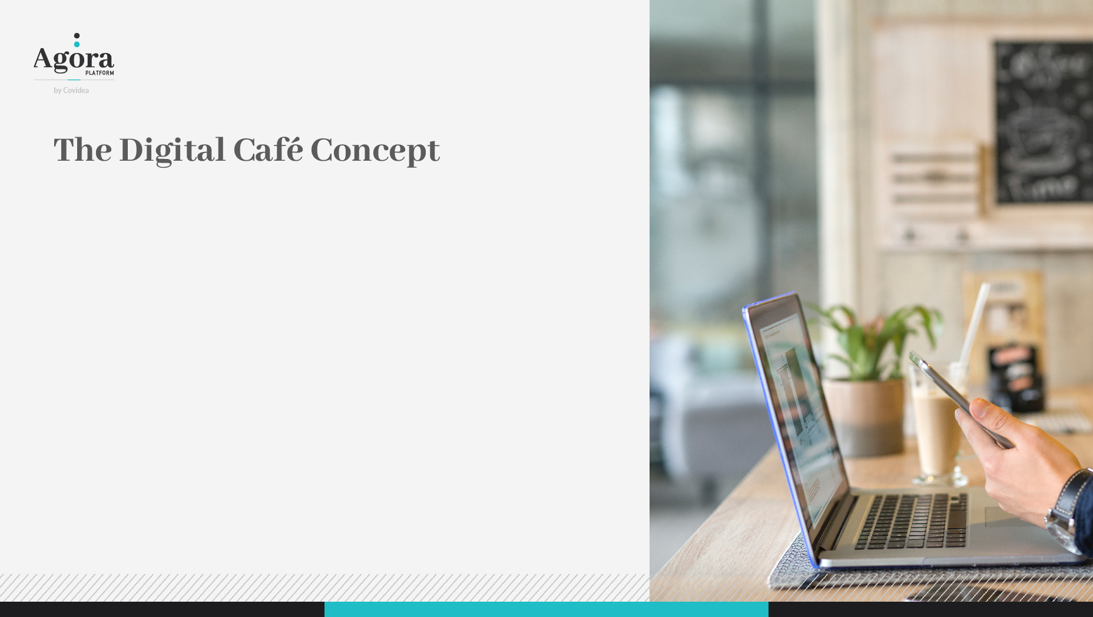
As in a Cafe, it must be a meeting point where people can interact.
As in a Cafe, people should have access to drink and food.
As in a Cafe, people may have access to knowledge.
As in a Cafe, people may have access to art.
As in a Cafe, people may have access to entertainment.
As in a Cafe, may have access to innovative experiences.
As in a Cafe, people may have access to a maker's environment.
As in a Cafe, there will be a shop.

Slide 3
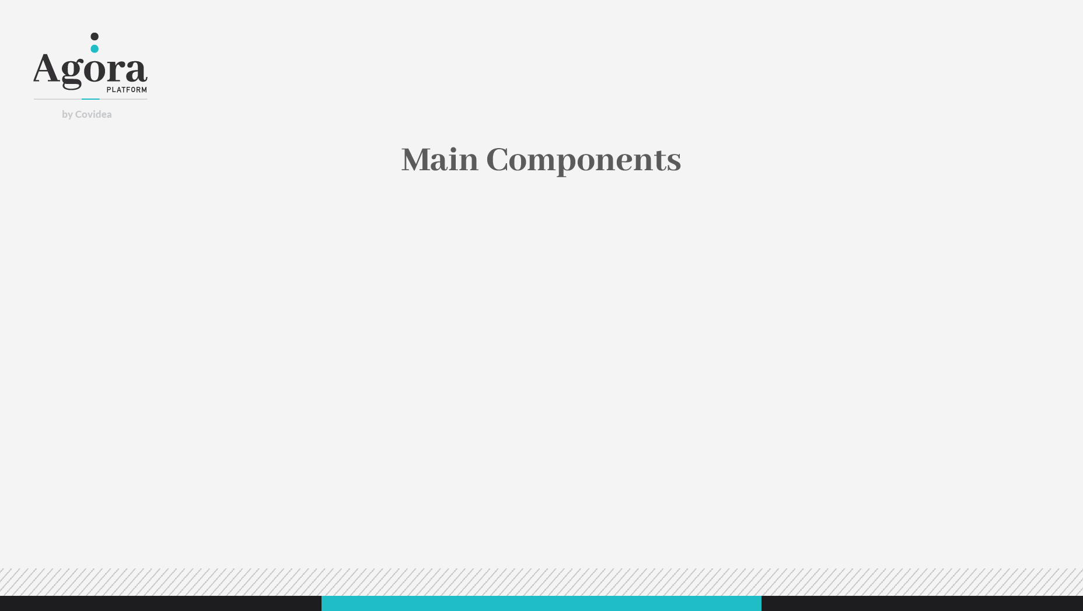
Information Management
Content
    Library / Digitarium / showroom
Data organization
    Search
    Visualization
    Interaction
Meeting Management
Create a room
Find a room
Interaction Strategies
Resources & Tools

Slide 4

Hierarchical organization:
Helps structuring the ideas
Facilitates search
Allow multiple Visualization strategies
Search strategies:
Key words (automatic selection of content based on the meeting key words)
Curated selection (personal selection of content by the meeting owner)
Google like searches (at request)
AI (interactive references suggestion based on the meeting conversation)

Slide 5

Visualization Strategies:
Library shelf
Screen wall (for videos)
AR tree
Interaction strategies:
Selected/support information in the background
Always present (ex: book shelfs in the background)
360º like approach

Slide 6
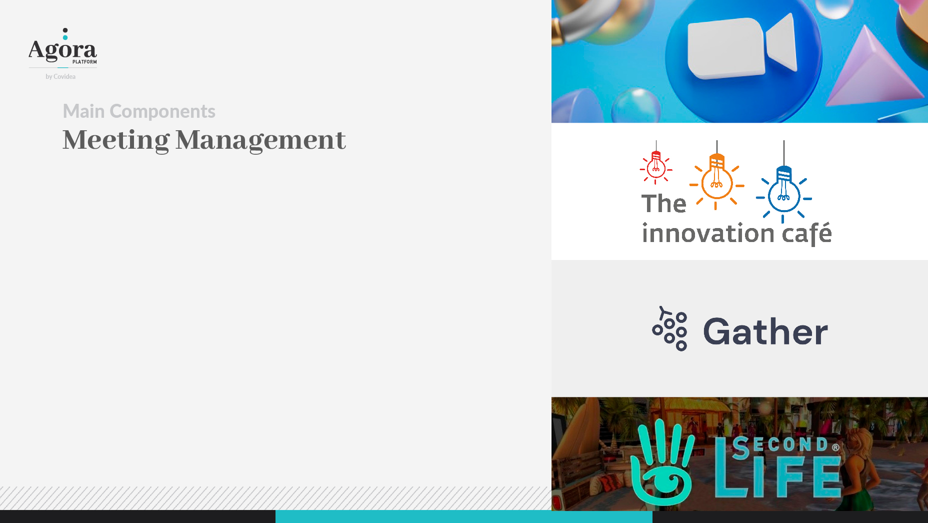
ZOOM like (priority to the face-to-face contact)
Innovation Café like Portal (collection of links to different rooms) Link
Gather world like (spatially distributed meeting rooms)
Link
Immersive worlds, Secondlife (Avatars)
Link I Link II
… or a mix of them

Slide 7
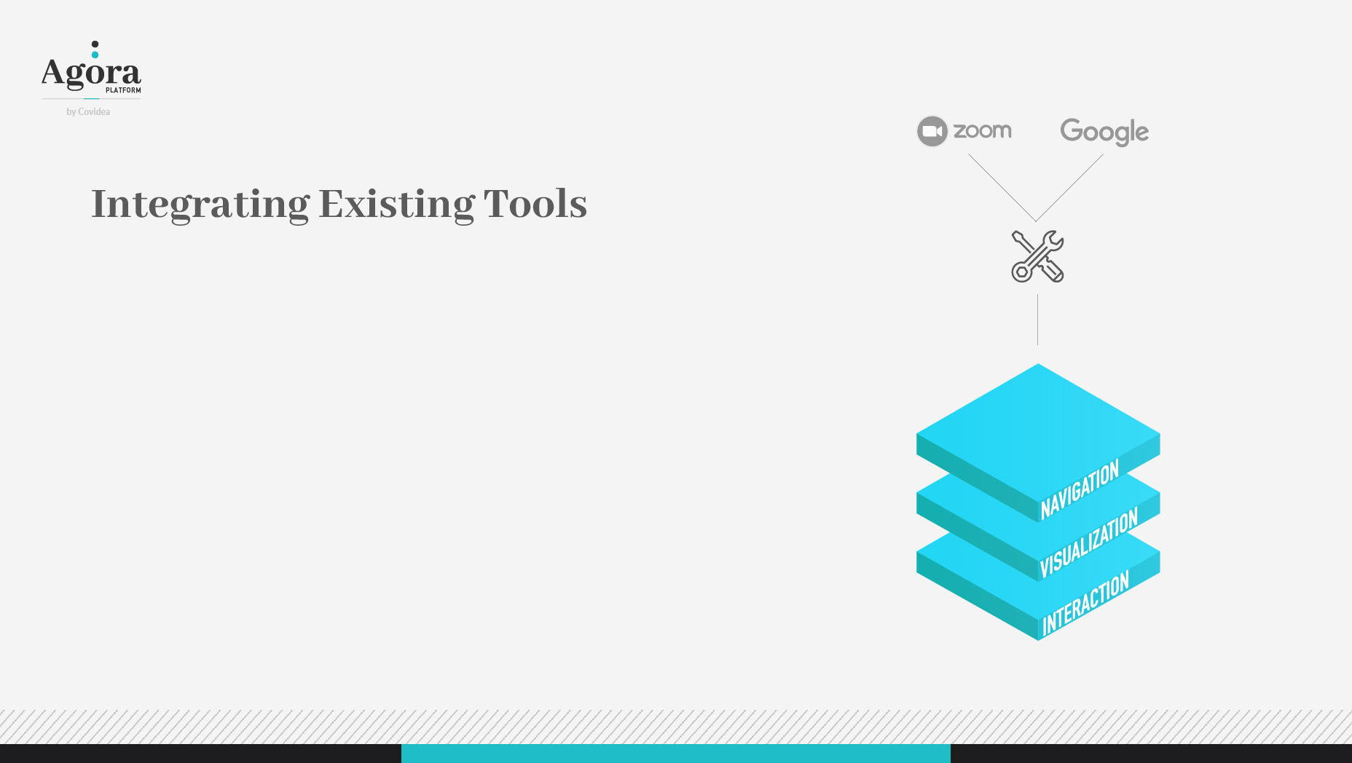
Key Tools:
Meeting tool: ZOOM
Search tool: GOOGLE
Encapsulation Interfaces:
Navigation Layer
Visualization Layer
Interaction Layer

Slide 8
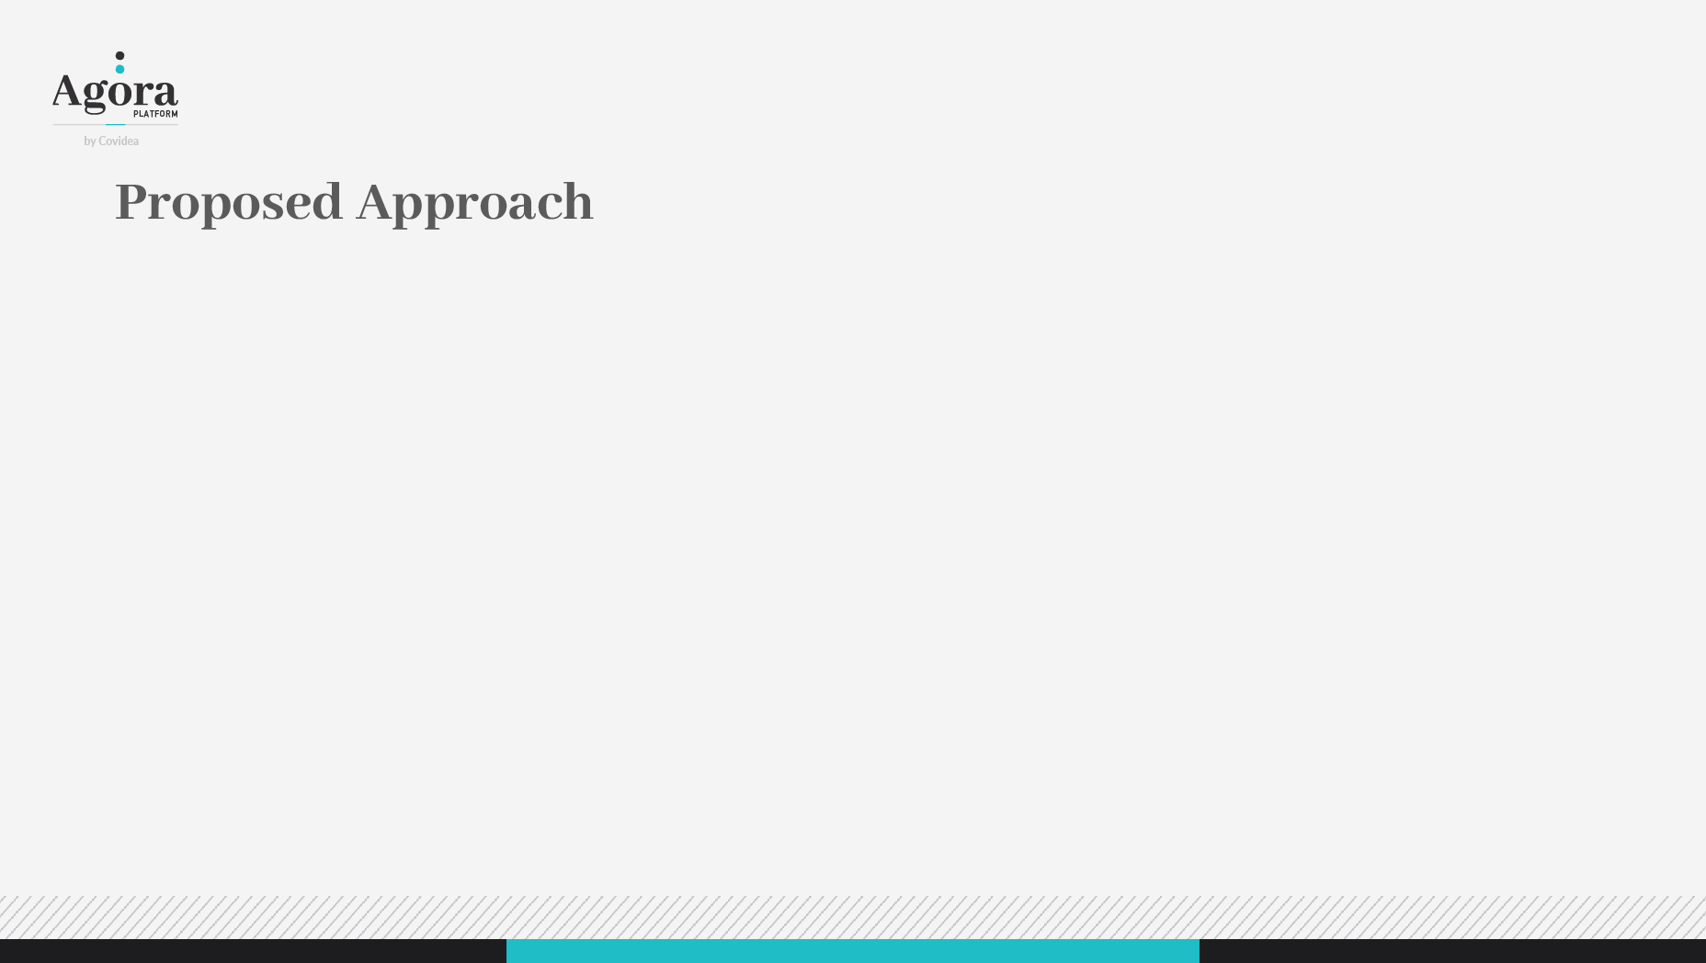
Portal like entering page
Management, General information, Schedules, …
Access to different type of meeting spaces
Virtual Bot (2D/3D) to guide visitors
allow direct access to meeting rooms via direct link
Different meeting room environment
2D Rooms (Zoom like)
3D environment (with Avatars, spatial sound): conference rooms, informal rooms
Mix rooms (Zoom like for communication + 3D contextual environment for data visualization): discussion/working rooms
Access to Tools & Information
Different tools for different meeting rooms (different purposes)

Slide 9
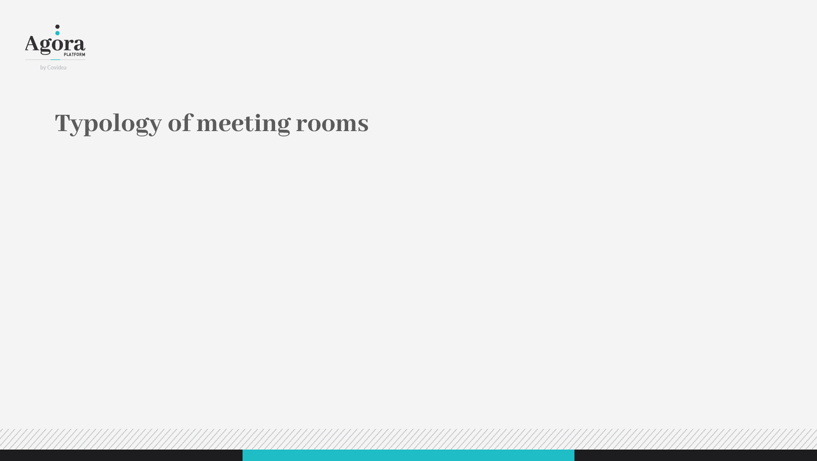
Informal rooms (Café room - for casual discussions)
Personal rooms (my own virtual room)
Meeting rooms (working room, Stakeholder Wing, Diplomatic Quarter)
Conference rooms (presentation room)
Knowledge rooms (access to Library / Digitarium / Showroom)
Entertainment rooms (Gaming Alley)

