Slide 1
Financing product development
Antonio Câmara
January 30th, 2021

Slide 2
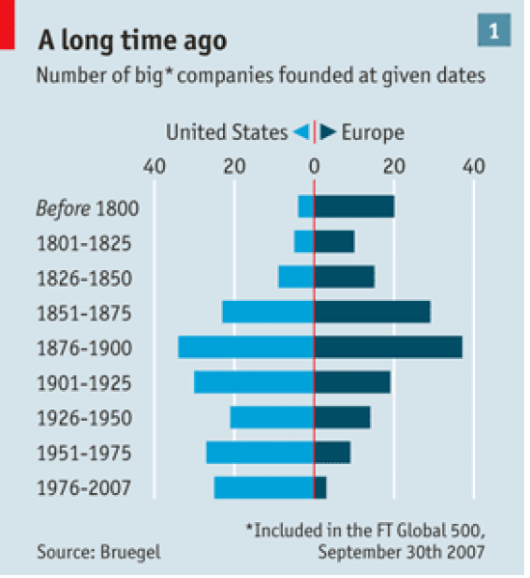
Notes:
Although Europe is a world leader in scientific research and the EU has spent two trillion Euros in research, we are failling to produce large companies

Slide 3

Notes:
Our education does not promote self-reliance, as described by Ralph Waldo Emerson. This essay is by the way required reading at Harvard entrepreneurship courses

Slide 4
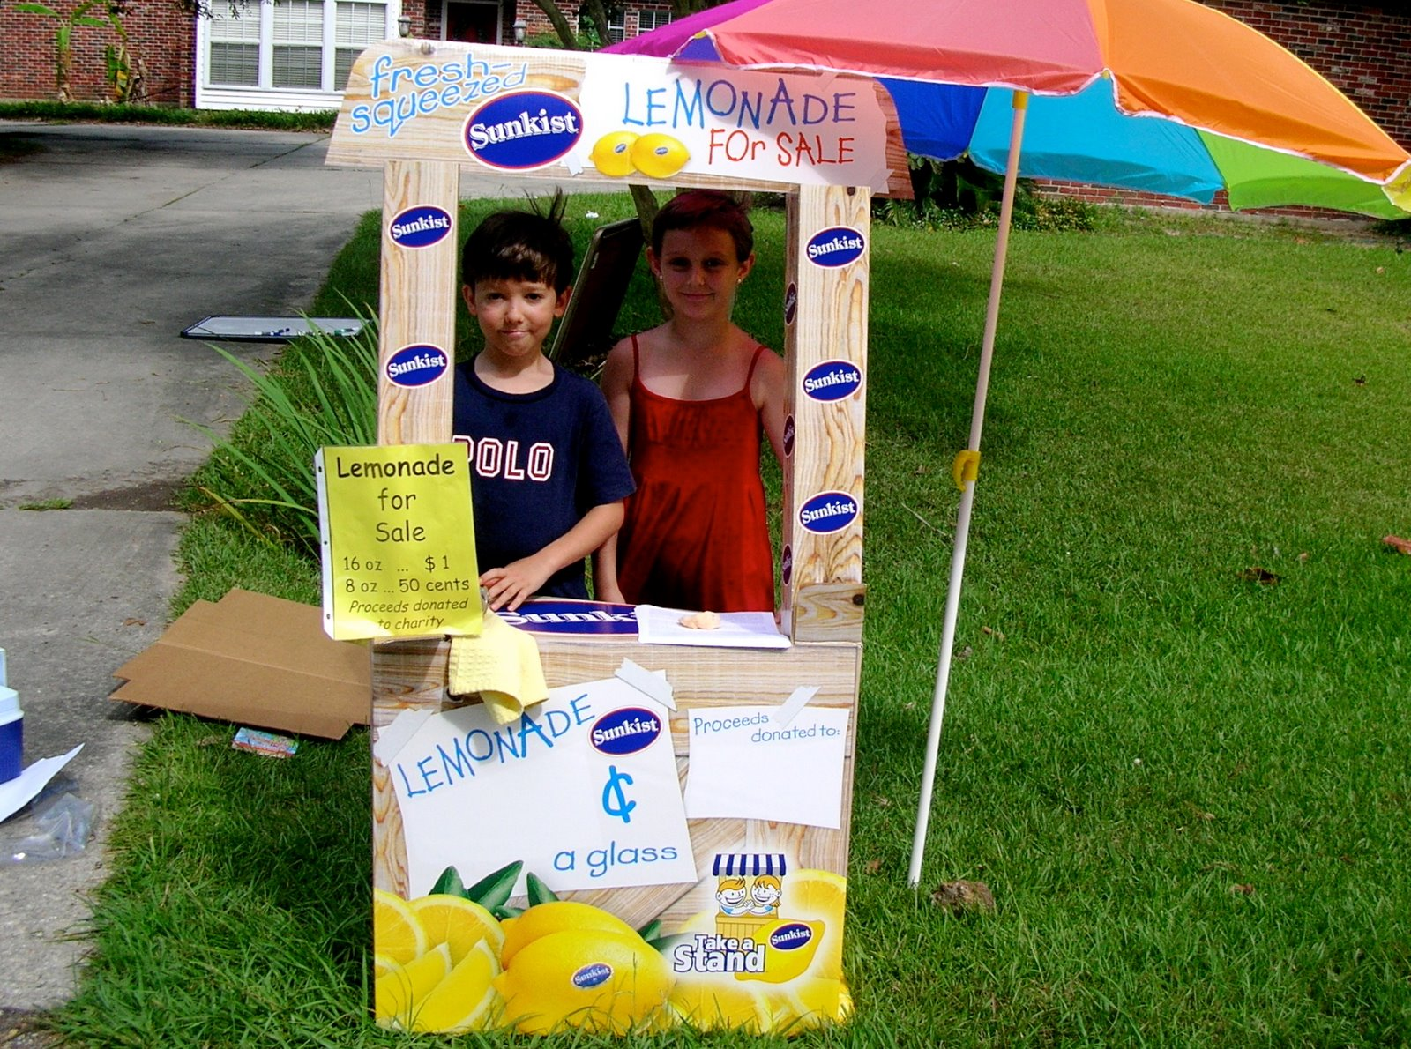
Notes:
The Global Director of Research for Siemens said at EIT that a major problem in Europe is that we are not trained “to perceive value”: we do not sell lemonades in the streets. Actually, if we were in Germany, the neighbors of these kids would denounce them to the police because they were disturbing public order, or even to the IRS to check if they were collected, according to the Siemens executive

Slide 5
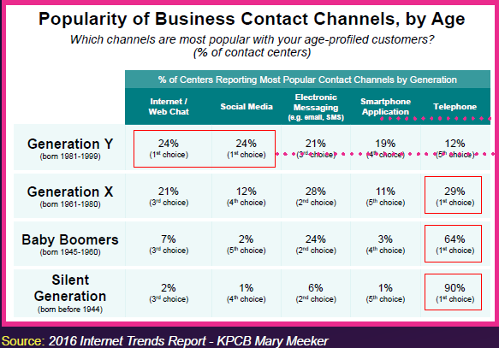
“The difference between the US and Europe, is that we believe in the young”
Nicholas Negroponte
Notes:
And the young have been disrupting every sector: media, telecommunications, and now even banking and law (crypto-currencies and the blockchain)

Slide 6
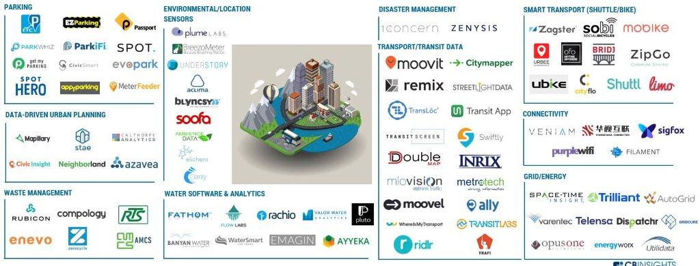
“Smart Cities” ecosystem
Notes:
Now, in almost every vertical market there are also opportunities that are being pursued by startups. This is the ecosystem map for smart cities. Similar maps can be produced for fin tech, edu tech, health, retail. Startups are “eating” the World of old.

Slide 7
Technological Possibilities
Understanding of
Client Needs
Early Product ideation
Creativity

Slide 8
Product
Development
co-development with partner
through client project
through research grants
Own product developments

Slide 9
Following Steps
Discontinuation
Own Product Catalogue
Licensed or sold
Product Spin-out
Filtering based on study of
Market potential
Volume production viability
Corporate strategy

Slide 10
Financing product development
It is possible to create lower risk/higher return startups with lesser investment, almost anywhere
Mature ecosystems are being created in several parts of the World
Lower costs for prototyping and product development (see http://www.visualcapitalist.com/side-hustle-economy/)
Crowdfunding is a market tester, funding aid, and provides global exposure
Notes:
Radu Caraus, alias Crazy PT, is a kid in Alcobaça that is creating educational toys for the World via http://the inventors.io. He has 25 million viewers. Magical Industry Tour, is a AIP project that is detecting talents such as Radu across Portugal.

Slide 11
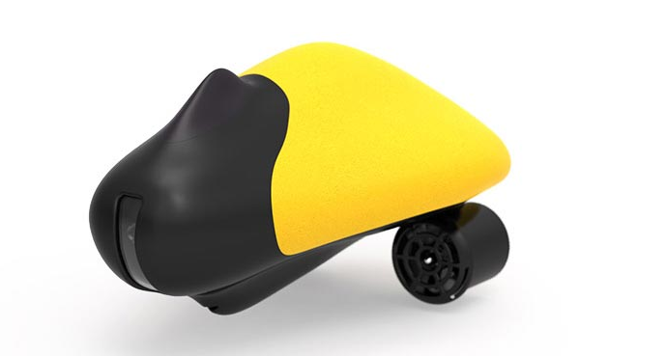

“Crowdfunding”
Global exposure
Community development
Free market study
Financing
Step-by-Step Guide to Launching a Successful Kickstarter campaign (Little Might)

Slide 12
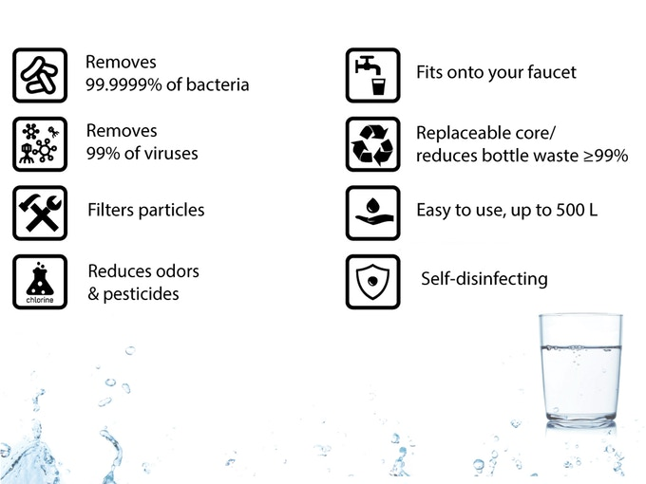

Crowdfunding
https://www.kickstarter.com/projects/drinkpurehome/drinkpure-home-safe-and-tasty-water-from-the-tap
https://www.kickstarter.com/projects/mayuwater/mayu-keep-your-water-healthy-with-a-natural-swirli

Slide 13
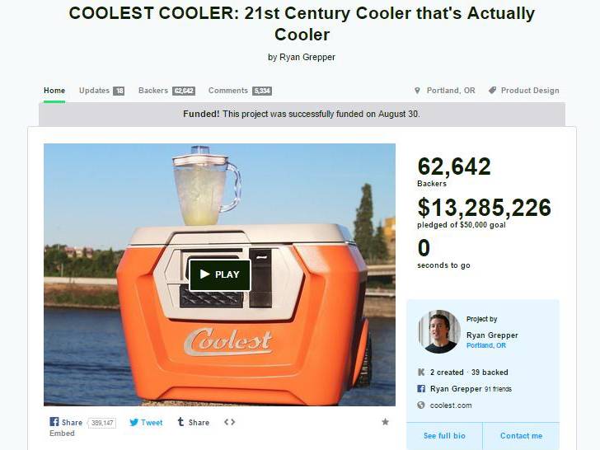

Slide 14
Financing product development
It is possible to create lower risk/higher return startups with
lesser investment, almost anywhere
Intellectual property are assets that can be monetized
Social media reduce marketing and communication costs
Amazon, Wallmart and AliBaba provide global logistics, marketing, sales and procurement
There are 150 million investors online that provide high liquidity in Exchanges like Deutsche Borse, TSX-V and ASX
Notes:
In addition to these Exchanges, Estonia’s Funderbeam, a blockchain exchange for startups is highly intreresting

Slide 15
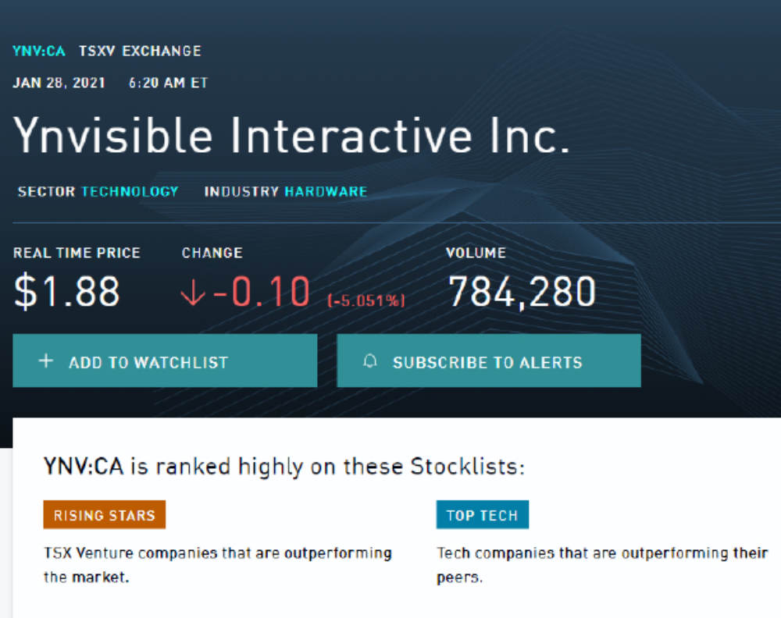

Slide 16
Financing product development
Accelerators
List of acelerators/incubators/
https://www.ycombinator.com/
https://bolt.io/

Slide 17
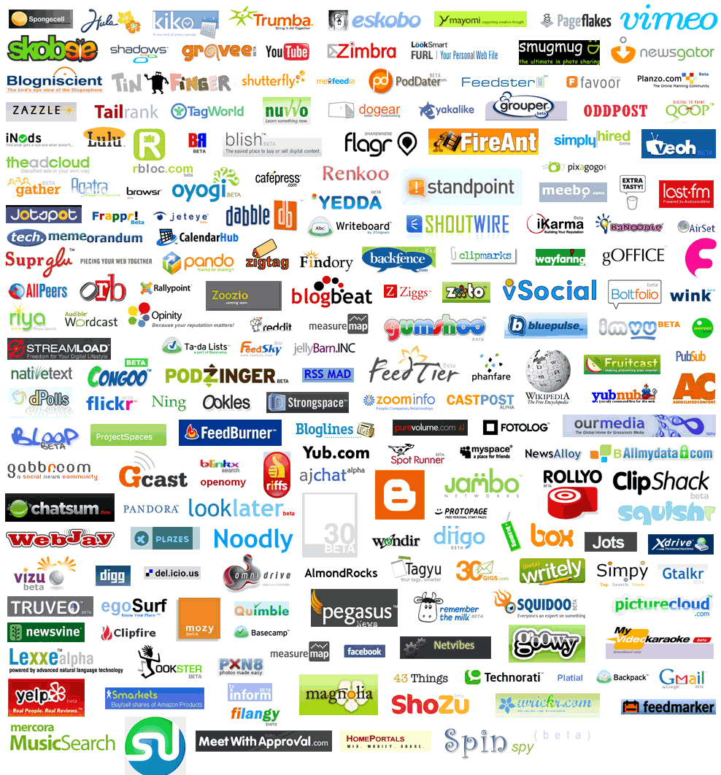




Silicon Valley Model
Angel funded start-ups
Billions of revenue
Winners
User Traction
VC Backing
Picture Credits: Ludwig Gatzke
Notes:
We are also following the Silicon Valley model. Thus, we will be able in time to generate infrastructural companies to challenge the current American dominance. It is also important to note that there is now an alternative model based on crowdfunding, accelerators, and venture exchanges (as mentioned later on)

Slide 18
Financing product development
Angel and venture financing (an american view)

Slide 19
Financing product development
Alternative funding sources to venture capital
EY-Cambridge alternative finance report
ICOs

Slide 20
Financing product development
https://www.sequoiacap.com/build/
The Elevator Pitch
A sample of “pitches”

