Slide 1
Prototyping
Antonio Câmara
January 29 th, 2021

Slide 2
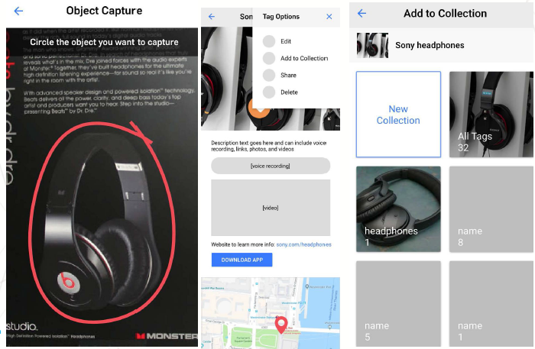
Software projects
Initial market validation
Requirements specification
Drawing of wireframes on "paper"
Implementation of the first
prototype based on wireframes
Usability testing
Interative process until you get a
functional version

Slide 3
Software Projects
UI/UX Prototyping
Square Space
https://www.squarespace.com/
Sketch
https://www.sketchapp.com/
Figma
https://www.figma.com/
Software development
GitHub for students
https://education.github.com/pack (incluindo Atom, AWS, Cart, Stripe, Unreal)
Help / Ajuda
Amazon Mechanical Turk
https://www.mturk.com/

Slide 4
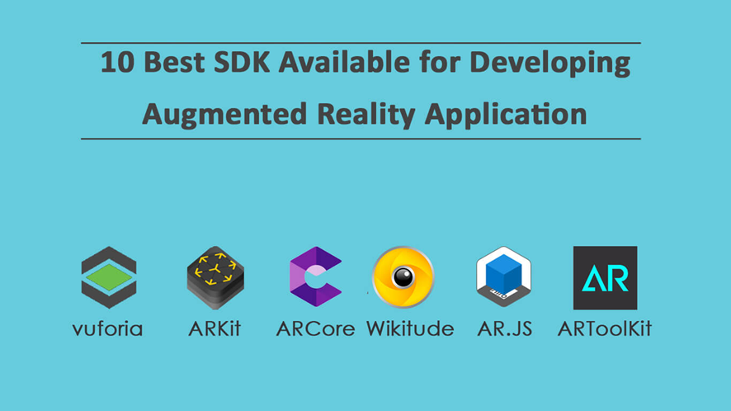
Augmented reality
Open source augmented reality SDKs

Slide 5
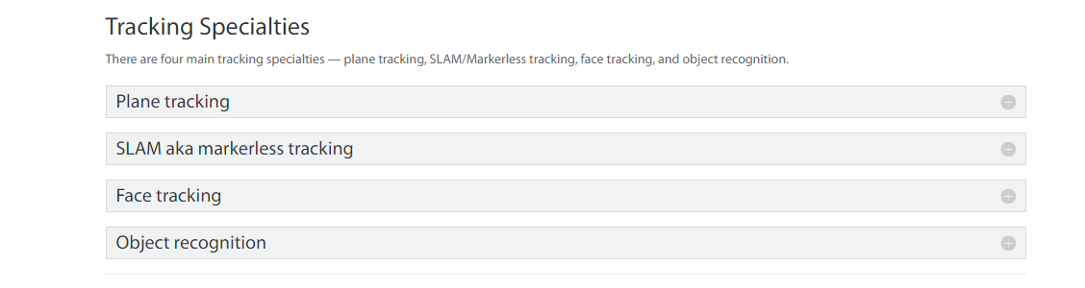
Augmented reality
Augmented reality SDKs compreehensive guide

Slide 6
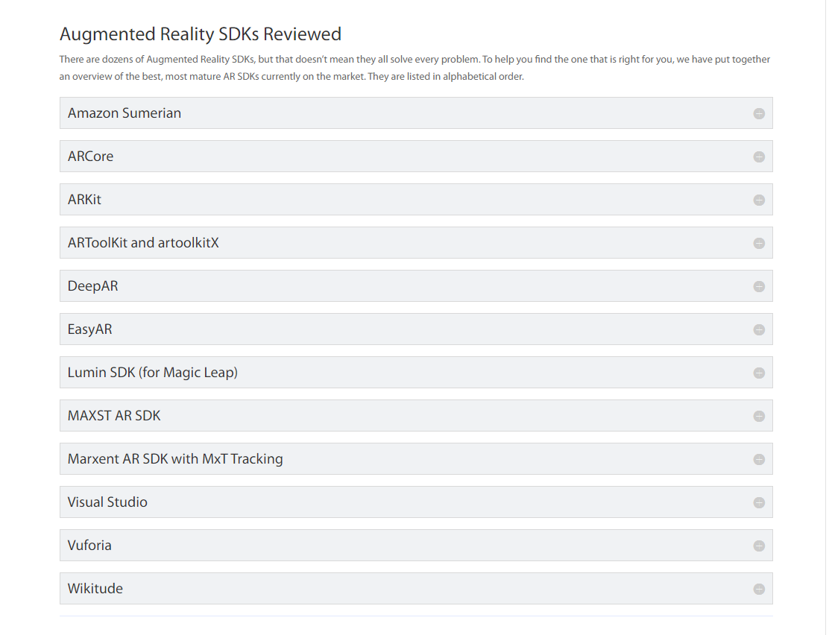
Augmented reality
Augmented reality SDKs compreehensive guide

Slide 7
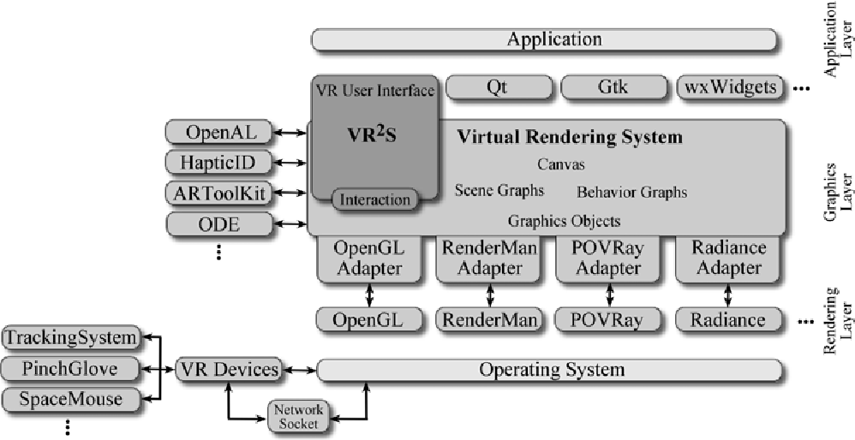
Virtual reality
A generic virtual reality software system's architecture and application

Slide 8
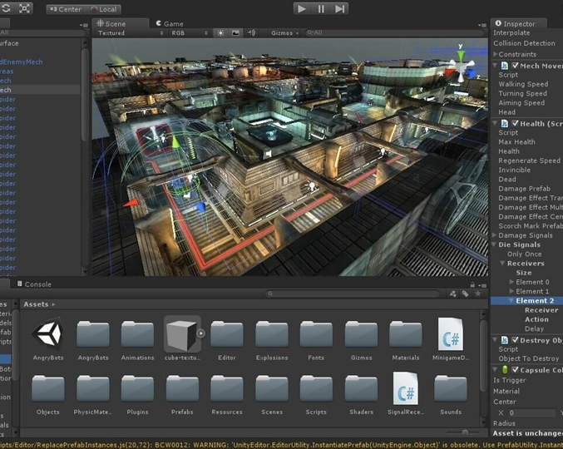
Virtual reality
Best virtual reality SDks tools
Unity 3D
Unreal Engine
Blender
Amazon Lumeryard
Cry Engine

Slide 9
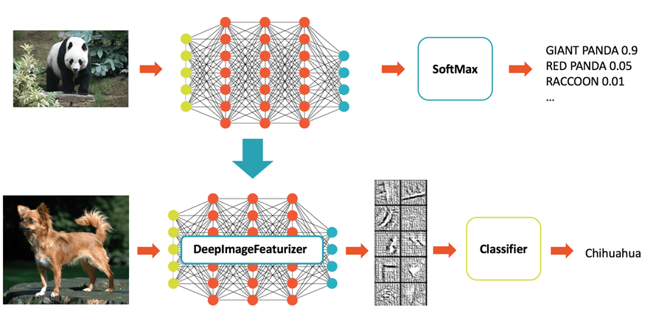
Machine Learning
Open source tools for machine learning

Slide 10
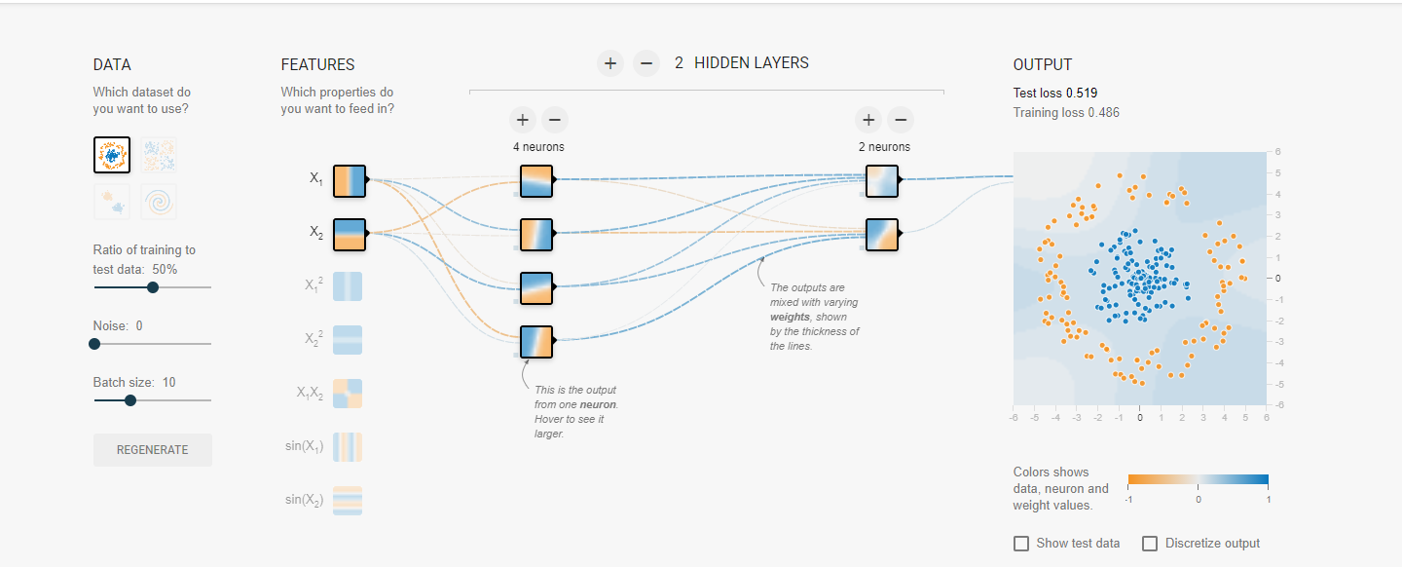
Machine Learning
Tensor Flow
Playground with Tensor Flow

Slide 11
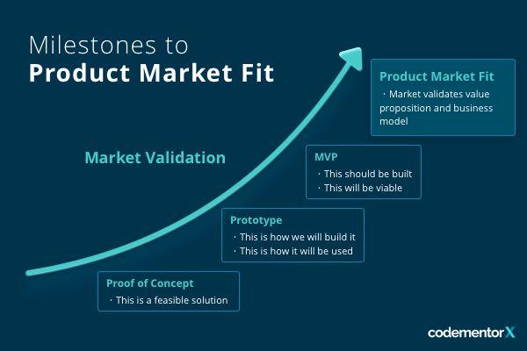
Hardware projects
https://www.codementor.io/blog/MVP-product-market-fit-2lvrzn68b2
Market validation
Proof of concept
Prototype
“Minimum Viable Product”
(MVP)

Slide 12
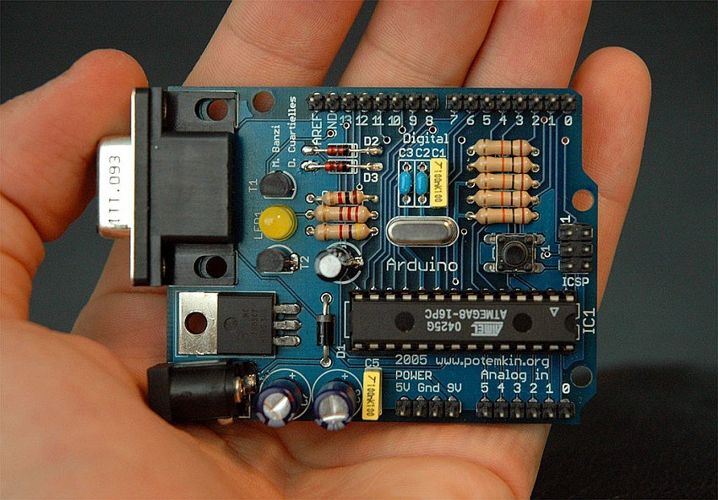
Hardware projects
Development of physical prototypes
https://predictabledesigns.com/how-to-prototype-hardware-product/
Arduino
https://www.arduino.cc/
Raspberry Pi
https://www.raspberrypi.org/
Sensores
https://www.sparkfun.com/
Blender (modelação 3D)
https://www.blender.org/
3D Printing
https://www.3dhubs.com/

Slide 13
Hardware projects
Help
Mechanical engineering
Grabcad
https://grabcad.com/
Electrical engineering
Instructables
https://www.instructables.com/

Slide 14
Interviews
https://www.youtube.com/watch?v=Xj8Zu8wuCNs
“procurement” by Francisco Mendes (Hardware City)
https://www.youtube.com/watch?v=CQYfz8Zf1ik
Prototyping by Francisco Mendes and Sofia Almeida (Line Health)

Slide 15
Prototyping
“Software”
https://ocw.mit.edu/courses/electrical-engineering-and-computer-science/6-831-user-interface-design-and-implementation-spring-2011/syllabus/
“Hardware”
https://ocw.mit.edu/courses/sloan-school-of-management/15-783j-product-design-and-development-spring-2006/syllabus/

Slide 16
Additional "Links"
Comparison of software prototyping tools
https://docs.particle.io/guide/how-to-build-a-product/intro/
Lean startup
Bresslergroup (innovation laboratory for product development)
Highway1 (“hardware startup accelerator”)
Altitude (“rapid prototyping”)

Slide 17
Leituras adicionais
David Wallace, Toy Product Design, 2008 (https://ocw.mit.edu/courses/mechanical-engineering/2-00b-toy-product-design-spring-2008/index.htm)
Neil Gershenfeld, How to Make Almost Anything, 2012 (http://ocw.mit.edu/courses/media-arts-and-sciences/mas-863-how-to-make-almost-anything-fall-2002/)
Olivier de Wek, Engineering Design and Rapid Prototyping, (https://ocw.mit.edu/courses/aeronautics-and-astronautics/16-810-engineering-design-and-rapid-prototyping-january-iap-2007/index.htm)
Ted Selker, Industrial Design: A Cognitive Approach, 2003 (https://ocw.mit.edu/courses/media-arts-and-sciences/mas-742-industrial-design-intelligence-a-cognitive-approach-to-engineering-fall-2003/index.htm)

Slide 18
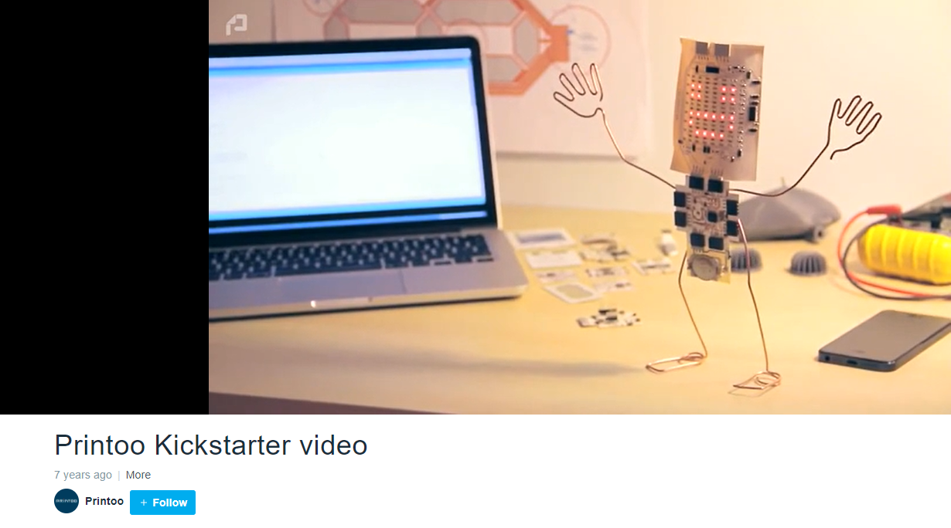
Printoo Kickstarter video
https://vimeo.com/92845728

Slide 19
Antonio Câmara

