Slide 1
Sistemas de Informação e Modelação em Ambiente (SIMA)
António Câmara
Theo Fernandes
2021
Workshop #2 – Project Management Insights

Slide 2
Practical Project Management Insights

Slide 3
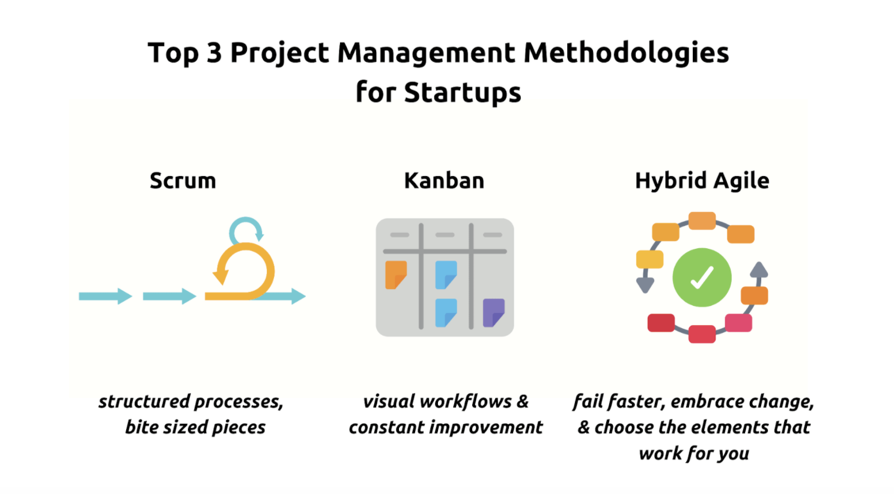
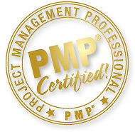
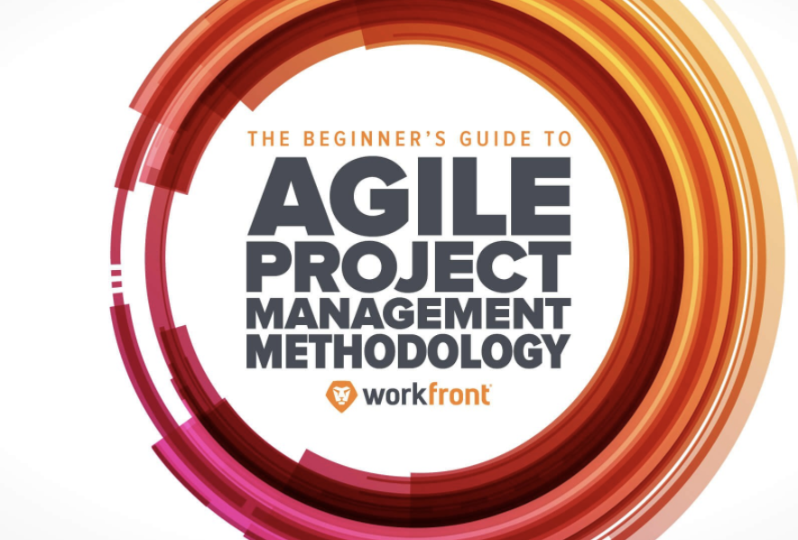
Being a Project Manager
Every project/programme needs one.
There are several ways to do it, and it really depends on the type of project.

Slide 4
Being a good Project Manager doesn’t necessarily require certifications…
Five Key Skills to become a good PM
1- Planning – “Failing to plan is planning to fail.”
2- Communication – ”Are we on the same page?”
3- Empathy – “I feel you”
4- Attitude – “Go hard or Go Home”
5- Hard working – “Lead by example”

Slide 5
Project Management & IT -Practical Learnings
Keep It Simple.
Bring the A-Team
You Don’t Have Time For Non-Participants
Have a Plan, Not a Thesis
Use the Right Tools
Speed is Key
Keep Deadlines Deadly
Make Decisions
Every Project Hits the Wall
Listen to the Doers
Beware The Fire Drill
You Have to Finish to Win
Source: The Project Management Ninja

Slide 6
















Tools – Project Management Platforms
...and more...

