Slide 1
Environmental data sources
Theo Fernandes
António Câmara
March 20th, 2019

Slide 2
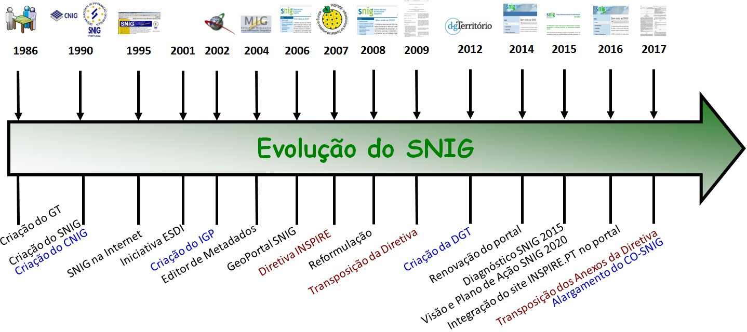
SNIG Evolution

Slide 3
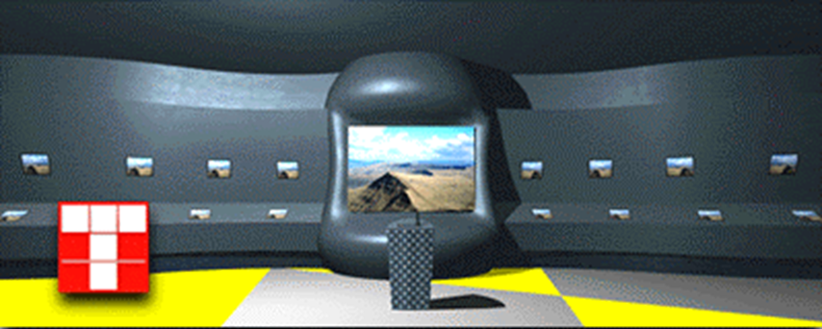
Digital Portugal
Expo98
Virtual flyover and thematic databases
connections in real time
1.5 million users
Expo98

Slide 4
Environmental data sources
An international perspective
A national perspective
Data analysis tools

Slide 5
An international perspective
US environmental data infrastructures
European environmental data infrastructures
Global environmental data infrastructures

Slide 6
US environmental data infrastructures
EPA
USGS
NOOA
NASA
NPS
NWS
NCBI

Slide 7
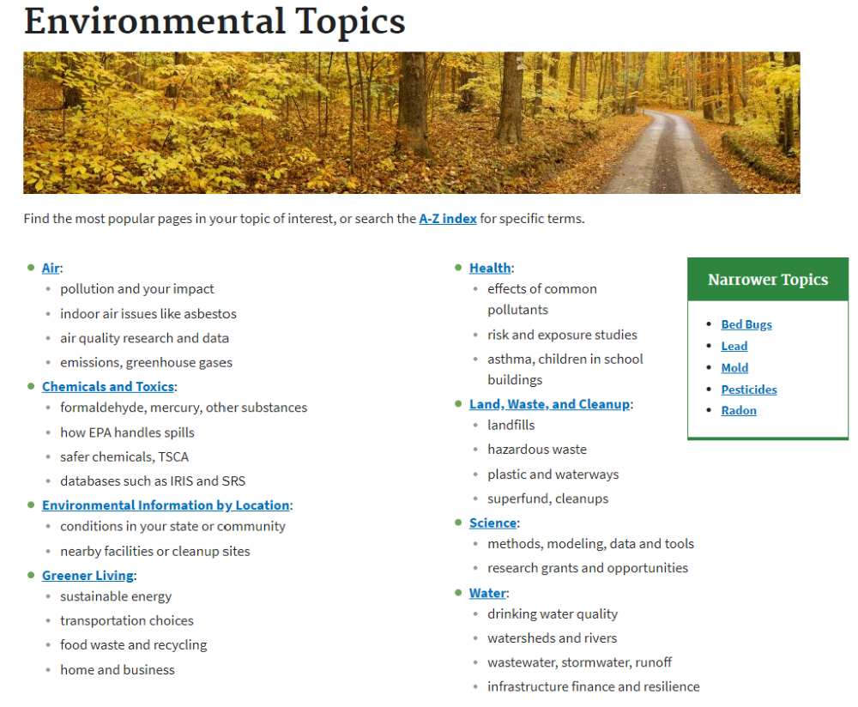
EPA’s Environmental Dataset Gateway

Slide 8
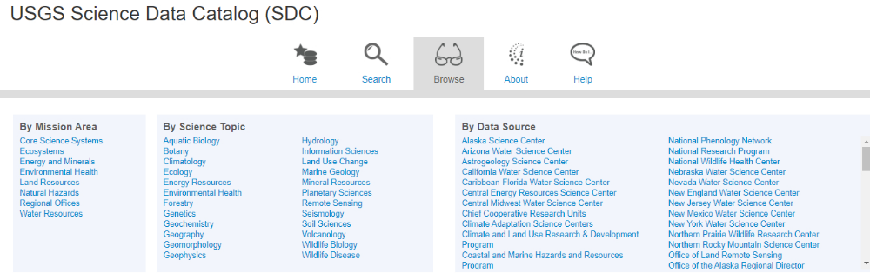
USGS Data Catalog

Slide 9
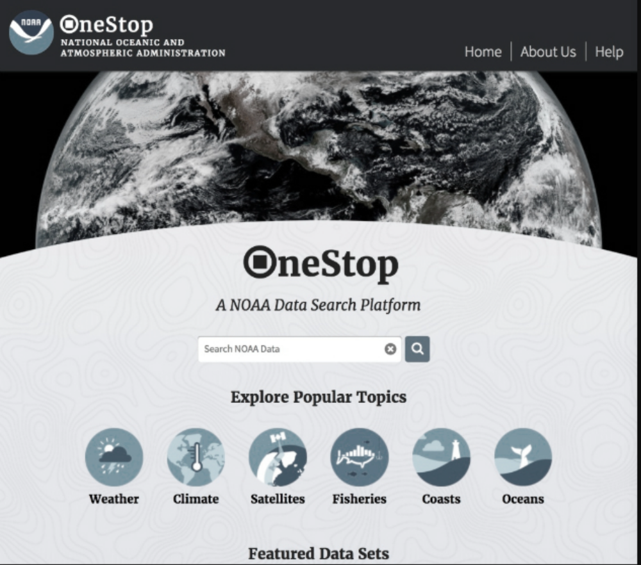
NOOA Data Discovery Portal

Slide 10
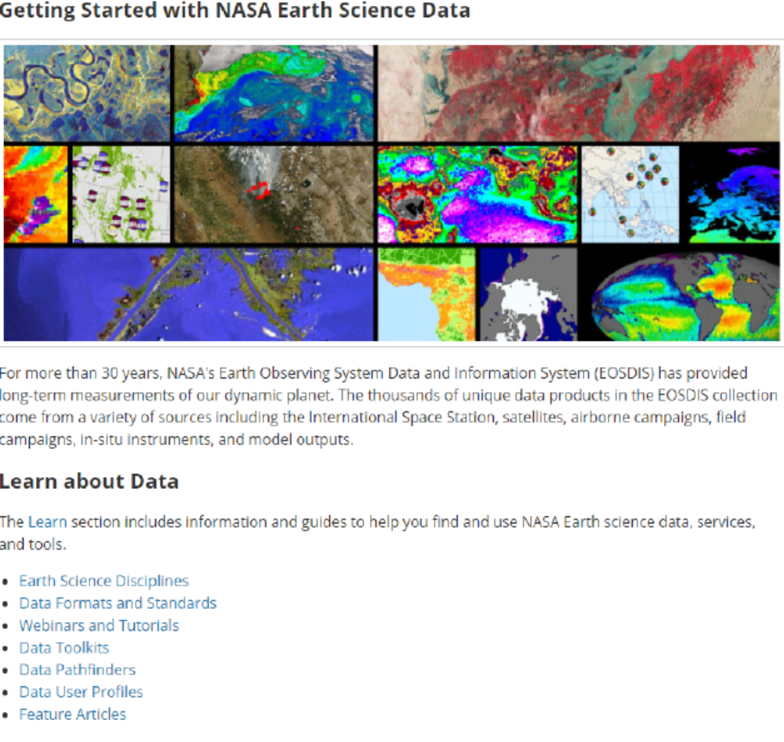
NASA Open Data Portal

Slide 11
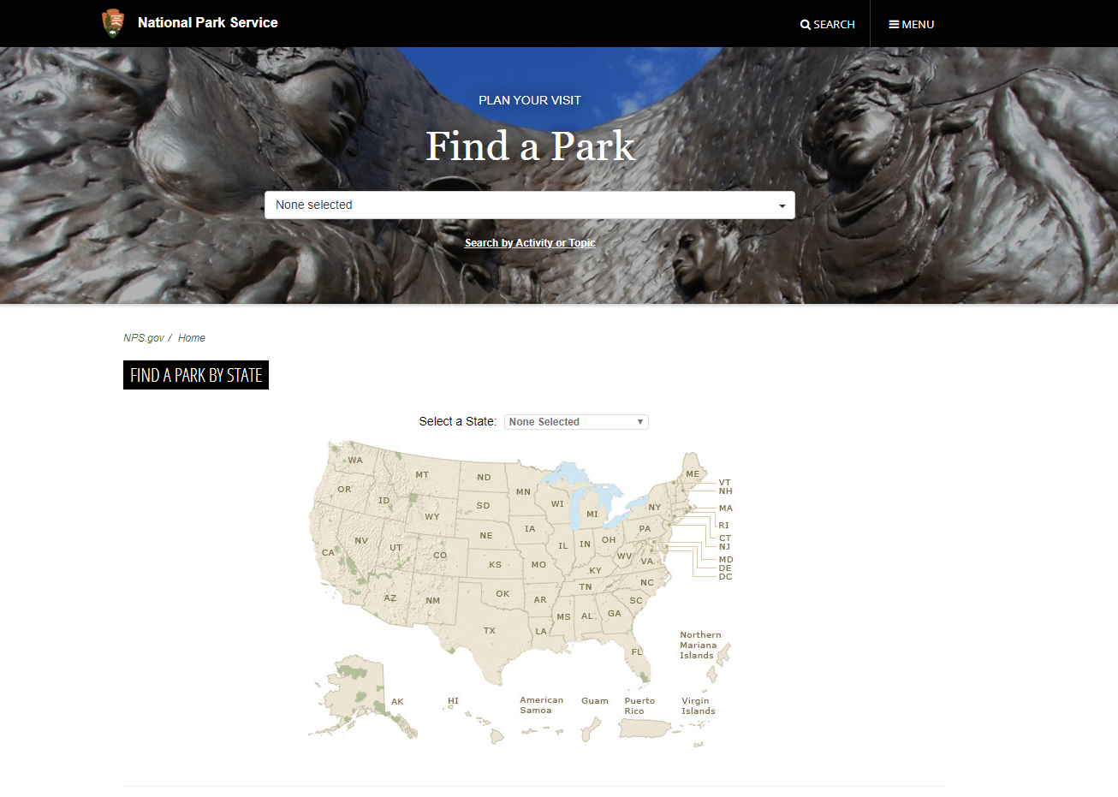
National Park Service

Slide 12
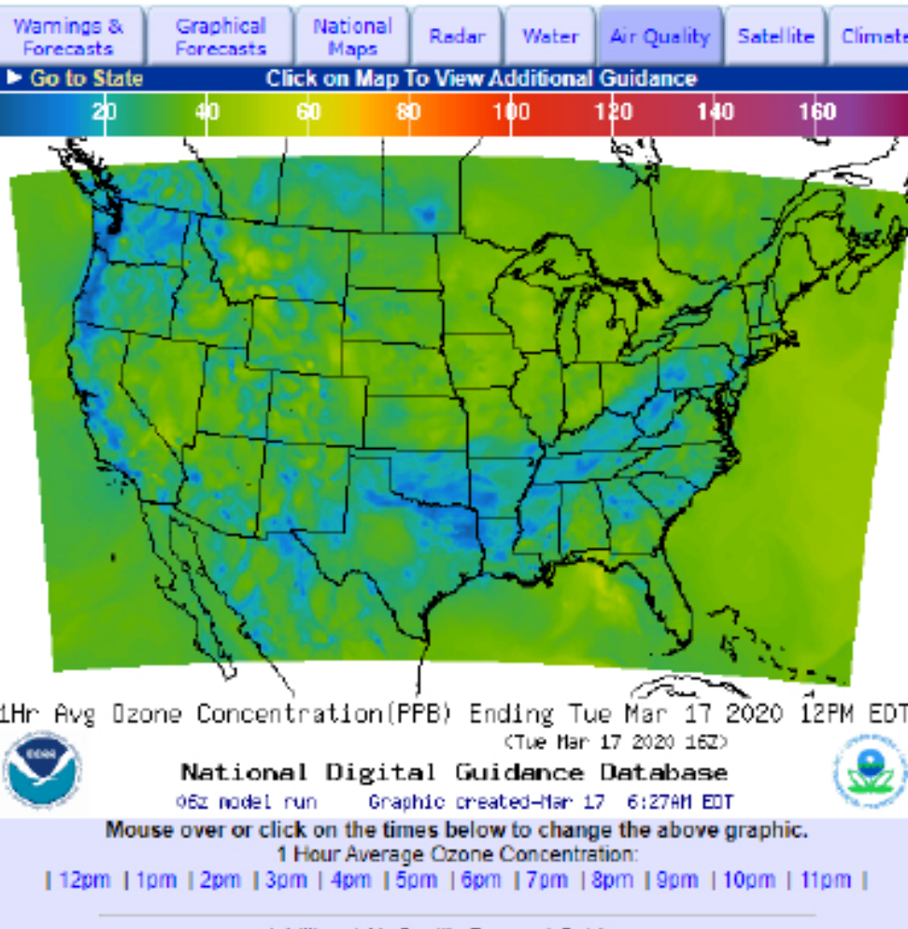
National Weather Service

Slide 13
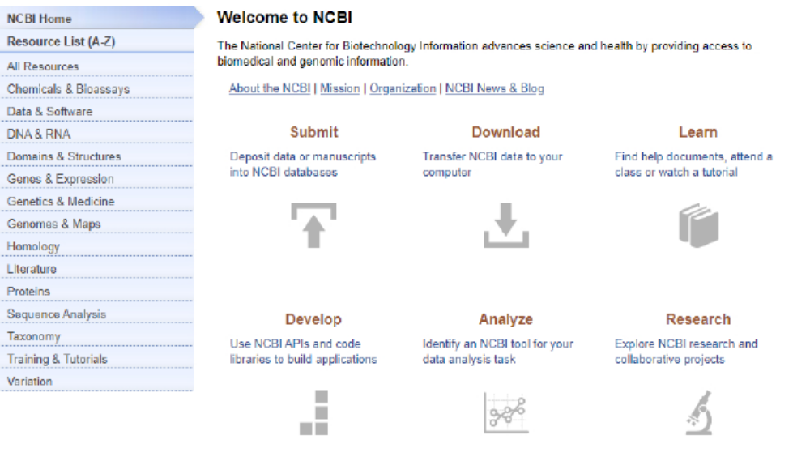
National Center for Biotechnological Information

Slide 14
European environmental data structures
ESA
Inspire
EEA
Eurostat

Slide 15
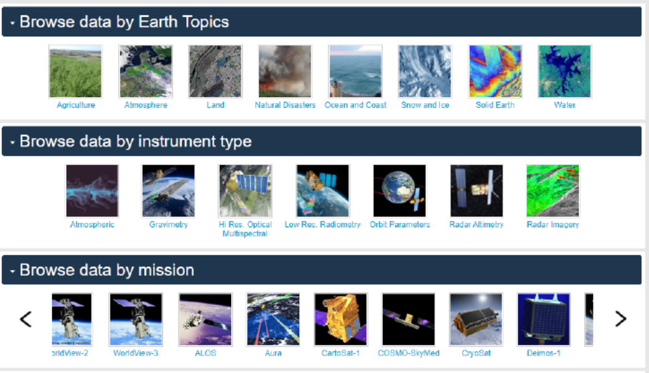
European Space Agency data

Slide 16
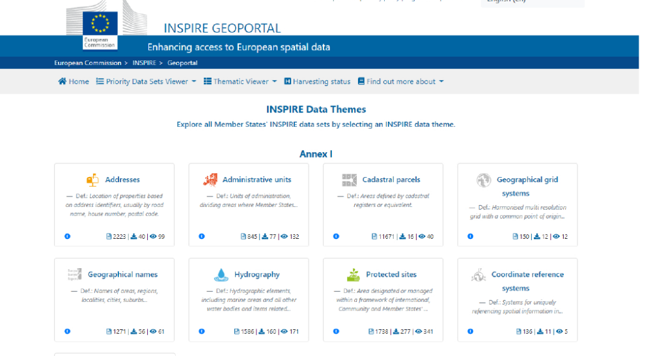
Inspire Data Themes

Slide 17
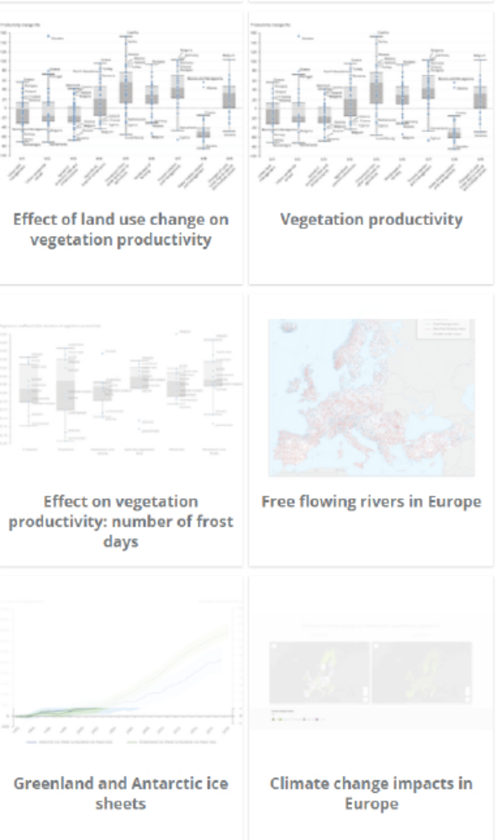
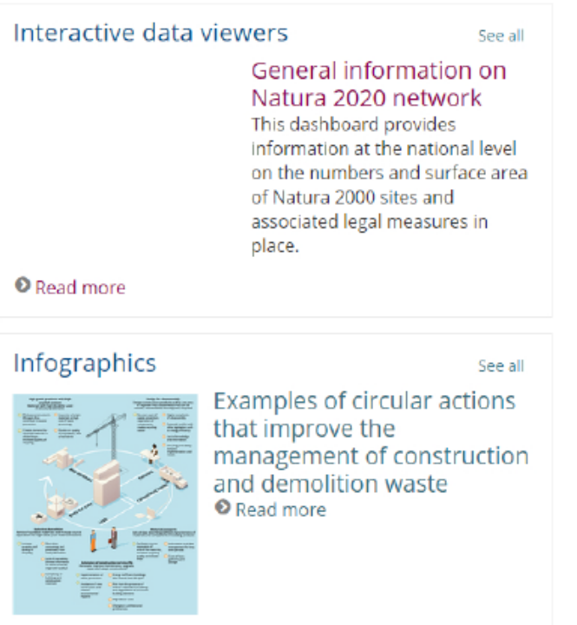
European Environmental Agency data and maps

Slide 18
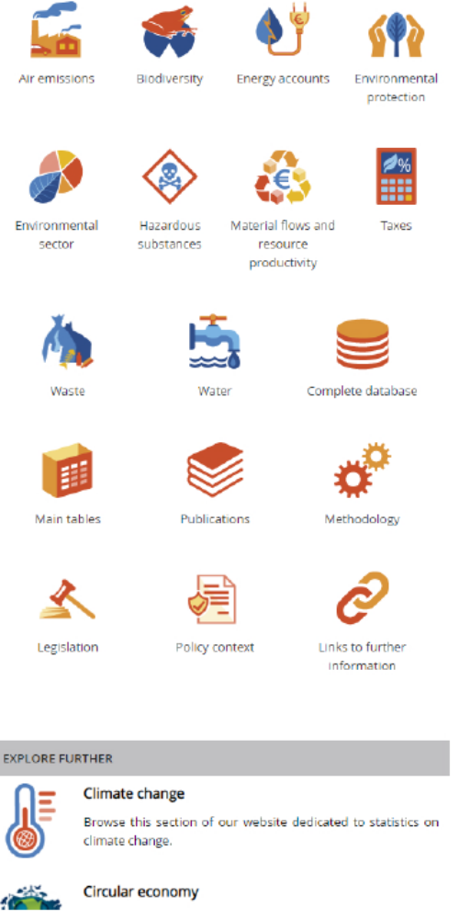
Eurostat environmental statistics

Slide 19
Global environmental data infrastructures
Google Earth
Protected Planet (UN)
Climate Change (UN)
IPCC
FAO (UN)
Lifecycle initiative (UN)
Environmental statistics (UN)
Remote sensing data market map

Slide 20
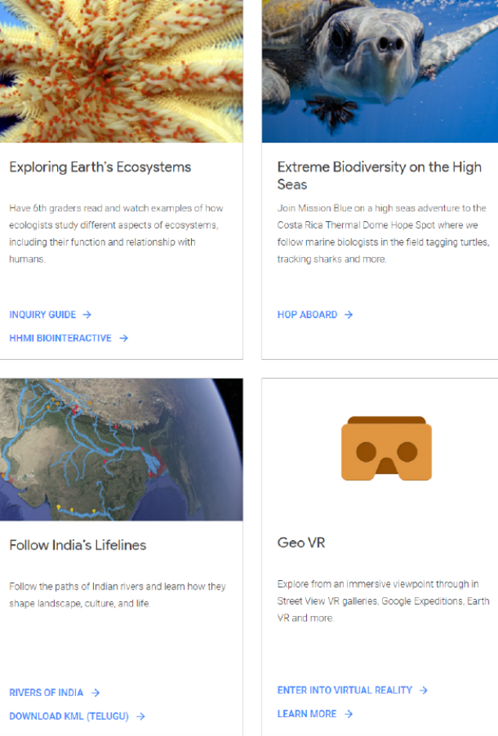
Google Earth

Slide 21
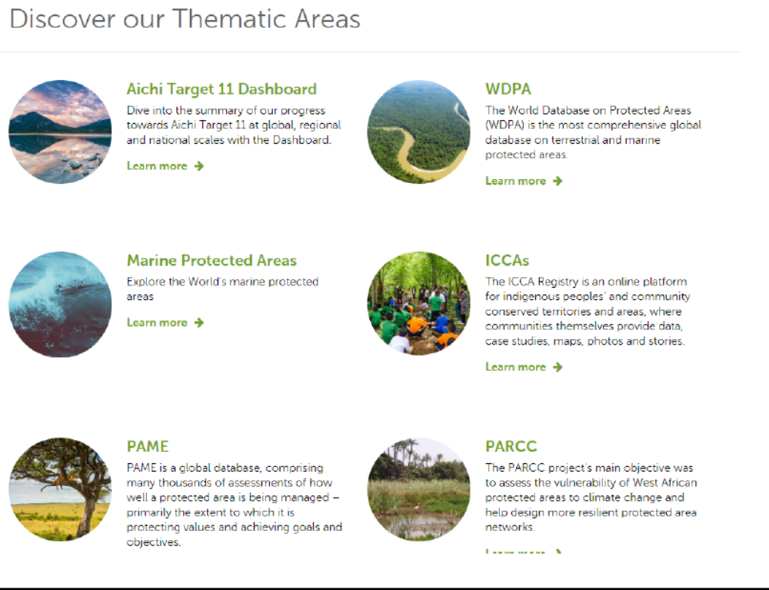
Protected Planet (UN)

Slide 22
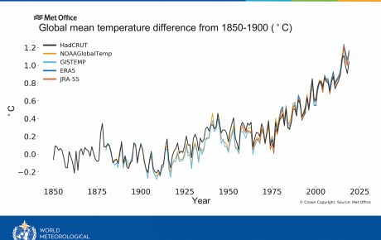
Climate Change (UN)

Slide 23
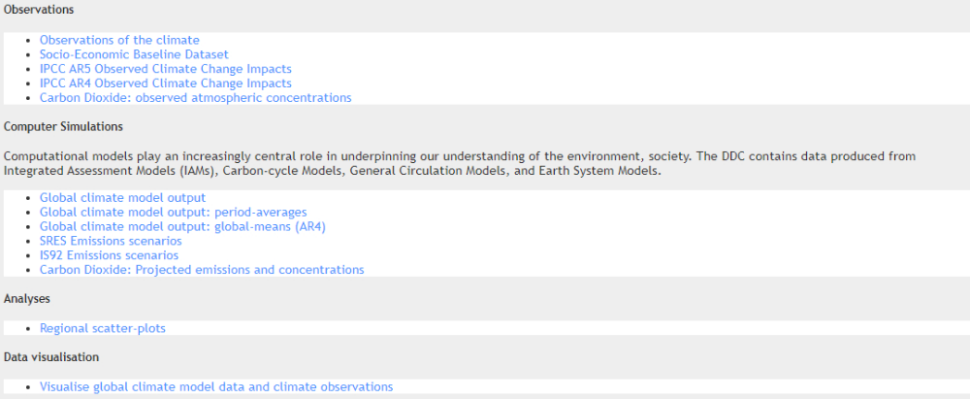
IPCC

Slide 24
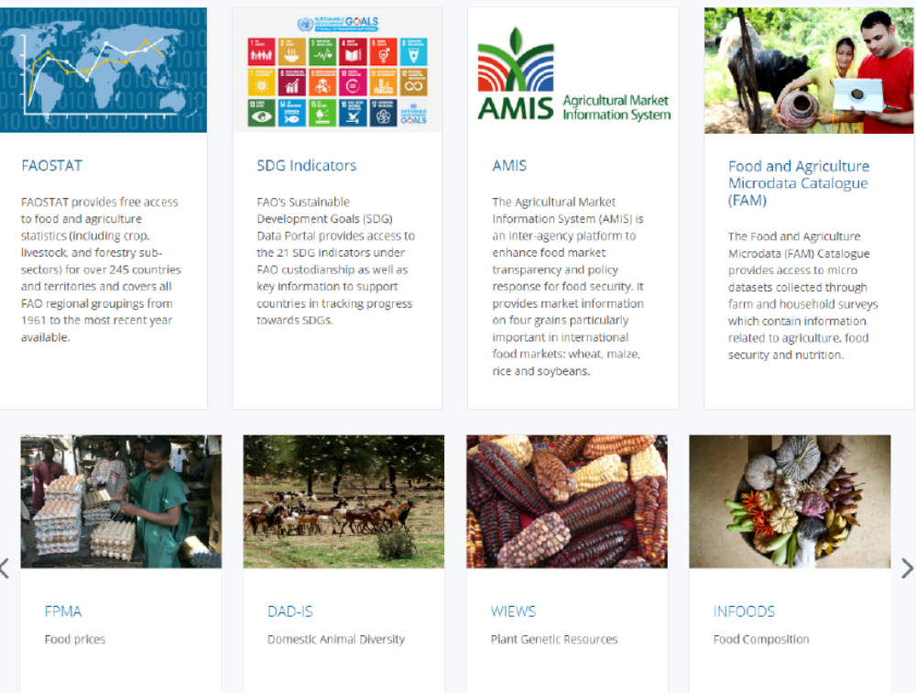
FAO (UN)

Slide 25
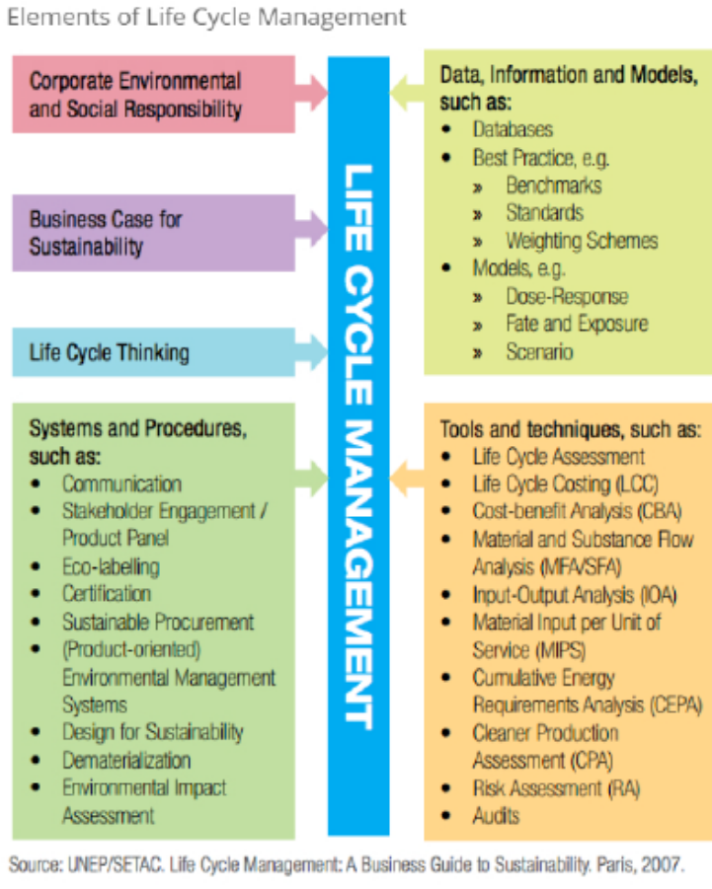
Lifecycle initiative (UN)

Slide 26
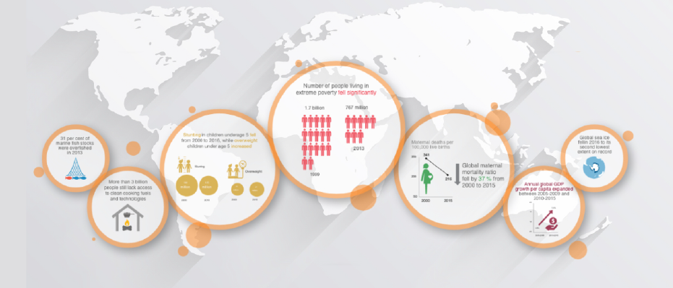
Environmental statistics (UN)

Slide 27
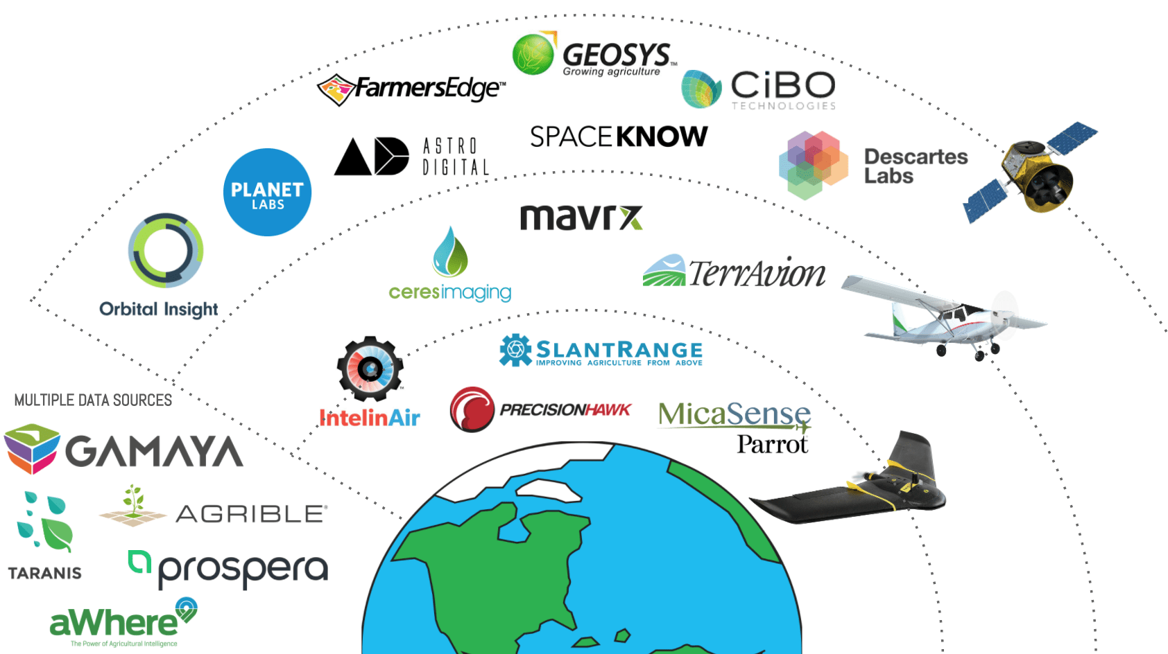
Remote sensing data market map

