Slide 1
Do you suffer from EAS?
Taylor Moore

Slide 2
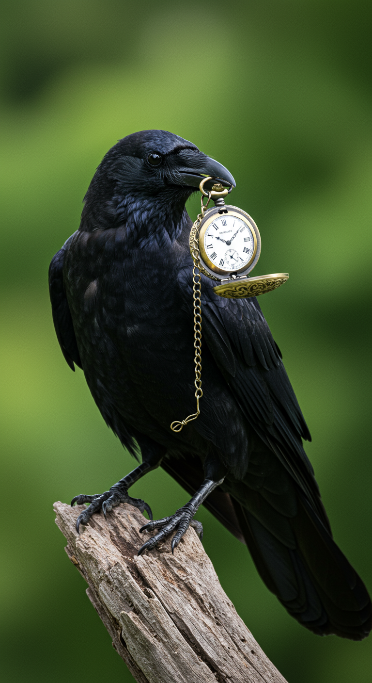
Early Adopter Syndrome
Síndrome do Utilizador Precoce
*Operators are Standing By: Call 1-351-ChatGPT*

Slide 3
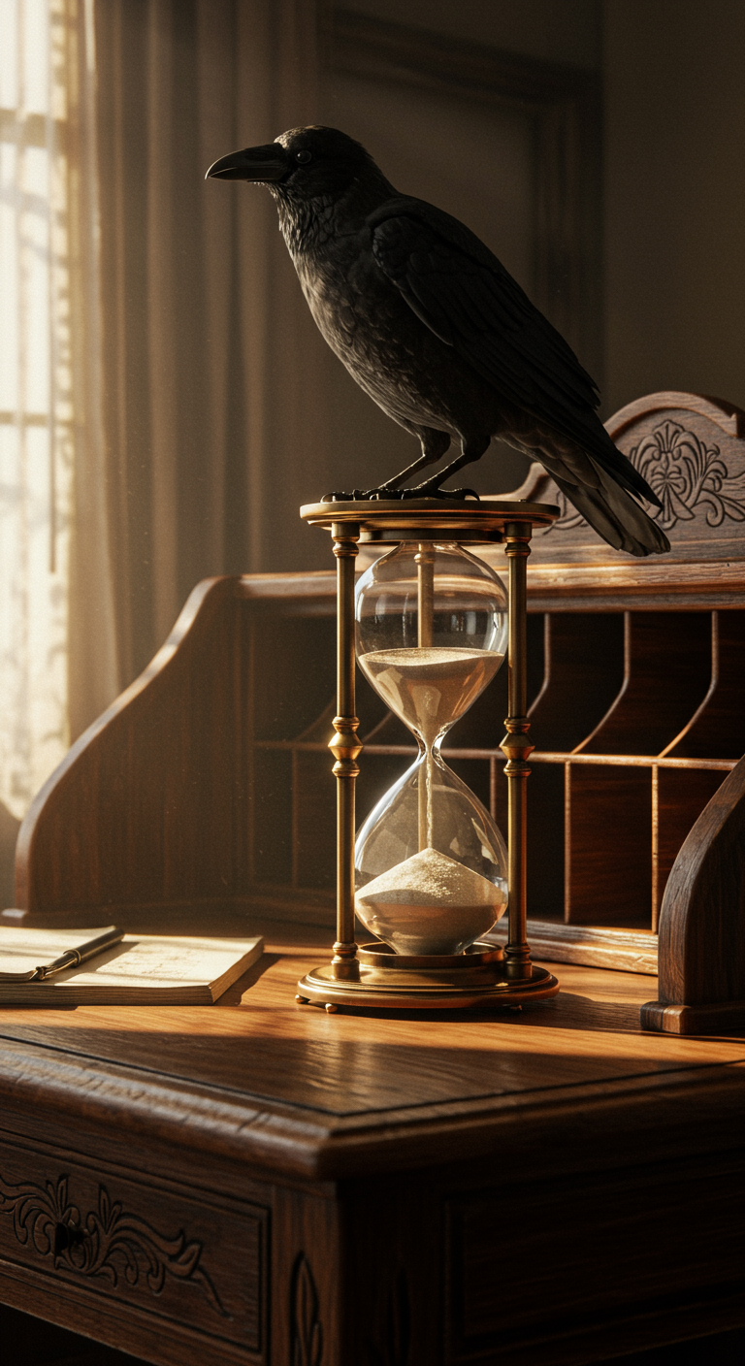
Also Know As:
Shiny Object Syndrome

Slide 4

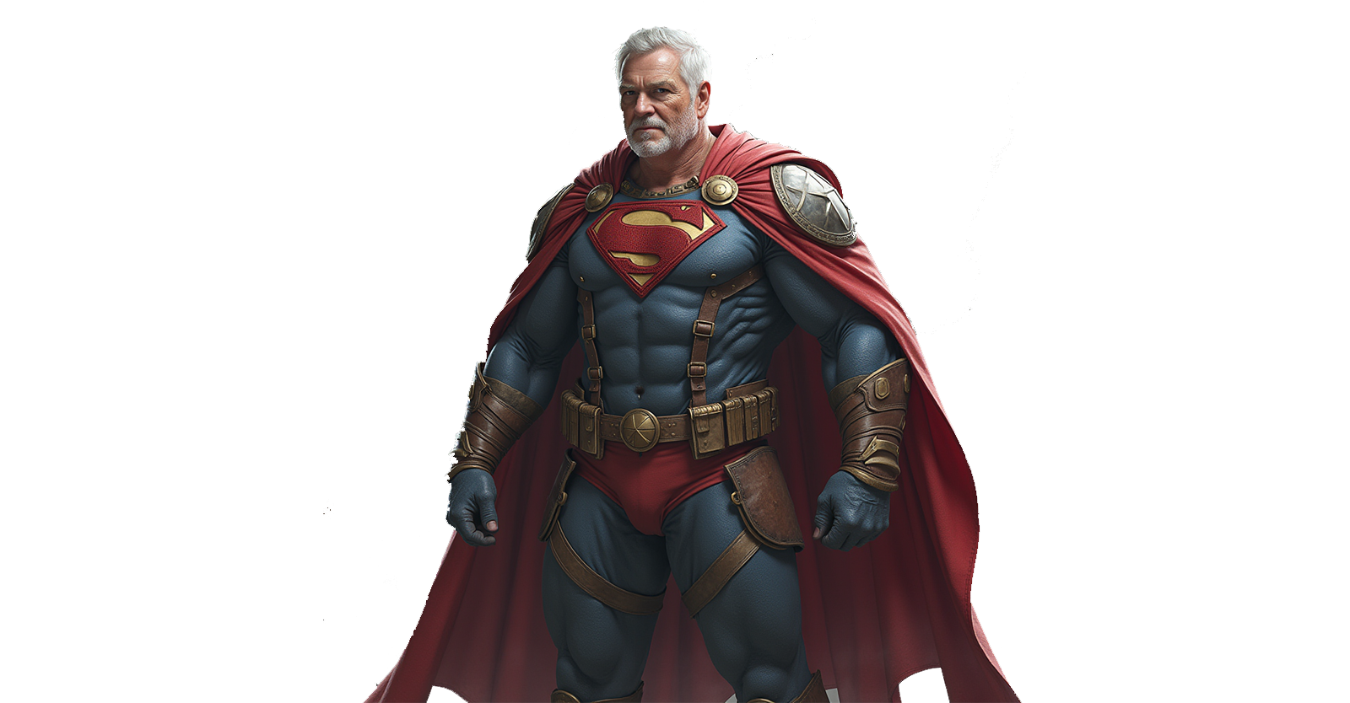
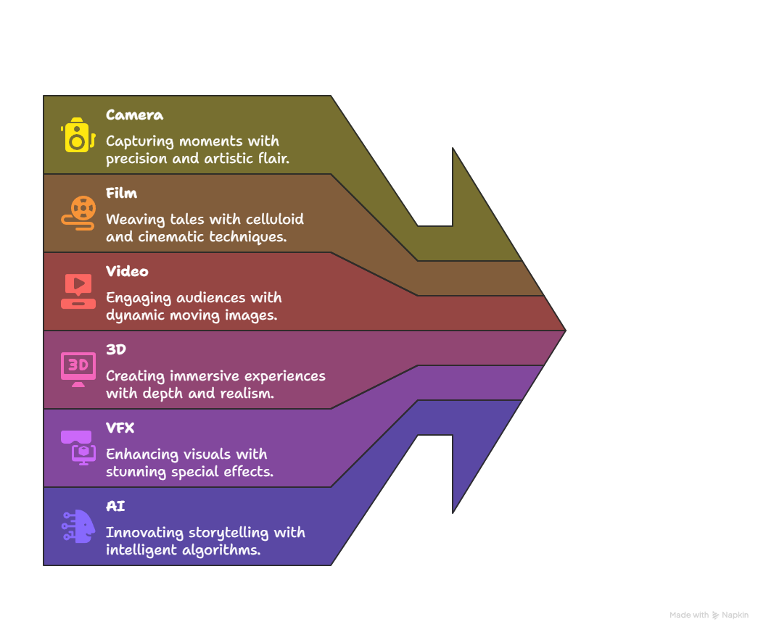
Who am I?

Slide 5
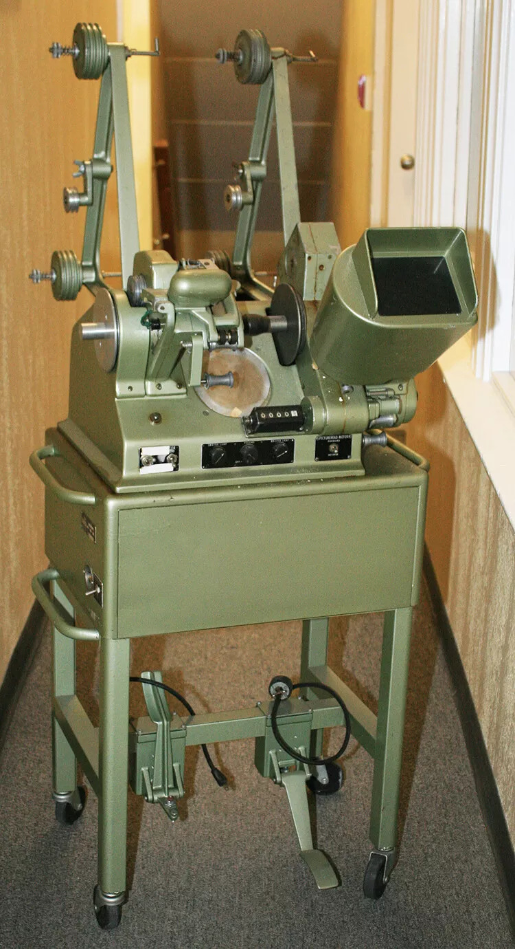

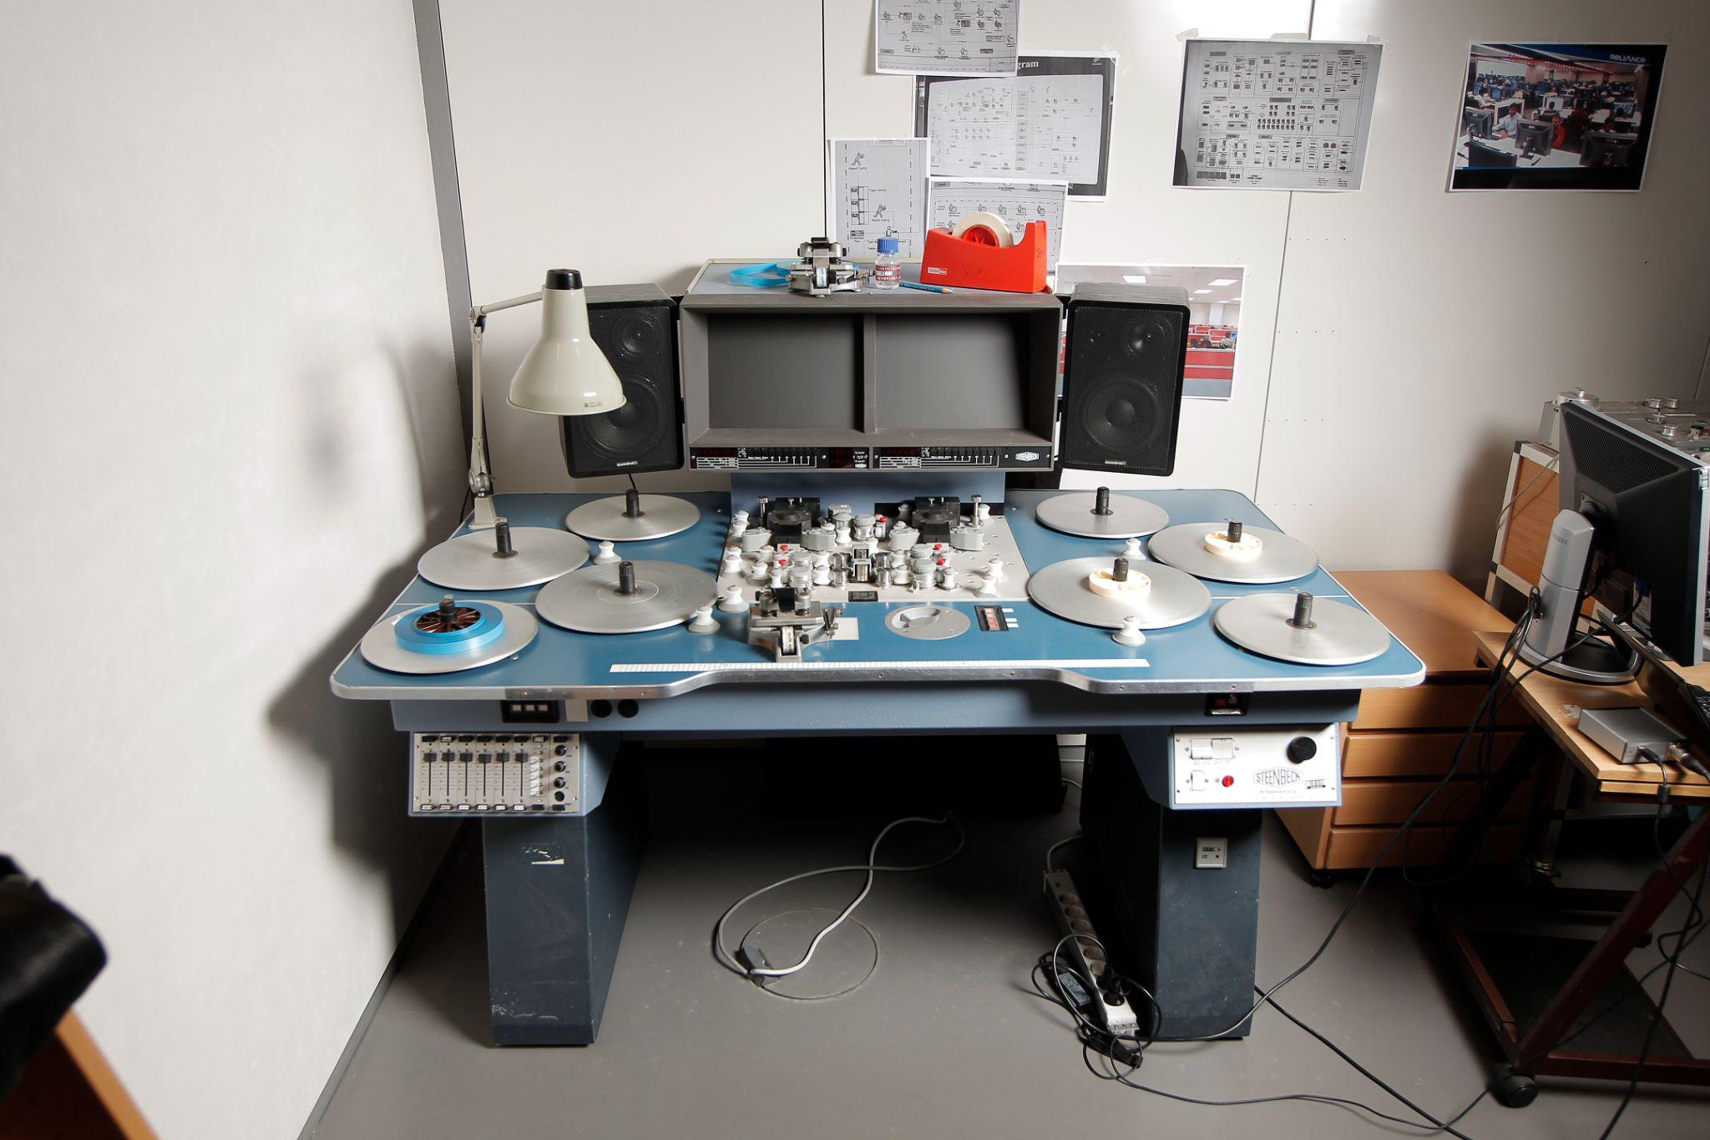
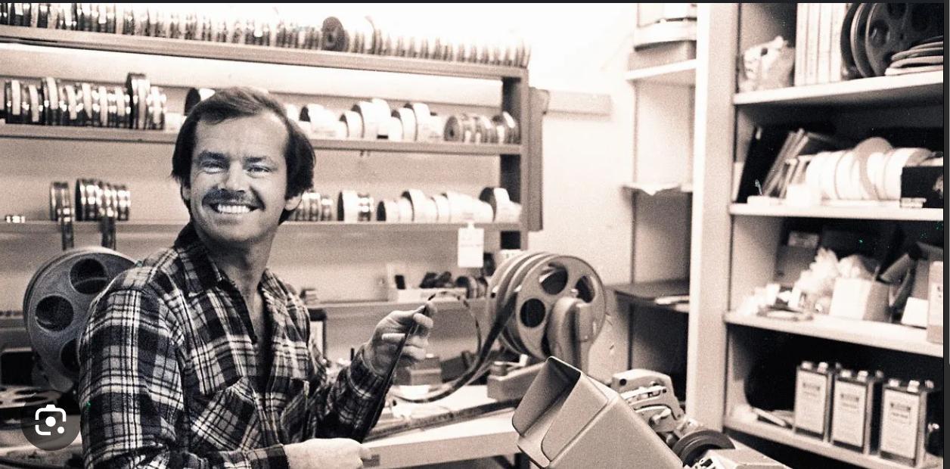
Film

Slide 6
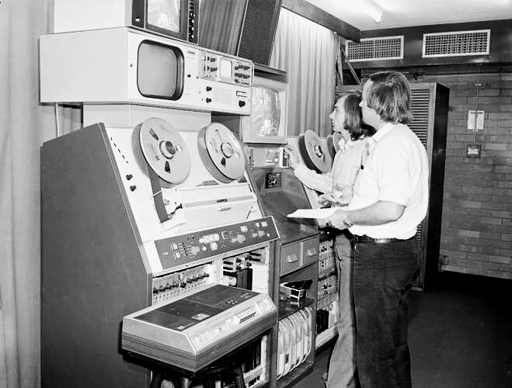
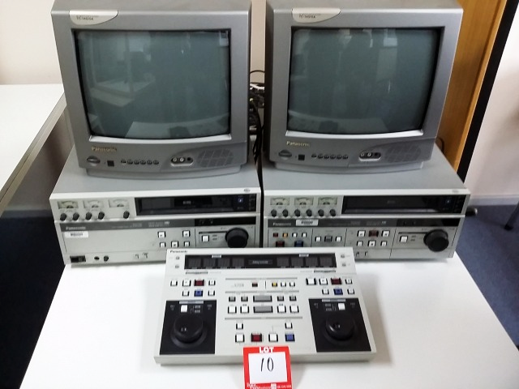
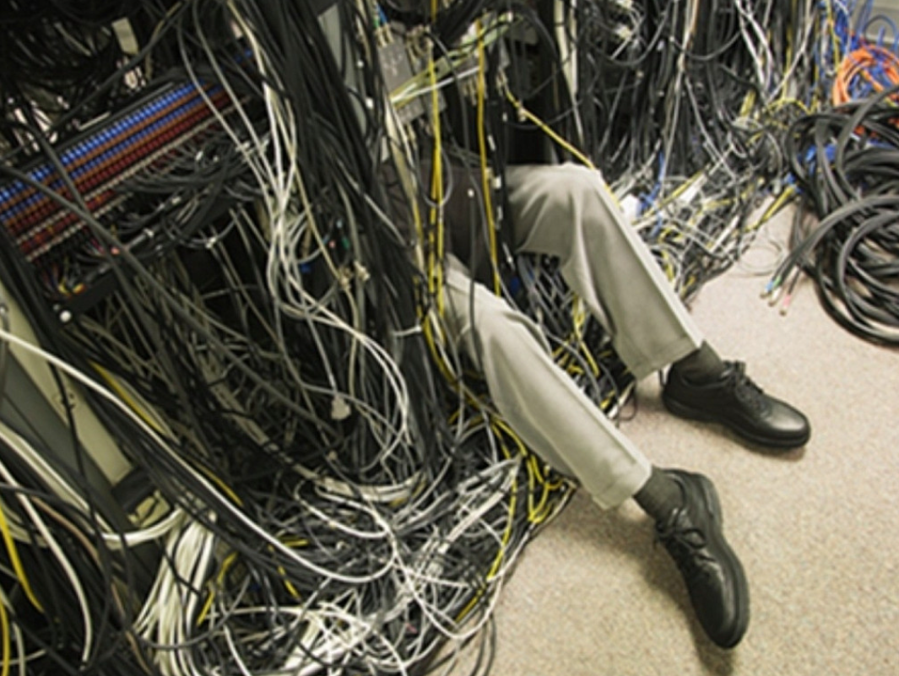

Video

Slide 7
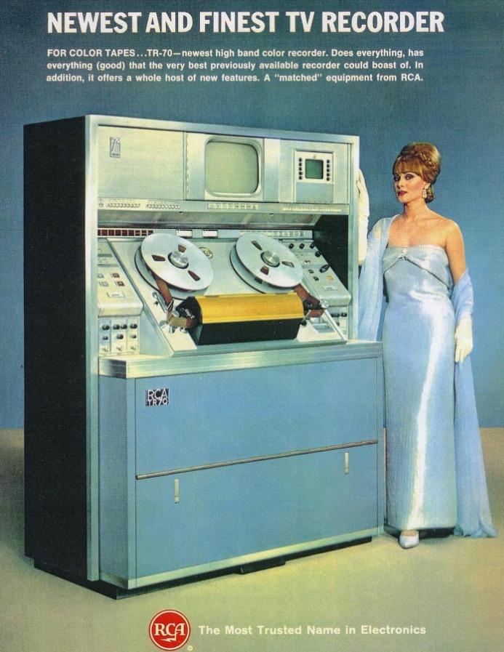
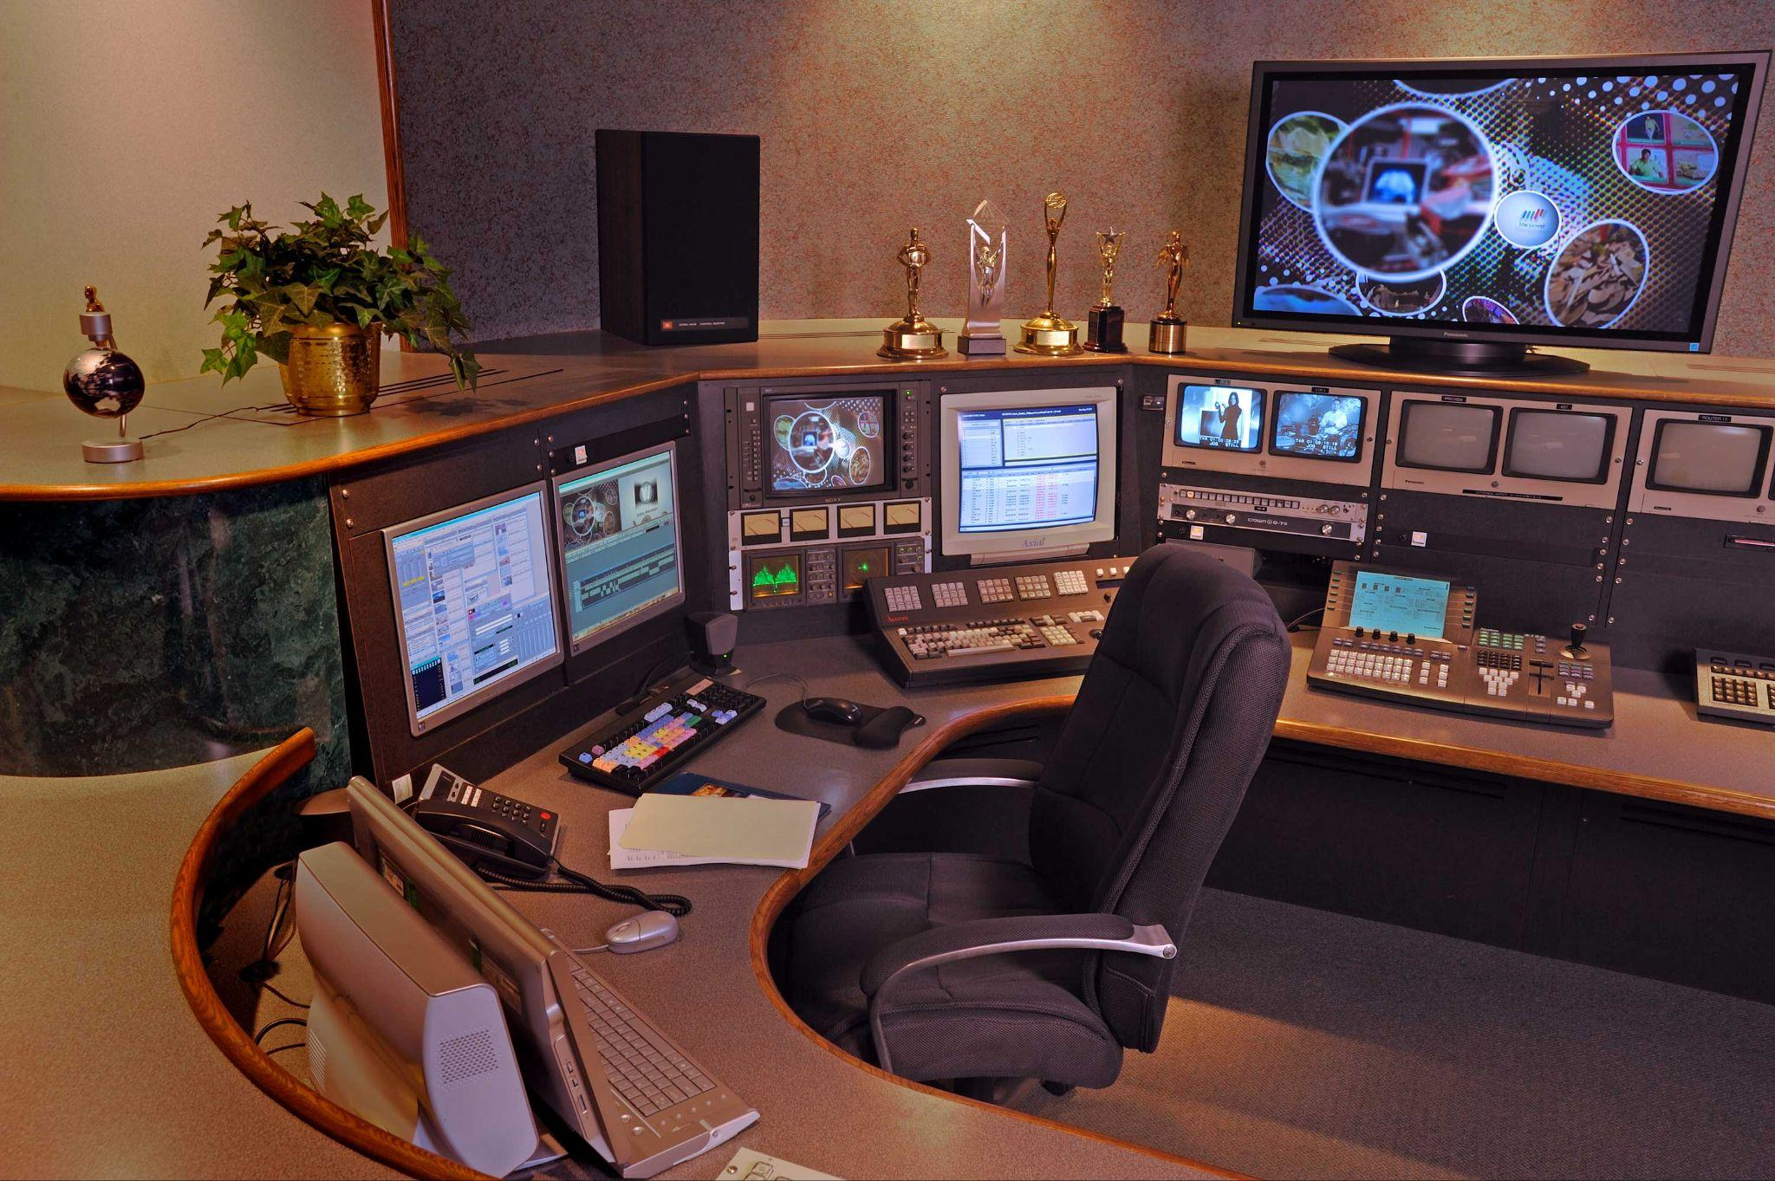
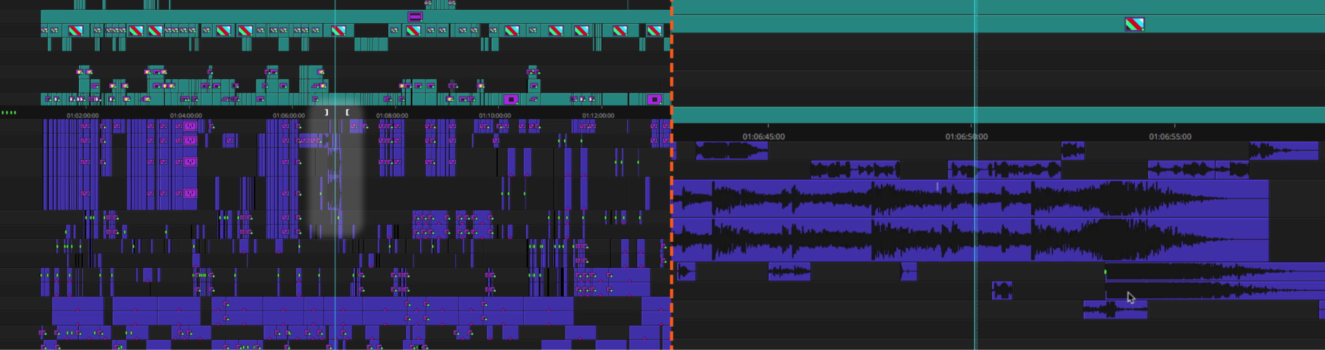

Slide 8


Cinematics Producer/Director
FIFA/World Cup/NHL
Cinematics Producer/Editor
FFVII and Parasite Eve and Film

Slide 9
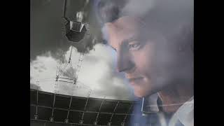

Slide 10
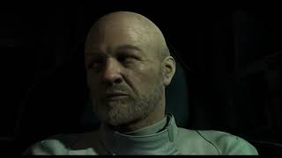

Slide 11
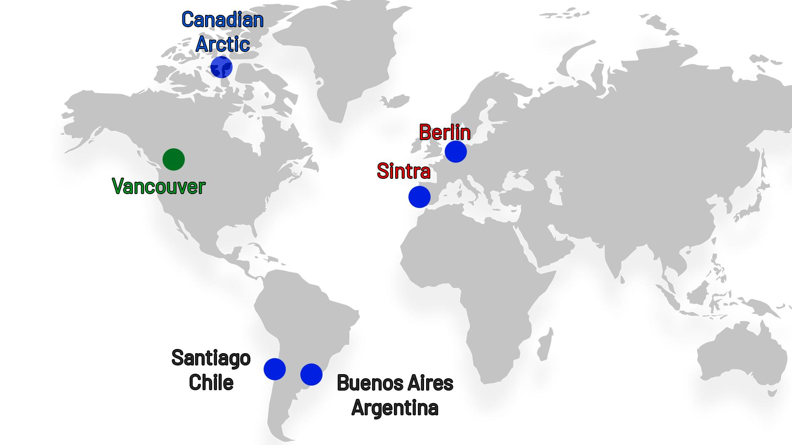

Slide 12

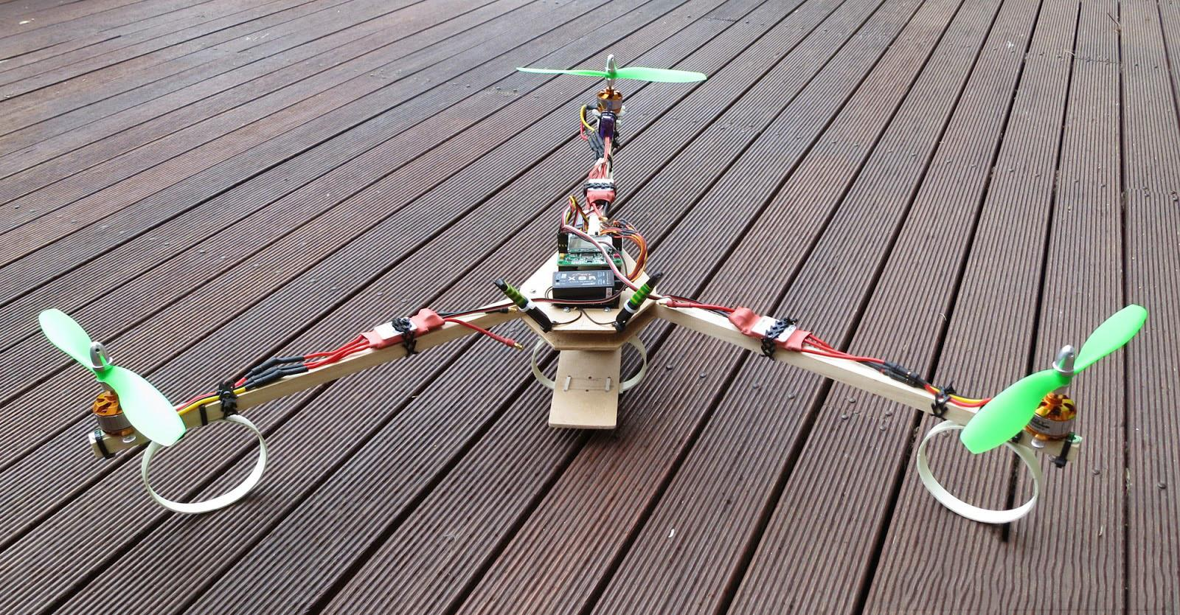
Aerials
EAS We Can Help

Slide 13



Berlin

Slide 14





Slide 15


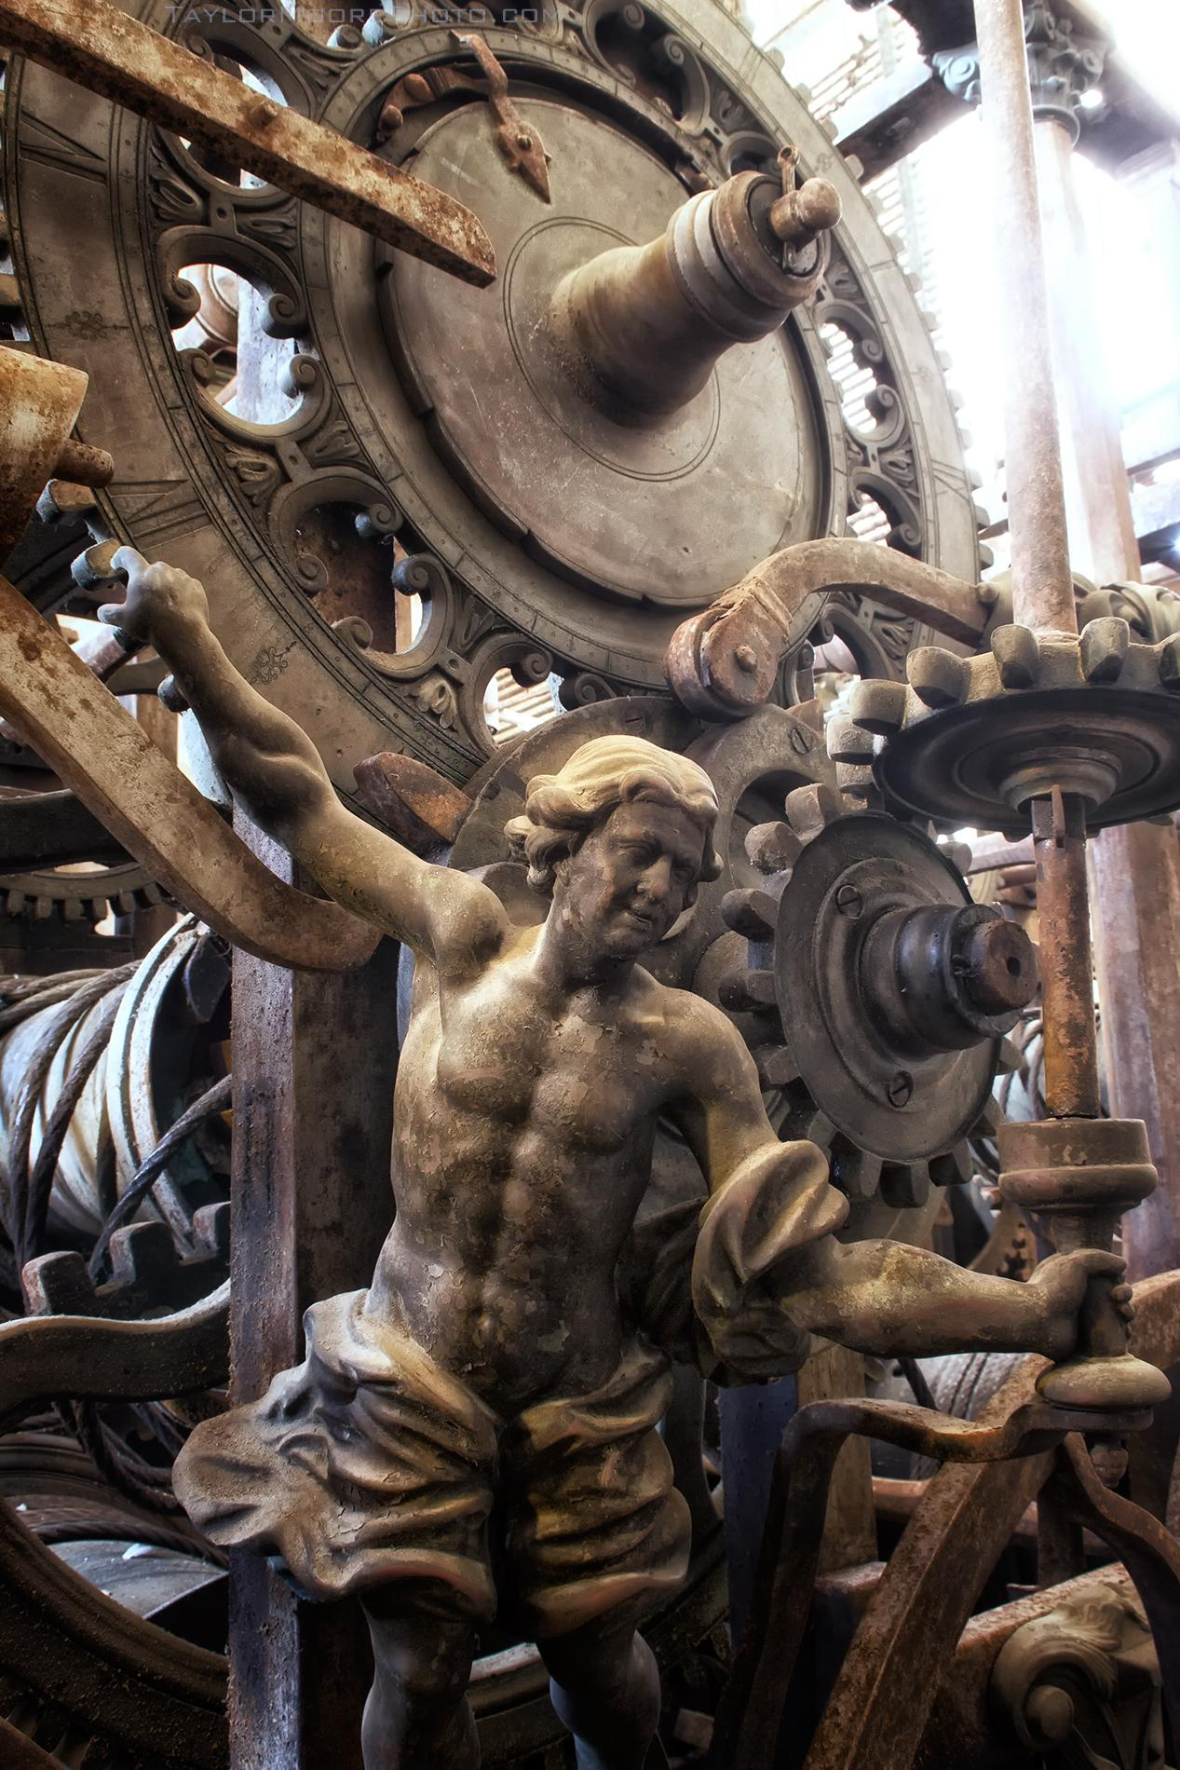


Slide 16
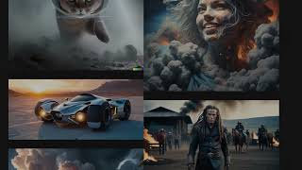

Slide 17
BLAH
BLAH
BLAH

Slide 18
AI - IA

Slide 19
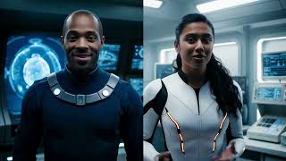

Slide 20
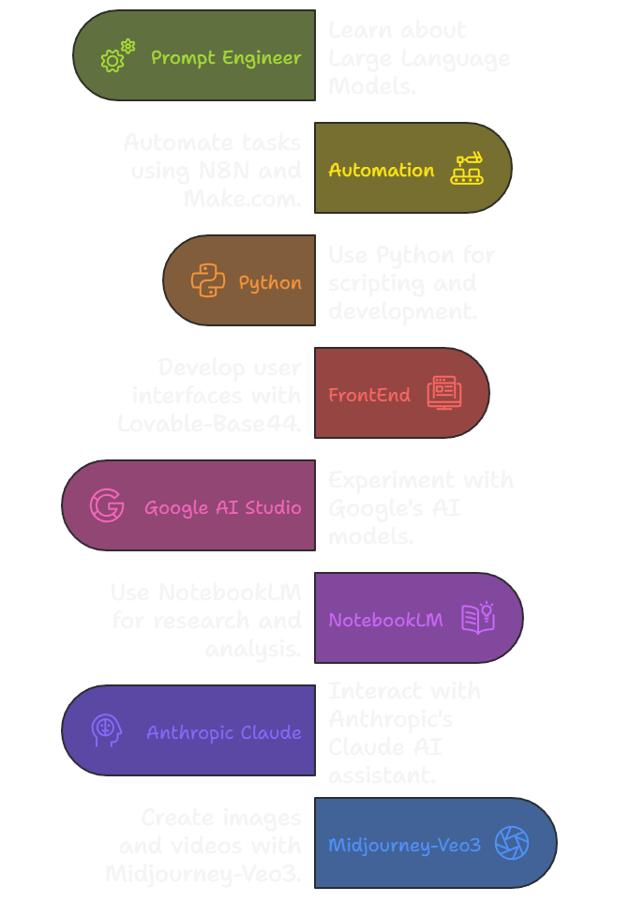
AI Skills and Tools
Prompt Engineer - Learn LLMs
Automation -N8N - Make.com
Python
FrontEnd - Lovable-Base44
Tools I Use Everyday
Google AI Studio
NotebookLM
Anthropic Claude
Midjourney- Veo3

Slide 21
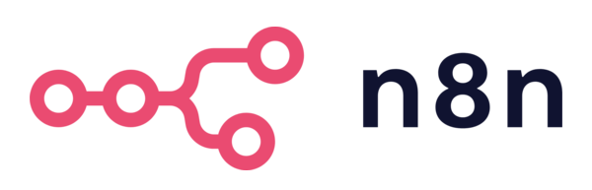
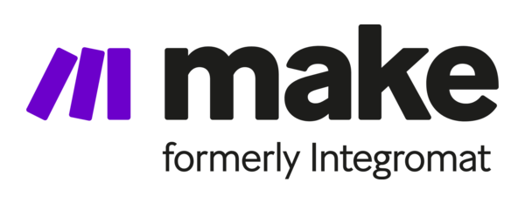
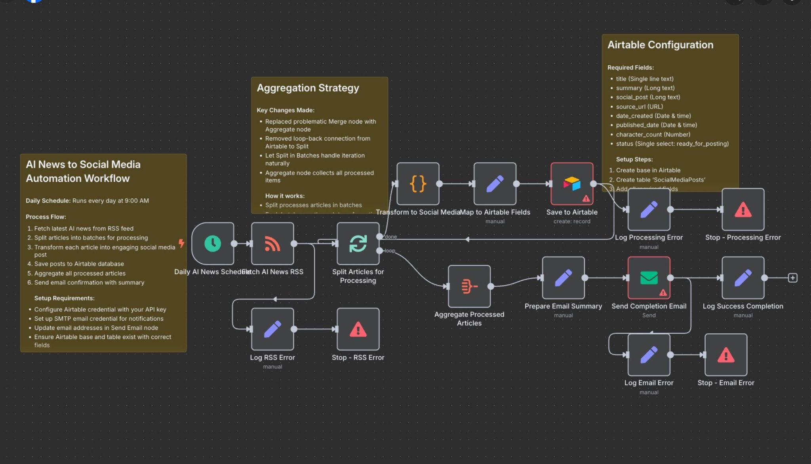
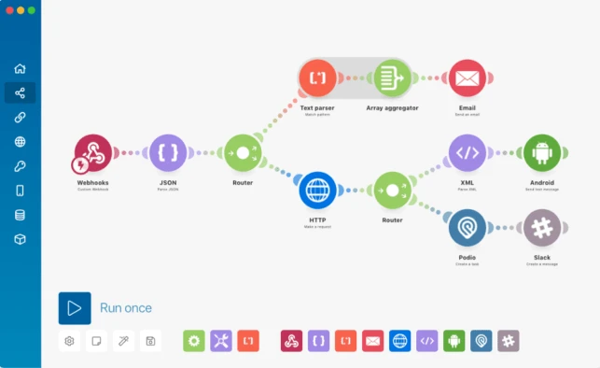
What is Automation?
Why this matters: Saves time, build once/repeatable action
N8N
Make

Slide 22


Why Python?
Why Python matters (simple language, used everywhere)
Python is the top language for artificial intelligence, machine learning, and automation. Learning it now puts you ahead of the AI revolution.
Python is like having a Swiss Army knife for the digital world - versatile, powerful, and essential for your future career.

Slide 23
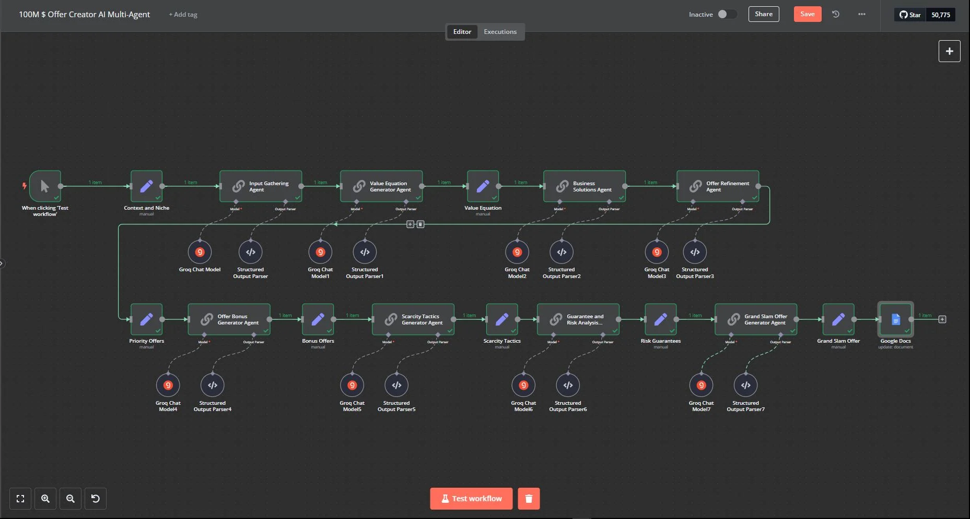
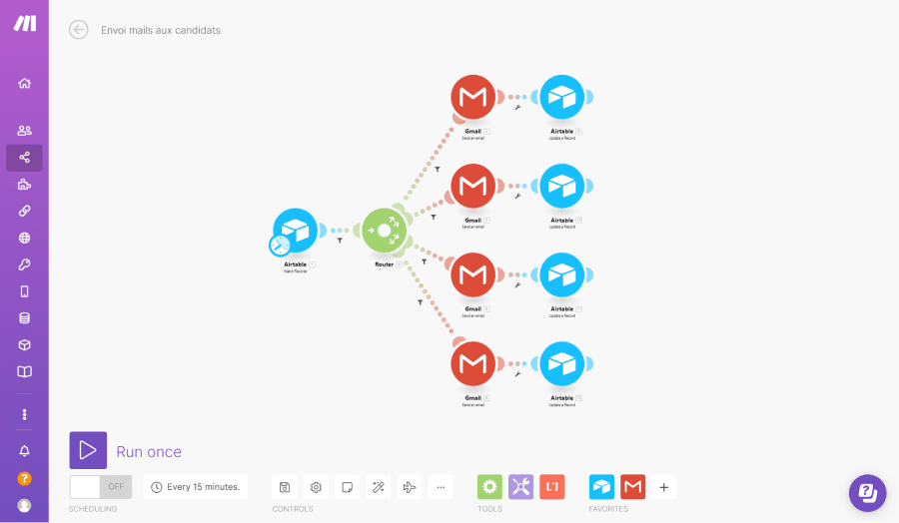
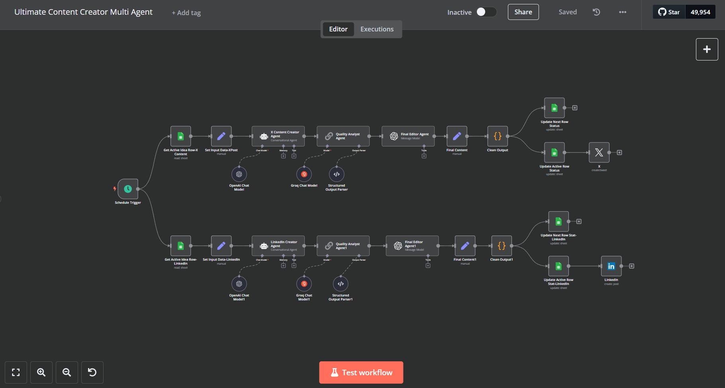
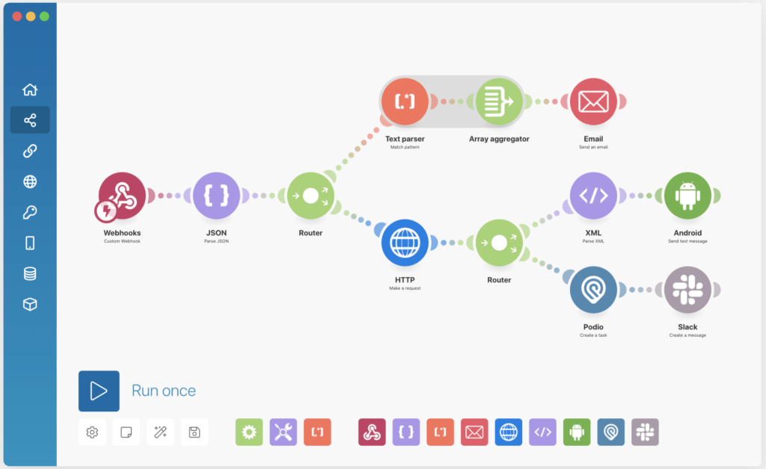
What can it do?
Create Smart Social Media Manager
Build Personal Finance Tracker
Automate Lead Generation Machine
Smart Home Integration Hub
AI-Powered Content Creation Pipeline
Customer Support Automation
E-commerce Order Fulfillment
Data Analysis Dashboard Creator
Personal Productivity Assistant

Slide 24
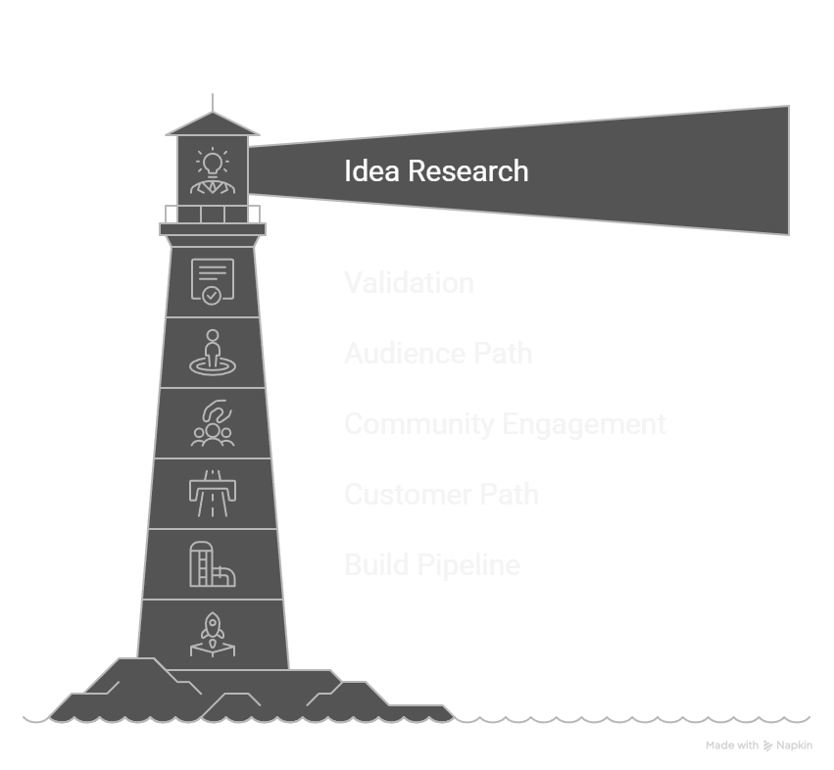
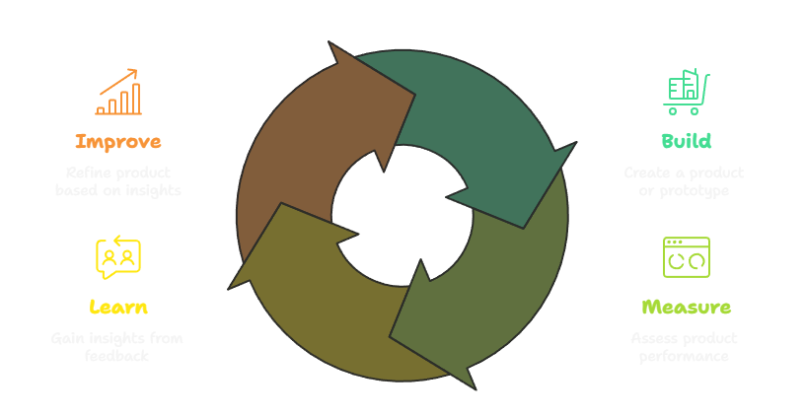
Start Learning/Start Building

Slide 25
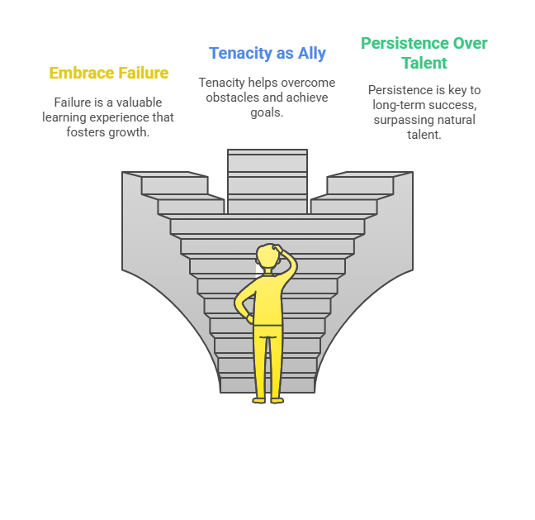
Learning and Progress
Aceita o Fracasso - É o grande mestre
A Tenacidade é a tua aliada
Sacode o pó e volta à sela
A Persistência importa mais do que o talento natural
Embrace Failure - It is the great teacher
Tenacity is you ally
Dust yourself off and get back on the horse
Persistence matters more than natural talent

Slide 26
"People online are constantly trying to trick you with fake news, scams, and lies. So you need to become a detective who questions everything, checks sources, and thinks before you click or share."
AI WISDOM
"AI will reshape every job and industry—the students who master AI now will have massive advantages over those who don't, because most people are still ignoring it."

Slide 27
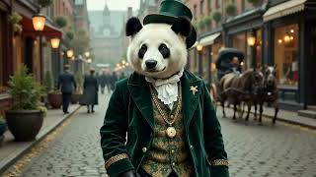

Slide 28
Taylor Moore
SquareCircleLabs.com

Slide 29
More tools
Obsidian.md – Your second brain
Lutra.ai- hook into everything
Hubspot- Great library of Pdfs
photopea.com- Free Photoshop
OpenRouter.ai- 75 LLMs Pay as you Gomd

