Slide 1
Sistemas de Informação e Modelação em Ambiente (SIMA)
António Câmara
Theo Fernandes
2021

Slide 2
SIMA
Fridays 9h-13h
https://us02web.zoom.us/j/5362353244
Antonio Camara asc@fct.unl.pt
Theo Fernandes theo.fernandes@chimp.pt

Slide 3
SIMA
https://myexplora.live/sima-2021/ (Workshops and library)
https://sima-fct.slack.com (Slack channel)
https://www.facebook.com/groups/829347674201354/ (SIMA group)
https://www.facebook.com/groups/183536175571026/ (Explora group)

Slide 4
Challenges
Proposals to be submitted to major funding programs in the Planet
Proposals should include demos/proofs of concept
Learning while doing
Global networking
Intellectual property
Publishing/broadcasting

Slide 5
Challenges
Challenge 1
Next generation environmental modelling
Challenge 2
Future living catalog
Challenge 3
Learning sustainability in a digital cafe

Slide 6
Challenge 1
Next generation modelling
  Humans, machines and Nature intertwinned
  Digital twinning
  Agent, particle, individual based modelling
  Machine learning
  The relationship with Nature and its services
  AR/VR based interfaces
  Case: “Sim” Tree- the role of trees in urban settings. Endgame: proposal to be submitted to Epic Mega Grants and national funds
  Tools: Unreal, Tensor Flow, ARkit
  Support: Tiago Carita, Edmundo Nobre, Nuno Cardoso, Luisa Ferreira Nunes, Nuno Carvalhais (Max Plank), Ana Pinheiro (Amazon), Pete Loucks (Cornell University), Ken Pimentel (EPIC Gaming), Ross Plummer and John Filipe (Ridley Scott), Henk Scholten and Azarakhsh Rafiee (Geodan)
  Key reference: https://myexploralive.files.wordpress.com/2021/03/digital-twinning-and-environmental-models.pdf

Slide 7
Challenge 2
Future Living Catalog (and toolkits)
  Software and hardware toolkits for sustainable living (and climate change fighting). Toolkits will include a new generation of calculators and other apps; sensors and actuators; wetware; and/or bio-ware
  Case: develop the “new Whole Earth Catalog in living form” and its tools; develop demo and proof-of-concept; pre-prove the case, including a business standpoint; endgame: submit proposal to Bezos Earth Fund, World Bank, other international and national funds
  Tools: Python, Unreal, GPT-3, Raspberry Pi, Arduino, sensor kits
  Support: Tiago Carita, Edmundo Nobre, Diogo Almeida (Google, Tokyo), Inês Sousa (Google Mountain View), Rita Margarido (Google Dublin), Paul Bottino (Harvard), Jack Lang (Cambridge, Raspberry Pi), Carlo Ratti (MIT), Haydn Rigby (ex-Arthur Andersen), Ross Plummer and John Filipe (Ridley Scott)
  Key reference: https://www.moma.org/interactives/exhibitions/2011/AccesstoTools/

Slide 8
Challenge 3
Learning sustainability in a digital café
  Information architecture and interactive visualization. Meeting rooms.
  Digital café design. Knowledge content and expert mediation. GPT-3 based interface
  Case: develop a demo for a digital café for the AGORA project, including key content, visualization and interaction tools. Endgame: submit proposal to UN, Smithsonian and other international and national funds
  Tools: Google+Zoom tools, Unreal, Synthesia, GPT-3
  Support: Edmundo Nobre, Tiago Carita, Marco André (ex-Google e YouTube), Ken Pimentel (EPIC Gaming), Risto Linturi (tech expert from Finland), Veerle Vandeweerd (education leader formerly with UN), Georgios Kostakos (project COVIDEA)
  Key reference: https://myexploralive.files.wordpress.com/2021/03/agora_conceptual_approach_fev2021-002.pptx

Slide 9
The plan
Three teams: one for each challenge with rolling leadership/project management
20 minutes with each of the three teams on Tuesday at 6pm and on Friday at 11am every week
Workshops of 2 hours on Fridays

Slide 10
The plan- workshops
March 2021
  12th- Introduction
  19th- Proposal writing
  26th- Project management
April 2021
  9th- Data infrastructures
  16th- Data visualization
  23rd- Unreal & AR kit
  30th- Tensor Flow
May 2021
  7th- GPT-3
  14th- Open hardware

Slide 11
The plan- meetings with supporting individuals
April
  9th-30th: interactions with supporting individuals
May
  7th-14th-21st-28th: interactions with supporting individuals
June
  4th-11th: presentations to selected individuals

Slide 12
The Library https://myexplora.live/sima-2021
Environmental data and modelling
Innovation strategies
Data sources
Sensors
Data infrastructures
Environmental models
Environmental software
AI and environmental modelling
Interaction design
Visualization
AR/VR
Back-of-envelope approaches
Idea generation and selection
Prototyping
Intellectual property
Comunication
Financing
Product development and management
Marketing and sales

Slide 13
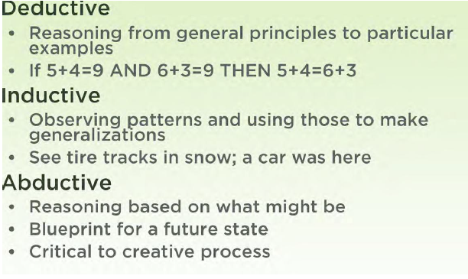

Slide 14
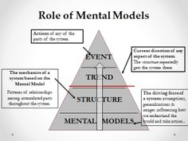
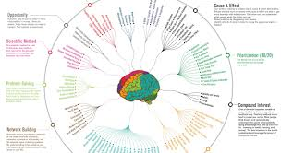
Mental models
https://www.visualcapitalist.com/12-ways-smarter-mental-models/
https://fs.blog/mental-models/
https://tinyurl.com/ydaktvz8

Slide 15
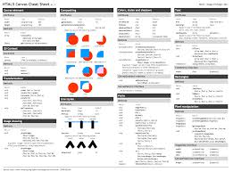
Knowledge summaries
https://www.cheatography.com/
http://www.cheat-sheets.org/
https://tinyurl.com/y8wuv9vk

Slide 16

Software tools
https://education.github.com/pack

Slide 17
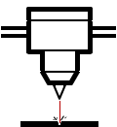






Hardware tools
DIY
Corte a laser
Impressão 3D
Electrónica
Kits DIY
Hacker
Spaces
Material open-source
Creative
commons
Crowdfunding
http://www.makery.info/en/2015/06/09/le-top-10-des-kits-de-prototypage-hardware-suite/

Slide 18
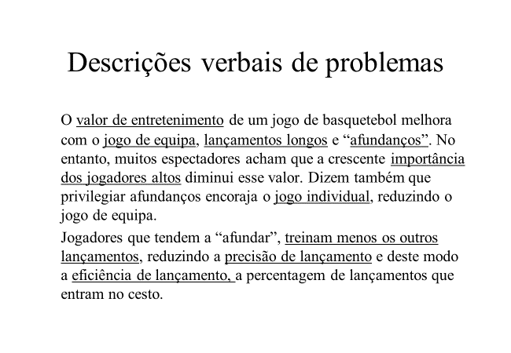
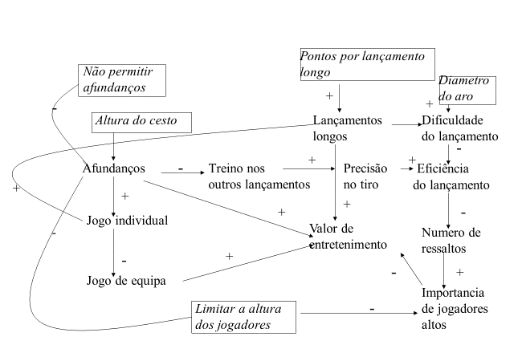
Mathematical models
  Analyze a system
  Applications of mathematics in real life

Slide 19
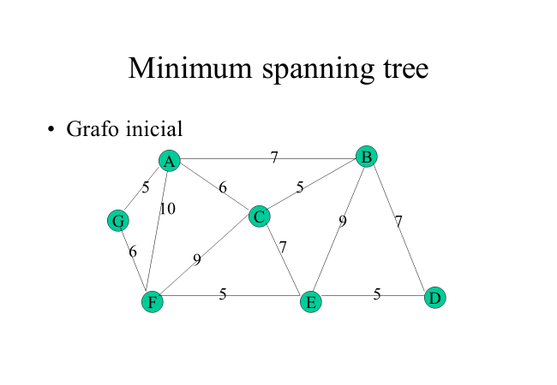
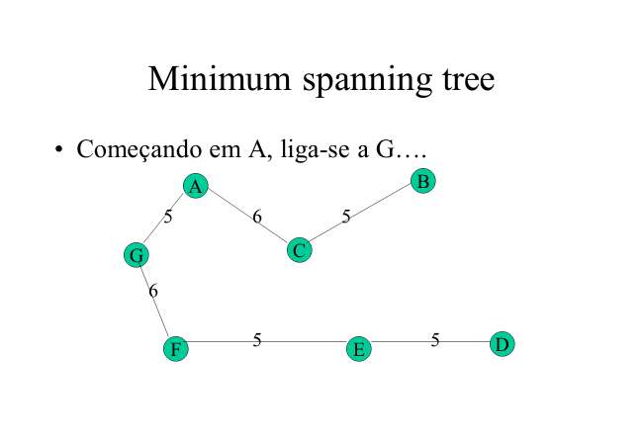
Mathematical models
  Obtain an optimal solution
  Applications of mathematics in real life

Slide 20
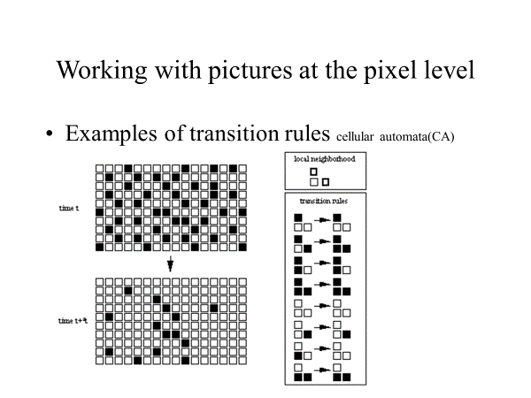
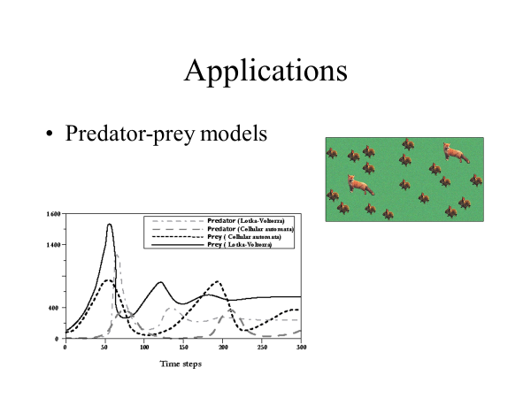
Mathematical models
  Predict the evolution of a system
  Applications of mathematics in real life

Slide 21
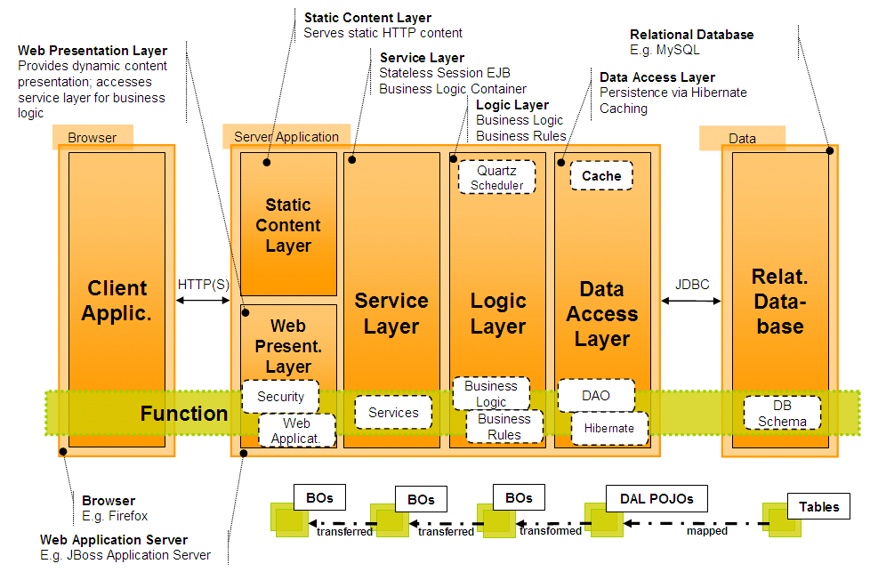
Software architectures
Ten software architectural systems

Slide 22
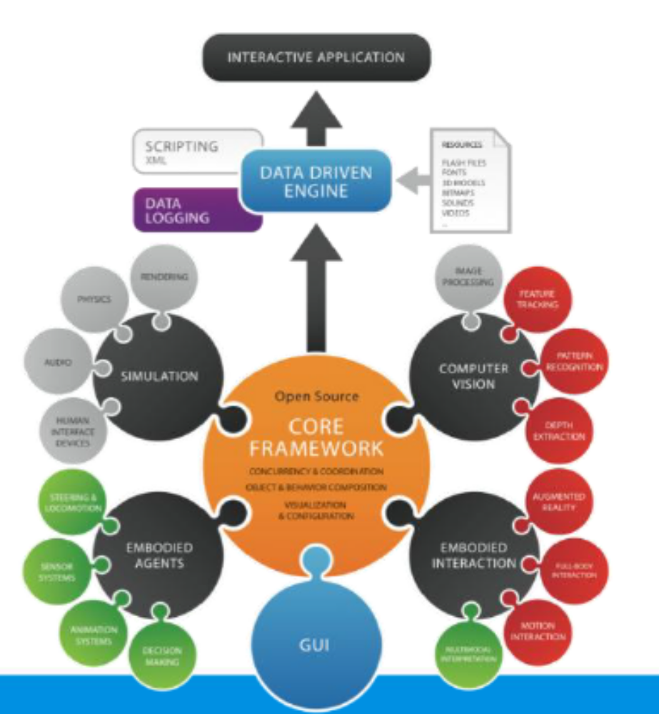
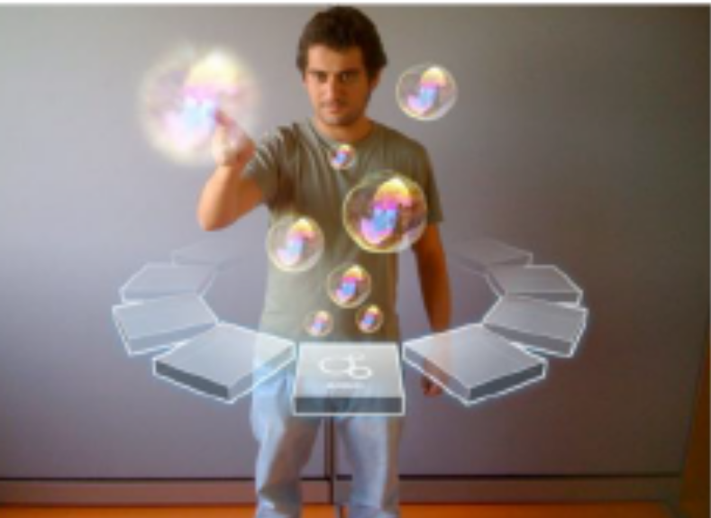
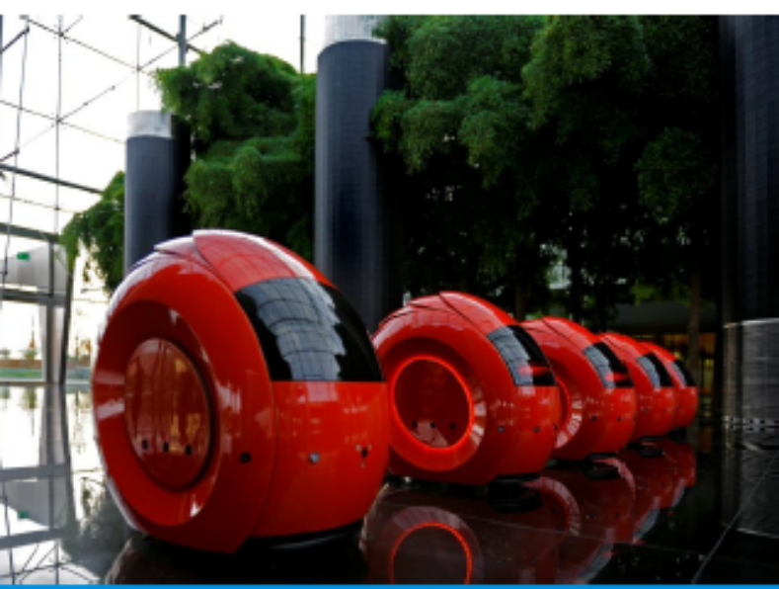

Slide 23
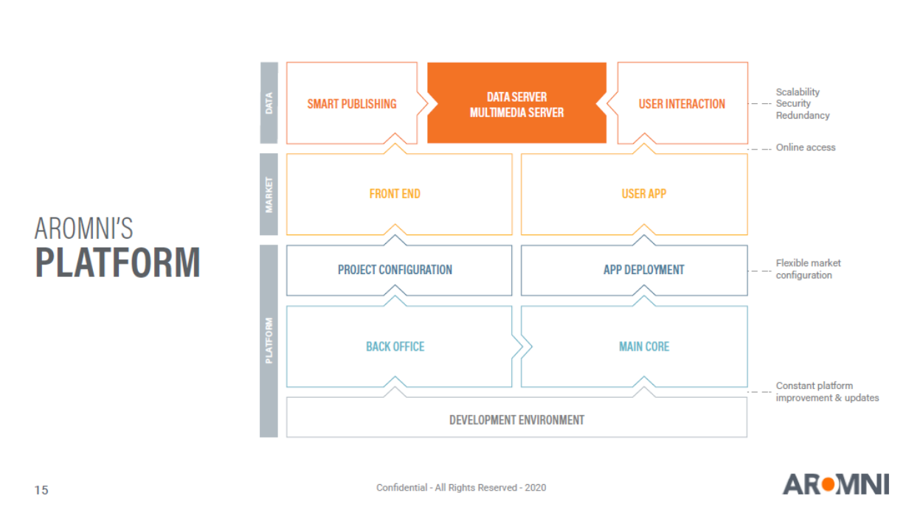

Slide 24
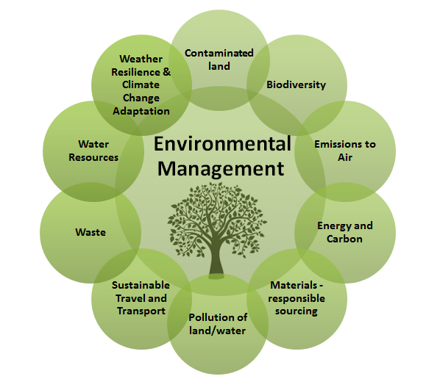
Environmental data sources
SILIAMB
SNIAmb
SNIRH - Recursos Hídricos
SIAIA - Avaliação de Impacte Ambiental
QUALAR - Qualidade do Ar
COSMO
SILOGR
Participa
APA Information systems
Environmental information components

Slide 25
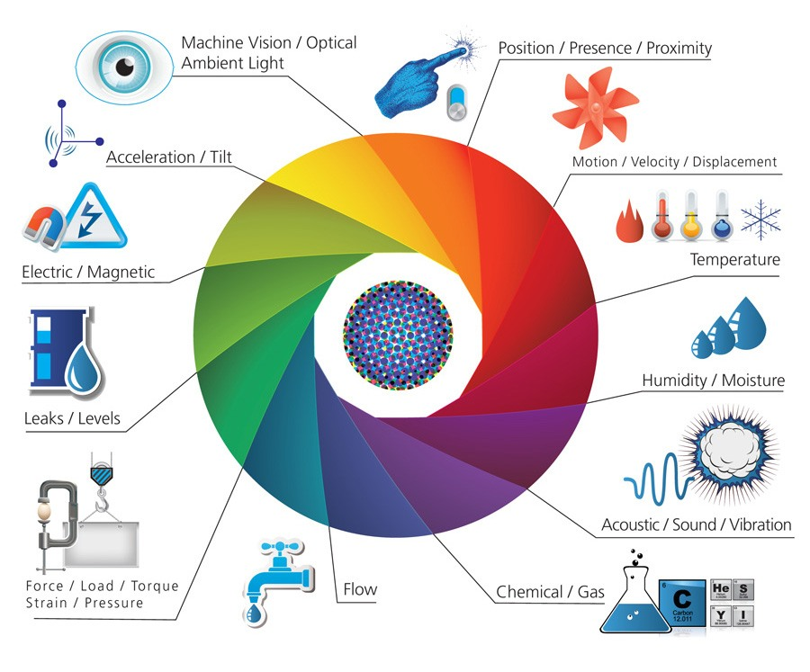
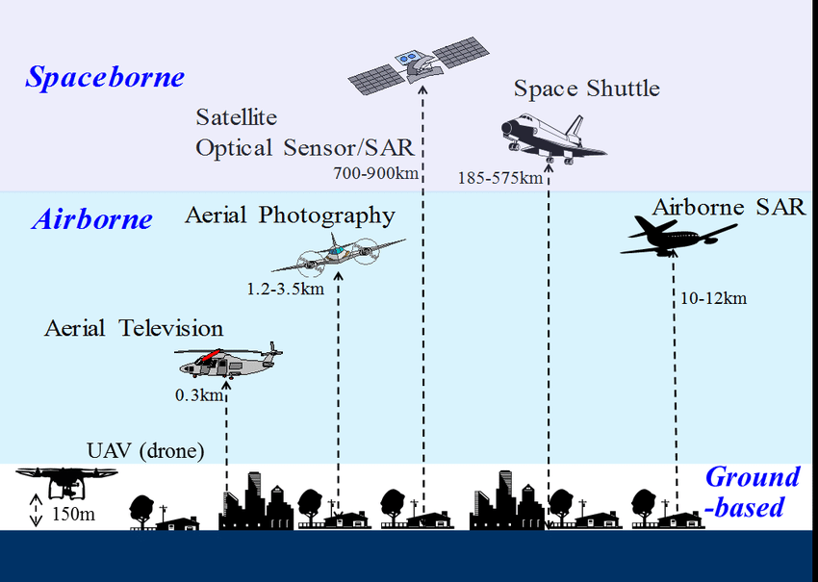
Environmental sensors
Environmental IoT sensors
Sensors used for remote sensing

Slide 26
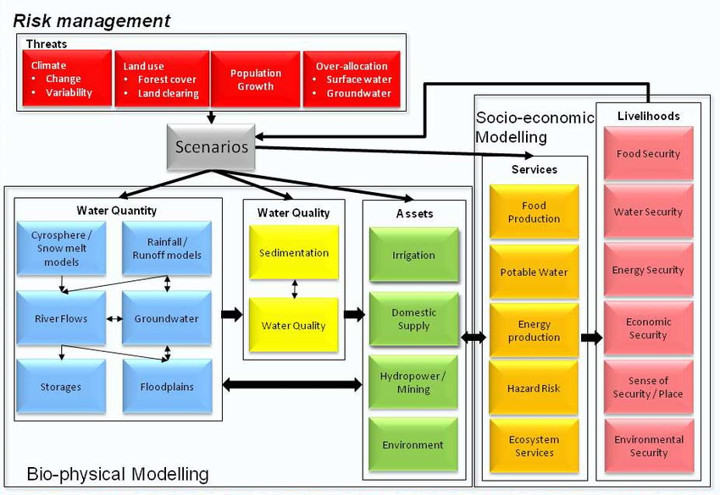
Environmental models
Water resource management models

Slide 27
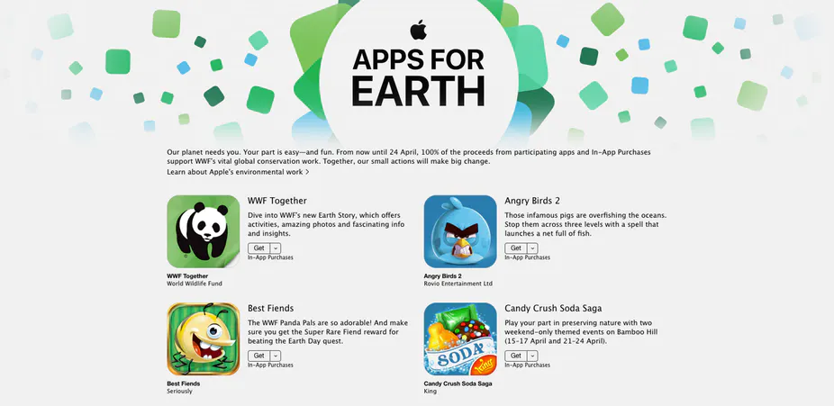
Environmental apps
Apple’s apps for Earth

Slide 28
AI approaches
Machine learning and NOVA environmental engineering students
  Input
    Environmental Engineering students 1982-2019
  Output
    Success (conventional, craftsmanship, societal) 1982-2019
  Hidden nodes
    Accounting for F in Output= F (Input)

Slide 29
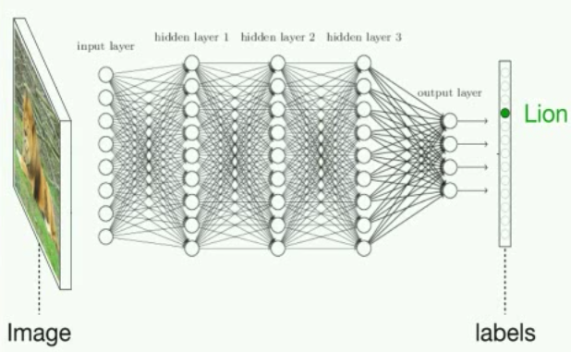
Neural networks

Slide 30
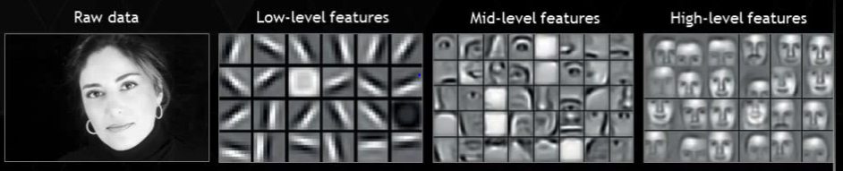
Neural networks

Slide 31
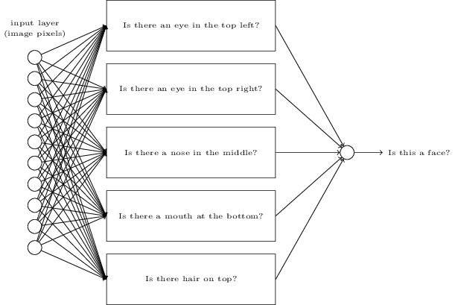
Neural networks

Slide 32
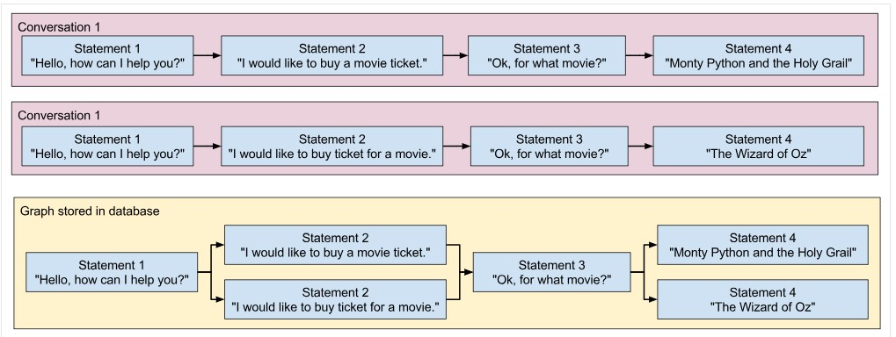
Chat bots

Slide 33
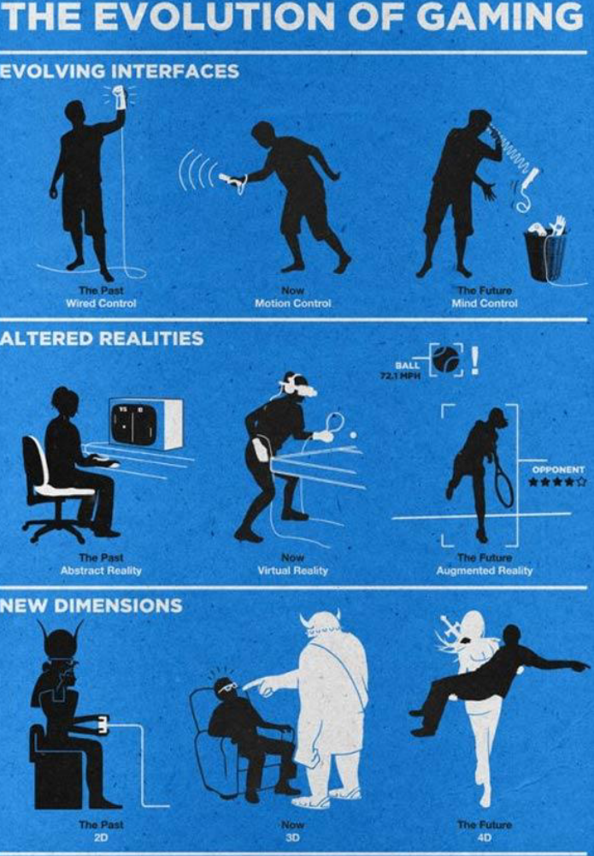

Slide 34
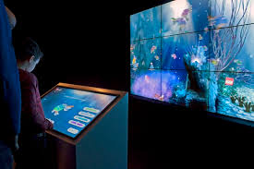
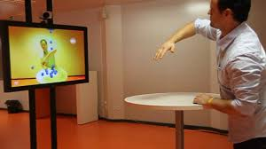
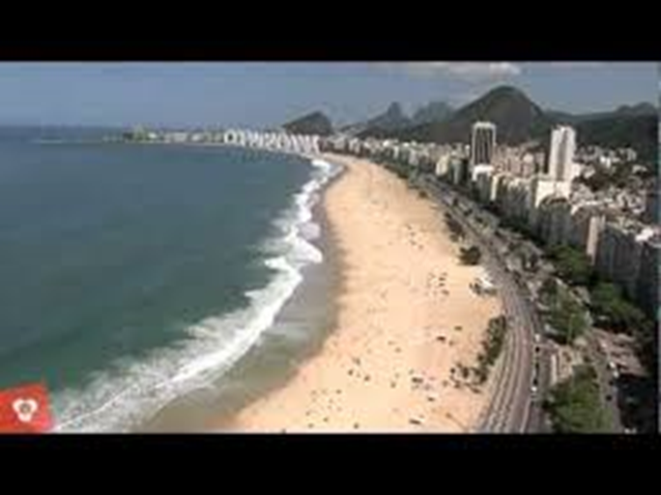
New interfaces: VR/AR/AI
https://www.youtube.com/watch?v=UaC0UoakO7k
https://www.youtube.com/watch?v=qXcIZ1R68SQ
https://www.youtube.com/watch?v=hnMBTU-kyh0

Slide 35
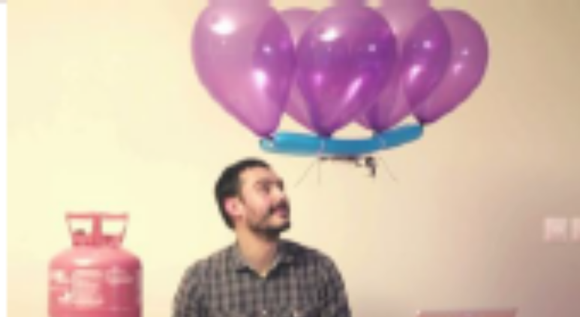
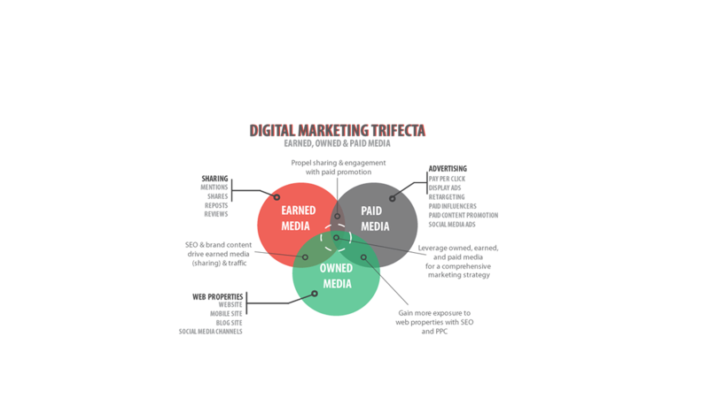
Product development
Generation and selection of ideas
Prototyping
Intellectual property
Communication
Financing
MVP
Marketing and sales

Slide 36
Ars Digita* Layer Cake
Ideas
Management (strategic, financial, IP, operations, product and project management, marketing & communications, human resources)
Design (conceptual, UI, UX, industrial)
Technology (energy, communications, hardware, software)
*https://en.wikipedia.org/wiki/ArsDigita

Slide 37
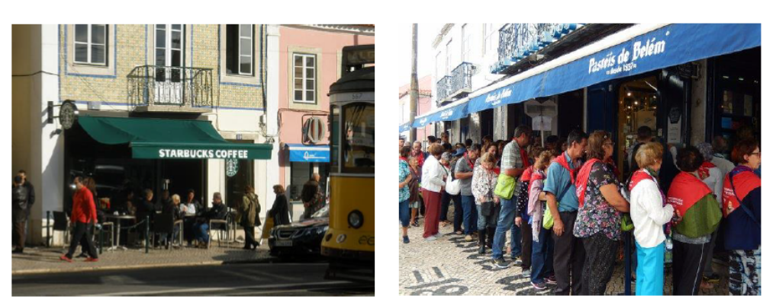

Slide 38
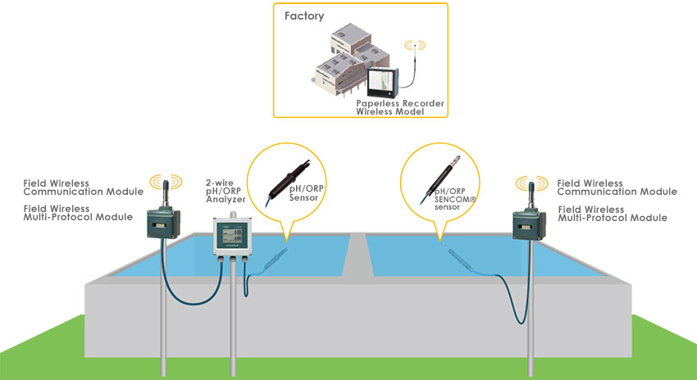
Your problems: benchmark levels
Wastewater treatment monitoring
Self-organizing map and clustering for wastewater treatment monitoring (academic)
Wastewater treatment system and method (intellectual property)
Wastewater treatment monitoring (industry)
Water market data (market)

Slide 39
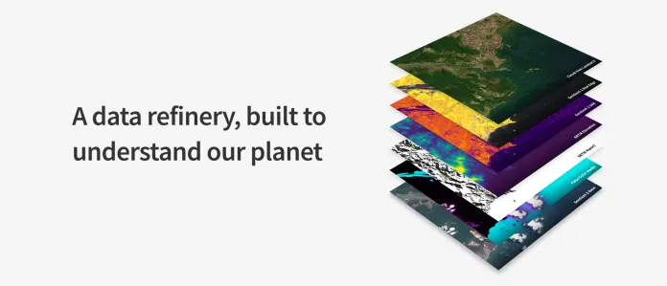
Your problems: quality standards
Remote sensing data analysis
  https://www.descarteslabs.com/

Slide 40
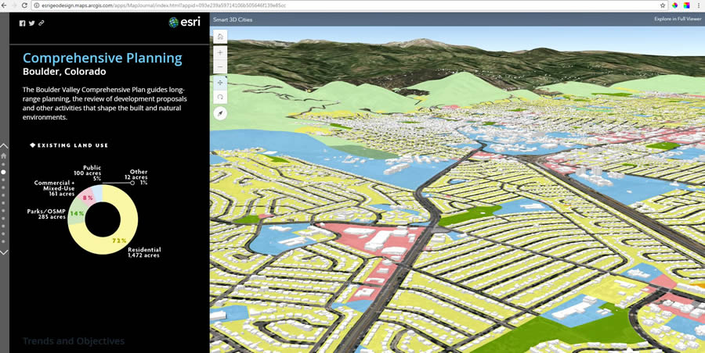
Your problems: quality standards
Land use planning engine
  Building blocks of a smart city

Slide 41
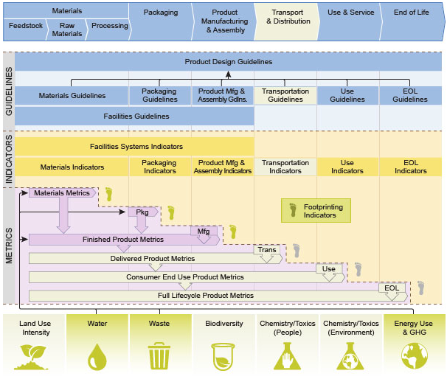
Your problems: quality standards
Life cycle analysis
  Sustainable design guide
  by Solid Works

Slide 42
Additional readings
Abraham Flexner, The Usefulness of Useless Knowledge, 1939 (https://library.ias.edu/files/UsefulnessHarpers.pdf)
Alexander Von Gabain, The EIT: Addressing Societal Changes Via the Integration of the Knowledge Triangle, 2012, (em http://slideplayer.com/slide/7723914/)
Clayton Christensen, The Innovator’s Dilemma, Harper, 2002 (http://dl4a.org/uploads/doc/The_Innovators_Dilemma.pdf)
Peter Thiel and Blake Masters, From Zero to One, Crown, 2014 (ver http://blakemasters.com/peter-thiels-cs183-startup)
Robert Pirsig, Zen and the Art of Motorcycle Maintenance, Harper, 1974 (http://www.arvindguptatoys.com/arvindgupta/zen-motorcycle.pdf)

