Slide 1
ADA in a nutshell
António Câmara
2021

Slide 2
ADA 2021
ADA 2021 site
ADA 2021 Facebook group
Antonio Camara
https://www.linkedin.com/in/antonio-camara/
asc@fct.unl.pt
Whatsapp: +351 913509370
Zoom room:
https://us02web.zoom.us/j/5362353244
ID da reunião: 536 235 3244
Join and follow Explora group
https://www.facebook.com/groups/183536175571026/
Send me an email if you want to receive Sunday News

Slide 3
ADA schedule until the end of the semester
25/Nov. ADAI in a nutshell. Humans, AI and Nature: the Internet of Everything
29/Nov. Environmental data types, infra-structures and sensors
2/dez. Knowldge discovery
6/dez. Machine learning
9/dez. Natural language processing
13/dez. Genetic algorthms
16/dez. Data visualization
20/dez. Augmented reality
3/jan. Virtual reality
6/jan. Student presentations

Slide 4
ADA projects AI/AR/VR
Formulate a problem dealing with ecosystem re-generation. Describe the data, logic and presentation layers of a software solution for that problem. Use AI in the back end and AR/VR on the front end.
Ecosystem re-generation problems (see https://regeneration.org/ for inspiration) may be defined in general terms or be site specific.

Slide 5
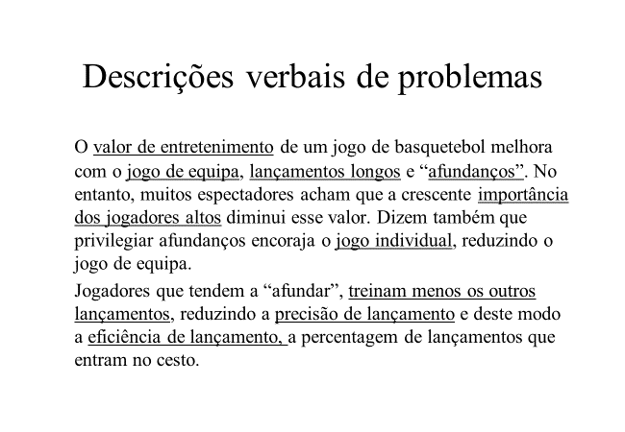
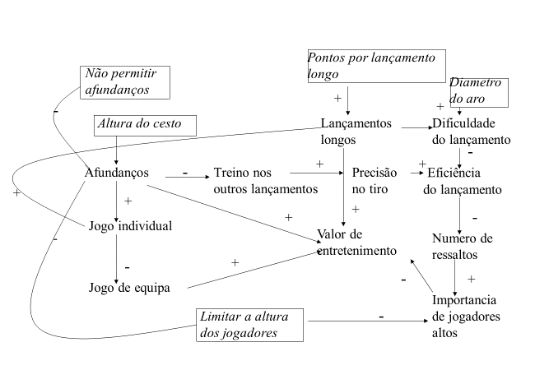
Mathematical models
  Analyze a system
  Applications of mathematics in real life

Slide 6
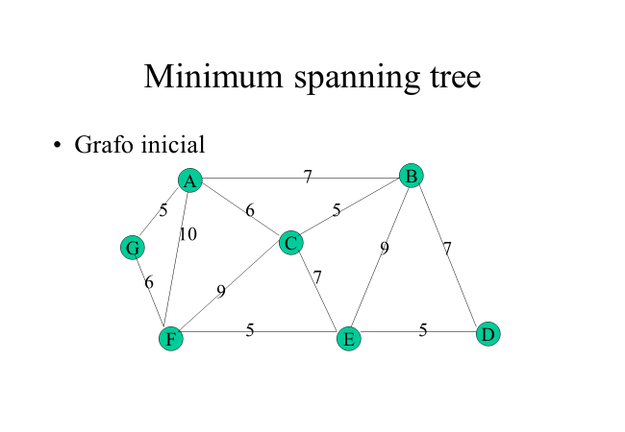
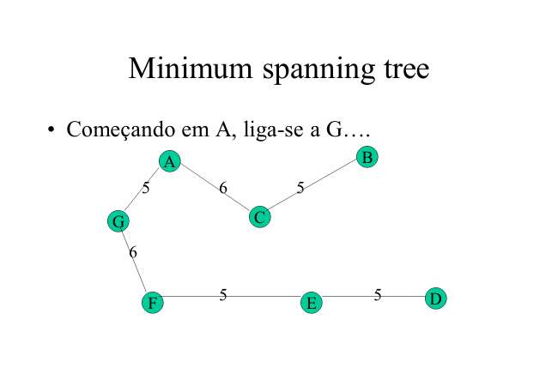
Mathematical models
  Obtain an optimal solution
  Applications of mathematics in real life

Slide 7
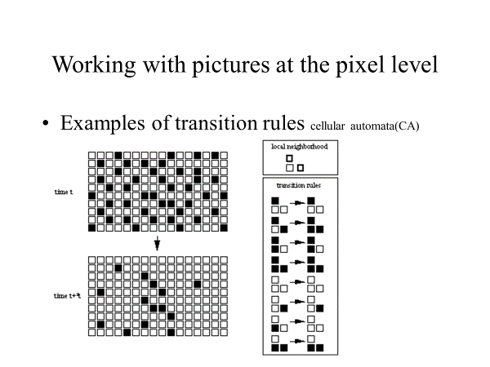
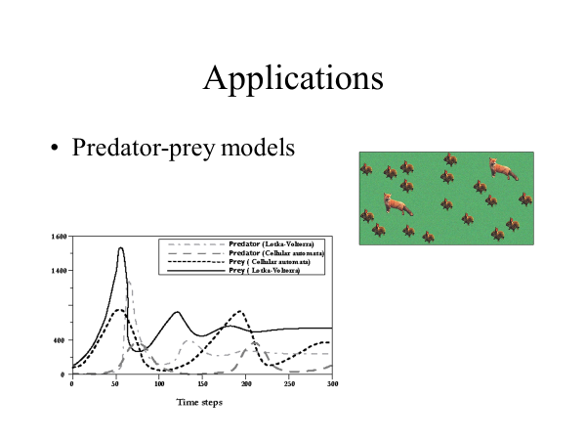
Mathematical models
  Predict the evolution of a system
  Applications of mathematics in real life

Slide 8
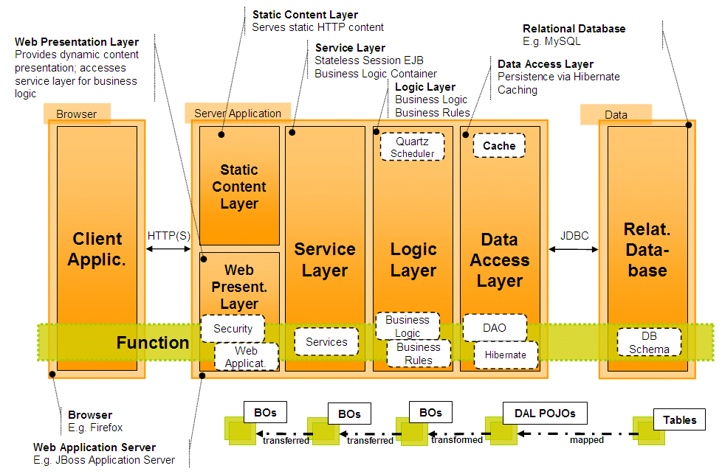
Software architectures
Ten software architectural systems

Slide 9
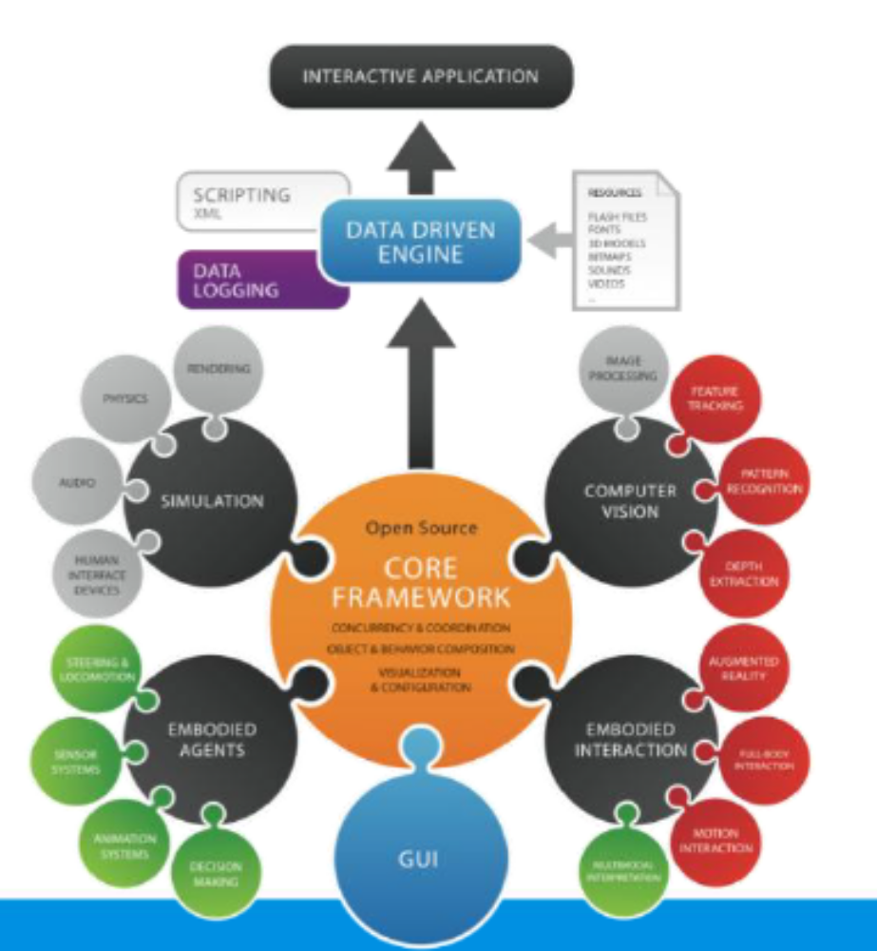
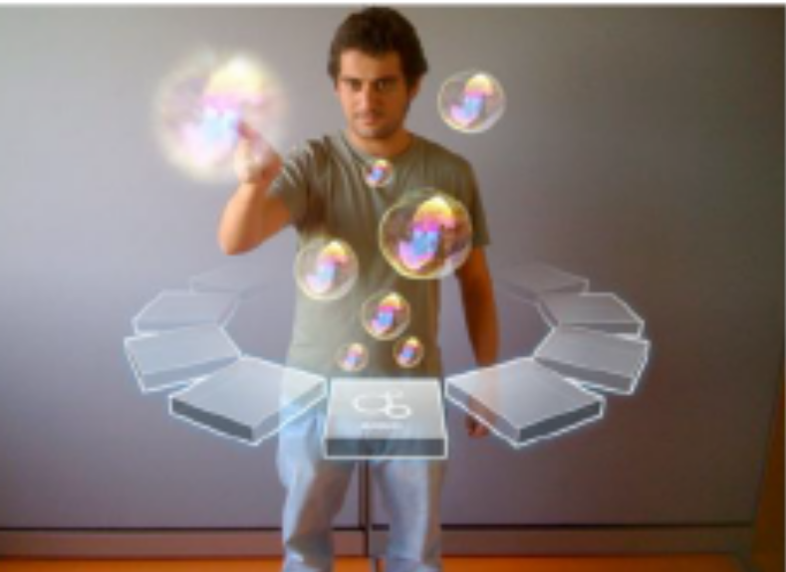
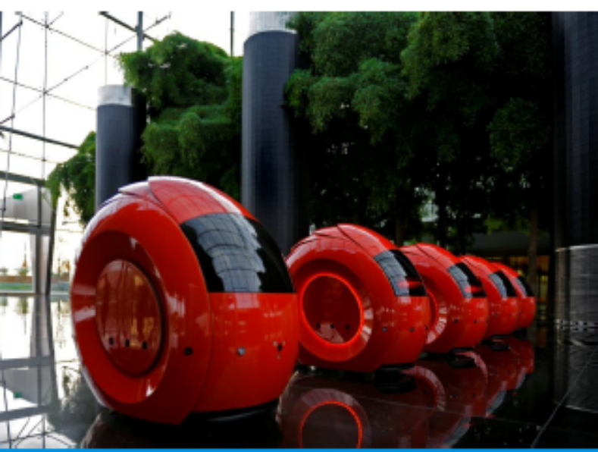

Slide 10
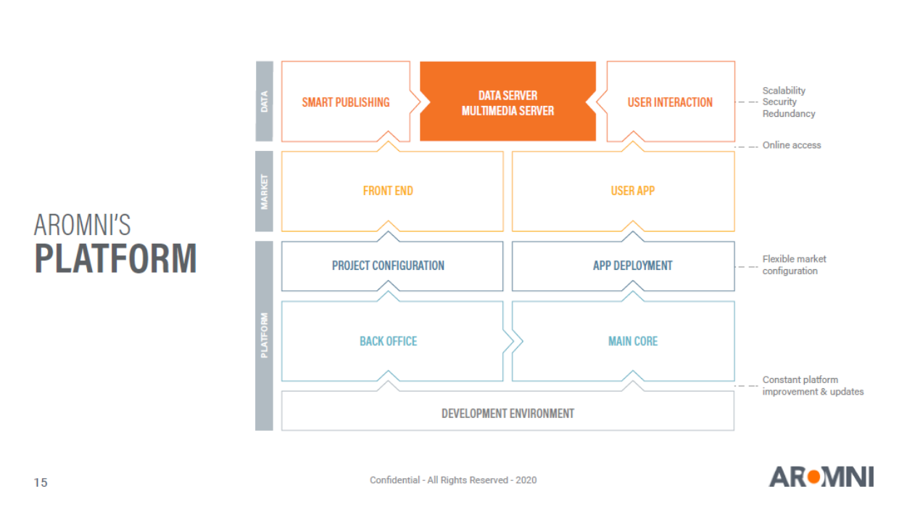

Slide 11
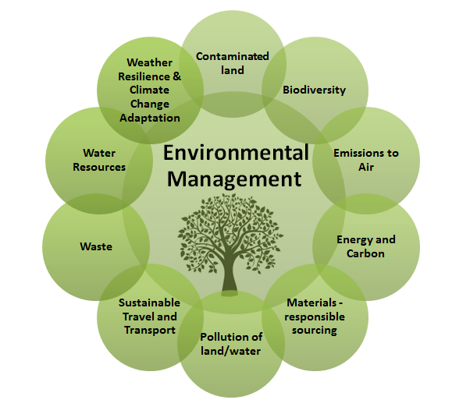
Environmental data sources
SILIAMB
SNIAmb
SNIRH - Recursos Hídricos
SIAIA - Avaliação de Impacte Ambiental
QUALAR - Qualidade do Ar
COSMO
SILOGR
Participa
APA Information systems
Environmental information components

Slide 12
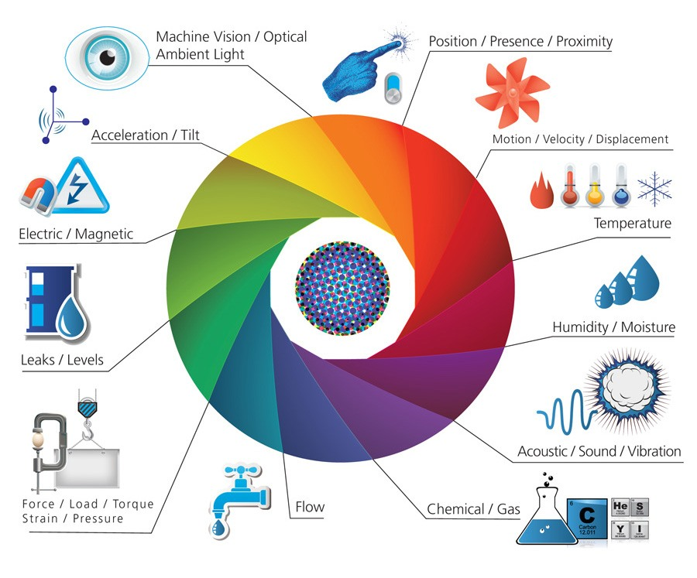
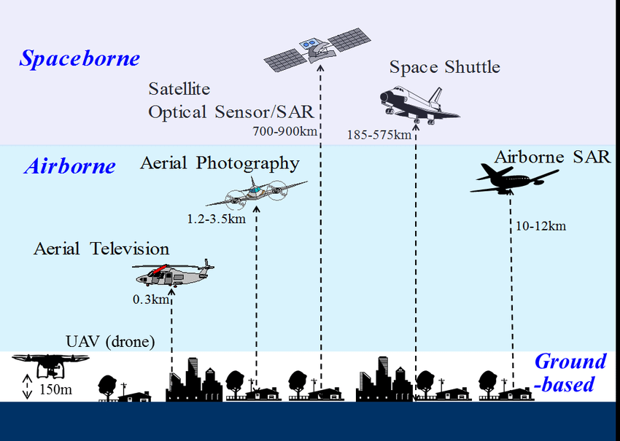
Environmental sensors
Environmental IoT sensors
Sensors used for remote sensing

Slide 13
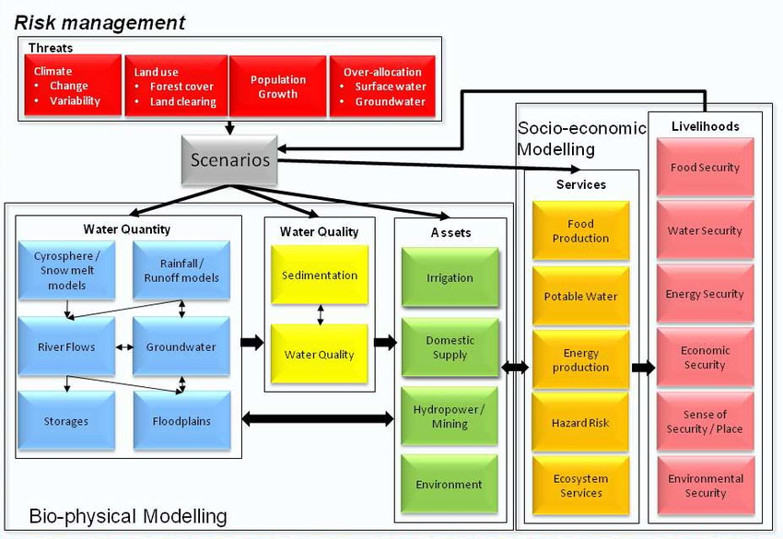
Environmental models
Water resource management models

Slide 14
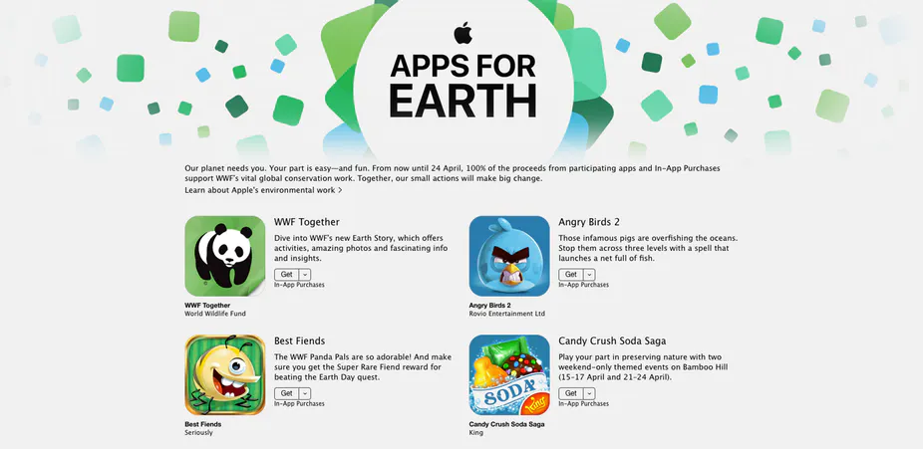
Environmental apps
Apple’s apps for Earth

Slide 15
AI approaches
Machine learning and NOVA environmental engineering students
  Input
    Environmental Enginnering students 1982-2019
  Output
    Success (conventional, craftsmanship, societal) 1982-2019
  Hidden nodes
    Accounting for F in Output= F (Input)

Slide 16
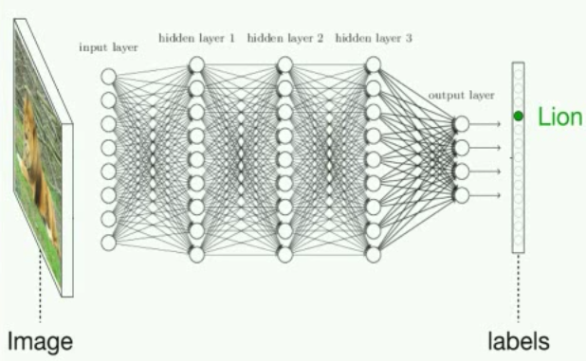
Neural networks

Slide 17
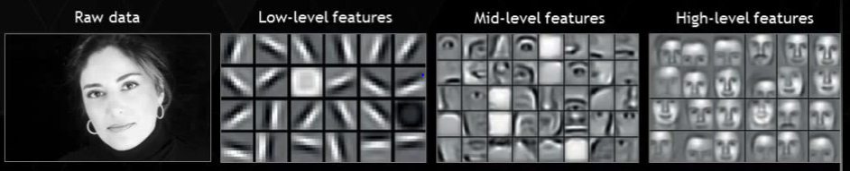
Neural networks

Slide 18
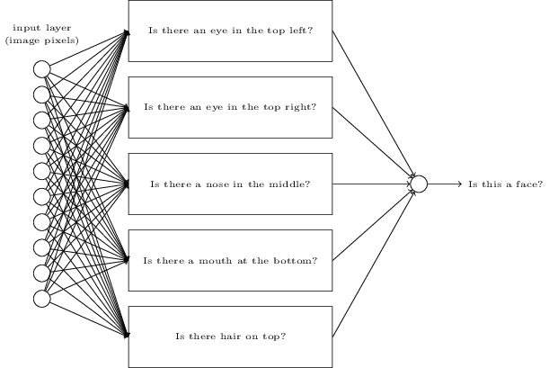
Neural networks

Slide 19
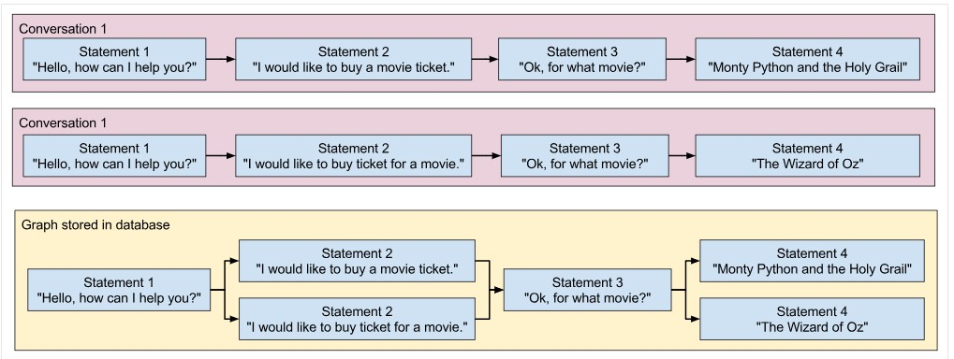
Chat bots

Slide 20
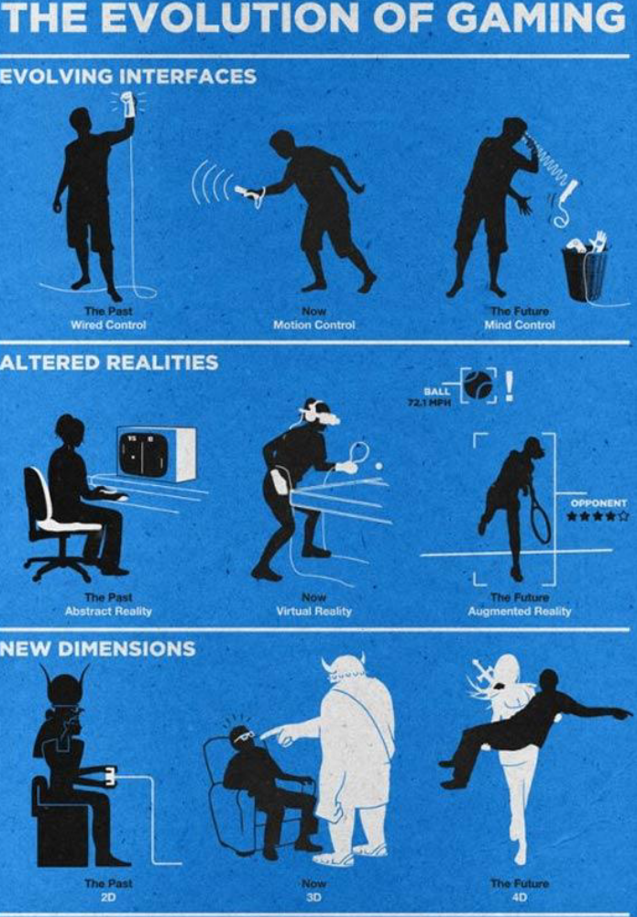

Slide 21
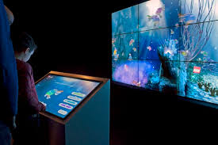
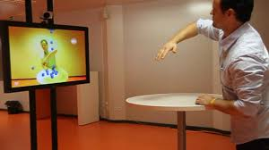
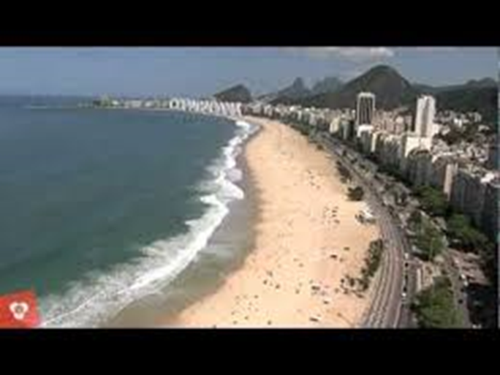
New interfaces: VR/AR/AI
https://www.youtube.com/watch?v=UaC0UoakO7k
https://www.youtube.com/watch?v=qXcIZ1R68SQ
https://www.youtube.com/watch?v=hnMBTU-kyh0

Slide 22
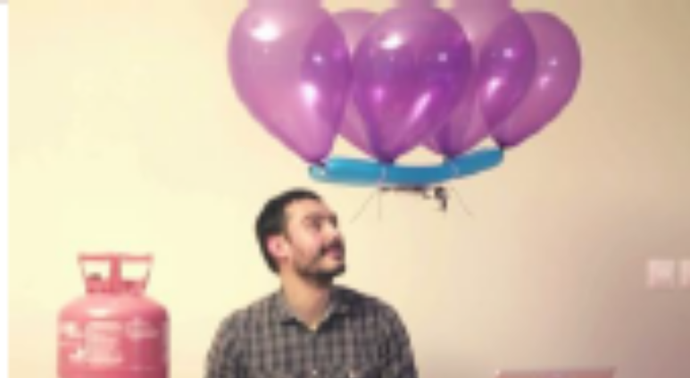
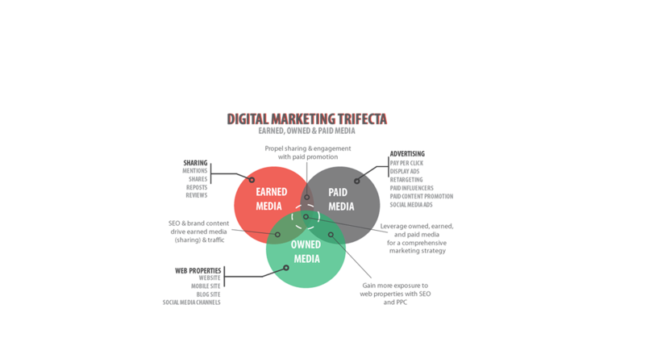
Product development
Generation and selection of ideas
Prototyping
Intellectual property
Communication
Financing
MVP
Marketing and sales

Slide 23
Ars Digita* Layer Cake
Ideas
Management (strategic, financial, IP, operations, product and project management, marketing & communications, human resources)
Design (conceptual, UI, UX, industrial)
Technology (energy, communications, hardware, software)
*https://en.wikipedia.org/wiki/ArsDigita

Slide 24
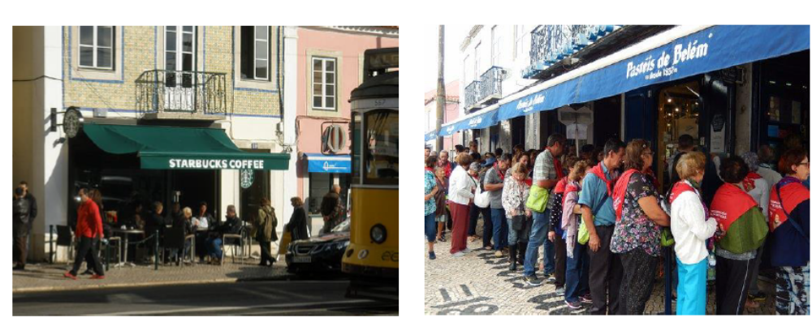

Slide 25
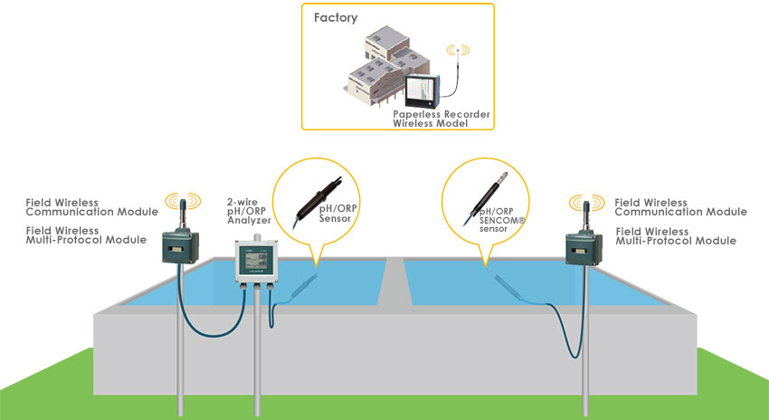
Your problems: benchmark levels
Wastewater treatment monitoring
Self-organizing map and clustering for wastewater treatment monitoring (academic)
Wastewater treatment system and method (intellectual property)
Wastewater treatment monitoring (industry)
Water market data (market)

Slide 26
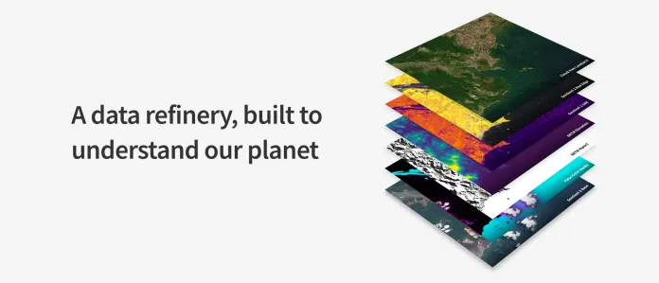
Your problems: quality standards
Remote sensing data analysis
  https://www.descarteslabs.com/

Slide 27
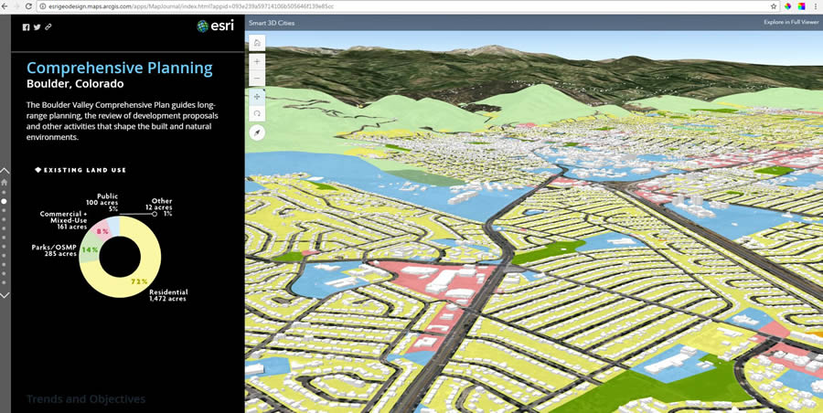
Your problems: quality standards
Land use planning engine
  Building blocks of a smart city

Slide 28
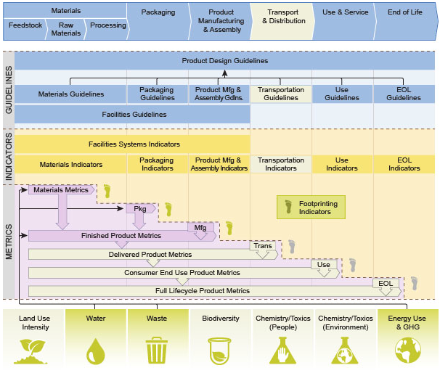
Your problems: quality standards
Life cycle analysis
  Sustainable design guide
  by Solid Works

