Slide 1
ADSA 2021
Modelling approaches in a nutshell
Antonio Camara
November 2021

Slide 2
Causal diagrams as a basis for simulation based games

Slide 3
NBA circa 1979
The entertainment value of a basketball game increases with a team-oriented game, long shots and dunks. However, many fans think that the growing importance of tall players diminishes that value. They also say that dunking encourages individualism, at the expense of a more collective team game.
Players that tend to dunk, practice less the other shots reducing their precision and, thus, the shot efficiency, the percentage of shots that go in.
Shot efficiency also depends on the difficulty of the shot as influenced by the opposing players or basket features. With less efficiency there will be more rebounds reinforcing the relevance of taller players.

Slide 4
Points per successful
long shot
Forbid
dunking
Basket
diameter
+
-
+
Basket height
Long shots
Shot
difficulty
-
-
+
+
Dunks
Practicing other shots
Shot
precision
Shot efficiency
+
+
+
-
+
Individual game
Entertainment
value
-
Number of rebounds
-
+
-
+
Team game
Importance
Of tall players
Limit players
height
-

Slide 5
Neural networks for learning and forecasting

Slide 6
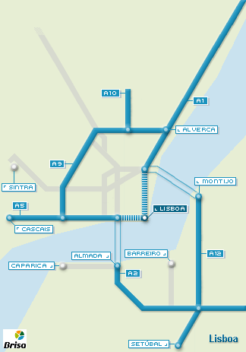
Network of traffic sensors
Neural networks learning
  Relates values of each sensor with all others, with time gapsof
    5 minutes
    10 minutes
    20 minutes
  Includes classification
    Hour
    Day of the week
    Day of the month
    Month
    Holidays
    Meteo data

Slide 7
Given the information at a given moment its is possible to prefict traffic intensity at each point in:
  5 minutes
  10 minutes
  20 minutes

Slide 8
Network optimization in mobility management

Slide 9
Shortest path
2
9
3
2
6
6
1
7
3
3
3
1
4
5
3
4

Slide 10
Minimum spanning tree
Initial graph
A
7
B
5
6
5
10
G
C
9
7
6
7
9
5
5
D
F
E

Slide 11
Minimum spanning tree
Starting in A, connect to G….
A
B
5
6
5
G
C
6
5
5
D
F
E

Slide 12
Chinese postman
  Seek intuitive solutions to this arc covering problem
8
e
d
5
5
6
6
c
5
5
8
a
b

Slide 13
Travelling salesman
  Node covering problems
    Start with “Minimum spanning tree”
11
8
*
31
3
1
25
29
9
29
36
*
7
2
36
10
*
*
34
5
27
*
*
4
6

Slide 14
Travelling salesman
Intermediary graph
11
8
*
31
3
1
25
29
9
29
36
*
(29)
7
2
*
36
10
*
34
(43)
5
27
*
*
4
6
(71)

Slide 15
Travelling salesman
Approximate solution
8
3
1
9
7
2
10
5
4
6

Slide 16
Travelling salesman
  Real solution
8
3
1
9
7
2
10
5
4
6

Slide 17
Back of the envelope calculations

Slide 18
Back of the envelope calculations links
Consider_a_Spherical_Cow. Approximate calculations in environmental science
Cheat sheets for almost every area. See also a cheat sheet for engineering here
Google back of the envelope calculations, a guide
Numbers every traffic engineer should know

