Slide 1
The game of life
António Câmara
November 2021

Slide 2
António Câmara
Failed tennis player
Successful sports manager
Professor at NOVA. Visiting Professor at Cornell and MIT
Serial entrepreneur
  YDreams
  YDX, Ynvisible and Azorean
  The Inventors
  Aromni andTUGA Innovations (still stealth)
Promoter
  Explora
  Disobedience Lab

Slide 3

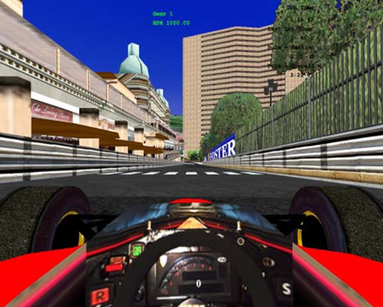
Academic life
Founder of GASA, now member of CENSE, NOVA SST
Pioneer in virtual reality (1992)
and augmented reality (1995)
“Environmental Systems” (OUP, 2002)
“Spatial Multimedia and Virtual Reality” (T&F, 1999, 2021)
“Voando com os Pés na Terra” and “O Futuro Inventa-se” (2009)
“Innovation without a Valley” and “Metaverse- Humans, Machines
and Nature” (forthcoming)

Slide 4

High Flying Bird, Netflix
“We blacks dominate basketball.
Then the whites developed a game on top of our game called NBA”

Slide 5
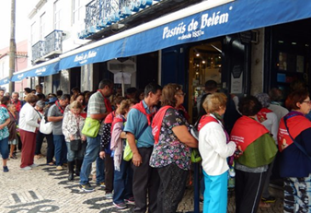


Slide 6

The game

Slide 7
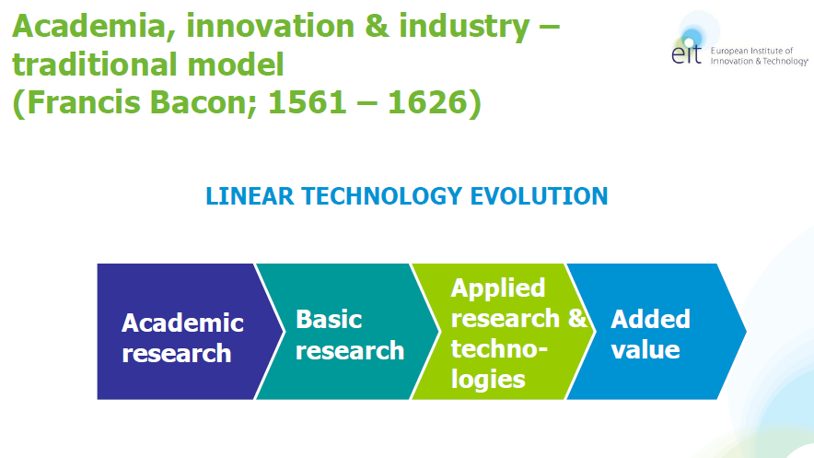
Linear model

Slide 8
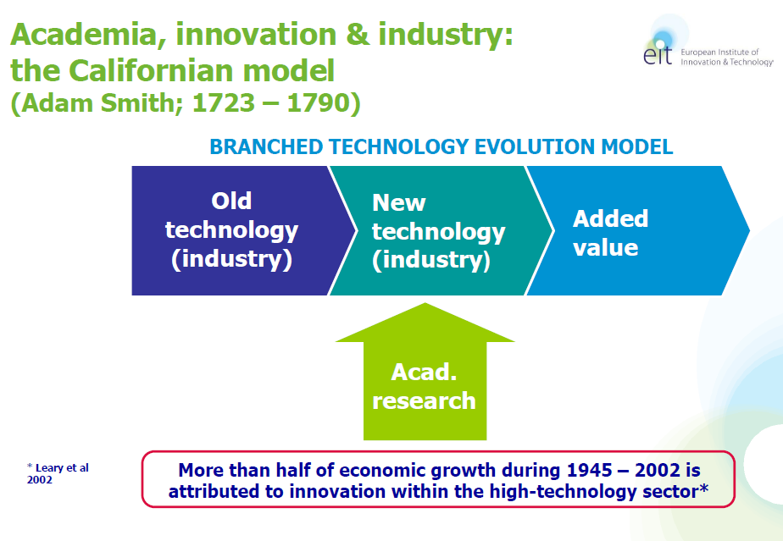
Californian model

Slide 9
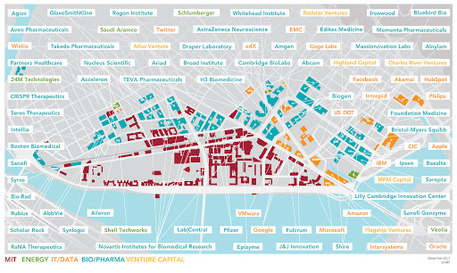

Slide 10
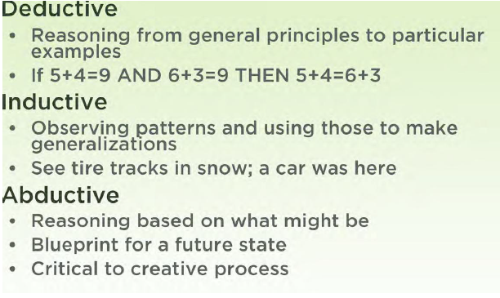

Slide 11
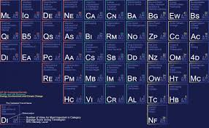
Future Tech Periodic Table

Slide 12

My game

Slide 13
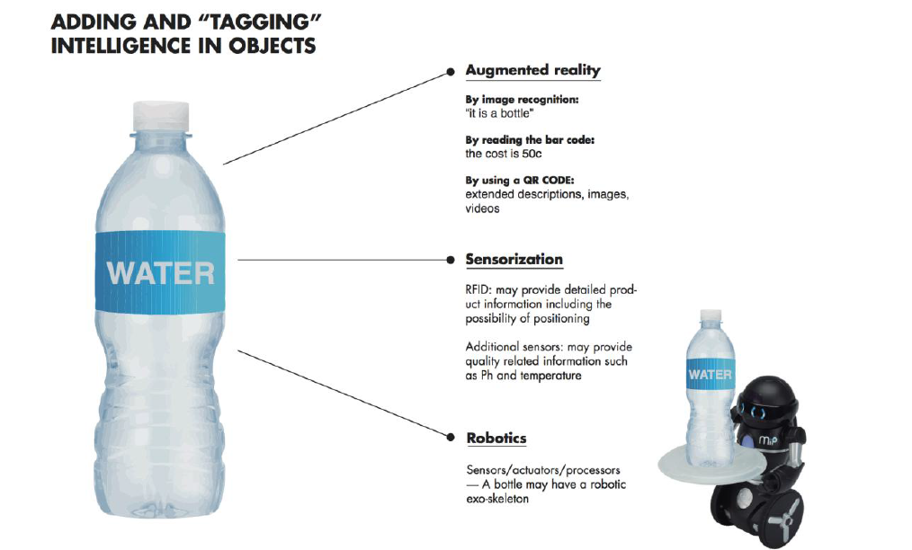
The Real World

Slide 14
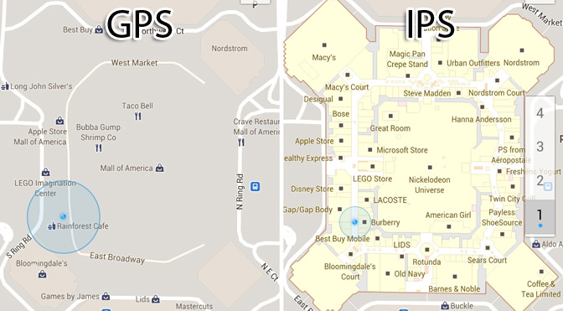
The Real World
Extreme Tech, 2012

Slide 15

Mirrorworld
Bridging the Real and Data Worlds

Slide 16
Technological Possibilities
Understanding of
Client Needs
Early Product ideation
Creativity

Slide 17
Product
Development
co-development with partner
through client project
through research grants
Own product developments

Slide 18
Following Steps
Discontinuation
Own Product Catalogue
Licensed or sold
Product Spin-out
Filtering based on study of
Market potential
Volume production viability
Corporate strategy

Slide 19

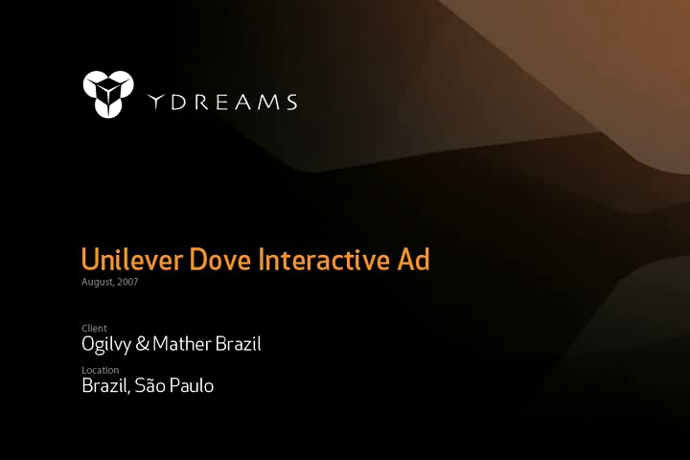
Discontinuation
Own Product Catalogue
Licensed or sold
Product Spin-out
Audience gaming concept idea
Joint-Venture, based in NYC, to explore audience gaming. Has delivered games to MSNBC, Volvo, Orange Mobile, Vodafone, Coca-Cola, Volkswagen, Disney, Redbull, Nokia, Sony among others
Aug 2007
Audience gaming client project for Dove in São Paulo, BR

Slide 20
The Model is intended to promote:
  Creativity
  Filtering based on technical, market and business strategy inputs
  Quick prototyping and constant market feedback
  Minimal risk exposure
  End goal: coming up with Killer Applications

Slide 21
Creativity is born out of small, diverse teams
Champion
Business
Designer
Champion
Engineer
Engineer
Champion
PhD
Product ideas need a Champion with the drive to make it succeed.
“Passion is the emotional fuel that drives your vision.”
Steve Jobs

Slide 22
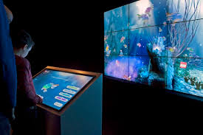
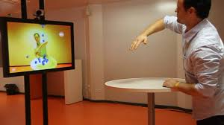

A new Internet of Everything
YDreams Magic: YDX (Toronto, Frankfurt). Aromni, YDreams Entertainment

Slide 23
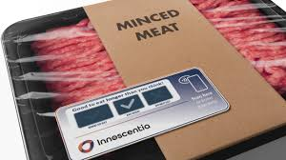
Internet of Things
Ynvisible
Listed in Toronto and
Frankfurt
Smart labels
Lisbon, Freiburg, Linkoping, Vancouver
https://www.teletrader.com/ynvisible-interactive/stocks/details/tts-160188310

Slide 24
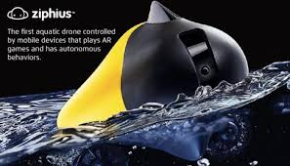
Ocean exploration
Azorean Aquatic
Technologies
Listed in Euronext Paris
Aquatic drones,
ocean exploration
Lisbon, Ponta Delgada
https://youtu.be/H9W1wmIl8YU

Slide 25
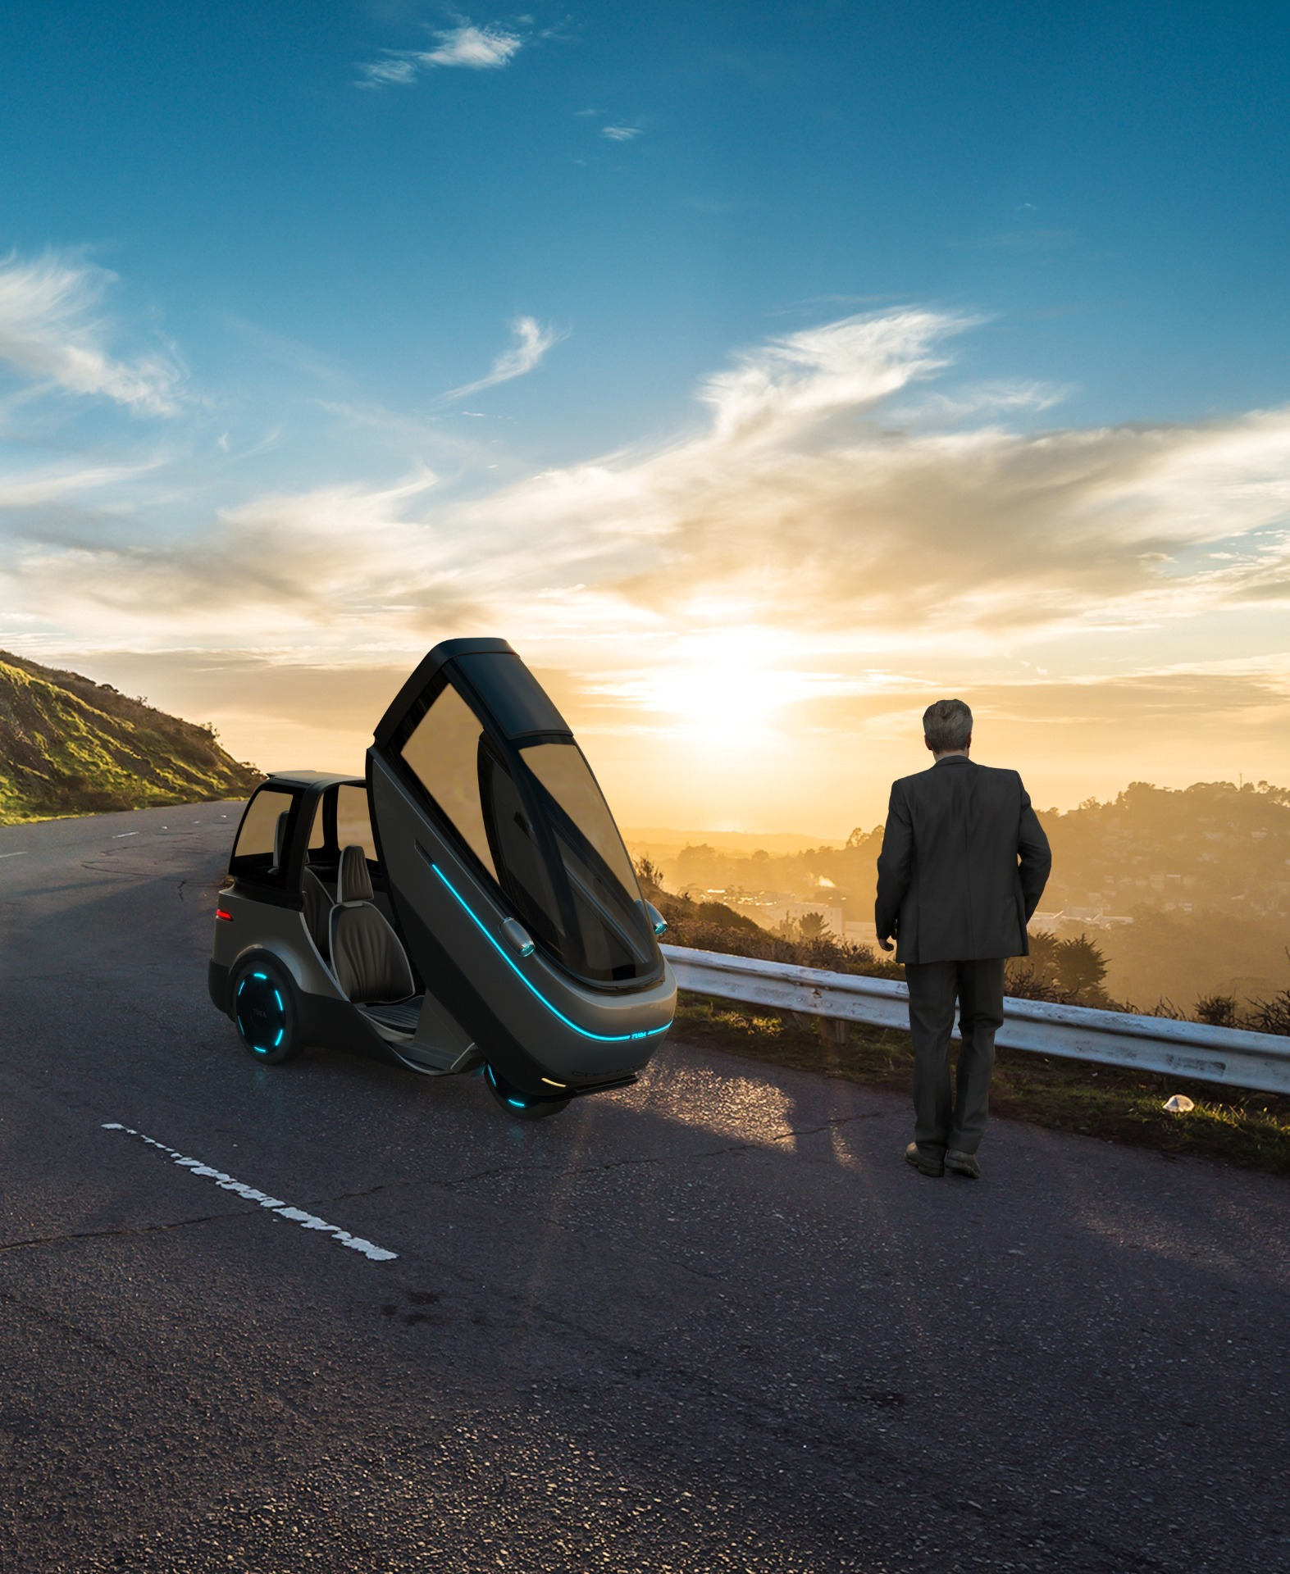

Mobility
TUGA Innovations, Inc.
Lisbon, Holland (Michigan), Vancouver
Filed for na IPO

Slide 26

The game on top of the game

Slide 27


Ars Digita layer cake
Ideas
Financing
Marketing & communications
Management
User experience
Content
Technological infrastructure
(applications, platforms, information systems,
operating systems, telecommunications,
power)
Adapted from Philip Greenspun’s Ars Digita Layer Cake

Slide 28

Ars Digita layer cake
Ideas/intellectual property
Financing/business models
Marketing/communication/
sales
Technical pyramid

Slide 29

Ars Digita layer cake
Ideas/intellectual property

Slide 30


Slide 31
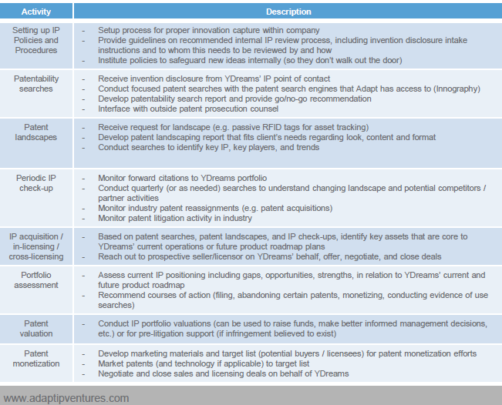
Intellectual Property Management

Slide 32
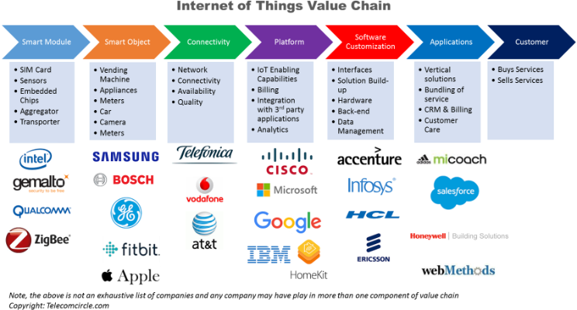
Ars Digita layer cake
Financing/business models

Slide 33
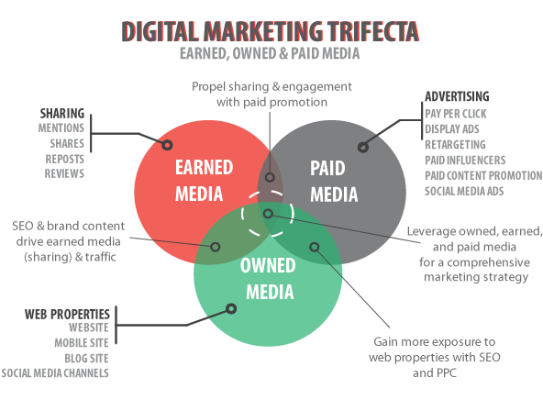
Ars Digita layer cake
Marketing/communications

Slide 34
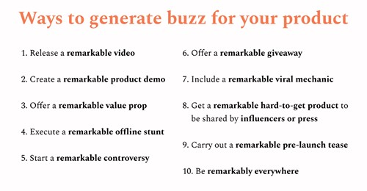
https://www.lennyrachitsky.com/
https://johnfilipe.com

Slide 35
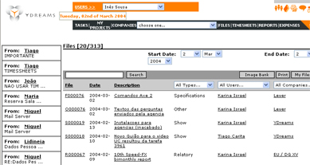
Ars Digita layer cake
Technical pyramid
  “Problem definers”
    “Architects”
    Researchers and
    creative personnel
  “Problem solvers”
    Project managers
    Analysts
    Programmers and
    designers
YNET : Slack, Trello, Jira and Sales Force into one

Slide 36
Ars Digita layer cake
Hiring the right people
  Passion
  Energy
  Self-assurance
  Ability to deal with stress
  and ambiguity
  Ability to delegate
  Ability to inspire
  Ability to deliver
  Adapted from Guy Kawasaki, The Macintosh Way, Harper, 1990
  “A players hire A players, B players hire C players and C players hire D players”
  Steve Jobs in The Art of the Start, Guy Kawasaki, 2004

Slide 37
“We sell computer direct. By making only to order and selling over the Internet, we have the highest return for capital invested in the industry”
Michael Dell

Slide 38
Three-dimensional analysis
What we can do
We can suppress the possible lack of skills by creating a support ecosystem, and use outsourcing services type
What we want to do
The path of the idea to the prototype and, later, product, is a challenge with difficulties and uncertainties. Perseverance and passion are fundamental
What we are paid to do
  There must be someone willing to pay for the product or service

Slide 39
“Timing”
The worst that can happen to us is to launch a product in a market that is in decline, involving an outdated technology
On the other hand, we must also take into account that the most difficult solutions to implement are usually neglected. This could be a business opportunity.
Gartner annually publishes its Hype Cycle, which helps to situate the state of maturity of the technology area in which we are working in relation to the market

Slide 40
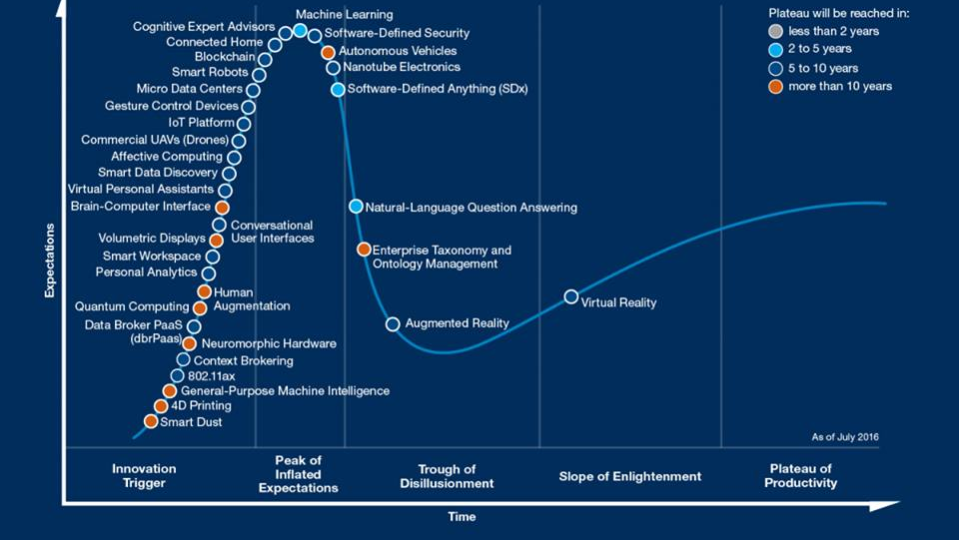

Slide 41
"99% of the time we should ignore our competitors. Especially when they make a lot of money or are talked about a lot in the press. Don't worry about the competition unless you're already producing and shipping products."
Sam Altman
http://playbook.samaltman.com/

Slide 42





The Silicon Valley Model
Angel funded start-ups
Billions of revenue
Winners
User Traction
VC Backing
Picture Credits: Ludwig Gatzke

Slide 43
“Based on my 40 years in business, I think the economy is driven mostly by entrepreneurs and the development of new products and services, which start to create demand that then creates a virtuous circle. When Steve Jobs invented the iPod and iPhone, that helped drive cloud computing and telecommunications systems, and so all of a sudden how many jobs have been created? The point is that if you talk to the people who are demand-side-oriented, they discount Steve Jobs or other entrepreneurs who create their own demand”
Fred Smith, Federal Express, in Fortune, Maio de 2011

Slide 44
asc@fct.unl.pt
https://www.facebook.com/groups/183536175571026

