Slide 1
Developing an Internet of Nature (IoN)
António Câmara and Edmundo Nobre
.
March 2023

Slide 2
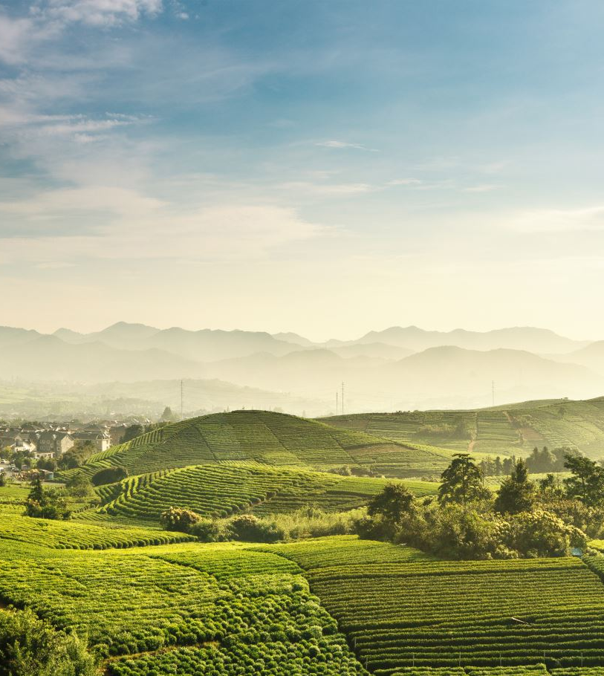
Developing an Internet of Nature´s
Goal:
To develop a platform that will enable the monetization of Ecosystem Services associated to Nature Markets

Slide 3
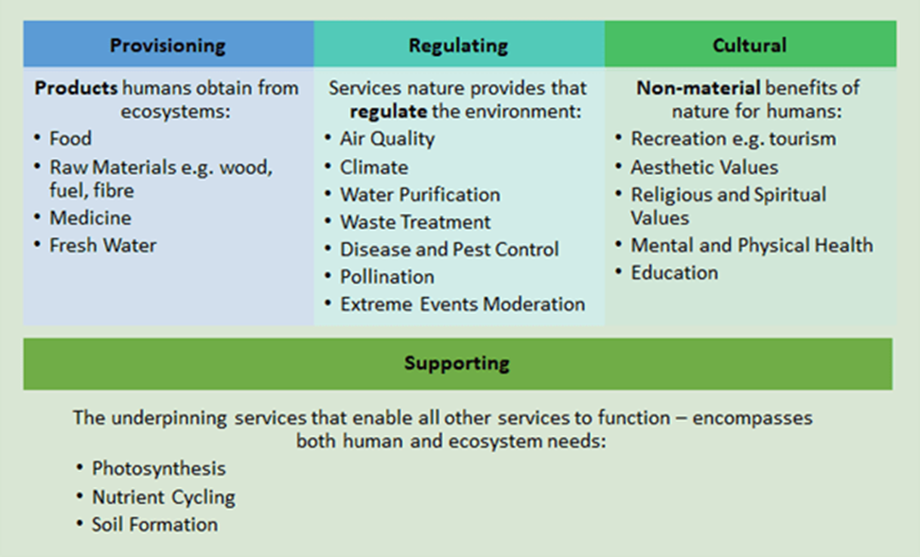
Ecosystem Services
Ecosystem Services: the Fundamentals, by Kyoko Yamafuji and Madeleine Woods, 2021
https://www.greenelement.co.uk/blog/ecosystem-services-the-fundamentals-part-i/

Slide 4
Nature Markets
Intrinsic markets - the trade of Nature itself including food, nature-based medical products, wood products, the sale of sand, earth and minerals, and tourism
Offset markets - investments and/or trade in aspects of Nature to offset negative impact elsewhere, including carbon and biodiversity offsets
Derivative markets - trade instruments that reflect the value of Nature embodied in the underlying economic assets such as non-fungible tokens (NFTs)
The Future of Nature Markets, Taskforce on Nature Markets, 2022 https://www.naturemarkets.net/publications/the-future-of-nature-markets

Slide 5
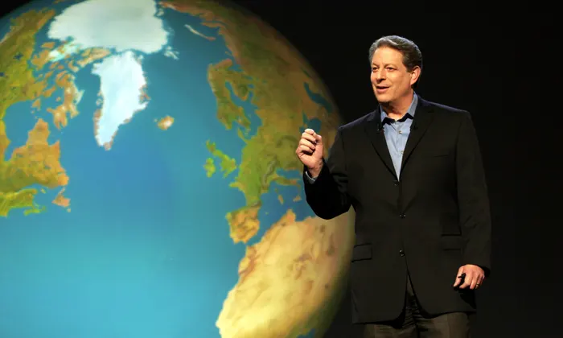
Towards an Internet of Nature
Internet of Nature
It all started with Al Gore’s Digital Earth
The Augmented Earth
The Digital Twinned Earth
The Virtual Earth
Farm to fork strategies may override current food supply systems in the Augmented Earth
Offset markets based on the Digital Twinned Earth will start with carbon (forest, soil, blue) and proceed with biodiversity and water markets
Derivative markets will grow on the Virtual Earth

Slide 6
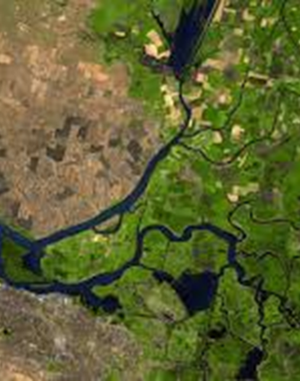
Towards an Internet of Nature
A platform, being developed by Explora Inc, will be a one stop shop for resource owners to fulfill the requirements to produce, certify and sell offsets. It will start with carbon offsets but is prepared to accommodate, in the future, other ecosystem services
Explora also enables the exploration of derivative markets creating augmented and virtual reality assets that can be minted and traded as NFTs.
The infrastructure being developed includes sensors, data, logic, presentation, certification and trading layers. It is based on a vision which ultimate goal is to create an Internet of Nature

Slide 7
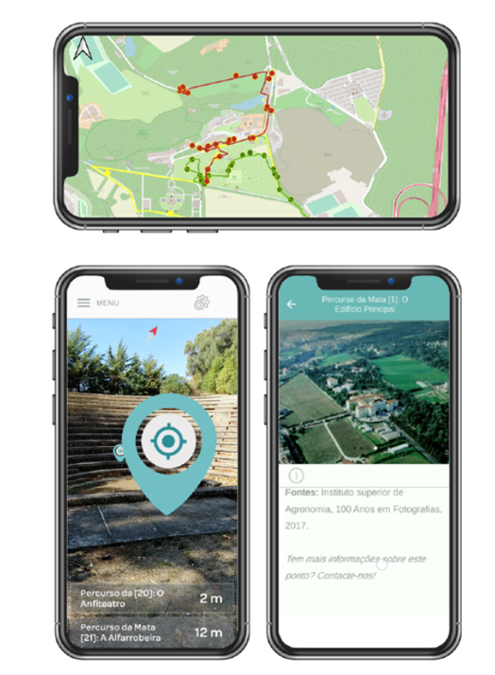
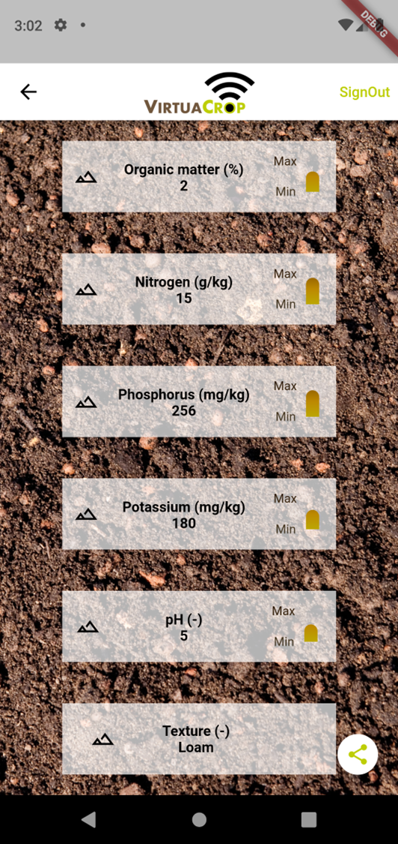
Explora Platform: Offset Markets
Explora Inc. is a platform that enables resource owners to be compensated for their contribution to carbon removal and other Nature services
The platform guides resource owners to adopt the best practices to achieve that goal, including overhauling their farming, conservation and restoration operations
Explora Inc. relies on proprietary high resolution satellite images, ocean imagery and ground data. AI based analytics are used in fusion mode considering both remote and local sensing- the latter refining the former

Slide 8
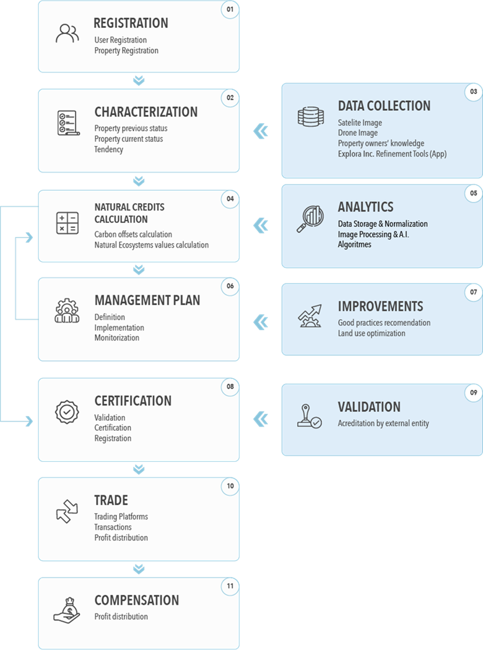
Workflow
Explora Inc. registered clients have access to:
  High resolution hyper-spectral satellite images that provide an array of useful data (plant typology, biomass, water, soil, health, areas)- They may also use drone-based data on these themes at selected resolutions
  An app to guide them to adopt best farming, conservation, restoration and carbon removal practices
  Management plans co-generated with top level consultants when needed
  Estimation of carbon removal offsets using AI based analytics for diferente land use types
  Quality verification of those offsets
  Sale and compensation associated to offsets
  Support for other Nature services markets as they reach maturity

Slide 9
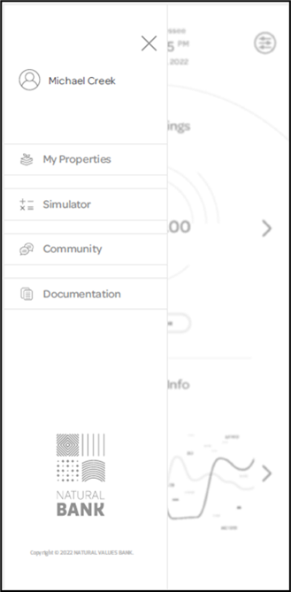
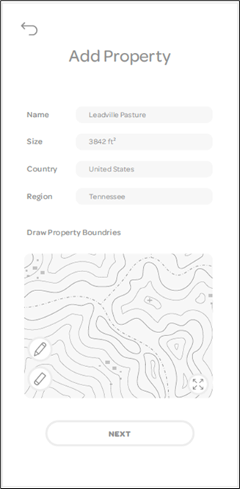
Solution
Explora Inc. clients will have access to an app connected to the platform where they can (1):
  Register their property
  Use satellite imagery analysis to estimate carbon retention in forests, grasslands and other agricultural uses
  Reduce uncertainty in those estimates by providing ground data using digital photography from smartphones. Drones may also be used for this purpose
  Run AI analytics to estimate carbon removal rates

Slide 10
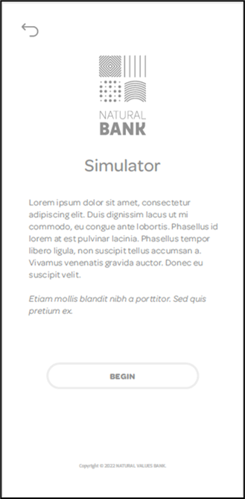
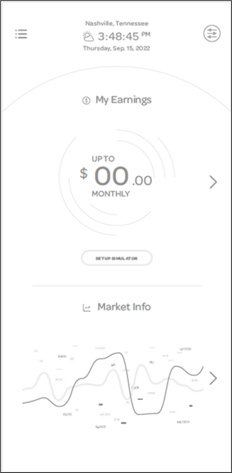
Solution
Explora Inc. clients will have access to an app connected to the platform where they can (2):
  Simulate the estimation of carbon credits earnings
  Simulate those earnings with improved farming, conservation and restoration practices
  Guidance to the adoption of those practices
  Guidance to the adoption of additional practices contributing to better overall operational results from regular business, carbon offsets and other Nature based services

Slide 11
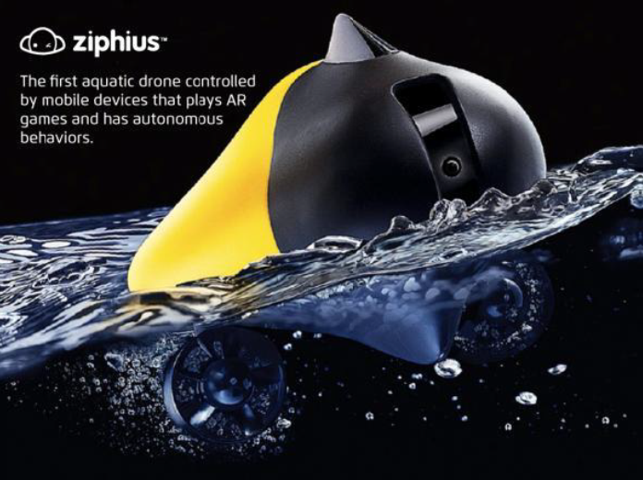
Solution
Explora Inc. will provide their clients with full support in (3):
  Qualifying their offsets
  Selling those offsets to companies or financial institutions, and in voluntary or regulated markets
This approach will be first developed for land clients. It will be adapted later to coastal and ocean entities, where imagery will be collected by drones and ground data will include DNA analysis of the plants’ carbon content

Slide 12
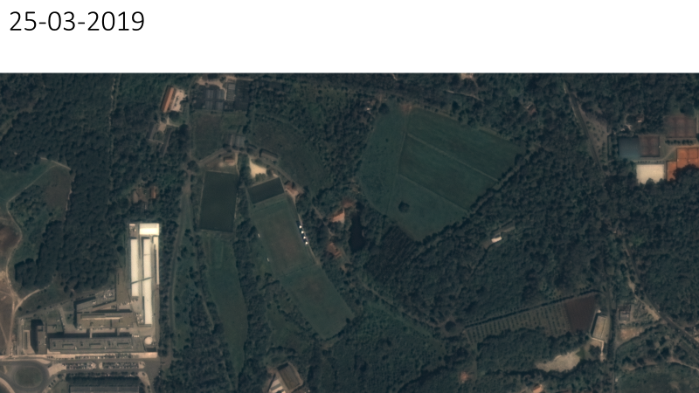
Primary Data Assets
Privileged access to on demand in near real time images from sub-metric very high -resolution satellite optical images and to a ten-year archive of more than 6 billion km2 of very high and medium resolution hyperspectral global images
Explora Inc. will develop a data infrastructure with the image used in carbon offsets and other Nature services estimation that will facilitate certification and sales of those offsets

Slide 13
Enablers: Registry and Certification
Voluntary Registry Offsets Database | Berkeley Carbon Trading Project
American Carbon Registry
Climate Action Reserve
Gold Standard Impact Registry
Verified Carbon Standard (Verra)
Climate, Community, & Biodiversity Standards (CCBS)
Plan Vivo
Social Carbon

Slide 14
Enablers: Buyers
Voluntary and regulated markets
Financial institutions: JP Morgan, Chase Manhattan Bank, Deutsche Bank, Bank of China

Slide 15
Explora Platform: Derivative Markets
Explora platform will enable the structured development of secondary assets of selected landscapes and locations for derivative markets including:
High quality photos, videos and 360º images that may used off site and in site using Augmented Reality
High quality 3D models draped with high quality/high resolution images that may be explored in Virtual Reality
Natural sounds in selected locations

Slide 16
Data Infrastructure for Derivative Markets
A spatial and time referenced Data Infrastructure for these assets will be developed
The Data Infrastructure will include analytical tools for ecosystem management purposes
It will also be connected to AI generative tools including text-image, text- video, text-3D and NERF creation

Slide 17
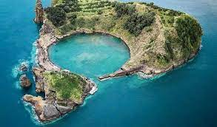
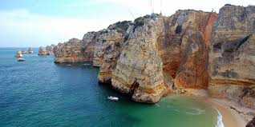
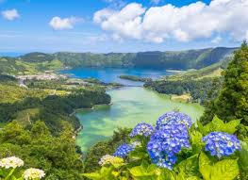
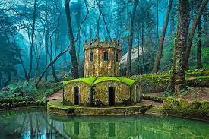
Data Infrastructure for Derivative Markets
Selected data assets may be minted to NFTs associated to smart contracts and may be sold in international exchanges
Use cases for ICNF’s NFTs may include:
  Memorable tickets for (celebrating) visits to selected locations
  Movie and gaming assets
  Content rights
  Tokenize real estate (that can be fractionalized and collaterized)
The Future of NFTS, by shivsak
https://entrepreneurshandbook.co/the-future-of-nfts-a-
visual-exploration-into-the-real-use-cases-948993f4c13a

Slide 18
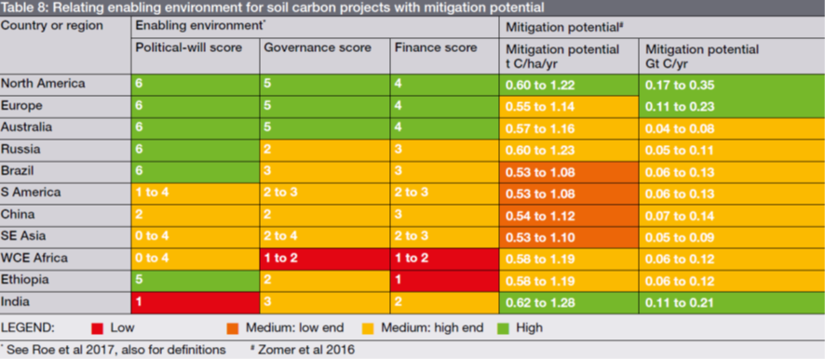
Soil carbon mitigation potential
Carbon Market Incentives to Conserve, Restore and Enhance Soil Carbon, Moritz von Unger and Igino Emmer, 2018 https://www.nature.org/en-us/what-we-do/our-insights/perspectives/carbon-market-incentives-to-conserve-restore-enhance-soil-carbon/

Slide 19
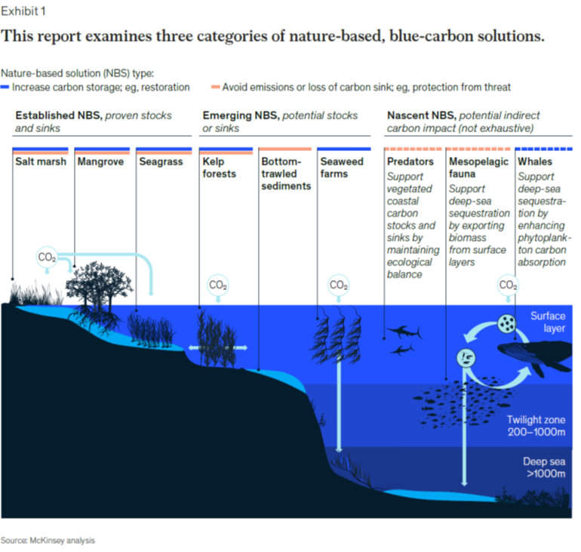
Blue carbon
Blue carbon: The potential of coastal and oceanic climate action, by Julien Claes, Duko Hopman, Gualtiero Jaeger, and Matt Rogers, 2022
https://www.mckinsey.com/capabilities/sustainability/our-insights/blue-carbon-the-potential-of-coastal-and-oceanic-climate-action

Slide 20
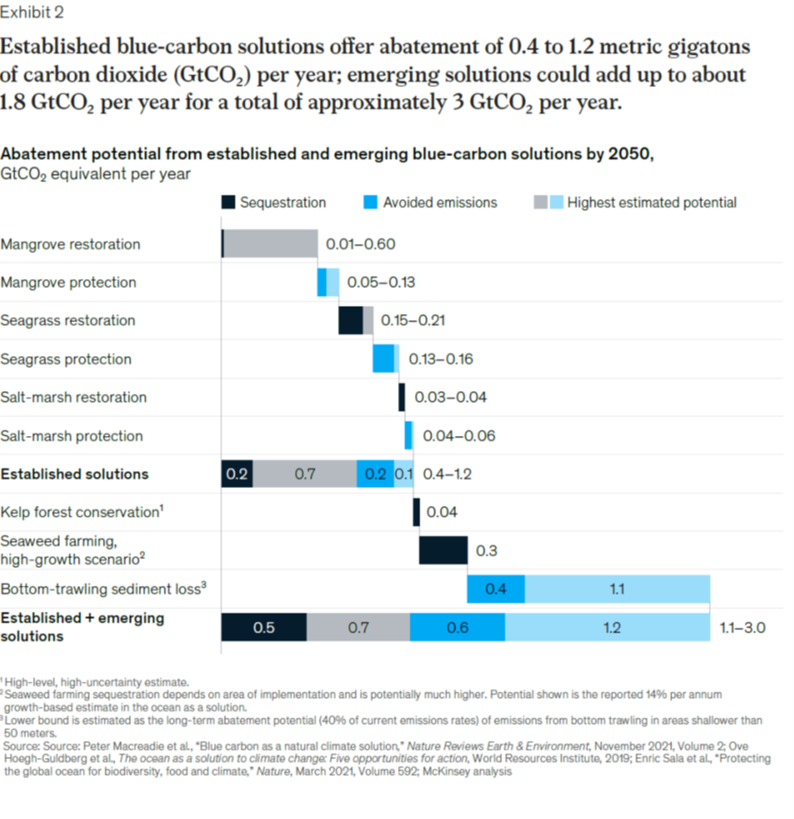

Slide 21
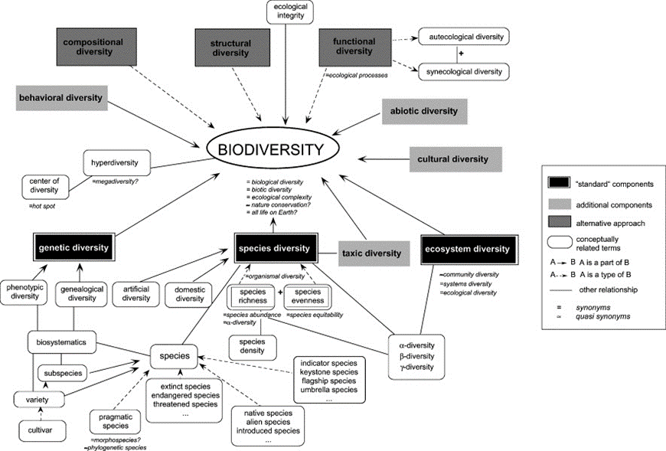
Biodiversity
P. Duelli, M.K. Obrist / Agriculture, Ecosystems and Environment 98 (2003) 87–98

Slide 22
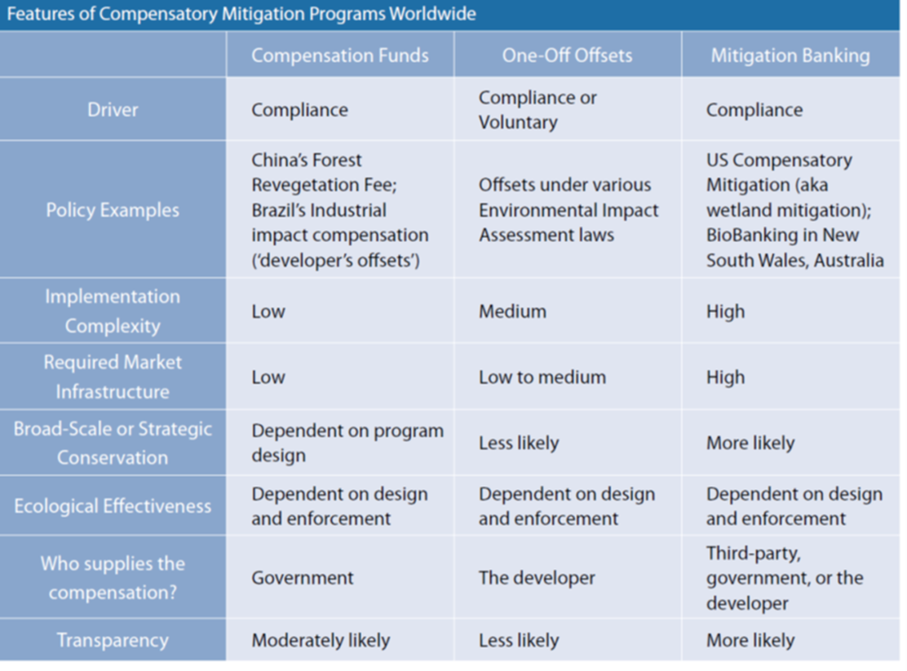
State of Biodiversity Markets Report: Offset and Compensation Programs Worldwide, 2010. Becca Madsen et al. http://www.ecosystemmarketplace.com/documents/acrobat/sbdmr.pdf

Slide 23
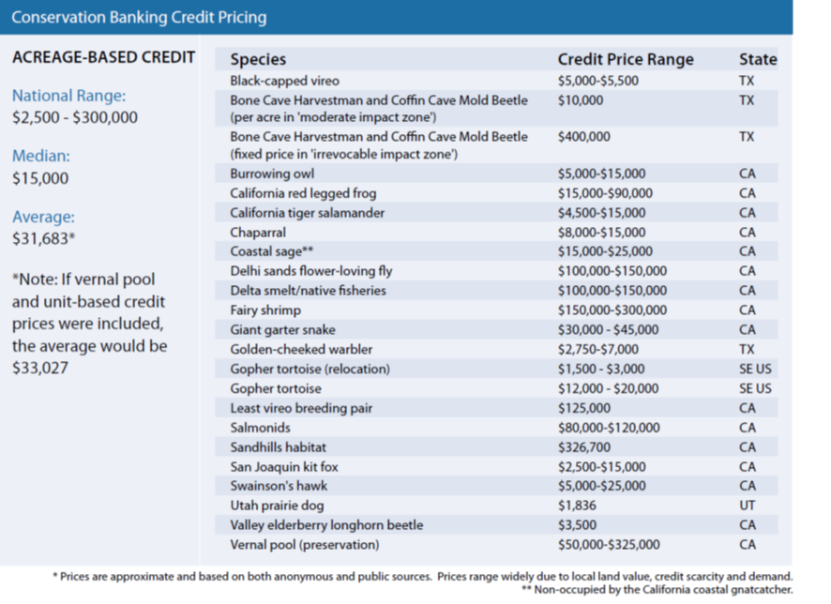
State of Biodiversity Markets Report: Offset and Compensation Programs Worldwide, 2010. Becca Madsen et al. http://www.ecosystemmarketplace.com/documents/acrobat/sbdmr.pdf

Slide 24
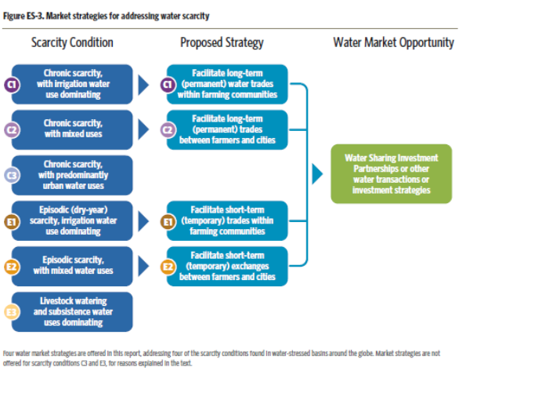
Water
Water Share, Using water markets and impact investment to drive sustainability, Brian Richter et al, 2016 https://www.nature.org/content/dam/tnc/nature/en/documents/WaterShareReport.pdf

Slide 25
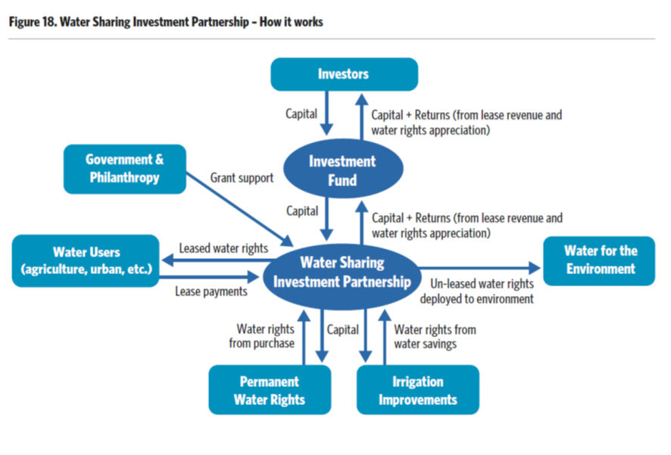
Water Share, Using water markets and impact investment to drive sustainability, Brian Richter et al, 2016 https://www.nature.org/content/dam/tnc/nature/en/documents/WaterShareReport.pdf

Slide 26
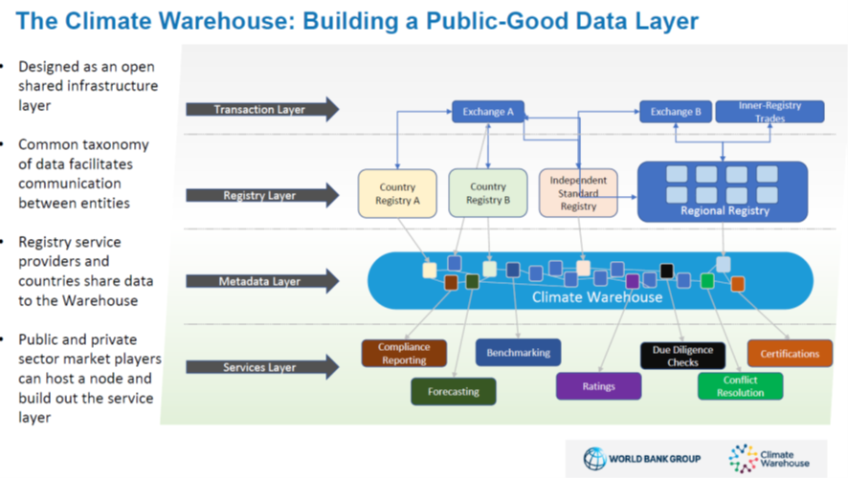
Inspirations for an Internet of Nature Architecture (1)

Slide 27
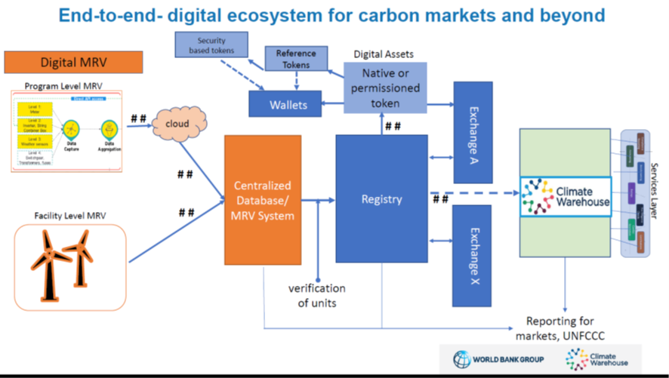
Inspirations for an Internet of Nature Architecture (2)

