Slide 1
Idea Generation and Generative AI
Antonio Camara
October, 2023

Slide 2
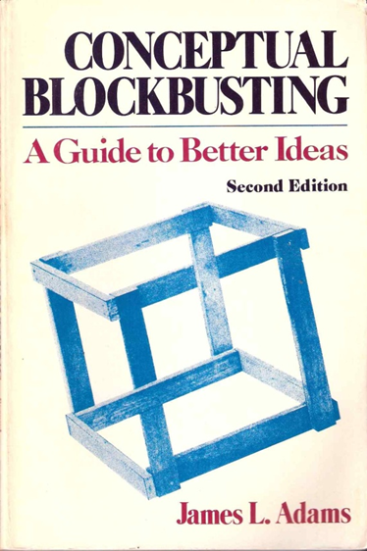
Generation of ideas
07
  Conceptual blockbusting
    Emotional
    Cultural
    Environmental
    Intellectual
http://courses.washington.edu/art166sp/documents/Spring2012/readings/week_3/2_ConceptualBlockbusting.pdf

Slide 3
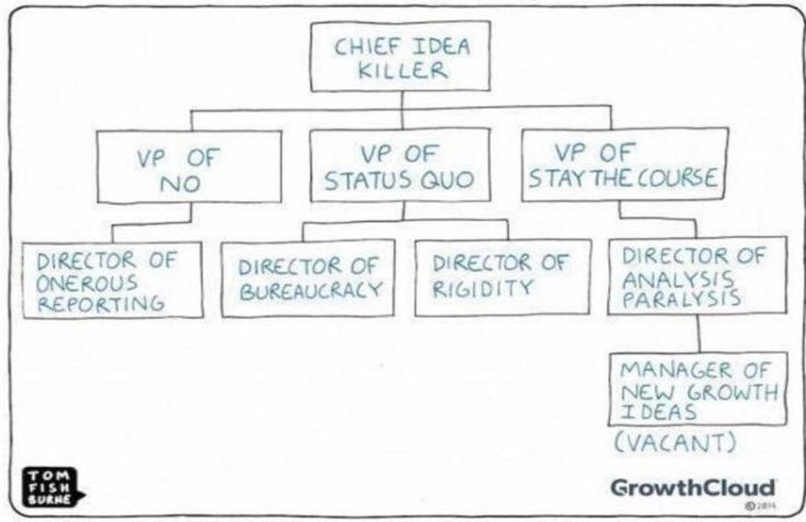
Generation of ideas
08
  “Where is the Pain School”
https://www.shopify.com/guides/what-to-sell/where-to-look-for-product-ideas
How to get Startup Ideas – Paul Graham
Peter Thiel’s CS183: Startup – Class 1 Notes Essay
When Ideas Have Sex
Startup Playbook

Slide 4
Generation of ideas
Collective intelligence
09
Open Source” (“hardware” e “software”)
https://opensource.org/
http://openmaterials.org/
http://opensourceecology.org/
“Crowdsourcing”
http://www.visualcapitalist.com/gig-economy-explained/
Role of groups
“Brainstorming" and Delphi method

Slide 5
Idea selection
11
“When you have an idea for a product, ask yourself: who will need it right away? Who needs so much will use even when it comes to a version made by two people of a "startup" who have never heard of. If you can't answer this, it's probably a bad idea."
Paul Graham
http://paulgraham.com/

Slide 6
Tri-dimensional analysis
15
What can you do?
What do you want to do?
Who pays?

Slide 7
Competitors
17
Generic analysis
Google www.google.com
“Startups” and products
Kickstarter/Indiegogo www.kickstarter.com, www.indiegogo.com
  Crunch Base www.crunchbase.com
  Angel List https://angel.co/
Intellectual property
Google Scholar (“prior art”) https://scholar.google.pt/
  Google Patents https://patents.google.com/

Slide 8
23
Generative AI
How to use AI to do practical stuff: A new guide, by Ethan Mollick
20 ChatGPT prompts that'll help you leverage business frameworks, by Moritz Kremb

Slide 9
Inteligência Artificial Generativa
24
:
  Generative AI explained by AI
  Generative AI: everything you need to know
  AiFindy- the catalog of generative AI applications

Slide 10
Inteligência Artificial Generativa
24
  Talking About Large Language Models
  Generative AI for Makers: AI Has Truly Arrived — and It’s Here to Help You Make and Craft

Slide 11
Tools
ChatGPT
Microsoft Designer

Slide 12
Interactive introductions
Visual Introduction to Machine Learning
Generative AI: What you Need to Know

Slide 13
Recommended readings
Conceptual Blockbusting, James Adams
Generative AI for Makers: AI Has Truly Arrived — and It’s Here to Help You Make and Craft, Stefania Druga e Keith Hammond
Generative AI: A Creative New World, Sequoia
How To Evaluate Startup Ideas, Kevin Hales

Slide 14
Recommended readings
https://a16z.com/2023/05/25/ai-canon/

