Slide 1
https://makezine.com/article/craft/fine-art/generative-ai-for-makers-ai-has-truly-arrived-and-its-here-to-help-you-make-and-craft/
https://www.sequoiacap.com/article/generative-ai-a-creative-new-world/
https://unchartedterritories.tomaspueyo.com/p/generative-ai-what-companies-will
https://www.fastcompany.com/90834337/generative-ai-powerpoint-decks
https://www.mckinsey.com/featured-insights/mckinsey-explainers/what-is-generative-ai
https://www.visualcapitalist.com/generative-ai-explained-by-ai/
https://aifindy.com/

Slide 2
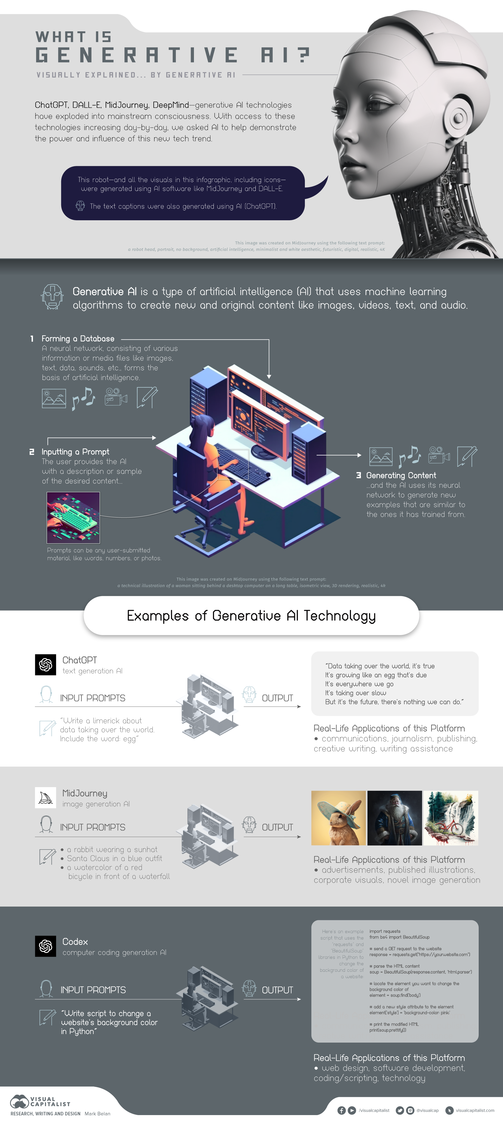

Slide 3
https://ramsrigoutham.medium.com/the-landscape-of-generative-ai-landscape-reports-615a417b15d
https://unchartedterritories.tomaspueyo.com/p/generative-ai-everything-you-need

Slide 4
https://youtu.be/5dvxY6vXHsA
https://youtu.be/z82TJxsfH9A
https://youtu.be/OuGfG48kA30

Slide 5
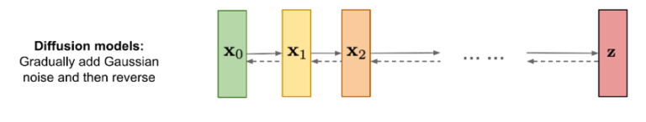
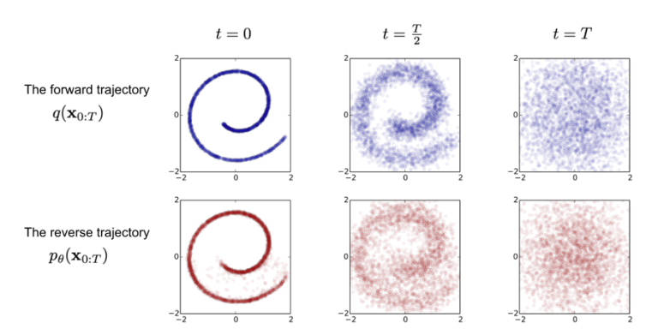

Slide 6
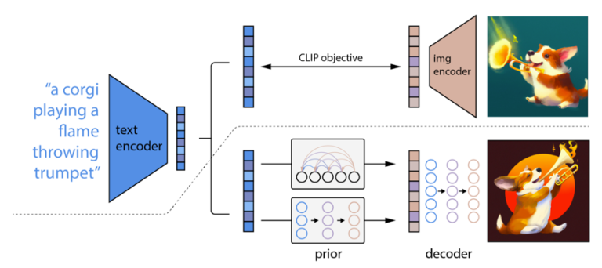

Slide 7
What Can I Make With Generative AI?
You can use generative AI to create images, text, music, games, avatars, UIs, videos, and even 3D models. Here are just a few platforms that have gained popularity:
IMAGES: DALL·E 2, Midjourney, Stability AI
TEXT: GPT-3 Playground, Jasper, Google’s AI Test Kitchen, Chat-GPT
VIDEO: Meta’s Make-A-Video, Google’s Imagen Video
MUSIC: Harmonai, Sony Flow Machines
AVATARS: Character.AI, Lensa
USER INTERFACES (UI): Figma plugins for Stable Diffusion
VIDEO GAMES: NVIDIA’s DLSS (Deep Learning Super Sampling)
VARIOUS DEMOS AND APPLICATIONS: Hugging Face Spaces

Slide 8
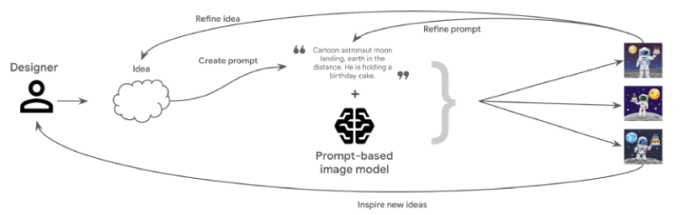

Slide 9
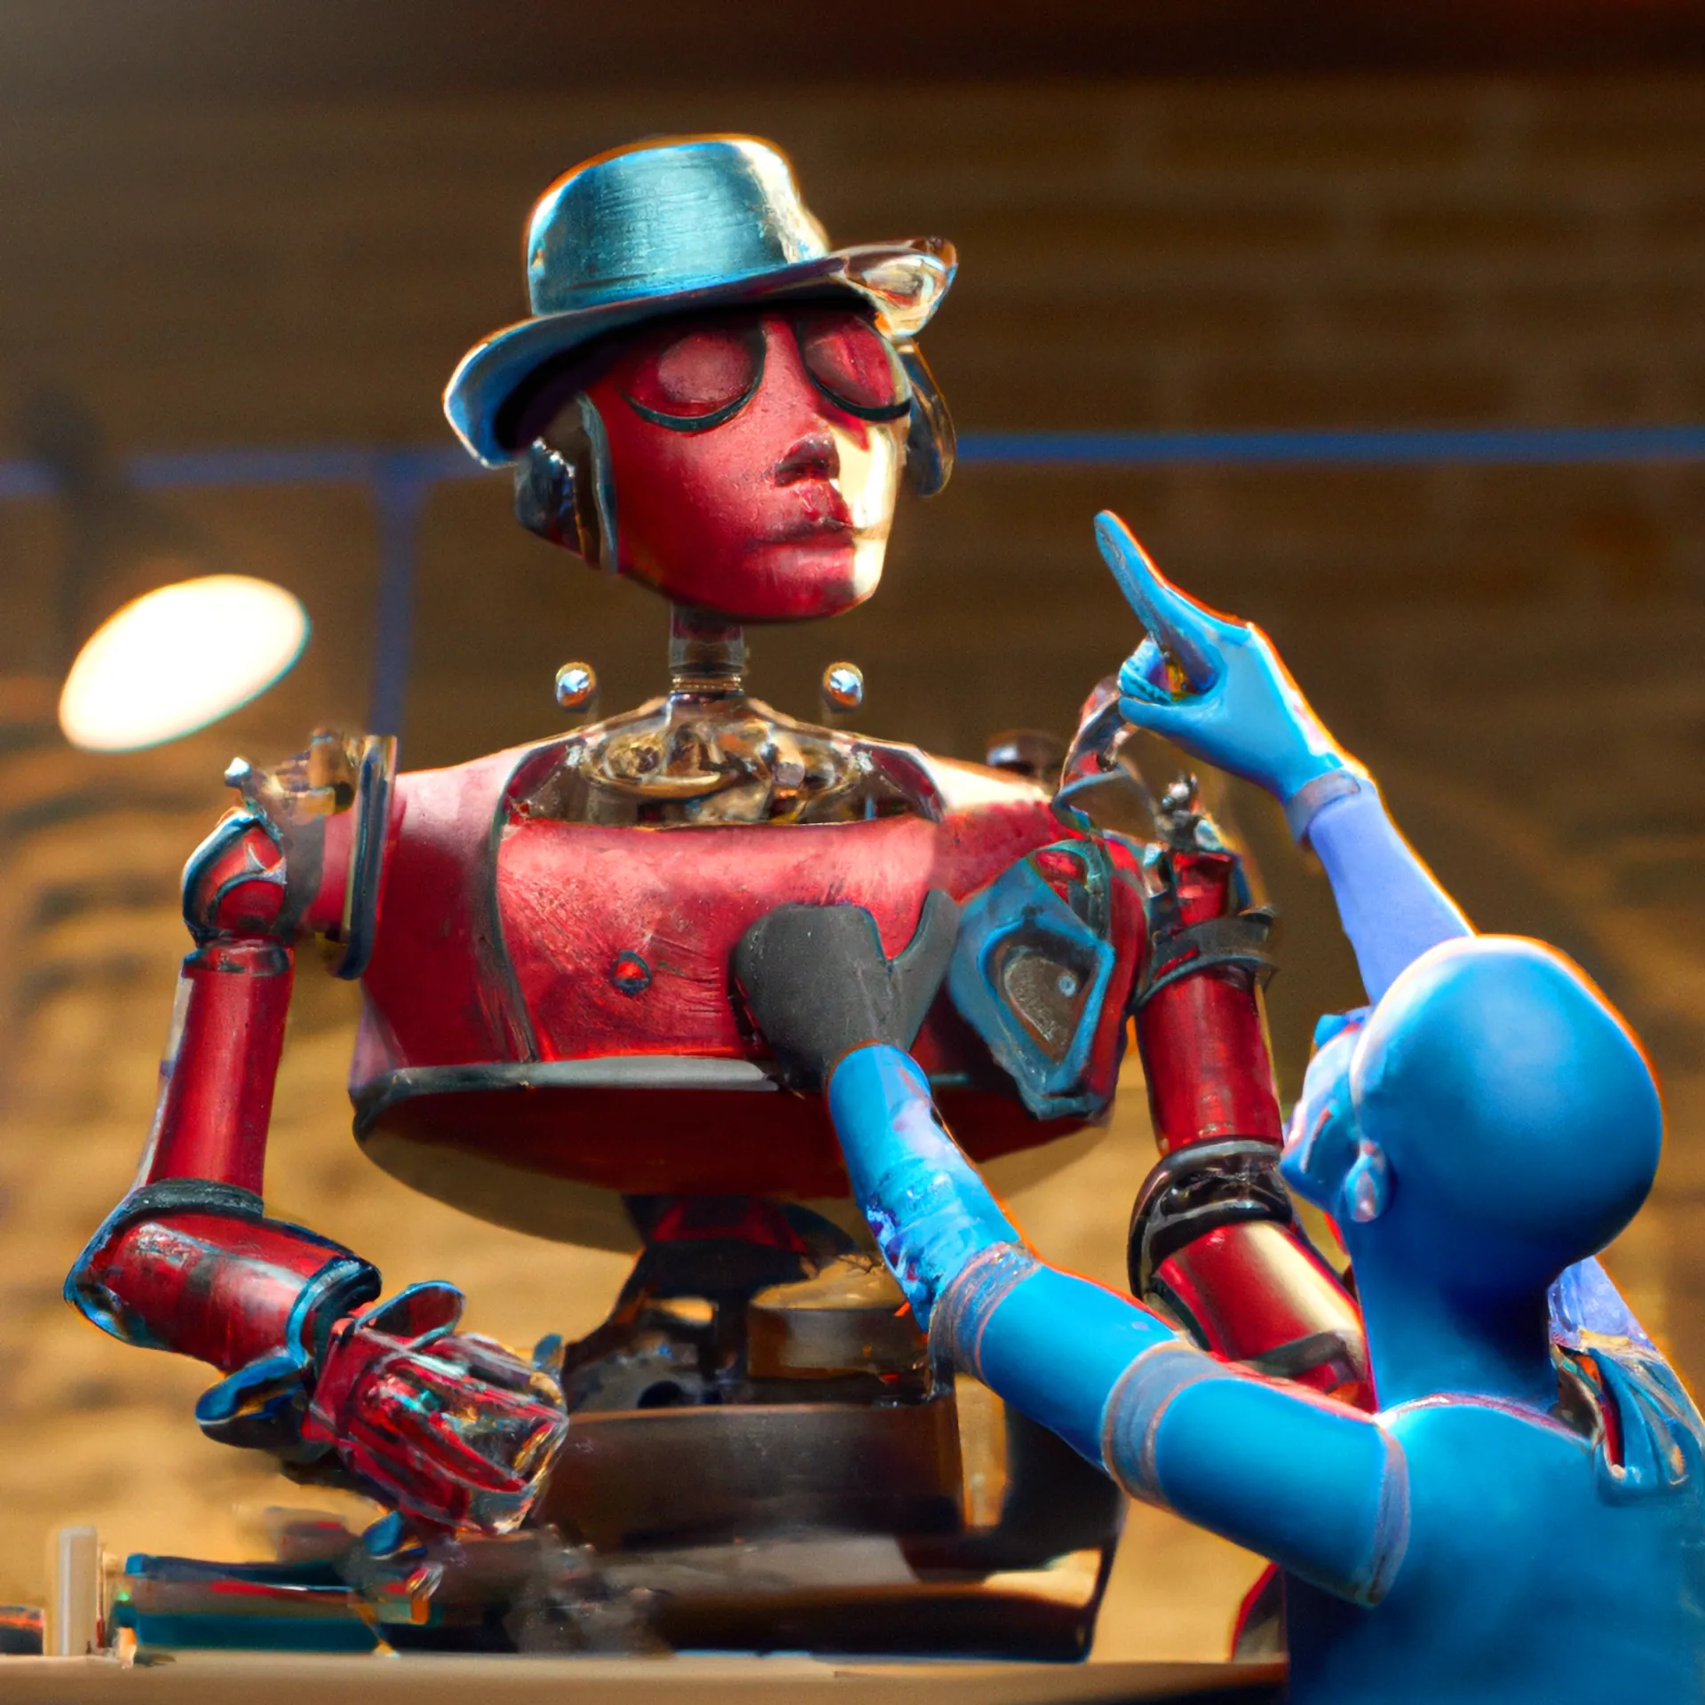

Slide 10
Created in DALL•E 2 to prove a point. Prompt: “A red robot making a blue robot. Insanely high quality, insanely intricate detail, studio photo, masterpiece, sharp focus, 8k artistic photography, ominous matte painting, dramatic studio lighting, trending on cgsociety, vibrant, epic, intricate, trending on artstation, volumetric cinematic perfect lighting.”

Slide 11
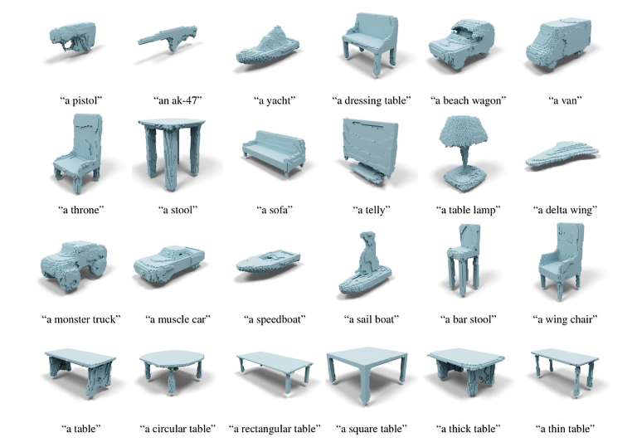

Slide 12
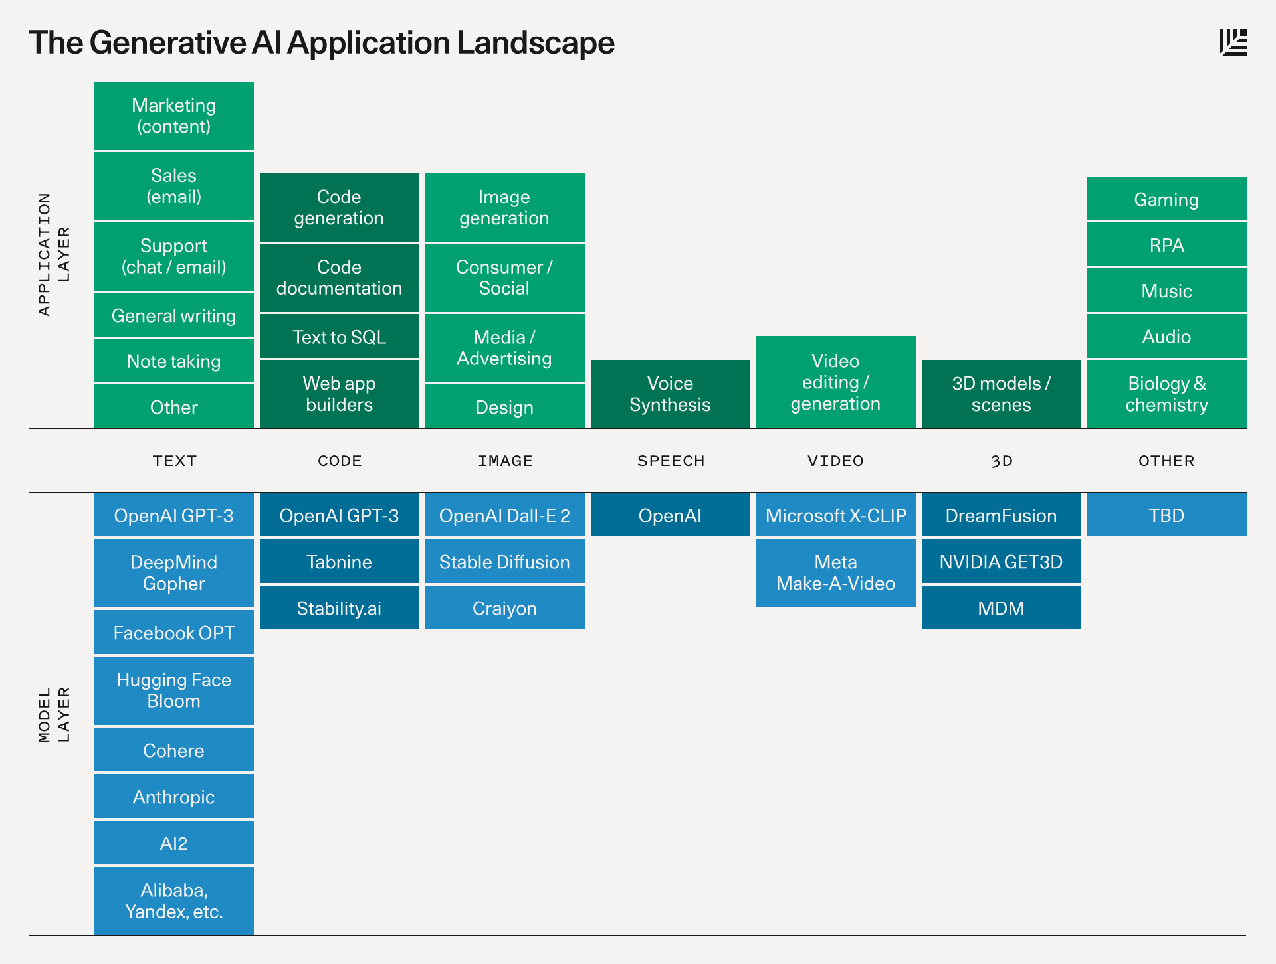

Slide 13
