Slide 1
Idea development and first prototype
ADAm 2023
António Câmara
November 2023

Slide 2
Mind mapping
Download and use https://xmind.app/
For further development in Creative Project I, you may use https://www.canva.com/
See Kruka

Slide 3

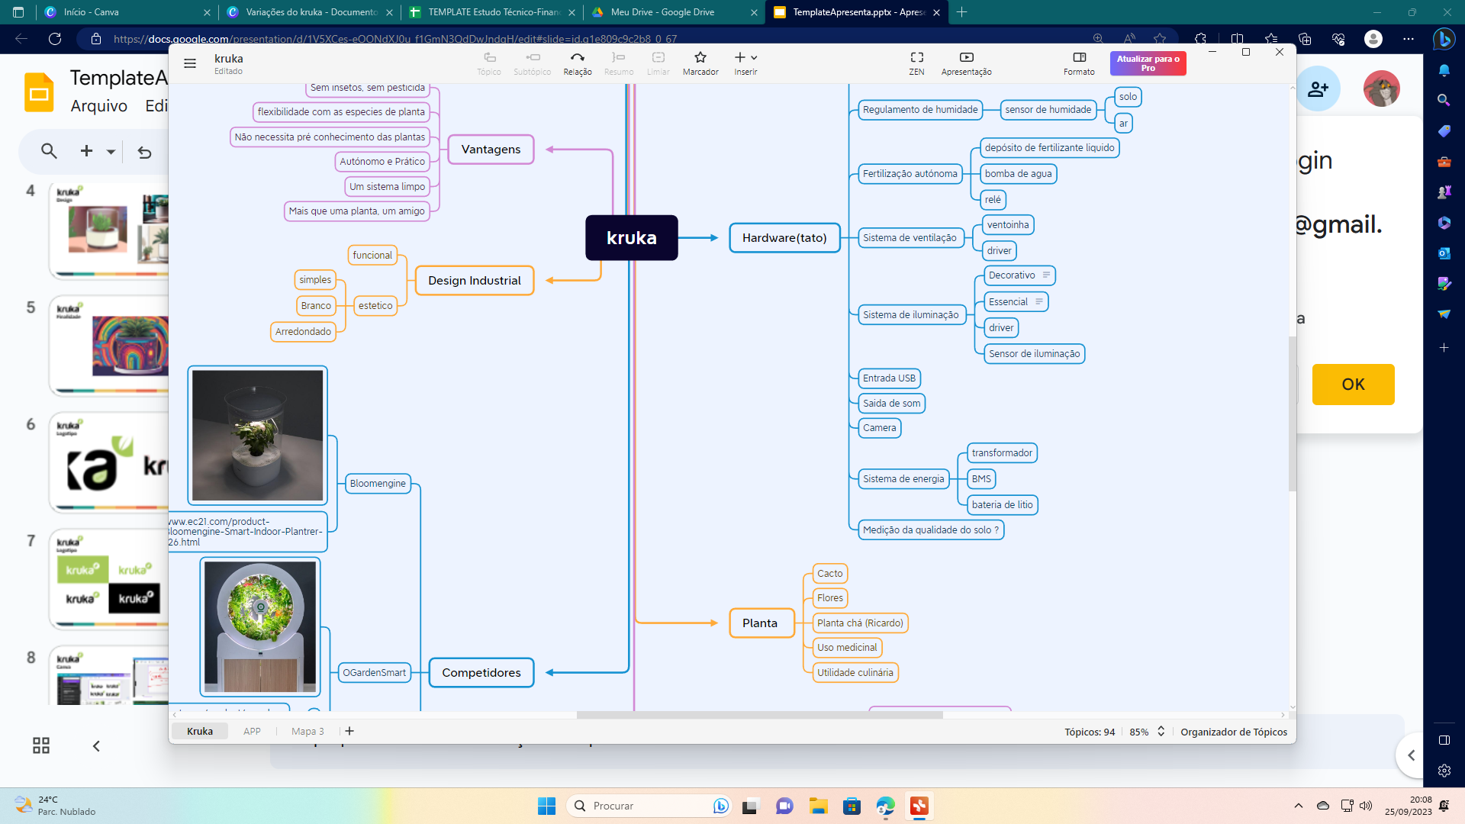
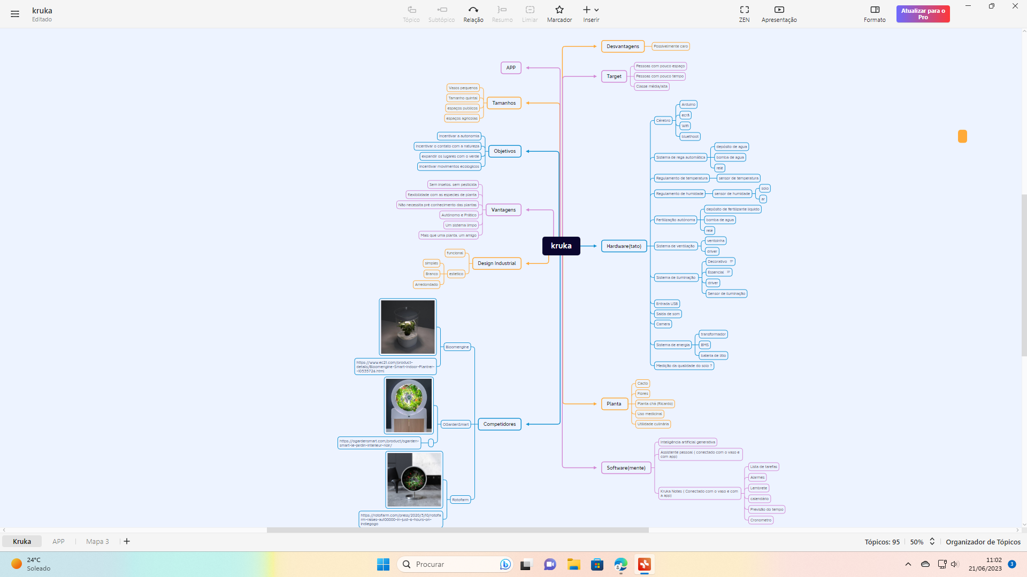
Criatividade

Slide 4
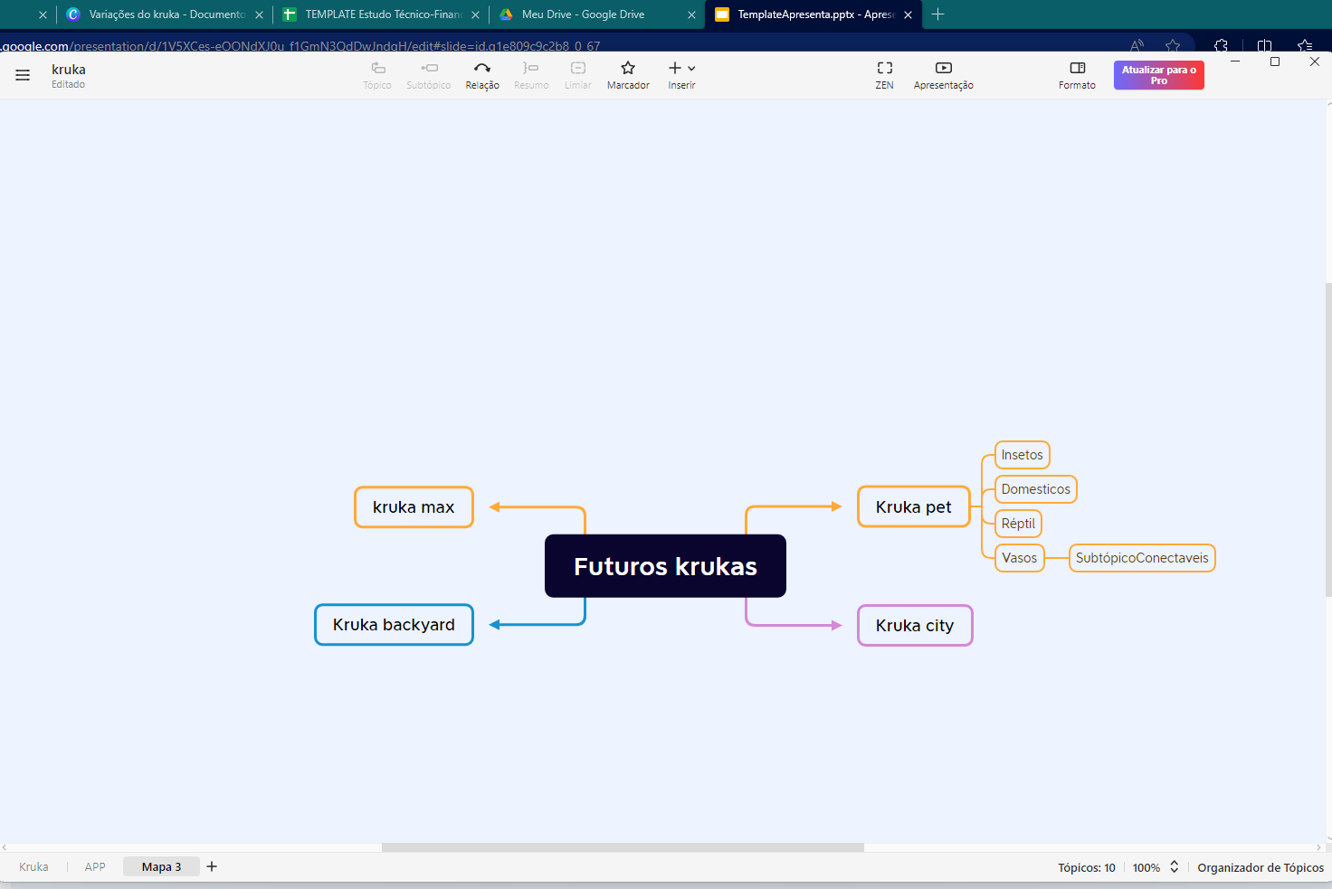
Criatividade

Slide 5
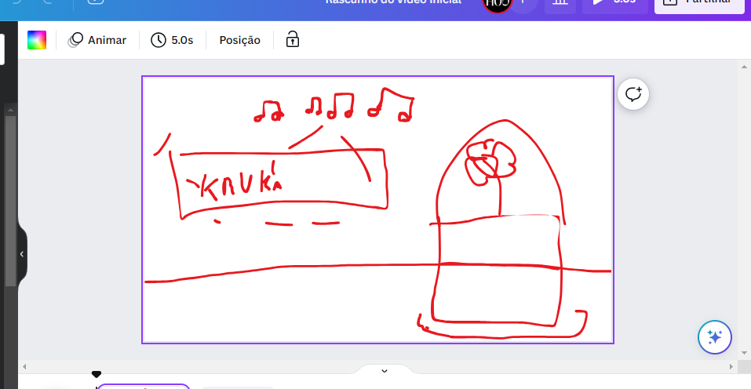
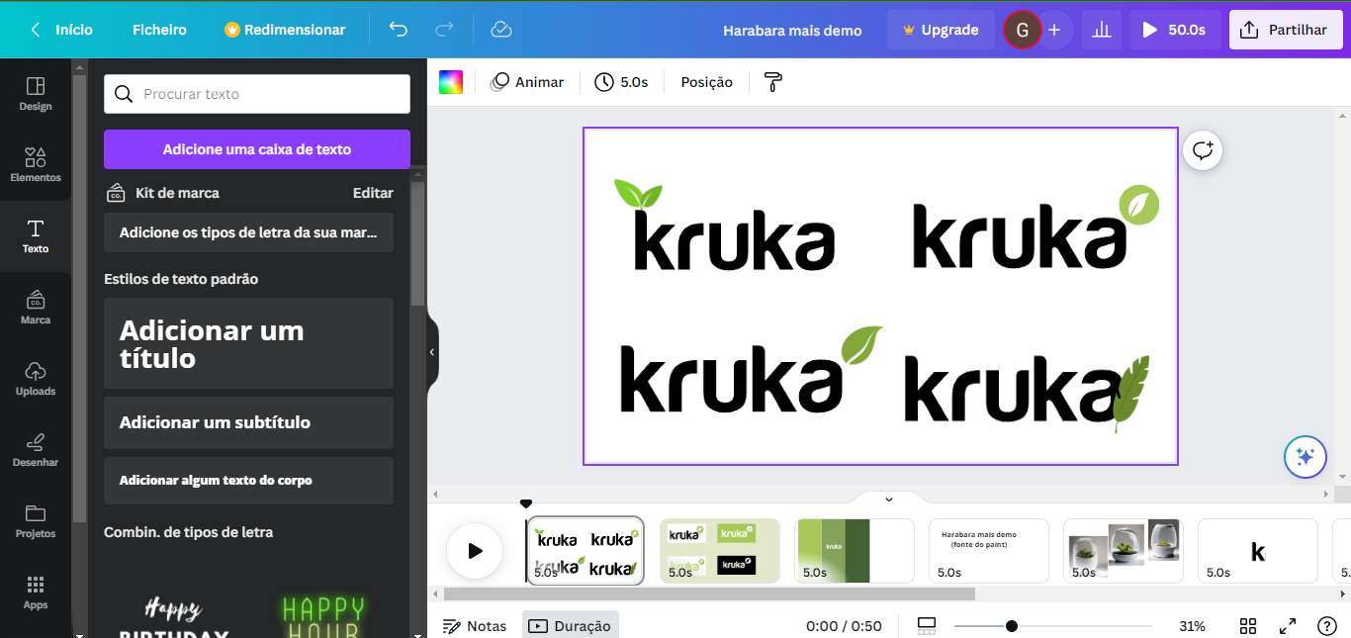
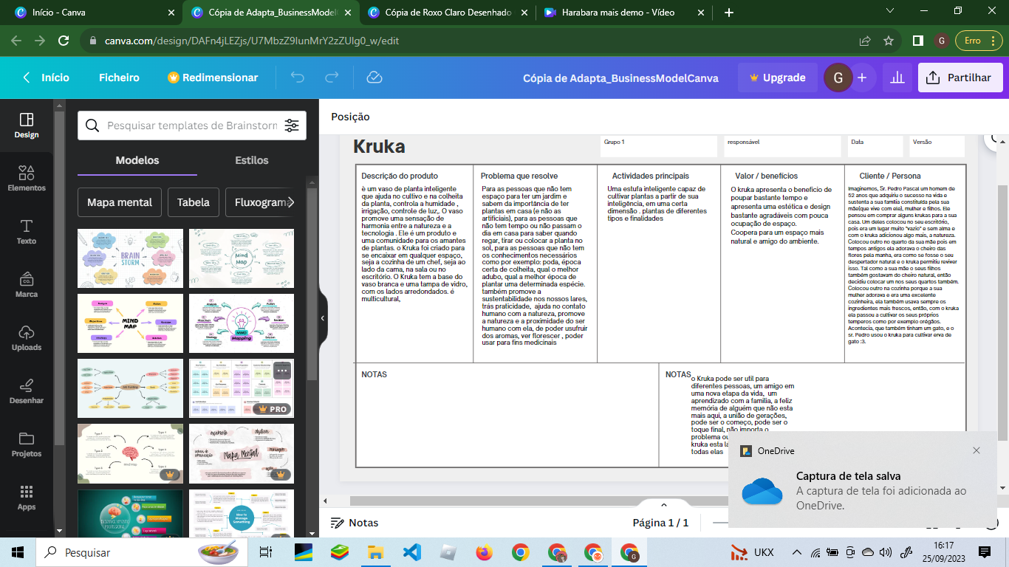
Canva

Slide 6
Develop first prototype
https://www.figma.com/education/
https://help.figma.com/hc/en-us/articles/360040314193-Guide-to-prototyping-in-Figma

Slide 7


Slide 8
https://xmind.app/

