Slide 1
Machine learning an introduction
Antonio Camara
November 2023

Slide 2


Slide 3


Slide 4
The fundamentals
y = mx + b
predicts some value of y given values of x
Predictive models are not always 100% correct. The measure of how incorrect it is the loss
The goal of machine learning it to take a training set to minimize the loss function
For example, suppose m = 2, x = 3, and b = 2. Then our predicted value of y = 2 * 3 + 2 = 8. But our actual observed value is 10. The loss is 10 – 8 = 2.
Michael Nielsen, http://neuralnetworksanddeeplearning.com/

Slide 5
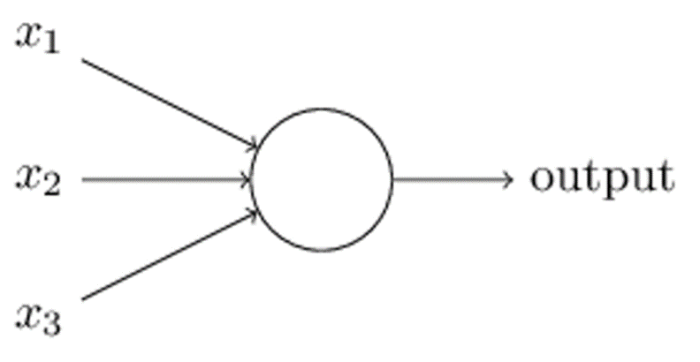
The fundamentals
In a neural network, we have the same basic principle, except the inputs are binary and the outputs are binary. The objects that do the calculations are perceptrons.
They adjust themselves to minimize the loss function until the model is very accurate
All of these inputs (x1, x2, x3) are fed into a perceptron. That then makes a yes or no decision and passes it onto the next perceptron for the next decision. This process repeats until the final perceptron. At which point we know what the handwriting is or whose face we are looking at.
Michael Nielsen, http://neuralnetworksanddeeplearning.com/

Slide 6
Machine learning and NOVA environmental engineering students
  Input
    Environmental Enginnering students 1982-2019
  Output
    Success (conventional, craftsmanship, societal) 1982-2019
  Hidden nodes
    Accounting for F in Output= F (Input)

Slide 7
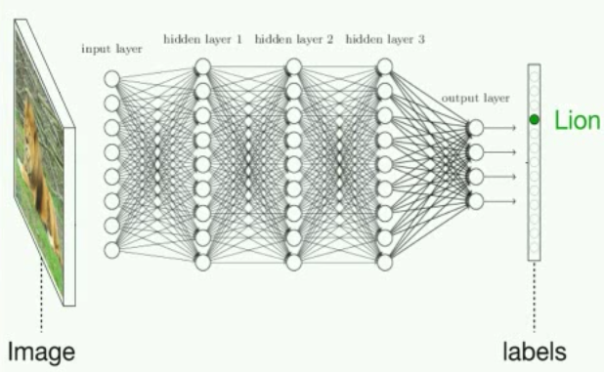
Neural networks

Slide 8
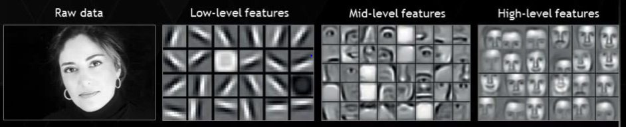
Neural networks

Slide 9
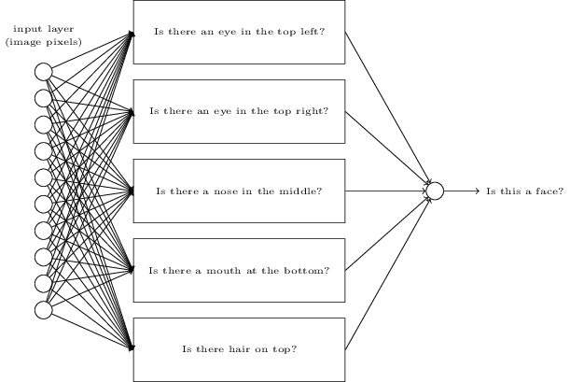
Neural networks

Slide 10
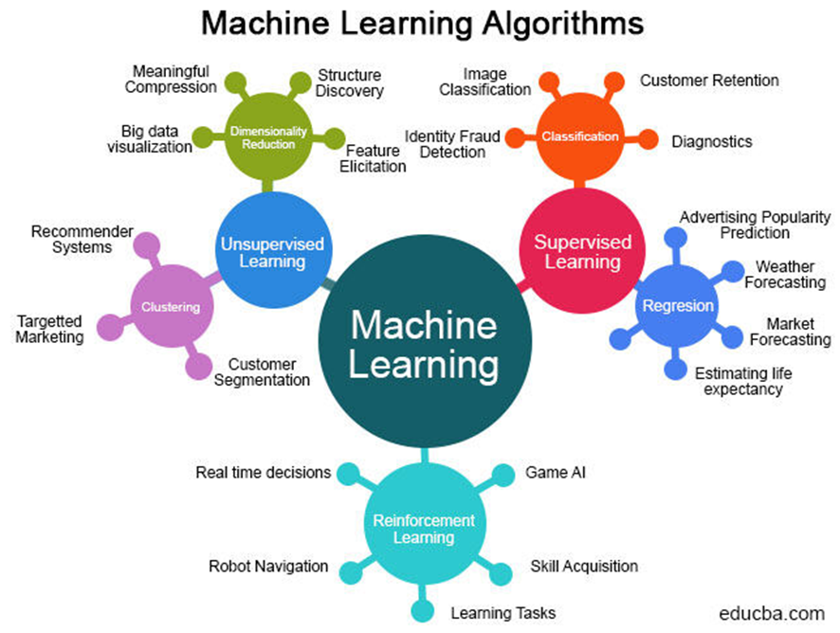

Slide 11
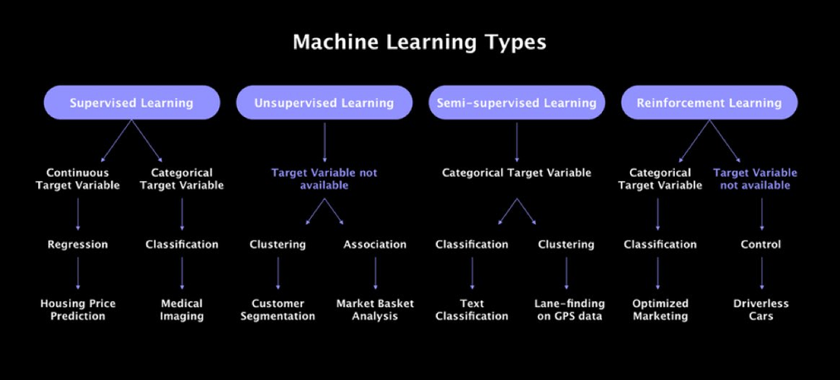

Slide 12
Explore Machine Learning fundamentals
Machine learning at Stanford- cheat sheet
One stop shop for educational resources
JP Morgan’s Machine Learning Guide

Slide 13
Useful links
Which machine learning algorithm?
Machine learning for humans
A neural network playground

Slide 14
Environmental applications
A learning surrogate LCA model for integrated product design. a pioneer example of machine learning as applied to ecological design by Inês Sousa, a former Environmental Engineering student at NOVA, when she was at MIT. She is now a senior environmental manager at Google
Intelligent Waste Sorting Using Deep Neural Networks
AI and environmental modelling
Tensor Flow and air quality
Tensor Flow and water quality

Slide 15
Environmental applications
Tackling Air Pollution with Urban AI
Machine learning and SNIRH
Machine learning and traffic forecast
Study on pollutant emissions of mixed traffic flow in cellular automaton
Collective Intelligence for Deep Learning: A Survey of Recent Developments

Slide 16
A review of interactive sites on machine learning
https://medium.com/@dreamferus/18-interactive-machine-learning-and-data-science-websites-faf52eea8181
See http://www.r2d3.us/visual-intro-to-machine-learning-part-1/ in detail

