Slide 1
Projetos ADAm 2023
2023
https://myexplora.live/2023/11/02/adam-2023/

Slide 2
Desenvolvimento inicial dos projetos- ideias, protótipo e video
Mapeando as ideias
  https://xmind.app/
O primeiro protótipo
  https://www.figma.com/education/
  https://help.figma.com/hc/en-us/articles/360040314193-Guide-to-prototyping-in-Figma
O primeiro video
  Usar Chat GPT, Bing AI ou equivalente no script
  https://www.canva.com/pt_pt/criar/videos/
  https://leonardo.ai (usar versão gratuita)
  https://app.runwayml.com/signup (usar versão gratuita)

Slide 3
Desenvolvimento inicial dos projetos (slide deck ou video)
  Apresentação do problema e sua relevância (usar MindMap para ilustração)
  Apresentação da solução proposta (usar Figma para ilustração)
  Breve análise da competição
  Próximos passos

Slide 4
Dimensão do problema e análise de competidores
17
Análise genérica
Google www.google.com
“Startups” e produtos financiados
Kickstarter/Indiegogo www.kickstarter.com, www.indiegogo.com
  Crunch Base www.crunchbase.com
  Angel List https://angel.co/
Propriedade intelectual existente
Google Scholar (“prior art”) https://scholar.google.pt/
  Google Patents https://patents.google.com/

Slide 5
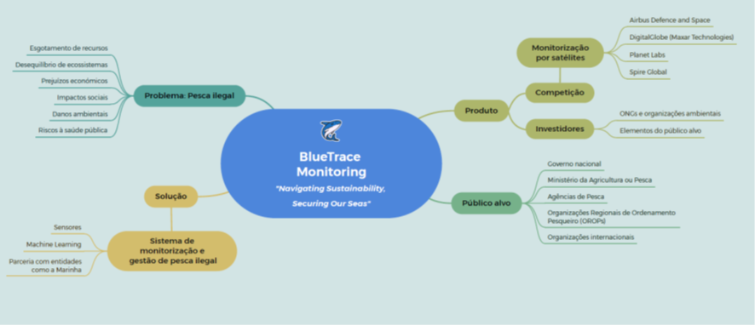
Blue Trace Monitoring (1)

Slide 6
Blue Trace Monitoring (2)
Relevância do problema
  https://worldoceanreview.com/en/wor-2/fisheries/illegal-fishing/
Soluções
  https://www.nature.com/articles/s41559-018-0499-1
  https://earth.org/solutions-to-overfishing/
Videos
  https://www.youtube.com/watch?v=9brmv0fgeoo

Slide 7
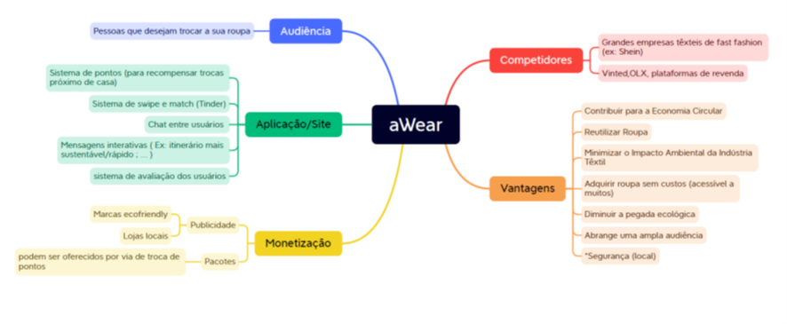
AWear (1)

Slide 8
AWear (2)
Relevância do problema
  https://www.roadrunnerwm.com/blog/textile-waste-environmental-crisis
Soluções
  https://enbrogue.com/2019/07/16/how-to-loan-your-wardrobe/
  https://begyourpardon.com.au/pages/rules-for-borrowing-clothing
  https://www.microsoft.com/en-us/research/wp-content/uploads/2013/01/azevedo-leshno-supply-and-demand-matching.pdf
Videos
  https://youtu.be/Quw9I40xNVE?si=xkJuoq03bk33TApf

Slide 9
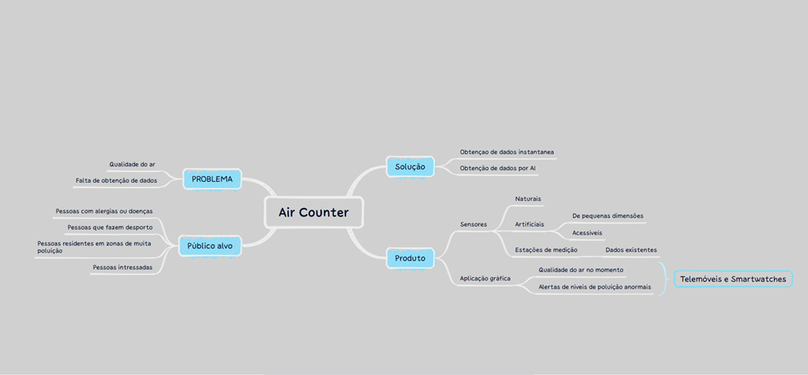
Air Counter (1)

Slide 10
Air Counter (2)
Relevância do problema
  https://www.nature.com/articles/s41598-020-74524-9
Soluções
  https://i-blades.com/pages/portable-air-quality-monitor-technology#:~:text=The%20i%2DBLADES%20Smartcase%20turns,and%20live%20a%20healthier%20lifestyle
  https://www.ncbi.nlm.nih.gov/pmc/articles/PMC10238623/
Videos
  https://www.youtube.com/watch?v=ucivtO4qNtU
  https://breathesafeair.com/best-aqi-apps/

Slide 11
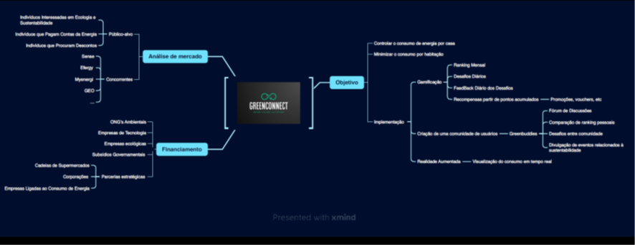
Green Connect (1)
Discutir com MyGreen Home o foco do projeto

Slide 12
Green Connect (2)
Relevância do problema
  https://www.greenmatch.co.uk/blog/2020/03/how-to-save-energy-at-home
Soluções
  https://www.hippo.com/blog/electricity-apps-to-save-money
  https://www.housebeautiful.com/uk/renovate/finance/a32218045/utility-bill-apps/
  https://energysavingtrust.org.uk/advice/saving-water-at-home/
Videos
  https://www.energy.gov/articles/future-home-tech-8-energy-saving-solutions-horizon

Slide 13
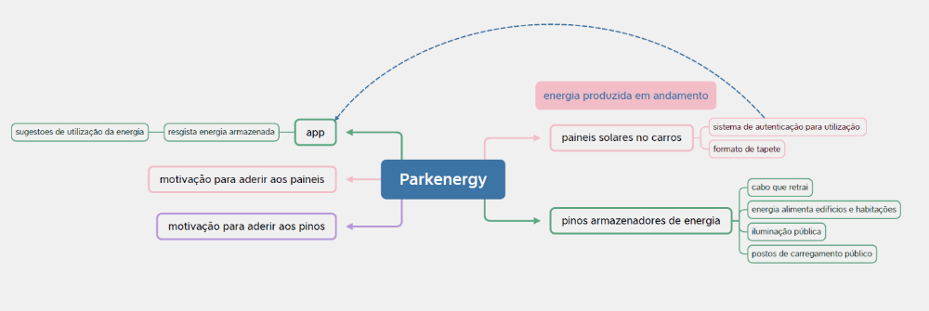
Parkenergy (1)

Slide 14
Parkenergy (2)
Relevância do problema
  https://en.wikipedia.org/wiki/Solar_car
Soluções
  https://www.dbusiness.com/daily-news/new-solar-vehicle-wrap-that-powers-batteries-will-debut-at-smart-automotive-surfaces-show-in-novi/
  https://www.forbes.com/sites/scottsnowden/2020/07/22/thin-film-solar-car-cover-can-recharge-your-electric-car-while-its-parked/
  https://observer.com/2022/07/sono-motors-unveil-solar-electric-vehicle-sion/
Videos
  https://youtu.be/jhguH8Z2Dlw?si=_wkSeBhi9nwvABBP

Slide 15
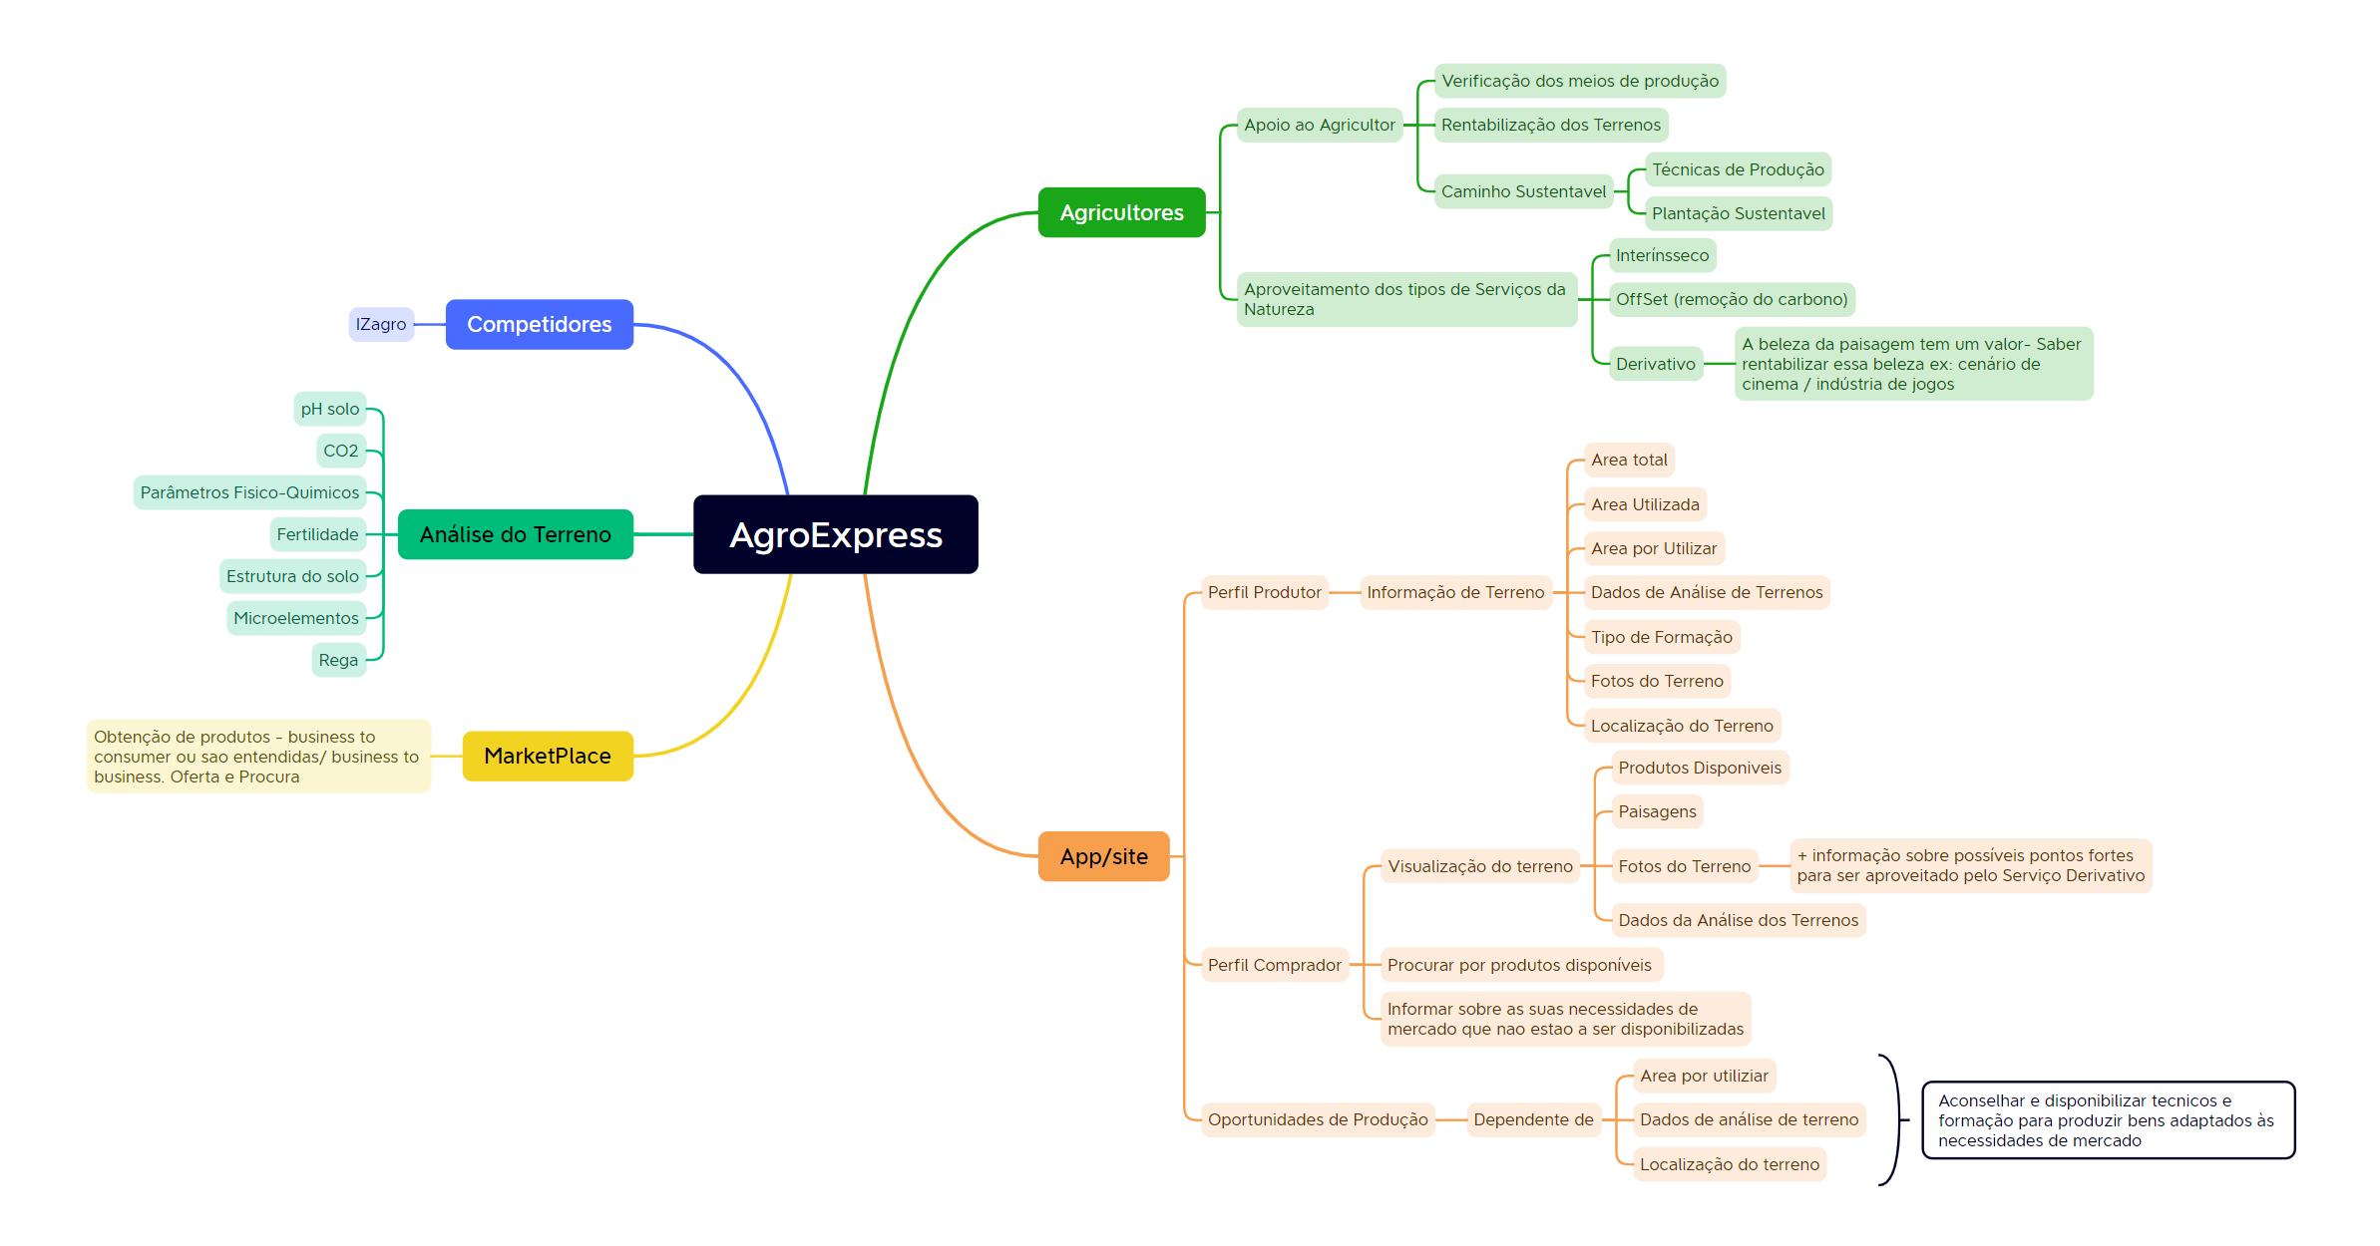
AgroExpress (1)

Slide 16
Agro Express (2)
Relevância do problema
  https://www.globalcitizen.org/en/content/why-smallholder-farmers-need-funding/
Soluções
  Land Suitability Analysis to Assess the Potential of Public Open Spaces for Urban Agriculture Activities
  Assessment of land suitability potentials for agriculture using a remote sensing and GIS based approach
  Agricultural land suitability analysis: State-of-the-art and outlooks for integration of climate change analysis
  https://arcadier.medium.com/the-next-ecommerce-revolution-agribusiness-marketplaces-ed875245431a
Videos
  https://www.youtube.com/watch?v=hYxBe84D-34

Slide 17
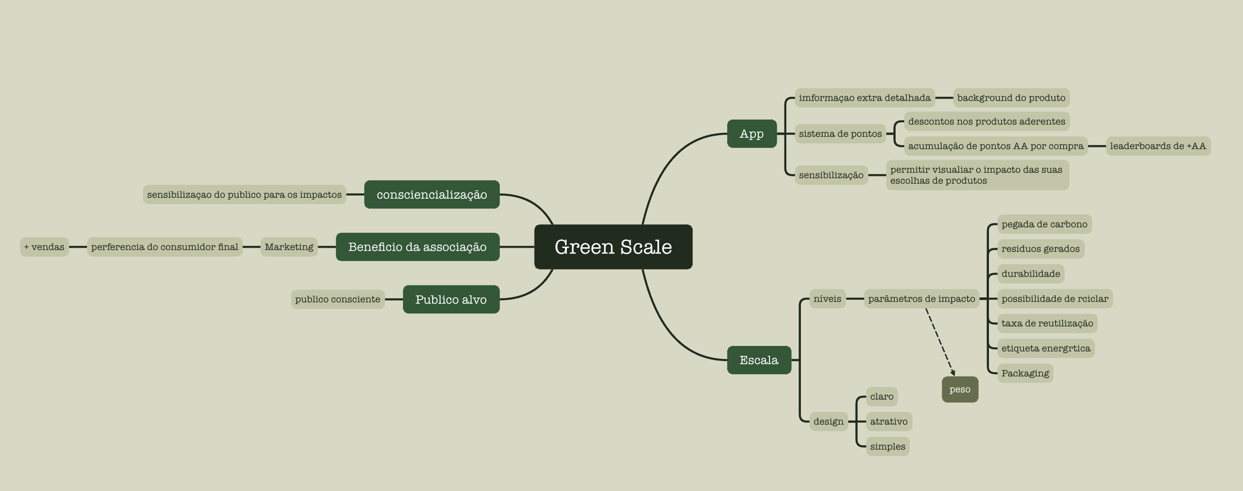
Green Scale (1)
Discutir foco com Green Label

Slide 18
Green Scale (2)
Relevância do problema
  https://environment.ec.europa.eu/topics/circular-economy/eu-ecolabel-home_en
Soluções
  https://www.positive.news/environment/food/food-sustainability-a-traffic-light-rating-system-will-soon-let-you-know/
  https://www.bbcgoodfood.com/howto/guide/a-guide-to-green-and-ethical-labels
Videos
  https://www.euronews.com/green/2021/06/22/10-of-europe-s-food-waste-could-be-avoided-with-better-labelling

Slide 19
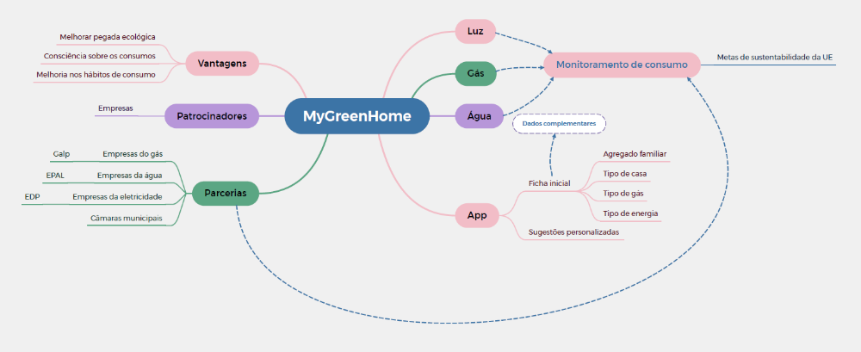
MyGreenHome
Discutir com Green Connect o foco do projeto

Slide 20
My Green Home(2)
Relevância do problema
  https://www.greenmatch.co.uk/blog/2020/03/how-to-save-energy-at-home
Soluções
  https://www.hippo.com/blog/electricity-apps-to-save-money
  https://www.housebeautiful.com/uk/renovate/finance/a32218045/utility-bill-apps/
  https://energysavingtrust.org.uk/advice/saving-water-at-home/
Videos
  https://www.energy.gov/articles/future-home-tech-8-energy-saving-solutions-horizon

Slide 21
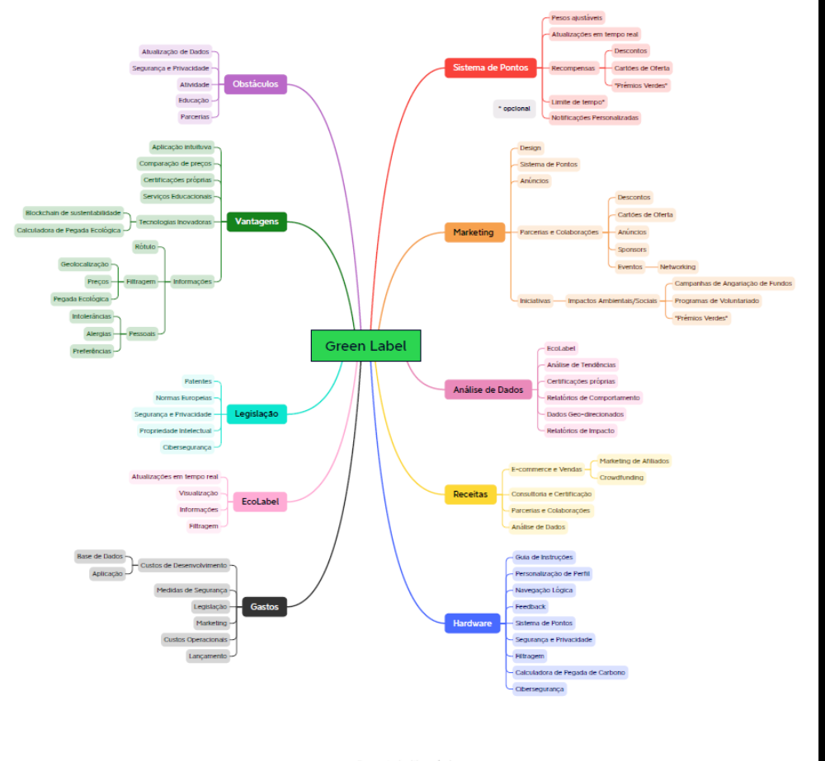
Green Label (1)
Discutir foco com Green Scale

Slide 22
Green Label (2)
Relevância do problema
  https://environment.ec.europa.eu/topics/circular-economy/eu-ecolabel-home_en
Soluções
  https://www.positive.news/environment/food/food-sustainability-a-traffic-light-rating-system-will-soon-let-you-know/
  https://www.bbcgoodfood.com/howto/guide/a-guide-to-green-and-ethical-labels
Videos
  https://www.euronews.com/green/2021/06/22/10-of-europe-s-food-waste-could-be-avoided-with-better-labelling

Slide 23
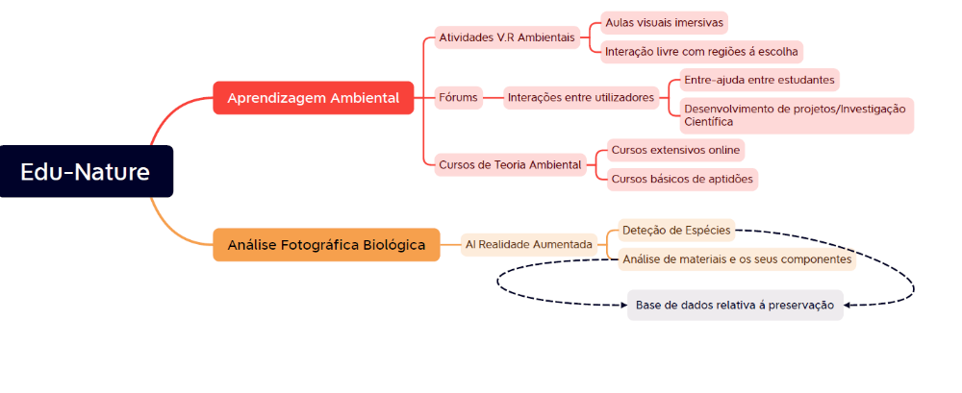
Edu-Nature (1)

Slide 24
Edu Nature (2)
Relevância do problema
  https://www.epa.gov/education/what-environmental-education
Soluções
  https://www.neefusa.org/story/environmental-education/apps-environmental-education-and-outdoor-activity
Videos
  https://www.youtube.com/watch?v=i8j5L1Cdq4Q

Slide 25
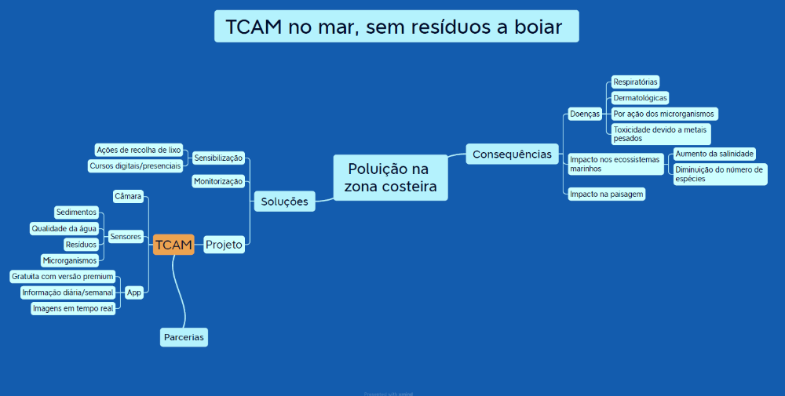
TCAM (1)

Slide 26
TCAM (2)
Relevância do problema
https://www.nrdc.org/stories/beach-pollution-101#whatis
https://www.sciencedirect.com/topics/earth-and-planetary-sciences/coastal-pollution
Soluções
https://oceanservice.noaa.gov/observations/monitoring/
https://ui.adsabs.harvard.edu/abs/2020EGUGA..22.1946P/abstract
Videos
https://projects.leitat.org/home/sailing-for-science-around-the-world-with-next-gen-sensors-for-marine-monitoring/

Slide 27


Slide 28


