Slide 1
Azorean Robotic Technologies
(A.R.T.)
"Smart Tools. Any Environment."
(confidential)
October 2025

Slide 2
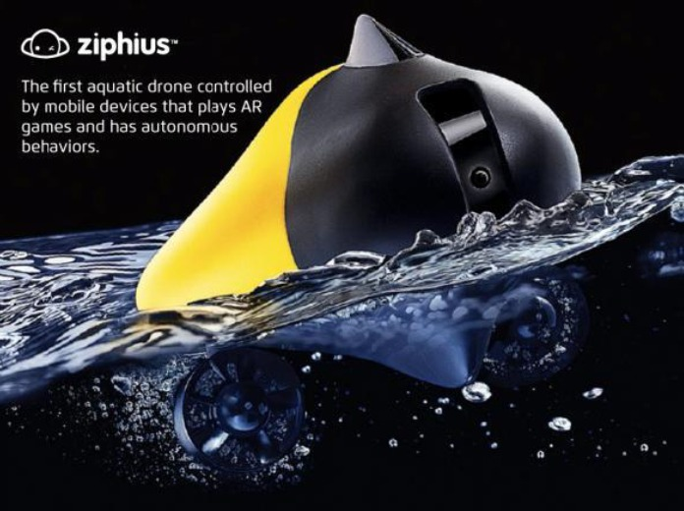
Azorean Robotic Technologies
(A.R.T.)
“Beyond Drones”

Slide 3
Strategic Overview
Due to the current drone industry hot moment, in 2025, Azorean will become A.R.T. (Azorean Robotic Technologies).
A.R.T. develops Smart Tools for any environment—land, air, and sea.
Four synergistic business units:
  AI-Based Rapid Prototyping Platform
  Learning Line – Educational robots
  Gadget Line – Consumer aquatic & lifestyle robots
  Professional Line – Industrial & marine robotics
Mission: Democratize intelligent robotics by merging AI, design, and manufacturing.

Slide 4
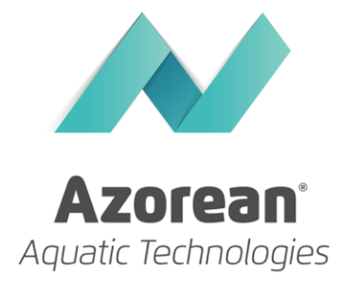


Background & Achievements
Founded in 2010, Azorean – Aquatic Technologies, S.A. (Azorean) aims to become a world leading company in marine robotics by providing a new generation of tools and vehicles for ocean exploration.
In 2013, ZiphiusTM (superficial drone prototype) won a competition promoted by Engadget (jury and public prize) to choose the “tech’s industry next great gadget” and, in July of 2013, Ziphius’ Kickstarter campaign was successfully funded.
The company is listed since the beginning of 2016 at the French Euronext, providing a clear exit strategy to any potential investor.

Slide 5
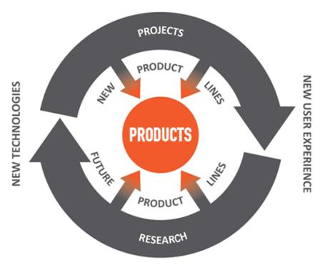
Company Structure
  A.R.T. is a product-oriented company that uses research, commercial and experimental projects as ways to achieve constant innovation.
  The integration of these areas will be the basis for sustainable growth, ensuring an efficient compromise between financial sustainability, brand promotion and technological innovation.

Slide 6

Company Focus
  A.R.T. is a horizontal hardware technology company that supports project & product development for several key vertical markets.
  A.R.T. will be aligned with the YDreams Factory Group (“Y”) strategy, in which it will be integrated:
    Smart Cities (YSpatial)
    Nature (YNature)
    Sports & Entertainment (YMagic)
    R&D areas (Ylabs)

Slide 7
Market Opportunity
Huge and rapid growing market with a large potential MOM for the identified vertical markets.
Vertical (A.R.T. Focus) | Global TAM (USD) | Suggested MOM % | Realistic MOM (USD) | Estimated Time-Frame
Smart Cities (YSpatial) | ~ $1.67T (2025) → $4.04T (2030) | 0.05–0.1% | $835M – $1.67B | Mid/Long-term (2028–2030) requires scale, partnerships, integration with city platforms
Nature (YNature) (precision agriculture & smart agriculture) | ~ $25.4B (2024) → $54.7B (2030) | 0.3–0.5% | $76M – $270M | Short/Mid-term (2025–2027) pilot projects in forestry & agriculture already underway
Sports & Entertainment (YMagic) (entertainment robotics) | ~ $35.6B (2024) → $114B (2029) | 0.2–0.4% | $71M – $456M | Mid-term (2026–2028) scaling B2C channels after validation of first products
YLabs R&D | N/A (internal) | — | — | (R&D support function, indirectly boosting other verticals)

Slide 8
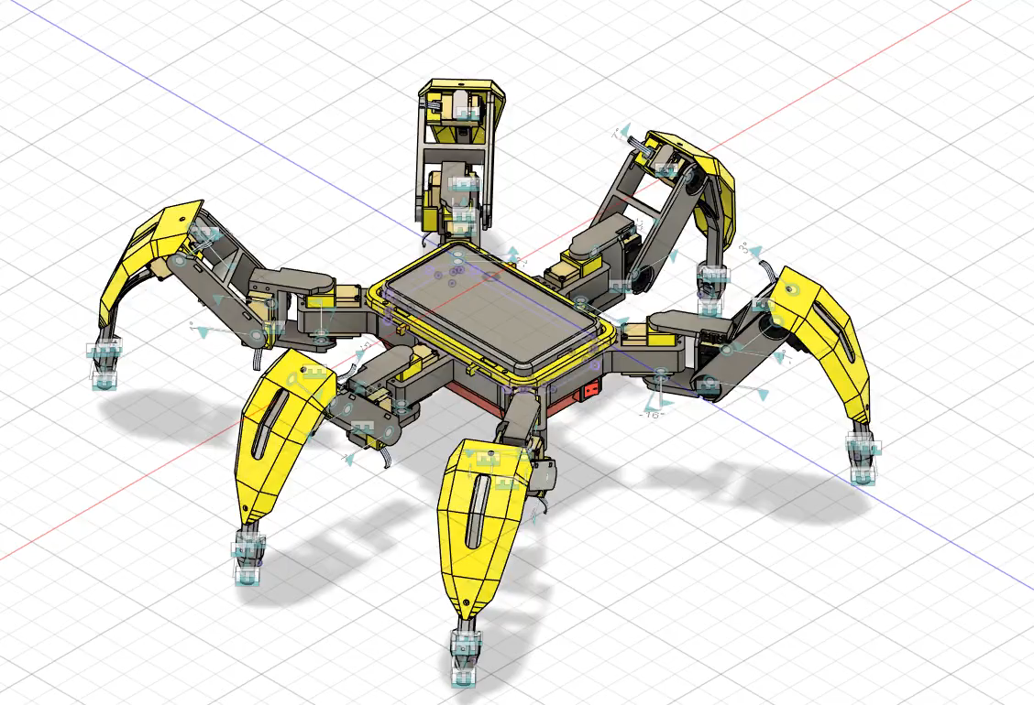
Product Lines
Besides the verticals related with the “Y” companies, A.R.T. will develop its own product lines based on its proprietary core technologies - the “Smart Tools” lines:
  Smart Tools - Learning Line (education)
  Smart Tools - Gadgets Line (B2C)
  Smart Tools - Professional Line (B2B)

Slide 9
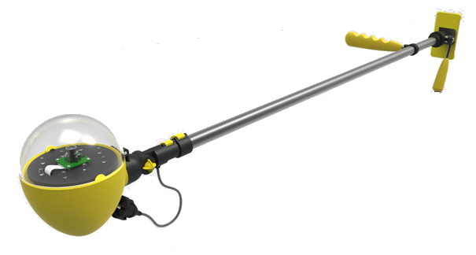
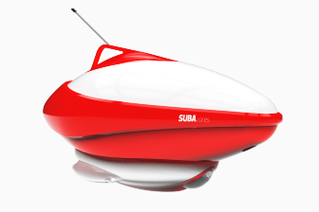
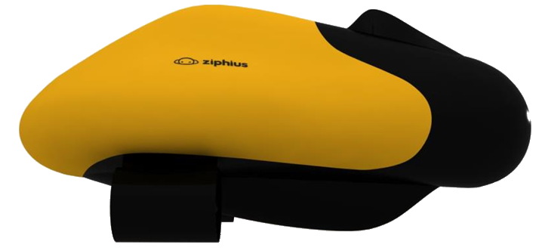
Product Lines
Starting with ideas and projects inherited from
the old Azorean (tolls for the ocean):
  Inspector TM (a tool for recreative boat hull inspection)
  Ziphius TM (aquatic superficial drone)
  Sub.A TM (remote control underwater drone)

Slide 10
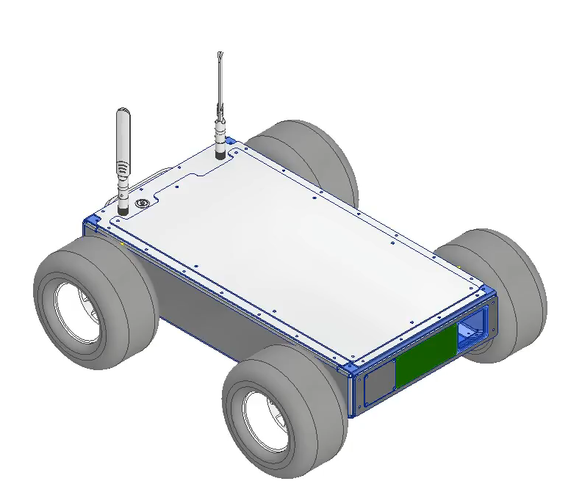
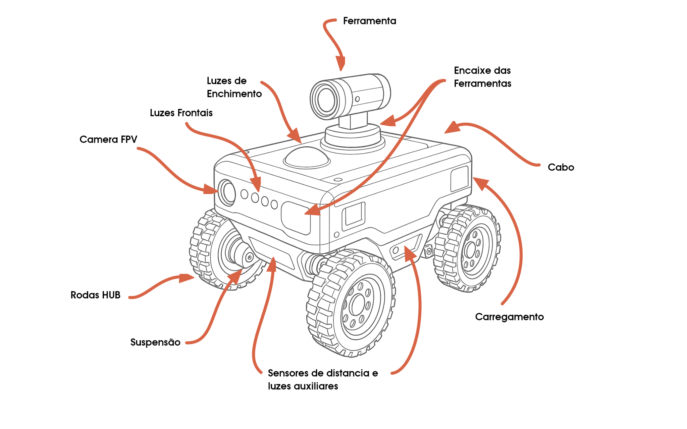
Product Lines
But following other opportunities arising from clients’ projects, YLabs R&D, and other opportunities.
  “ARGUS” (an autonomous underground robot )
  MKVI Platform (A remote-controlled robotic land platform)
  SIRCA/ISA projects/SC projects (“Kruka”, “Wise Lamp”, “Melody”, “DIY precision) Agriculture”)

Slide 11
Market Approach
A.R.T. will follow a flexible market approach strategy supported by his multi-domain Rapid Prototyping Platform (and other proprietary technologies), providing the following main arguments:
  Low-cost
  Rapid deployment
  Modular
  Disruptive

Slide 12
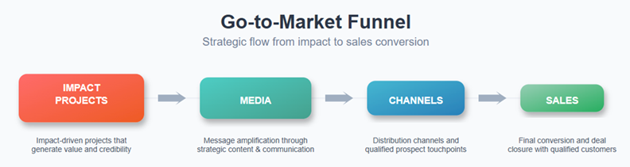
Go-to-Market
A.R.T.’s marketing strategy will leverage impact project narratives to enhance communication through both traditional media and innovative AI-driven approaches.”:
  own media (site, YouTube, Instagram), paid media, earned media
  specialised (investors) channels

Slide 13
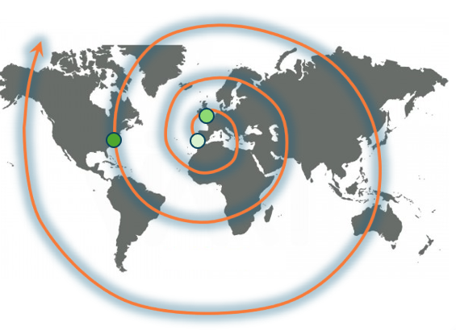
Go-to-Market
Start in Portugal as the testing market, use UK as the sales distribution base, assuming the world as the target market.
Traction: Early Clients & Pilots”
  IH: tools for the ocean
  ICNF: smart tools for the forest
  AdP: managing tools for large infrastructures
  Local Administration: ex ARGUS project, from CM Seixal (culture, education)
  CCDR Centro: tools to remote control of protected natural areas (tourism)
  Multiple opportunities from iNature initiative (agriculture)

Slide 14
Go-to-Market
Sales focus on online channels and premium stores
Online stores charge smaller margins. Retail stores function as product showrooms. Products will be available through four major different online channels:
  A.R.T. online shop ( 5% of 3rd party commission)
  Online general stores (e.g. Amazon) (15% of reseller commission)
  Gadget focused online stores (e.g. Brookstone) (35%-50% of reseller commission)
  Curated stores (e.g. Grand St.) (40%-60% of reseller commission)
A specialized B2B sales team to target industrial clients for the Professional Line will be created.

Slide 15
Go-to-Market
Some relevant stores with existing contacts:
  On-line stores: Amazon
  Curated stores: RobotShop, Brookstone, NewEGG
  TV Shows: BBC, Dr Gadget, Discovery Channel, Aljazeera
  Blogs & magazines: Wired, Engadget, Gizmodo, Cool Hunting
  Trade fairs: CES, Metz Nautical Fair, NYC Toys Fair, Maker Faire

Slide 16
Competition & Differentiation
A.R.T. will act in a very competitive area, with strong brands already established, but not operating in some of A.R.T.’s verticals
  Boston Dynamics (EUA)
  SeaDrone (EUA)
  Reel Robotics (Brasil)
  Kongsberg Maritime (Noruega)
  DJI (China)

Slide 17
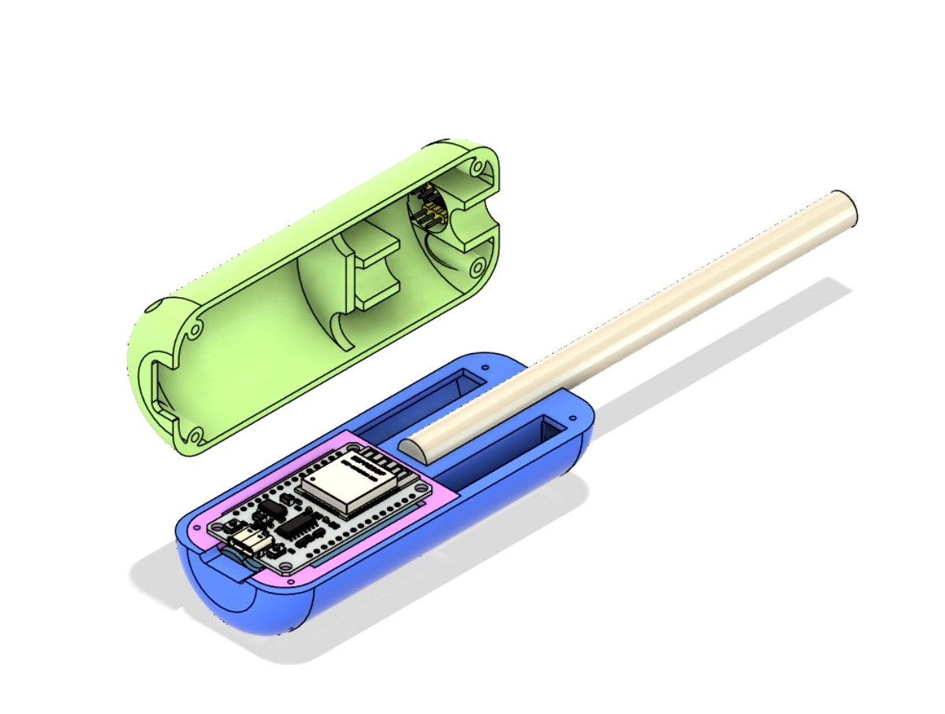
Competition & Differentiation
A.R.T. will seek differentiation by exploring different markets, approaches & multiple field integration:
  Low-cost tools for everyday needs supported by A.R.T.’s Rapid Prototyping Platform
  Integration of multiple layers (Hardware + AI/AR/VR)
  Multidomain (air, land, water)
  SPA approach (bring the life experience of experimented workers to specialised tools)

Slide 18
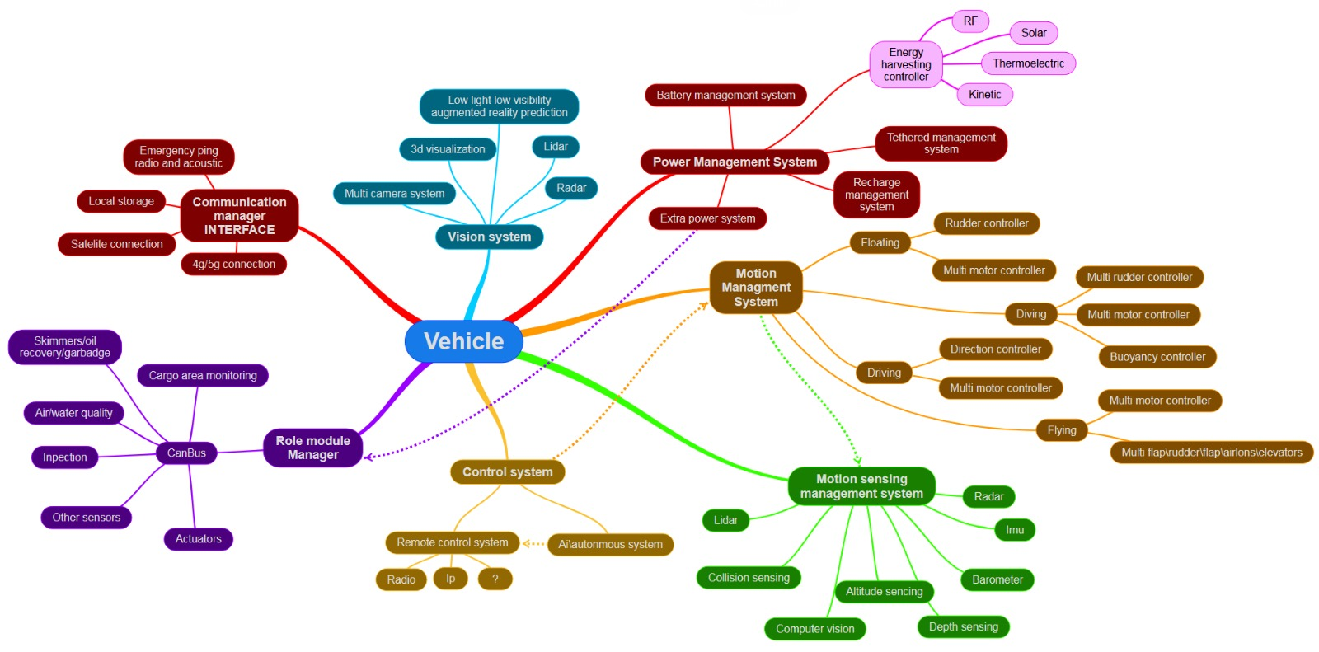
Technology & IP
A.R.T. rely on their own proprietary technologies to become a competitive company:
  Rapid Prototyping Platform
  SPA (Sensing, Processing, Actuating)
  Core components
  AI/AR/VR + Hardware
  Robotic AI Agents

Slide 19
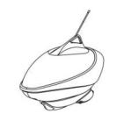
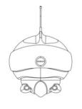
Technology & IP
The R&D investment will be followed by a strong motivation for IP protection. The objective is to build a solid IP portfolio on Drone’s and robotic technologies, providing the company with:
  Freedom to operate
  Contributions to the company valuation
  News to the equity story
  Monetization possibilities

Slide 20
Technology & IP
The following list of patents will be explored:
Regarding Industrial Design, A.R.T. will promote the registration for all proprietary vehicles and devices (several pieces).
# | Project | Focus
1 | “ARGUS” | Strategies and mechanisms for efficient underground drone exploration
2 | “SPA’s” | Strategies and mechanisms for
3 | “A.R.T. platform” | Strategies and mechanisms for multi-domain hardware rapid prototyping
4 | “Inspector” | Strategies and mechanisms for optimized AI underwater image visualization
5 | “Ziphius” | Strategies and mechanisms for efficient drone surface navigation
6 | “SUB.A” | Strategies and mechanisms for underwater remote control
… | Others… | Related with health and wellness devices

Slide 21
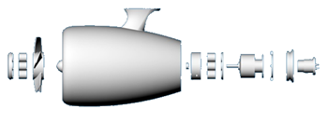
Research & Future Innovation
To keep competitive advantages in this very demanding market, A.R.T. will follow a continuous research program focus on a set of strategic lines:
  Keep evolving A.R.T.’s Rapid Prototyping Platform to create a new generation of low-cost / fast deployment hardware-based tools
  Develop core technologies for instruments and autonomous vehicles (energy harvesting, decision support, communications)
  Develop core technologies for extreme conditions (depth sea, underground)
  Explore experimental approach using new materials, printed electronics, radical design

Slide 22
Team & Network
A highly skilled management team with large experience growing start-ups.
A small, but strong and motivated core Teck team, covering all A.R.T. key areas (robotics, electronics, Software & AI, Communications, Industrial designer).
Outsourcing of non-critical competences and Sharing support services with the “YDreams Factory Group”.
Main Goals:
  Reduce costs
  Gain flexibility
  Attract talent

Slide 23


Team & Network
A strong network of partners built in the past years of activity
  Transversal to the company:
  Sales, Production, Suppliers, R&D
  Very strong partnerships with sister companies:
  Ynvisible (printed electronics ) &
  TUGA Innovations (smart mobility)
  A long-term partnership with recognized brands such as:
  AMD, Intel, NOKIA, NVIDIA and Raspberry PI

Slide 24
Communication & Equity Story
As a listed company, communication will have a key role on the company development and valuation. The equity story will become the focus of A.R.T.’s communication strategy, mainly oriented to capital markets investors with selected news related with:
  Corporate & Financial (“Provide Credibility & Trust in the Company”)
  Research & Development (“Towards a Solid Foundation“)
  Marketing & Sales (“Clear Go-to-Market“)
  Inspirational Projects (“Drones for Good”)
  IP (“Creating Value”)

Slide 25
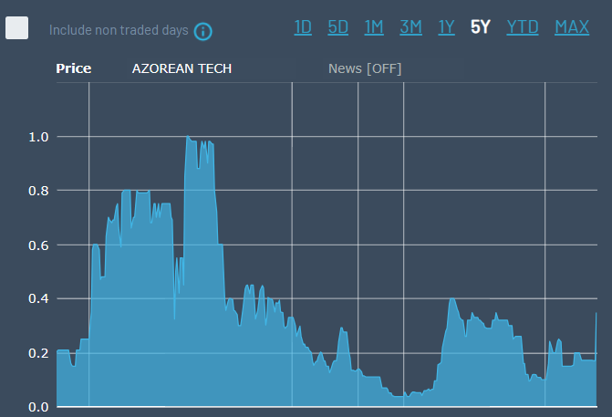
Communication & Equity Story
  Past resume
  2021: maximum share price ~1.00€
  2024: share price grew from 0.05€ to 0.30€ with no effort (the Ukrainian drone war effect)
  2026: move the company to a more robust market ASAP (ex: Frankfurt, TradeGate)
  2027: increase the share price up to 5.00€ until the end of this year

Slide 26
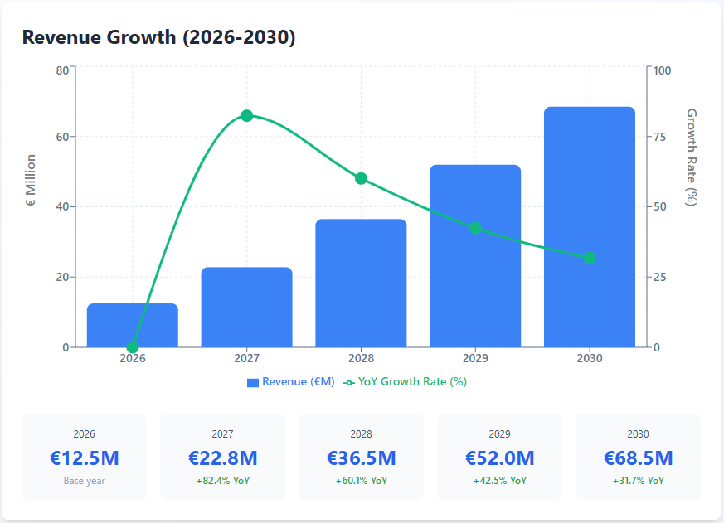
Financial summary

Slide 27
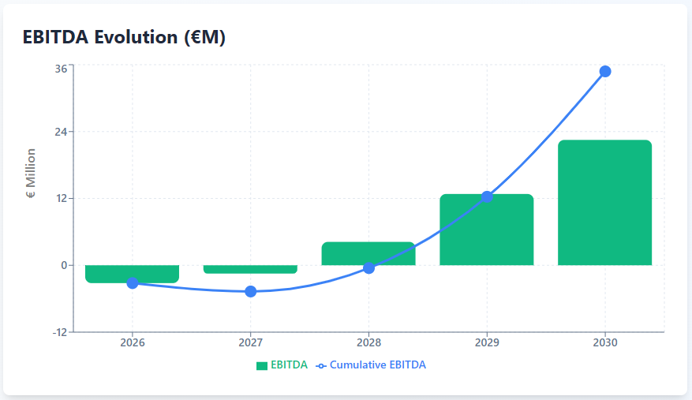
Financial summary

Slide 28
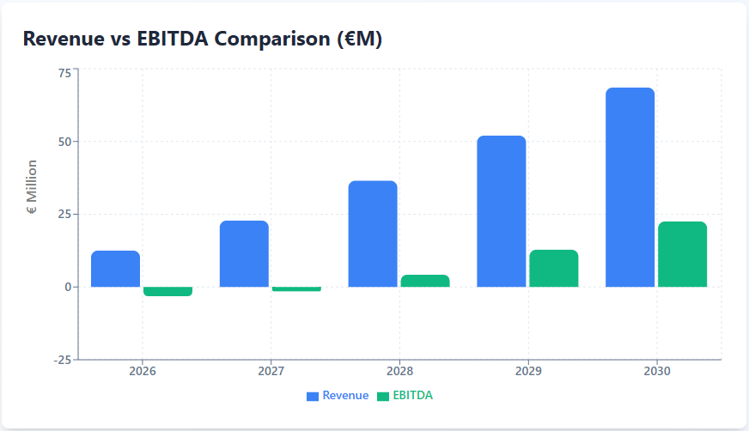
Financial summary

Slide 29
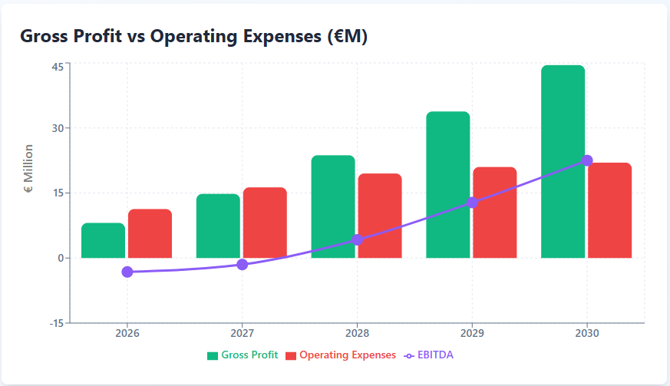
Financial summary

Slide 30
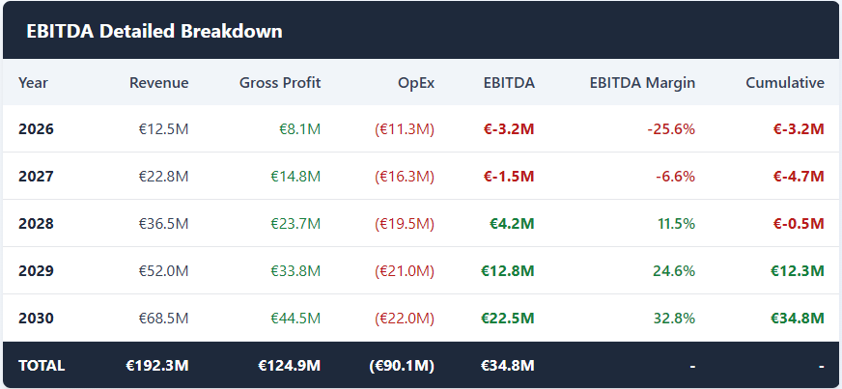
Financial summary
EDITDA Detailed Breakdown
  EBITDA 2023: €22.5M
  Cumulative EBITDA (5Y): €34.8M
  Margin 2030: 32.8%
  Break-even: Q3/2028

Slide 31
Investment Plan & Valuation
We are seeking 5M€ investment to support a 3 years development plan, in the following conditions:
  Pre-money base valuation: 15M€
  Investment required: 5M€
  Post-money valuation: 20M€
  Equity base: 20%
Valuation scenarios 2030 :
  Conservative: €93.3M (2.5x annual revenue Y5)
  Base case: €119.4M (3.2x annual revenue Y5)
  Optimistic: €149.2M (4x annual revenue Y5)

Slide 32
Use of proceedings
€5M Initial Investment
R&D and Platform Refinement (~€1.5M):
Further develop the core AI Rapid Prototyping Platform, secure IP through patents, and move product designs from prototype to production-ready. Rebrand to A.R.T. and reenforce the digital presence.
Manufacturing & Supply Chain (~€1.5M):
Establish manufacturing capabilities (beyond 3D printing for consumer lines) and build a resilient supply chain for components.
Go-to-Market (Sales & Marketing) (~€1.25M):
Build a B2C e-commerce presence for the Learning/Gadget lines. Hire a small, specialized B2B sales team to target industrial clients for the Professional Line.
Operations & Working Capital (~€0.75M):
General and administrative expenses, operational costs, and contingency funds.

